Slide 1

The nuclear obscurer of
Active Galactic Nuclei
Johannes Buchner
FONDECYT fellow
http://astrost.at/istics/
Collaborators: @PUC: Steve Schulze, Franz Bauer
@MPE: A. Georgakakis, K. Nandra, M. Brightman, ML. Menzel, Z. Liu, L-T. Hsu, M. Salvato, C. Rangel, J. Aird, A. Merloni

Slide 2
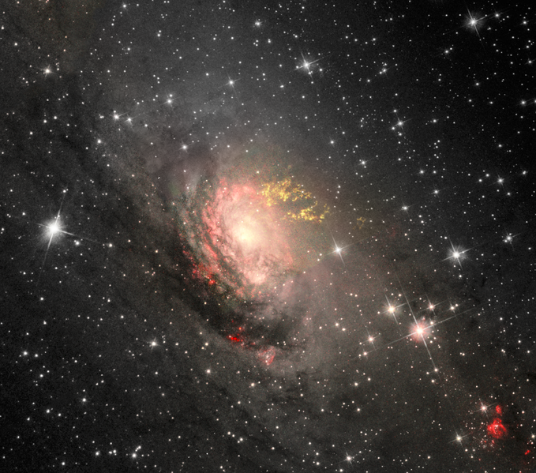
What are AGN?
Signatures of AGN:
Hard UV ionisation field
Ionised line ratios (OIII)
Hard X-rays
Radio
Circinus CC Judy Schmidt

Slide 3
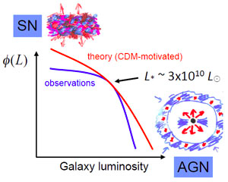
Why study AGN?
Galaxy evolution
  “Feedback” from
  SMBH growth
  solves GMF, colors, …
Black hole growth
  How and when?
  0.2% of galaxy mass in compact objects
  AGN sometimes outshines the galaxy
  Extreme environments
Silk&Mamon12
Croton+06

Slide 4
AGN: Accretion onto SMBH
Accretion Disk
“Torus” Obscurer
Galactic Center gas
Star forming regions
e.g. in spiral arms
UV, Opt, X-ray, ...
<0.1pc
10pc
1 kpc
10 kpc
Nuclear obscuration
Galaxy-scale obscuration

Slide 5
AGN: Accretion onto SMBH
Accretion Disk
“Torus” Obscurer
Galactic Center gas
Star forming regions
e.g. in spiral arms
1/3 AGN heavily obscured
3/4 AGN mildly obscured
Buchner+15
Accretion flow?
SMBH growth over cosmic time?
Self-regulation?
AGN-galaxy connection?
How is it stable and extended?
Density? Substructure?
Feeding of SMBH?

Slide 6
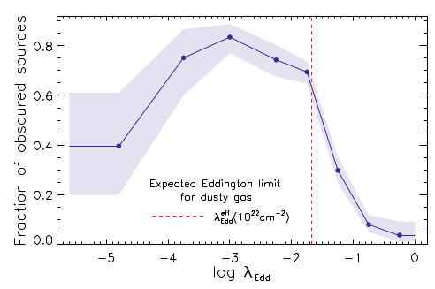
Obscuration & Edd-rate
Winter+09
Wilkes+13
Buchner+15
Buchner+17b
Mateos+17
Here: BAT survey, Direct measurement, Ricci+17

Slide 7
What is the “Torus”?
The nuclear obscurer of AGN
substantial covering (30-80%)
few pc scale – VLBI, ALMA
Non-spherical – polarisation
  –> donut?
polar dust emissions – high-res IR
  –> wind/outflow?
Eclipses, Si feature
  –> clumpy?

Slide 8
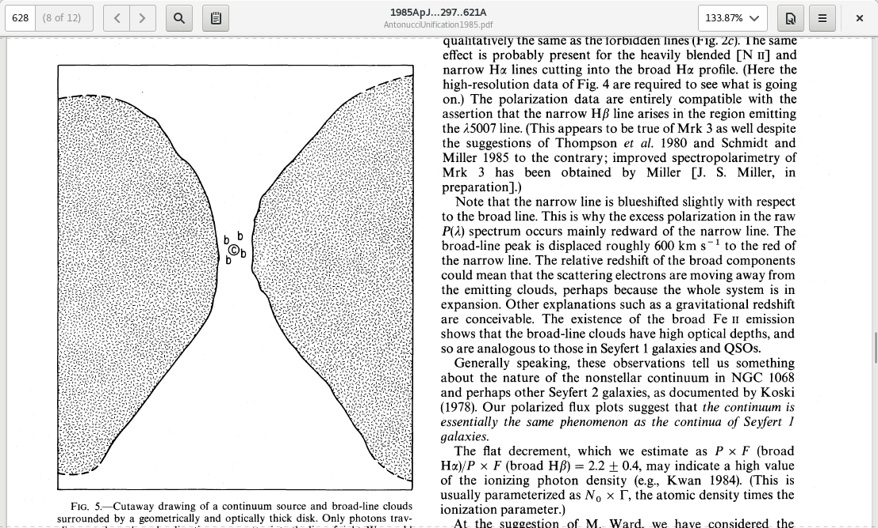
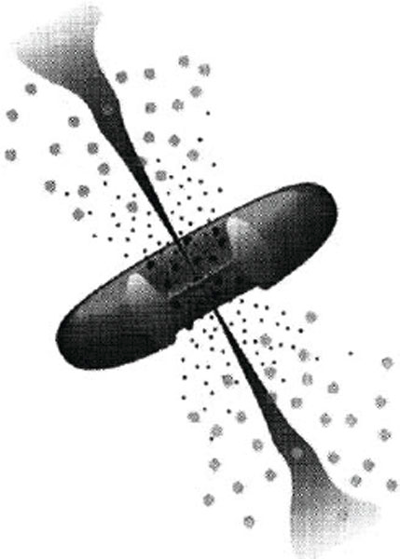
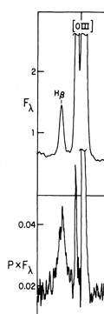
Old picture
Radio jet
Antonucci&Miller85
An actual torus/donut
  Evidence: non-spherical
  from polarisation direction
NLR
BLR
4861A

Slide 9
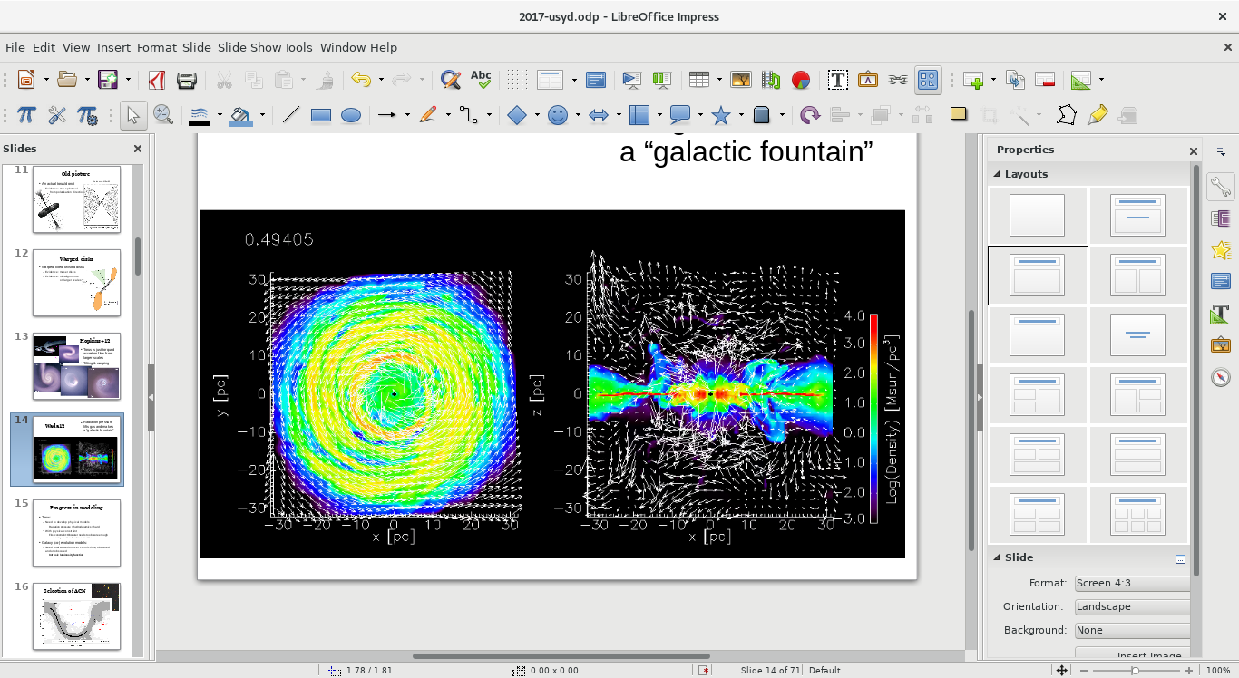
Wada12
Radiation pressure lifts gas and makes a “radiation-driven fountain”

Slide 10
Wada12
Radiation pressure lifts gas and makes a “radiation-driven fountain”

Slide 11
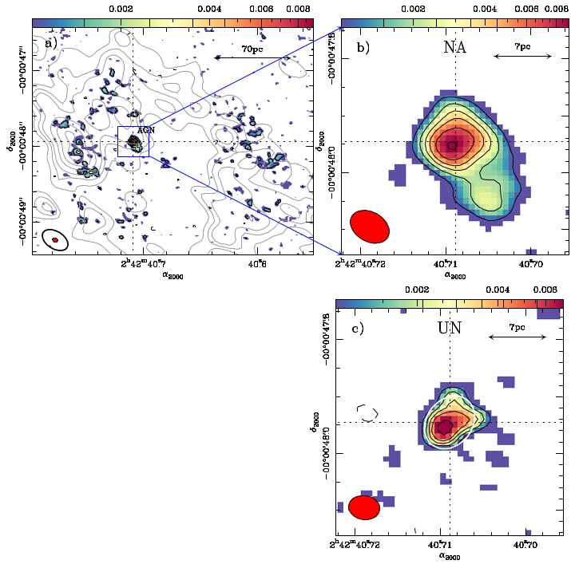
Best picture
ALMA 694 GHz (432 μm)
NGC1068
Garcı́a-Burillo et al. (2016)

Slide 12
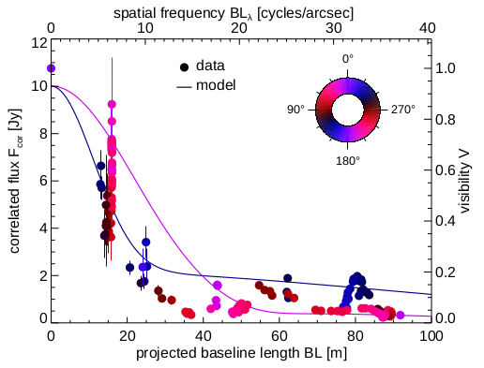
Polar dust
Tristram+13
IR interferometry
MIDI, Circinus, 8+13µm

Slide 13
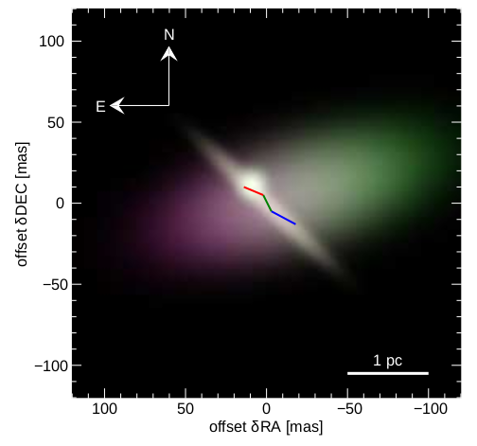
Polar dust
Tristram+13
Model with 3 Gaussians
1 perpendicular!
80% emission from that component

Slide 14
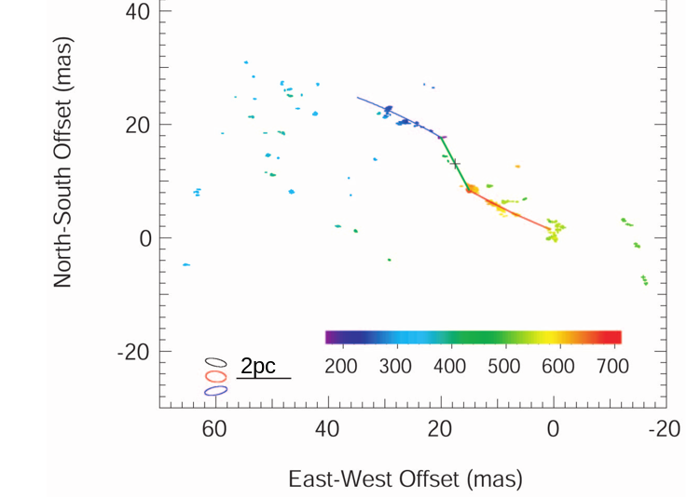
Warped maser disks
VLBI 1.3 cm
H₂O maser clumps
Keplerian warped disk
Greenhill+03
Difficult to avoid warped disks in radiation environment (Pringle96)

Slide 15
Warp + Dusty Wind?
“Where did my torus go?”

Slide 16
Large-scale obscurers

Slide 17
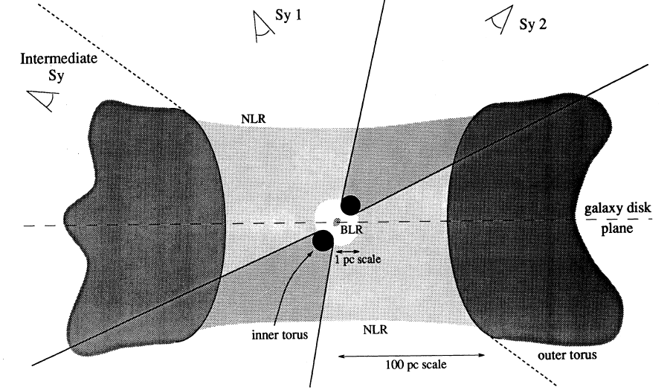
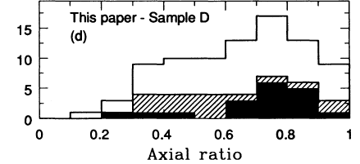
Host galaxy obscuration
Maiolino&Rieke 1995: “Sy1 are mostly found in face-on galaxies, intermediate type are mostly found in edge-on hosts.”
Sy2+Sy1
Sy 1-1.5
Edge-on
Face-on

Slide 18
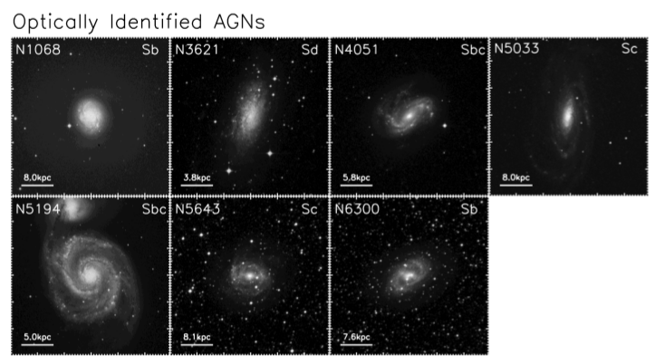
Spitzer identification of AGN
Volume-limited
Goulding & Alexander 2009

Slide 19
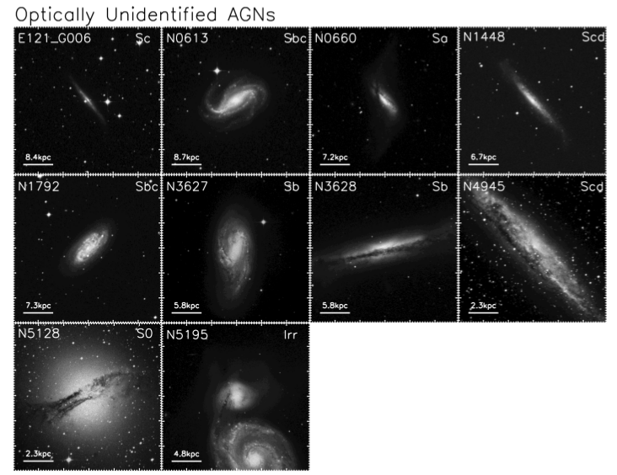
Spitzer ID of AGN
Volume-limited
Goulding & Alexander 2009

Slide 20
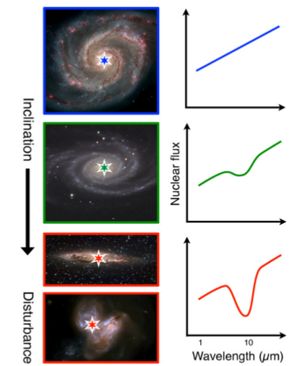
Local Compton-thick sample
Goulding+2012

Slide 21
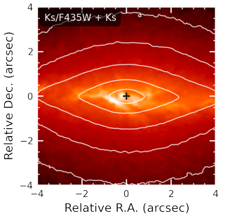
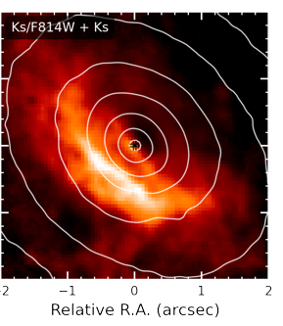
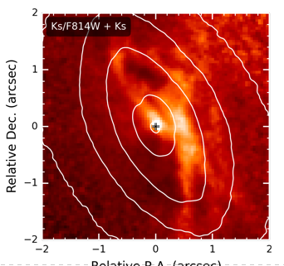
Larger scale obscurers
Narrow-line (obscured) AGN sample
Most show nuclear dust lanes extending to kpc
CMZ in Milky Way is dust-rich too
Prieto+14, 200pc scale

Slide 22
Column density N_{H}
N_{H} … number of H atoms along line-of-sight
N_{H} = few atoms / cm³ x few kpc = 10²²/cm²
Compton-thick: ~ 10²⁴ cm² – Circinus, NGC1068
  Nuclear regions with high density
  Mergers – major accretion events for SMBH
Fe, O
  absorb everything except hard X-ray, re-radiate thermally in IR
  Measure N_{H} from X-ray spectrum assuming local abundances

Slide 23
Galaxy-scale obscuration
Need:
  Probe that is sensitive to high columns
  Not just a central point source
  Provides X-ray, for column densities
  z=0.5-3
Lets try to understand the obscurer of LGRBs

Slide 24
GRBs x-raying Galaxies
Long (>2s) Gamma Ray Bursts:
  Collapse of massive stars
  Produce γ-ray
    Detected through any obscuration
    Detected at z=0-10
  X-ray, Opt, … Radio
  Follow blue light, general SF
    But: avoid high-Z galaxies
    SF, low-mass galaxies
Idea:
  X-ray tomography
  Can we reconstruct the galaxy from LOS densities

Slide 25
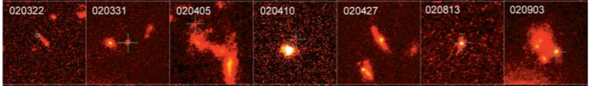
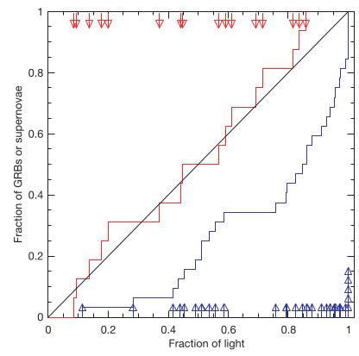
HST, blue or ultraviolet rest-frame images of GRB host galaxies
Massive O/B stars
Die early
In star-forming regions, molecular clouds
Need low metallicity gas
Follow blue light, general SF
But: avoid high-Z galaxies
SF, low-mass galaxies
Fruchter+06
SN: proportional
to blue light
GRB:
concentrated at bluest regions

Slide 26
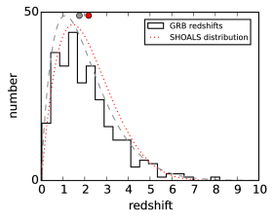
LGRB surveys
Swift: >900 sample of LGRBs, good positioning
Limited follow-up = redshift bias
Solutions:
  Include sources without redshift in analysis
  Use highly complete, unbiased samples
    SHOALS: defines criteria that do not depend on properties of the host galaxy

Slide 27
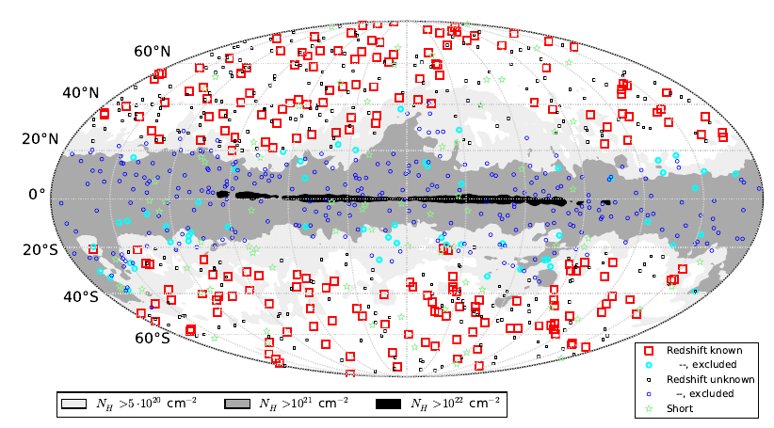
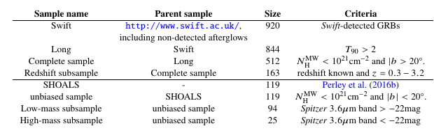
Data
Entire swift.ac.uk archive
Exclude flares & prompt emission
  Automated + visual inspection
Samples

Slide 28
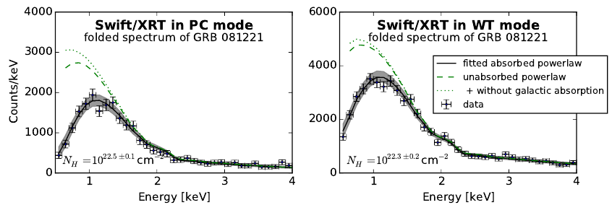
X-ray spectroscopy
Obscurer model:
  Intrinsic powerlaw
  a) tbabs
  b) SPHERE (Compton scattering)
Normalisation

Slide 29
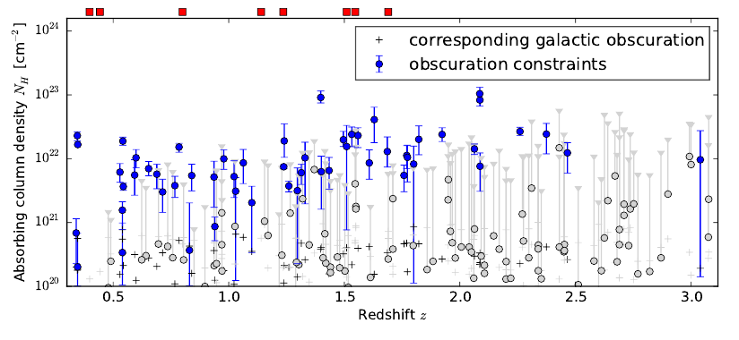
Column density distribution
“Galaxy gas as obscurer: I.”
Buchner, Schulze & Bauer (2017)

Slide 30
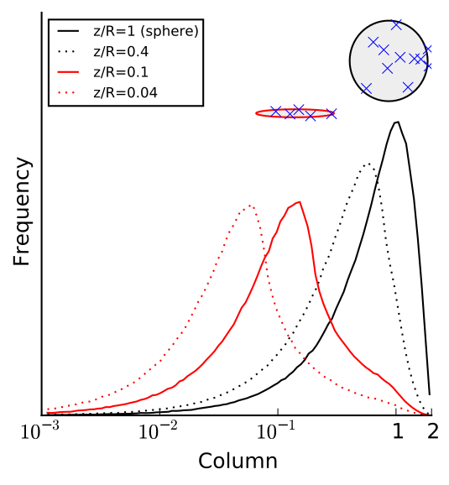
N_{H} distribution: Primer
~0.5 dex from geometry
“Galaxy gas as obscurer: I.”
Buchner, Schulze & Bauer (2017)

Slide 31
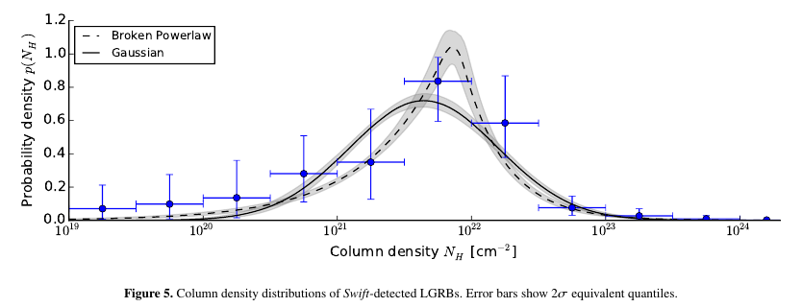
N_{H} distribution: observed
“Galaxy gas as obscurer: I.”
Buchner, Schulze & Bauer (2017)

Slide 32
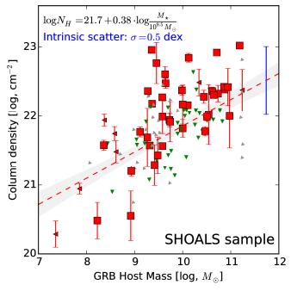
Host Mass - Obscuration
SHOALS
  Perley+15
  Deep follow-up
  ~90% redshift complete
  Spitzer masses
“Galaxy gas as obscurer: I.”
Buchner, Schulze & Bauer (2017)

Slide 33
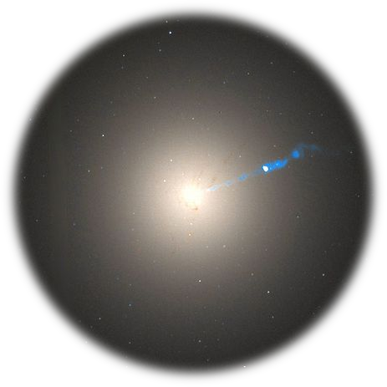
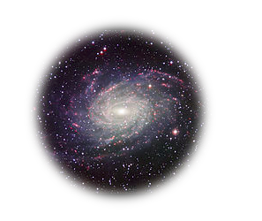
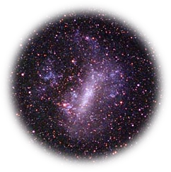
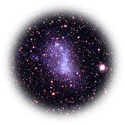
Host Mass – Obscuration
SHOALS
  Perley+15
  Deep follow-up
  ~90% redshift complete
“Galaxy gas as obscurer: I.”
Buchner, Schulze & Bauer (2017)

Slide 34
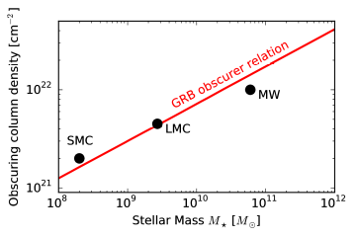
Local Galaxies
1% densest column from HI maps
Gas metallicity-corrected
“Galaxy gas as obscurer: I.”
Buchner, Schulze & Bauer (2017)

Slide 35
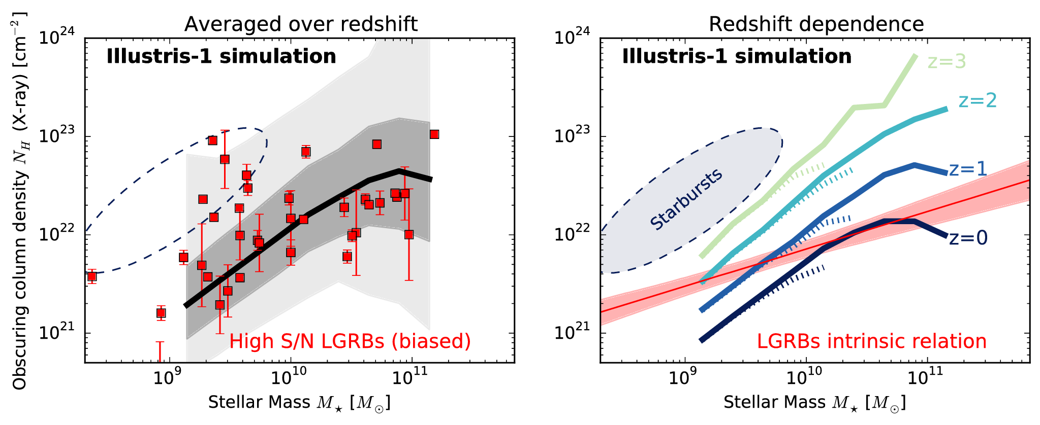
Predictions by simulations
“Galaxy gas as obscurer: I.”
Buchner, Schulze & Bauer (2017)
Notes:
Reproduce M* function
Reproduce observed HI, CO masses
Reproduce galaxy radii
They put the right amount of gas into galaxies
Resolution is problem, but averages out over long LOS

Slide 36
Host Mass – Obscuration
SHOALS
  Perley+15
  Deep follow-up
  ~90% redshift complete
Hosts?
  Actively star-forming, AGN not necessarily
  Metallicity bias
N_{H} – M* relation
Obscurer is host galaxy
Understand normalisation
Understand slope
Understand scatter
“Galaxy gas as obscurer: I.”
Buchner, Schulze & Bauer (2017)

Slide 37
From GRBs to AGN
New Relation from GRBs
AGN fraction
Aird+12, Bongiorno+12
Stellar Mass Function
Ilbert+13, Muzzin+13
Marginalisation
“Galaxy gas as obscurer: II.”
Buchner & Bauer (2017)

Slide 38
From GRBs to AGN
New Relation from GRBs
AGN fraction
Aird+12, Bongiorno+12
Stellar Mass Function
Ilbert+13, Muzzin+13
large-scale host galaxy causes
40% obscured
0% heavily obscured
Marginalisation
“Galaxy gas as obscurer: II.”
Buchner & Bauer (2017)

Slide 39
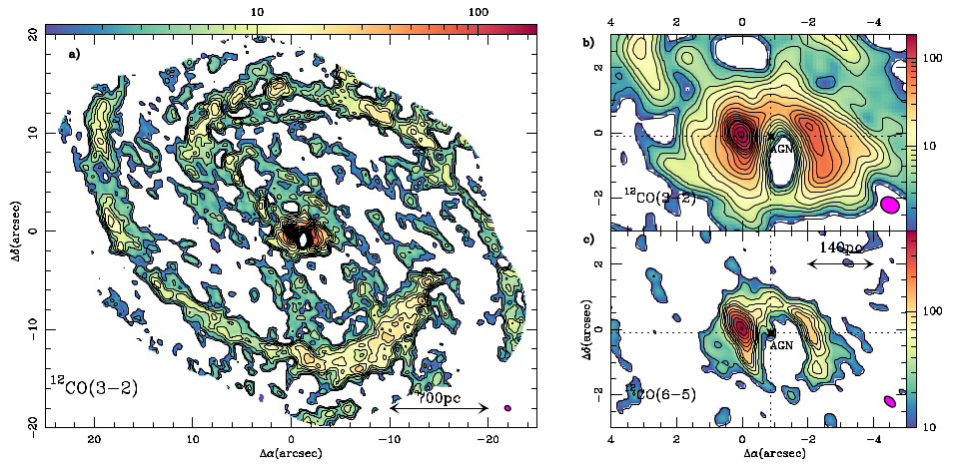
NGC 1068 on larger scales
ALMA CO(3-2)
García-Burillo+14

Slide 40
NGC 1068 on larger scales
ALMA CO(3-2)
García-Burillo+14

Slide 41
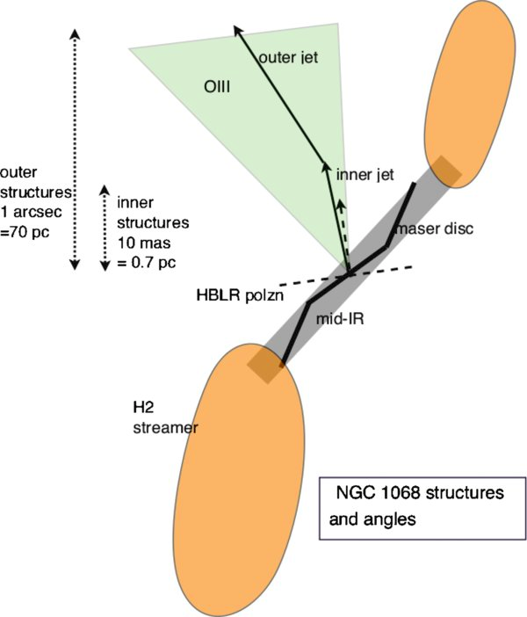
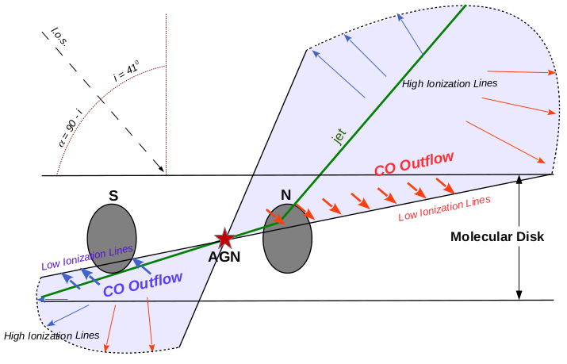
Misalignments on larger scales
García-Burillo+14, Tecza+01
Lawrence & Elvis (2010)

Slide 42
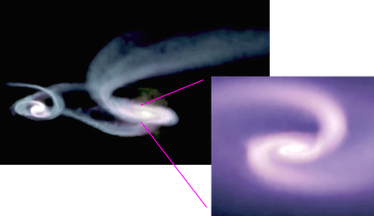
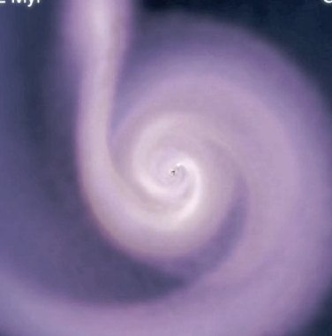
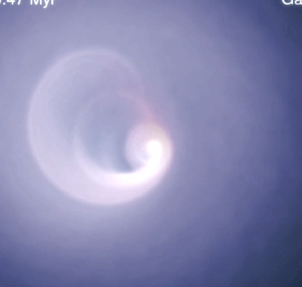
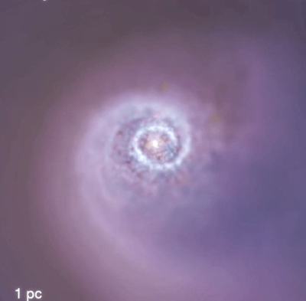
Hopkins+12
Torus is just torqued accretion flow from larger scales
Tilting & warping

Slide 43
Substructure

Slide 44
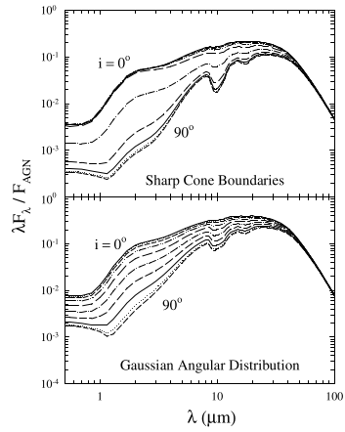
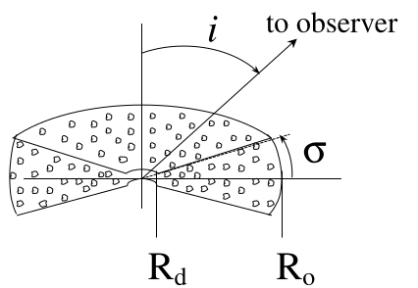
Infrared SED
Nenkova+08a,b
Si feature 10µm

Slide 45
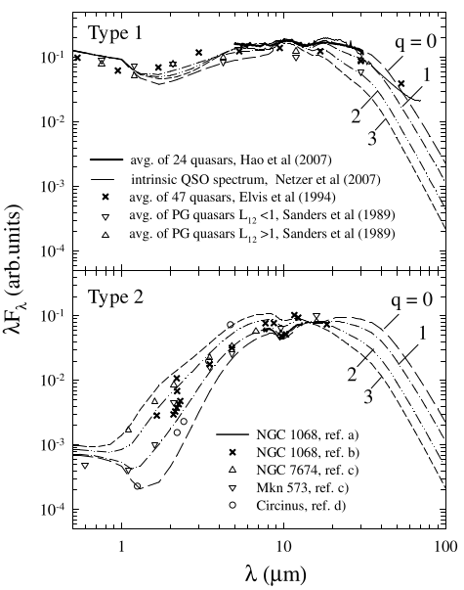
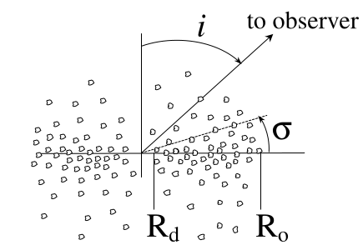
Infrared SED
Nenkova+08a,b
Also: Hot dust problem

Slide 46
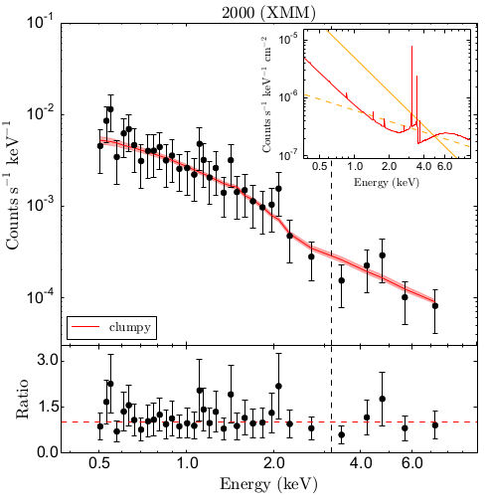
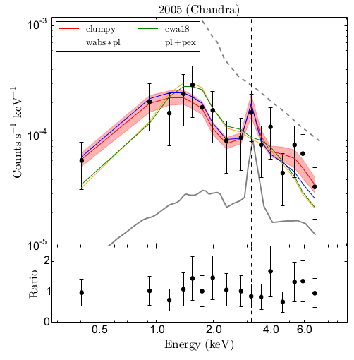
A type-1 with Compton-thick eclipse

Slide 47
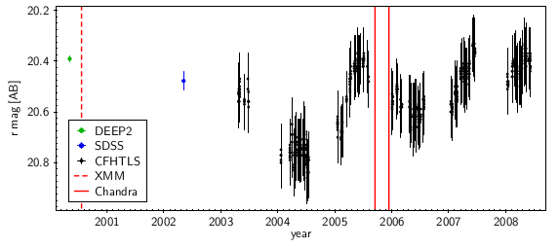
A type-1 with Compton-thick eclipse

Slide 48
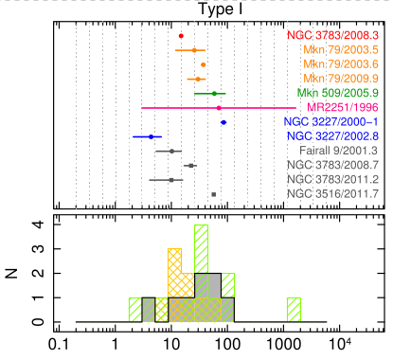
Substructure: Eclipse events
Duration
Markowitz+14, RXTE archive
Days

Slide 49

Substructure: Eclipse events
Duration
Location
Markowitz+14

Slide 50

Substructure: Eclipse events
Duration
Location
Frequency
Days
Markowitz+14, RXTE archive

Slide 51


Substructure: Eclipse events
Assumptions:
Keplerian circular orbits
Vary covering factor
inner-most cloud period: 1 day
–> outer-most cloud period: 8 years
–> inner-most cloud orbital radius of 42 au M₇^{1/3}
Buchner+ (in prep)

Slide 52


Slide 53


eROSITA
Deepest all-sky X-ray survey
  0.2-2keV primarily
  But also 2-10keV
Science:
  Primary: Cosmology with clusters
  3 Million AGN expected!
Survey strategy:
  L2
  Stripes with overlaps
  Entire sky every 6 months, 8 times
Data:
  Time-domain
  X-ray spectra
  New parameter space!
Built by MPE
Launch: April 2019!

Slide 54

Eclipse events with eROSITA
Predictions:
340,000 extragalactic AGN in 6m catalogue
13,000 2-10keV detected
1-10% eclipses expected after 6 months, 50% sky

Slide 55
Summary
“Torus model” needs:
  ~parsec scale
  Polar dust
  Hot dust
  Hydro-dynamic stability
  Large covering factors (accretion-rate dependent)
  Connection to galactic environment (100pc)
(Galactic disk)

Slide 56
Conclusions
Need more models
  Radiative hydro-dynamic models
  Geometry diversity
Need more data
  High-resolution MIR imaging (VLTI)
  X-ray polarimetry?
  Eclipse events with eROSITA

