Slide 1

Model-independent limits on the incidence of
SMBH seeds
Johannes Buchner
FONDECYT fellow
http://astrost.at/istics/
Collaborators (PUC & ETH): Ezequiel Treister, Franz Bauer,
Lia Sartori, Kevin Schawinski, Roberto Gonzalez, Nelson Padilla

Slide 2
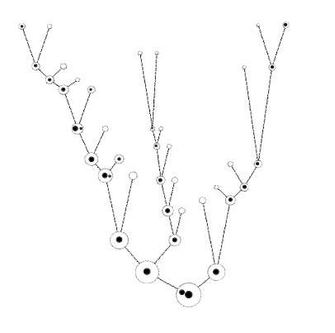
Motivation
Local galaxies host SMBHs
Built from many small halos
How does the seeding process need to behave?
Insights independent of specific seeding model
credit: M. Volonteri

Slide 3
Assumptions
Halos are born and grow
At some threshold mass M_{c}: chance p for seeding success
Can approximate physical seeding mechanisms
Does not need assumptions of
- seed black hole mass
- accretion
- feedback
see also Menou+01

Slide 4
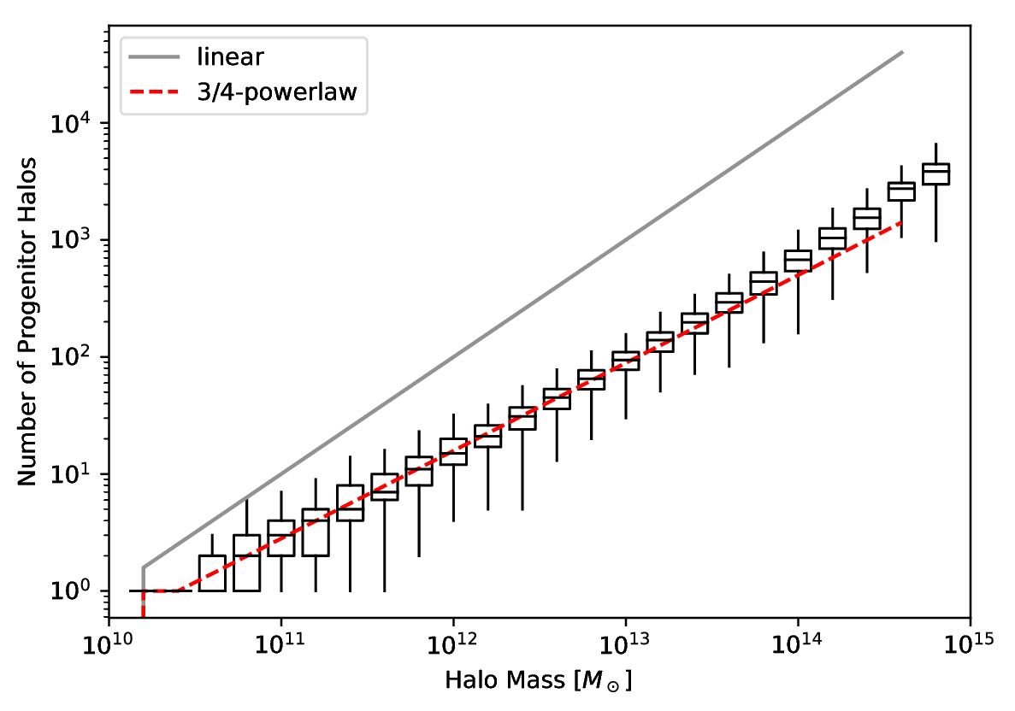
Building blocks
Count leaves of merger tree
z=0 halo building blocks
of size
SMDPL dark-matter simulation
Rockstar subhalos
Planck cosmology

Slide 5
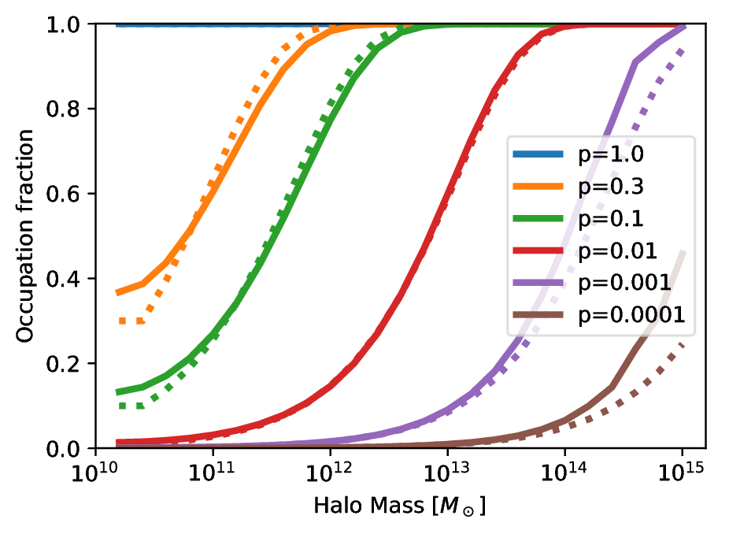
Occupation at z=0

Slide 6
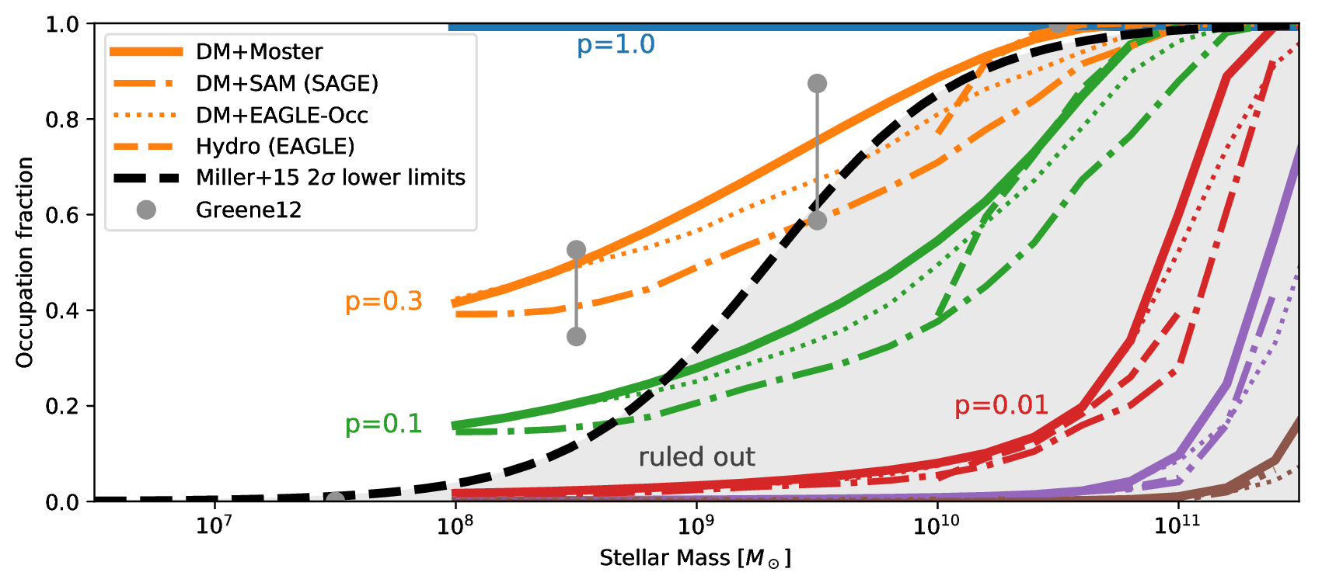
Occupation at z=0
Buchner et al. (in prep)

Slide 7
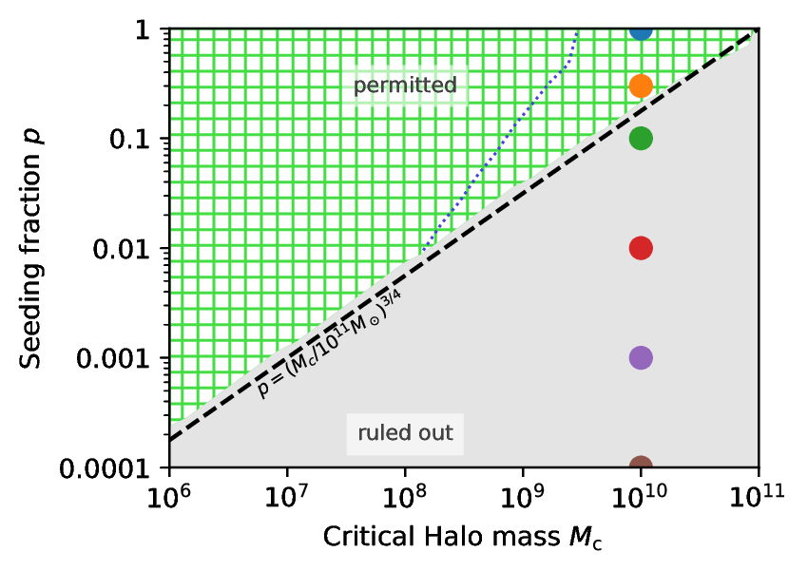
Required Seeding Efficiency
Buchner et al. (in prep)

Slide 8
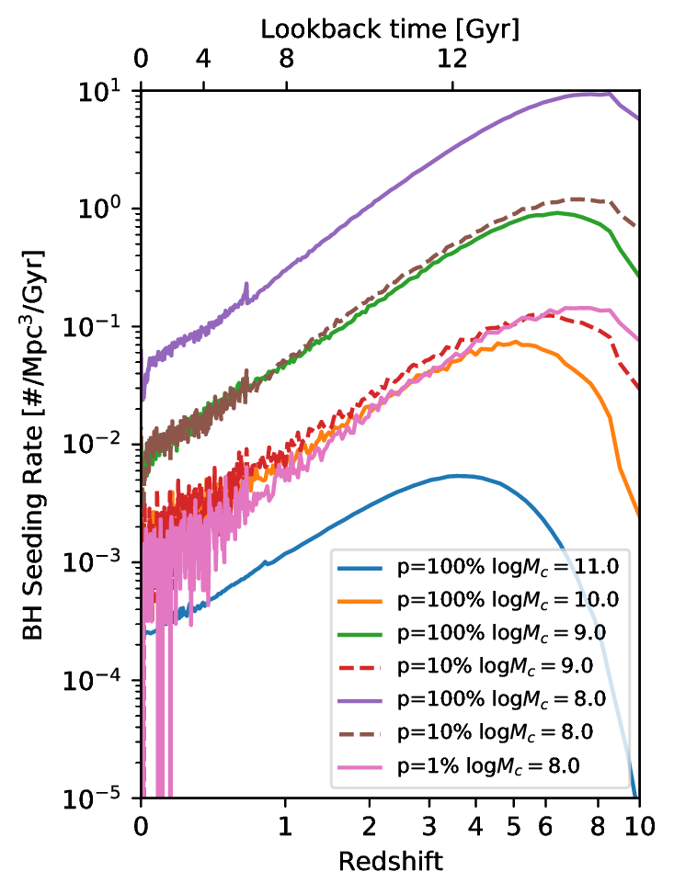
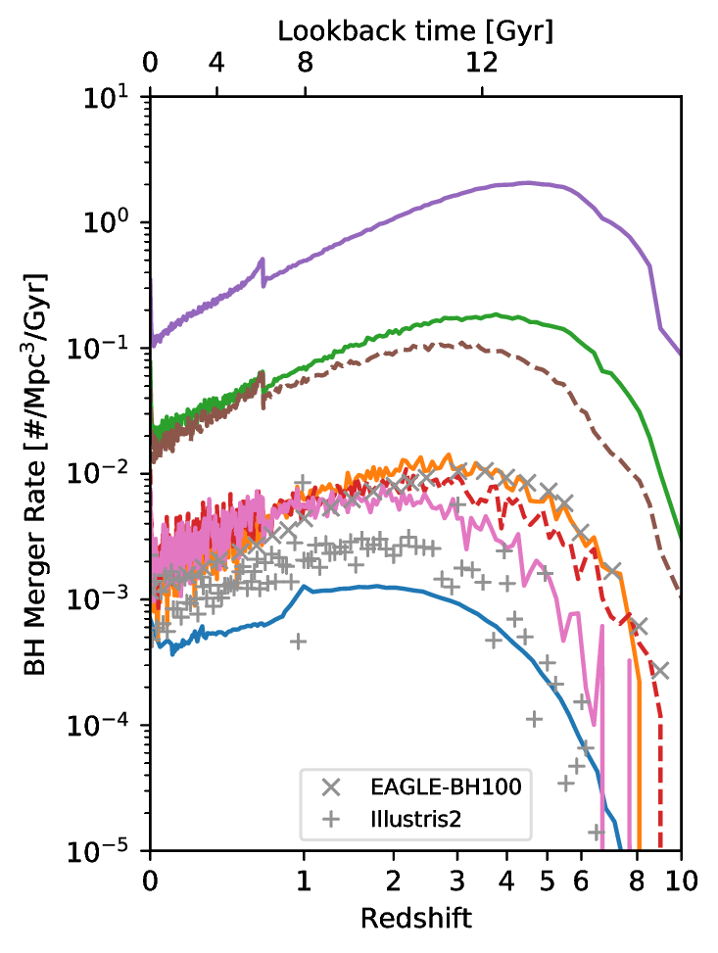
Population Evolution
BH births
BH host mergers

Slide 9
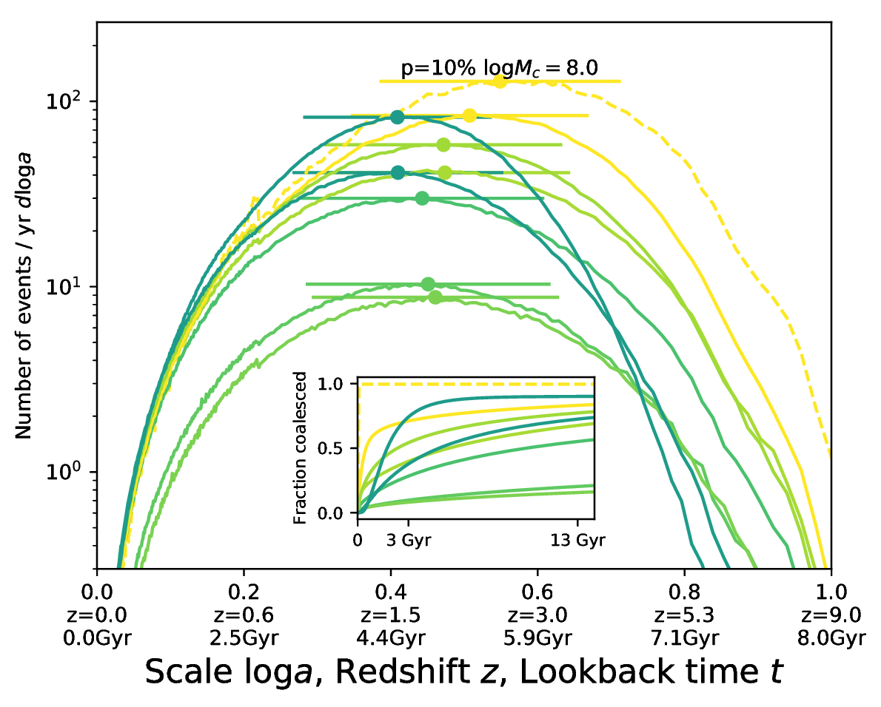
SMBH merger delays
Kelley+17

Slide 10
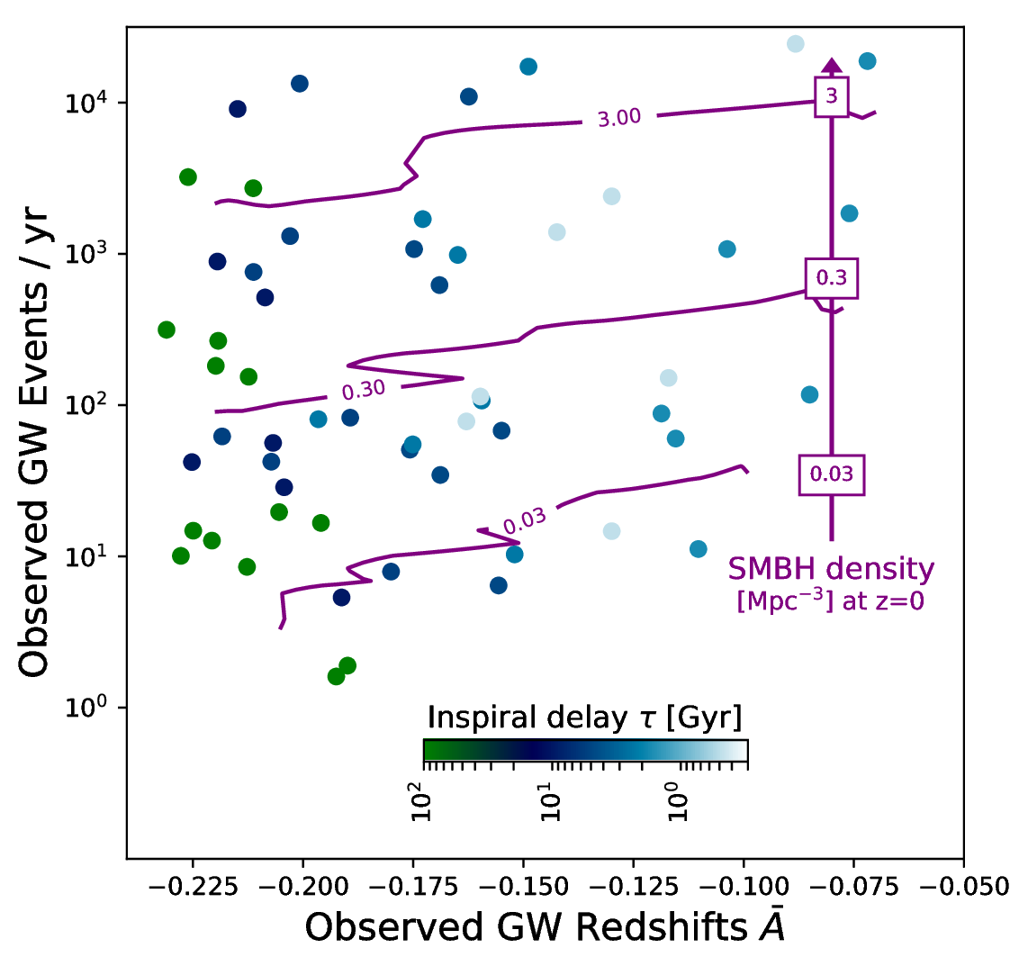
LISA Gravitational Wave Events
Buchner et al. (in prep)
All SMBH mergers will be detected
(Salcido+16, EAGLE sim + waveshape modelling)
Combination of z mean and std

Slide 11
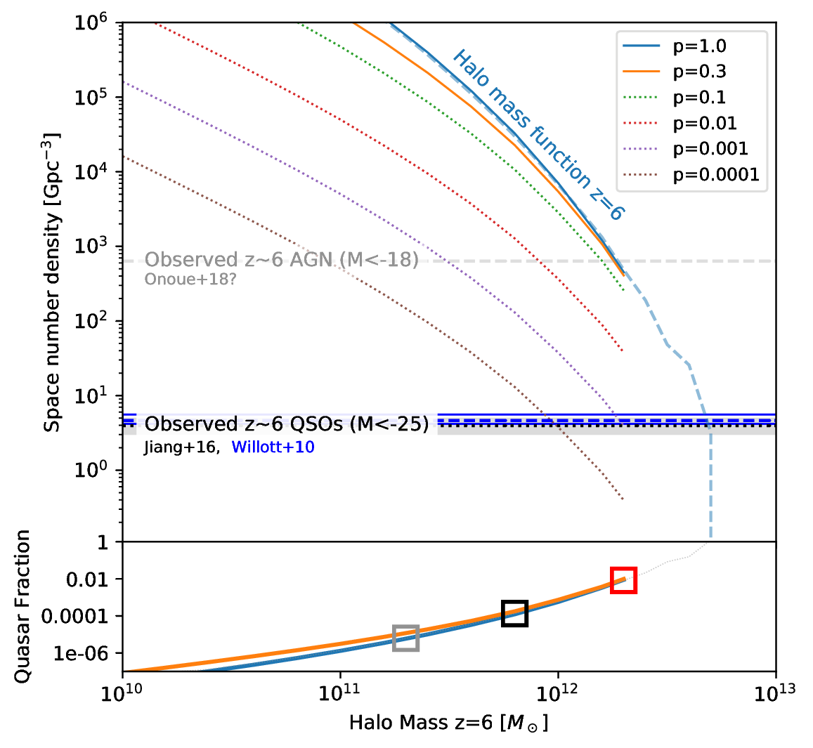
High-redshift quasars
z=6 QSO surveys (SDSS)
Earliest census of active SMBH population
There are more SMBHs
Live in massive halos?
Massive halos or duty cycle?

Slide 12
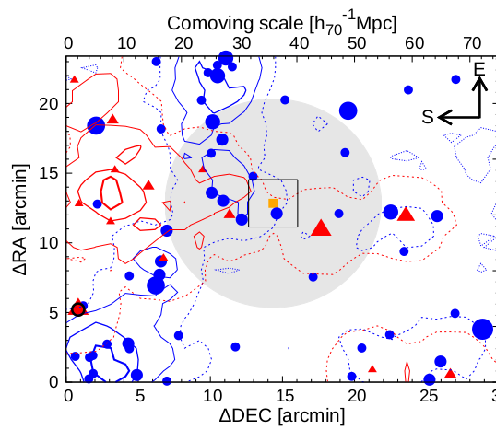
Overdensities near Quasars
LBG
Literature has conflicting results:
- Overdensities
- Equal
- Underdensities
compared to control fields
What is happening?
LAE
QSO
Ota+18

Slide 13
Overdensity predictions
QSO Hosts definition:
  Halo mass cut, e.g.:
  only >10^{12.3}M_{O}
Look at neighbourhood
Galaxies definition:
  LBG: Hatfield+17
  LAE: Kovač+07, Sobacchi&Mesinger+15
  selection as in observations (redshift window, magnitude)
Simply count galaxies within radial shells around quasar

Slide 14
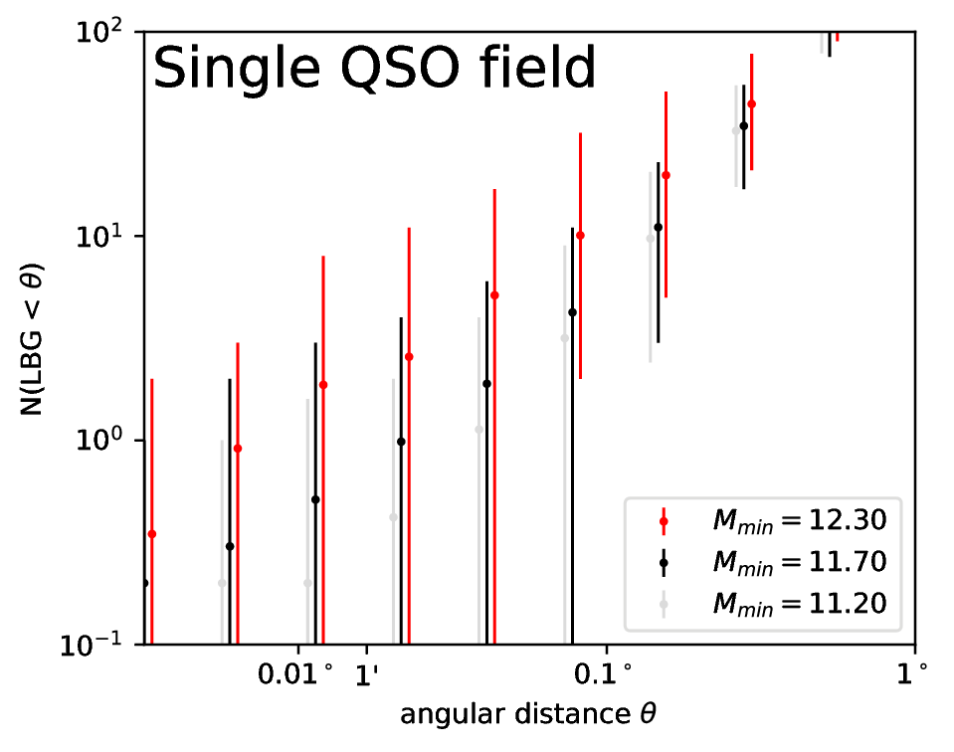
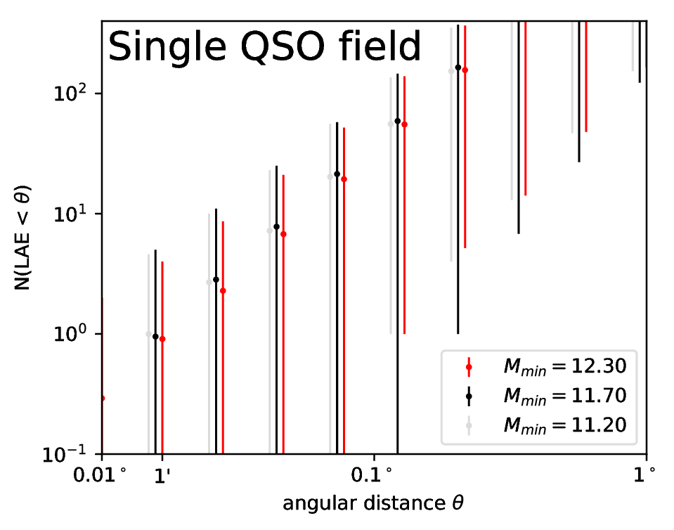
Understanding high-z quasars
LBG
LAE
Large diversity!
Large volume in z!
Large diversity!
Poisson noise!

Slide 15
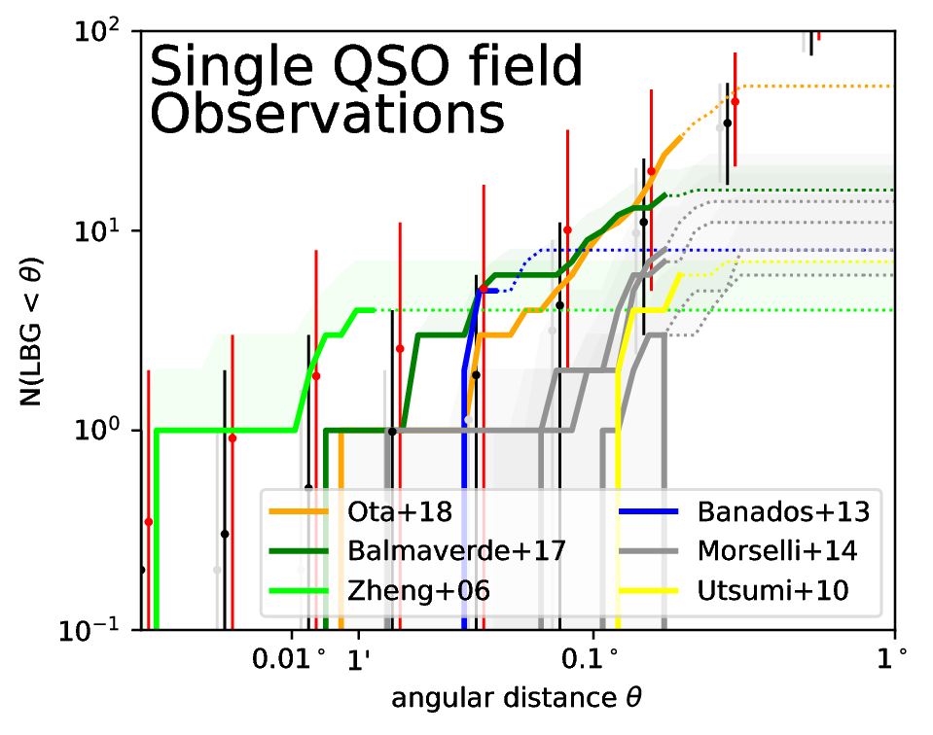
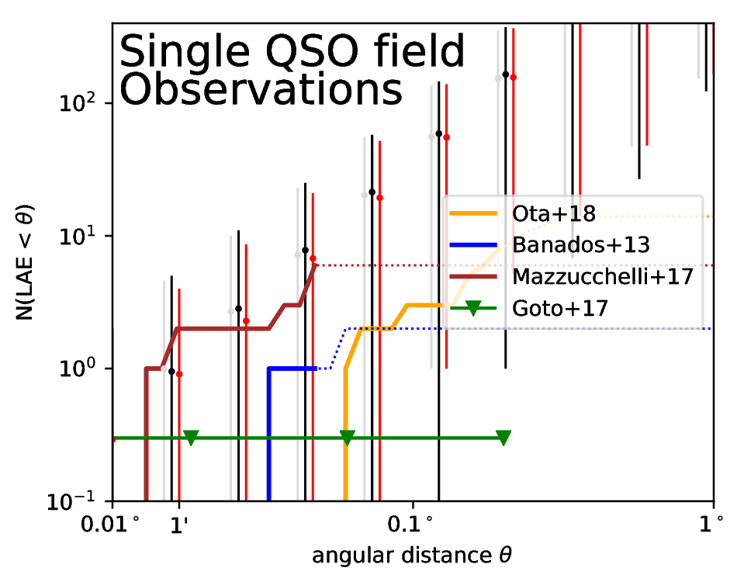
Understanding high-z quasars
LBG
LAE
Buchner et al. (in prep)

Slide 16
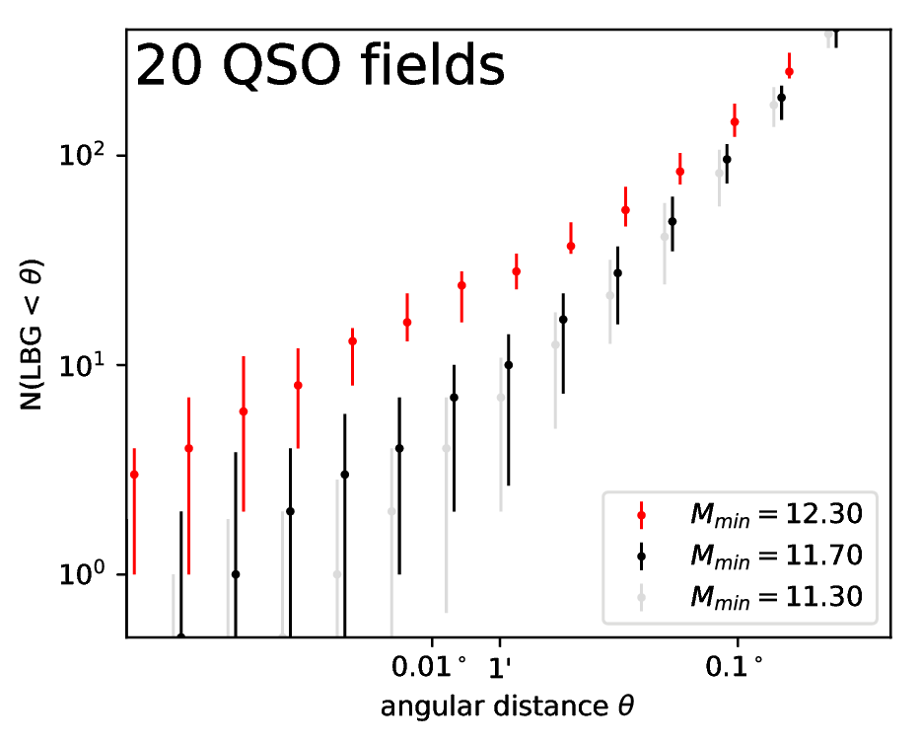
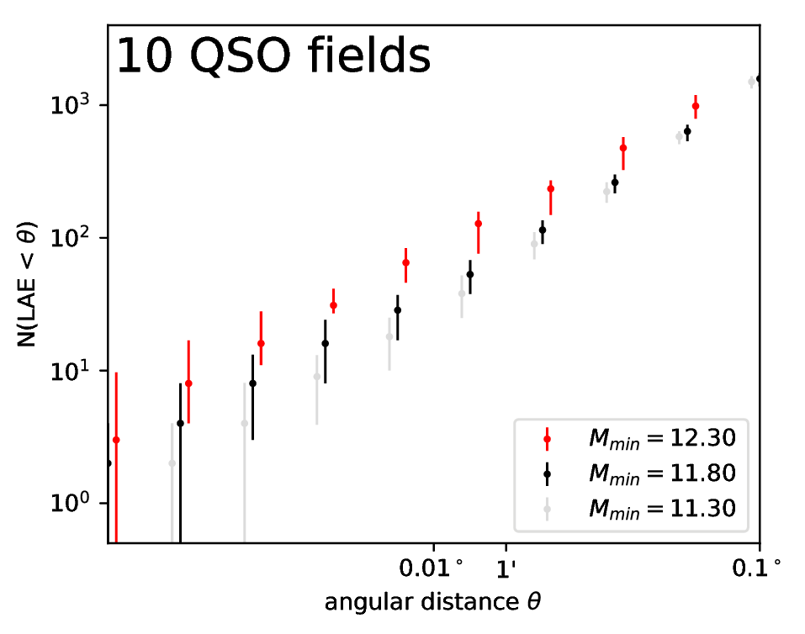
Understanding high-z quasars
LBG
LAE

Slide 17
Model-independent seeding
Seeding efficiency
LISA will directly
  Detect >1 merger/year
  Measure the SMBH space density
  Measure the merger delay time
High-z Quasar host environments are diverse
  Observe many(ten) fields
see Buchner et al. (in prep)

