Slide 1
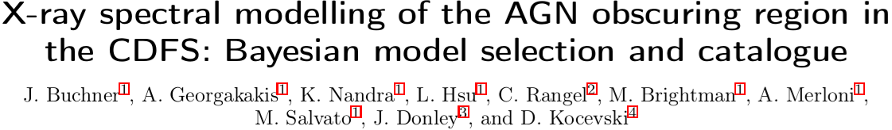
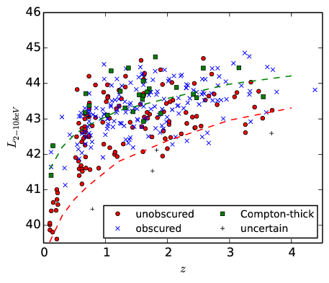
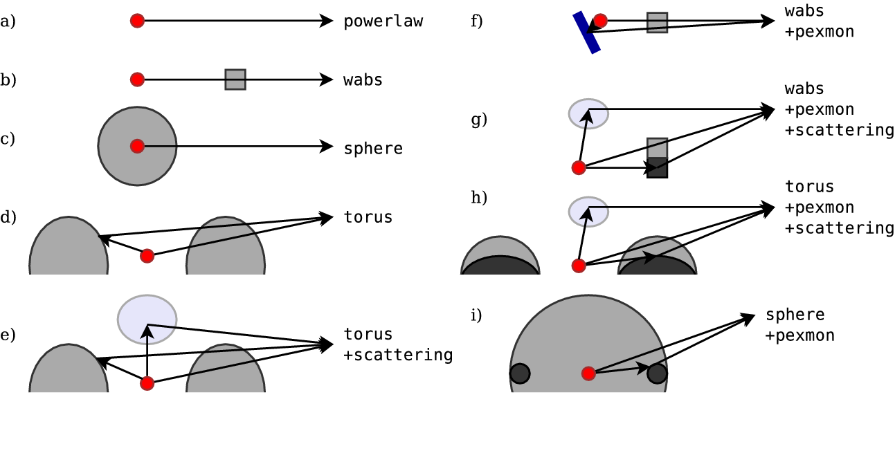
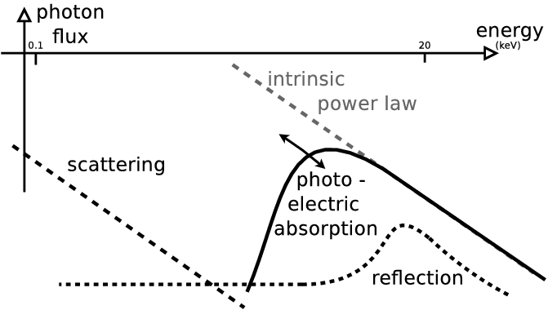
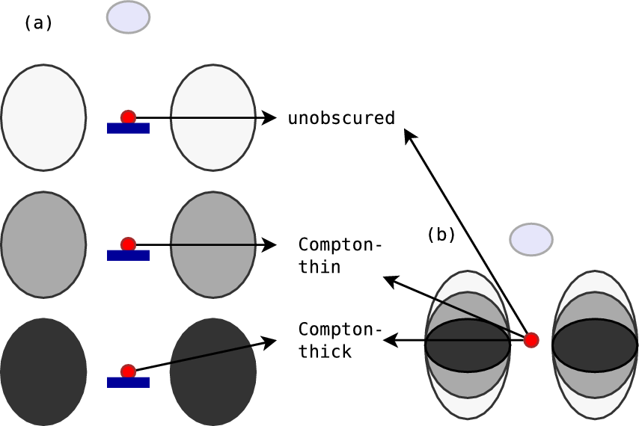
http://arxiv.org/abs/1402.0004
General purpose model comparison method for X-ray and γ-ray spectra
Computes and compare evidence for models by integrating their parameter space
→ Global search of parameter space
Software available for Xspec and Sherpa
CDFS ~300 AGN analysed
10 physically motivated models – What is the best spectral model for z>0.5 AGN?
Necessary Components:
Intrinsic powerlaw
Cold reflection – accretion disk or denser regions
Extended obscurer: torus, not disk/blob, not sphere
Soft scattering unobscured powerlaw – Thomson scattering off ionized clouds

