Slide 1

Galaxy Gas as Obscurer:
GRBs x-ray their host galaxy
Johannes Buchner
CONICYT fellow
Collaborators: @PUC: Steve Schulze, Franz Bauer
Formerly MPE HEG
http://astrost.at/istics/

Slide 2
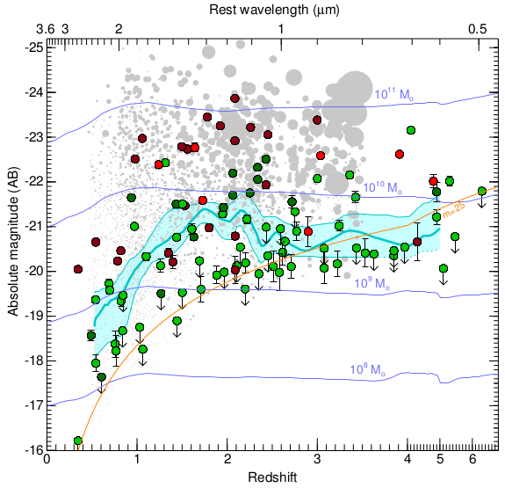

Stellar Mass
Perley+16
Redshift

Slide 3
GRB obscuration survey
X-ray afterglow column densities
Distribution, evolution, origin

Slide 4
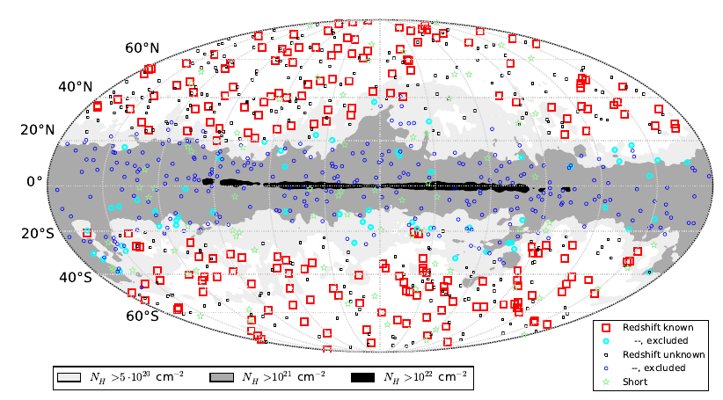
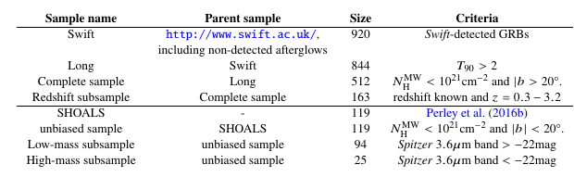
Data
Entire swift.ac.uk archive
Exclude flares & prompt emission
  Automated + visual inspection
Samples

Slide 5
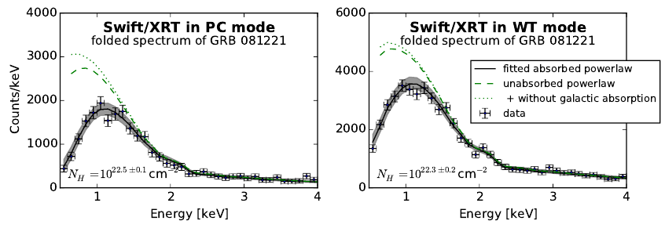
X-ray spectroscopy
phabs wabs tbabs
angr wilm
Most important: Fe, O, He
cross-section improvements
local ISM abundances
Normalisation

Slide 6
X-ray spectroscopy
phabs wabs tbabs tbnew
SPHERE
cross-section improvements
Compton scattering
Normalisation
22
23
24
25
Column density NH

Slide 7
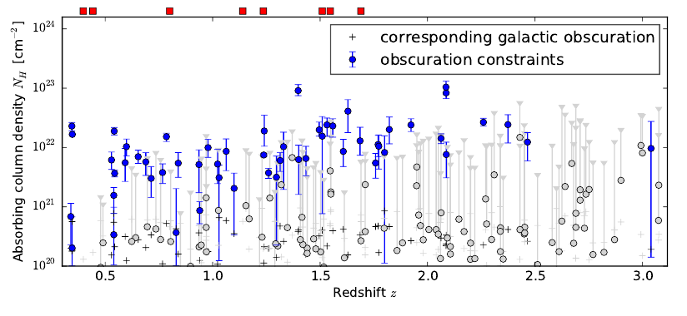
Column density distribution

Slide 8

From Sample to Population
Probability clouds
Convolve with model distribution = Likelihood
Explore possible models
Include afterglows without redshift information
Reichart (2001)
Marshall et al. (1983)

Slide 9
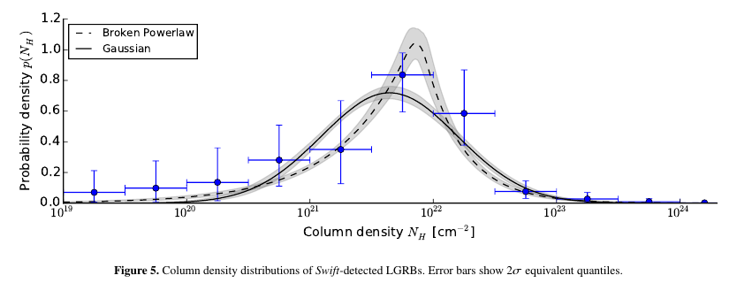
Empirical models
Model comparison (AIC): broken powerlaw is better

Slide 10
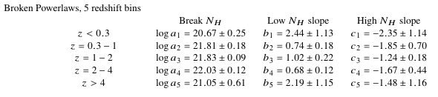
Redshift evolution
Not monotonic
Consistent within factor 2
KS test not valid
Splitting sample not valid

Slide 11
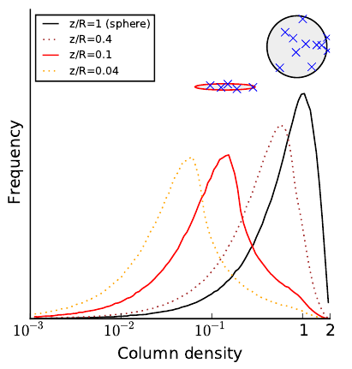
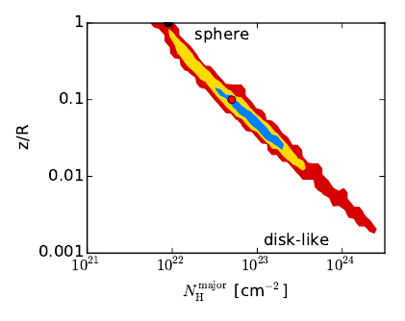
Toy model
Ellipsoid gas
convolved with log-Gaussian
Better model

Slide 12
Mass dependence
Stellar Mass
Perley+16
Redshift

Slide 13
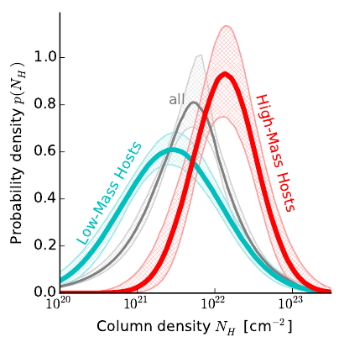
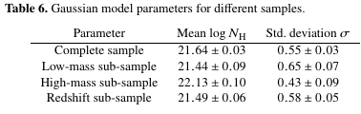
Split by mass
SHOALS
  Perley+15
  Deep follow-up
  ~90% redshift complete
  Spitzer masses

Slide 14
Conclusion #1
No evolution, if present < factor of 2
redshift sample ~ low-mass sample
complete sample ~ SHOALS sample

Slide 15
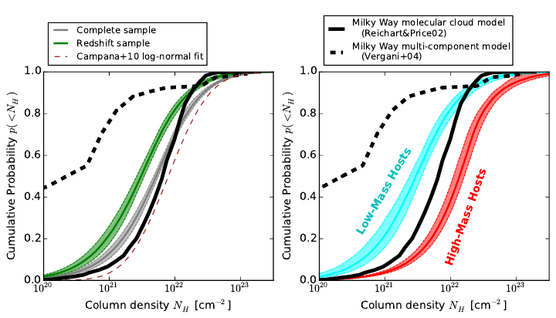
Obscurer Models

Slide 16

Host Mass – Obscuration
SHOALS
  Perley+15
  Deep follow-up
  ~90% redshift complete
  Spitzer masses
“Galaxy gas as obscurer: I.”
Buchner, Schulze & Bauer (submitted)

Slide 17




Host Mass – Obscuration
SHOALS
  Perley+15
  Deep follow-up
  ~90% redshift complete
“Galaxy gas as obscurer: I.”
Buchner, Schulze & Bauer (submitted)

Slide 18

Local Galaxies
1% densest column from HI maps
Gas metallicity-corrected
“Galaxy gas as obscurer: I.”
Buchner, Schulze & Bauer (submitted)

Slide 19
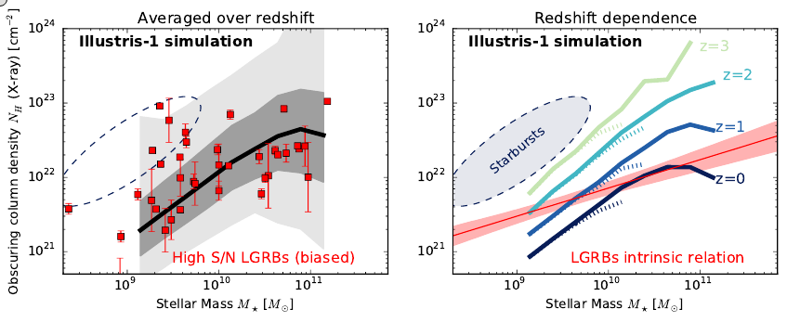
Simulations
ray-trace galaxy from densest regions
(Stellar) metal-poor galaxies also have metal gas

Slide 20
Conclusion #2
Host galaxy is the main obscurer!
  Relation valid for local galaxies
  Slope understood
  Scatter understood
  Zero-point as expected from simulations
No evolution, if present < factor of 2
redshift sample ~ low-mass sample
complete sample ~ SHOALS sample

Slide 21
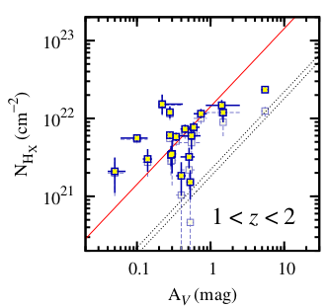
A_{V}/N_{H}
X-ray absorption (metals)
exceeds
Optical dust extinction
Watson+13

Slide 22
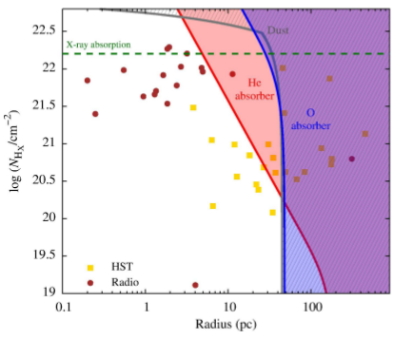
Non-local ISM abundances
Circum-burst, <30pc
Ionisation of H
Ionisation of O, Fe
(some) He left
  Original (He) column must have been 7 times higher
Predictions:
  No metals in LOS
  Energy dependence
  No stellar mass-dependence
    Larson’s laws
Watson+13

Slide 23
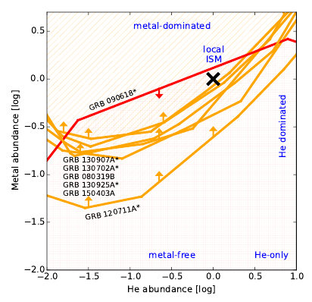
Metals in X-ray absorber
Expectation:
  He-dominated
Local ISM

Slide 24
Metals in X-ray absorber
GRB 090618: Consistent with XMM analysis Campana+11
GRB 130925A: super-solar opt. Abundances Schady+15
All with * have odd A_{V}/N_{H}
There are metals

Slide 25
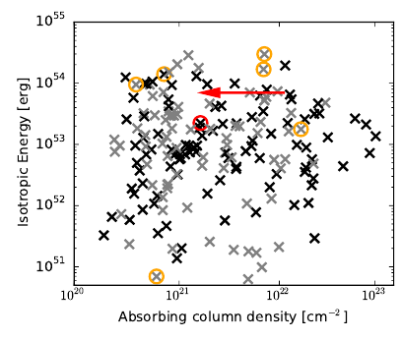
Energy-dependence
Expectation:
  For energetic bursts
  systematic decrease
  Most energetic ones: unobscured

Slide 26
Energy-dependence
SHOALS sample
Orange:
metals detected

Slide 27
Conclusions
Host galaxy is the main obscurer!
  Relation valid for local galaxies
  Slope understood
  Scatter understood
  Zero-point as expected from simulations
A_{V}/N_{H} are weird and I don’t know why.
2nd paper: apply to AGN population
(but I am not alone)

