Slide 1

BXA robust parameter estimation & practical model comparison
Johannes Buchner
FONDECYT fellow
http://astrost.at/istics/

Slide 2
BXA – Bayesian X-ray Analysis
Plugin connecting xspec/sherpa with MultiNest
  https://github.com/JohannesBuchner/BXA
Nested Sampling vs. MCMC for parameter estimation
Model comparison with evidences/Bayes factors
Population inference instead of samples statistics
Buchner+14
Buchner+15

Slide 3
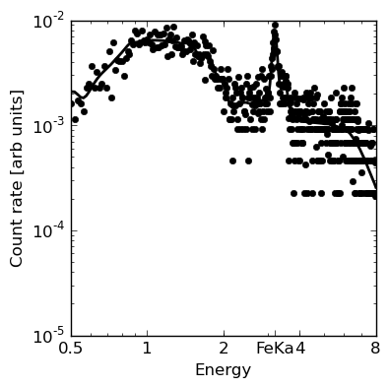
L, N_{H} from X-ray spectrum
Scattered Powerlaw component
CTK flat spectrum + FeK line

Slide 4

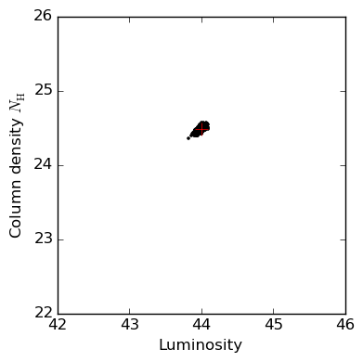
L, N_{H} from X-ray spectrum
Probability cloud

Slide 5
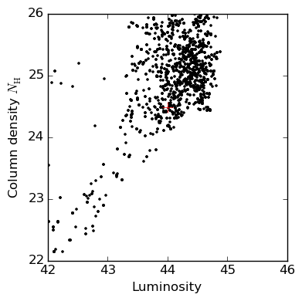
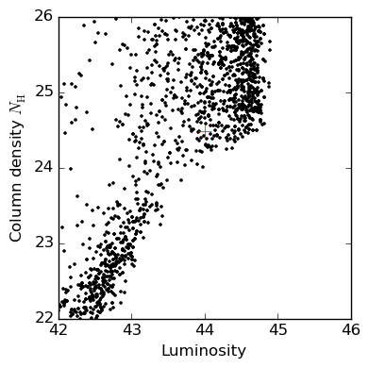
L, N_{H} from X-ray spectrum
MCMC (emcee/GW)
Nested Sampling (BXA/Multinest)
Simple fitting:
One minimum
MCMC:
One minimum
convergence tests
can be fooled

Slide 6

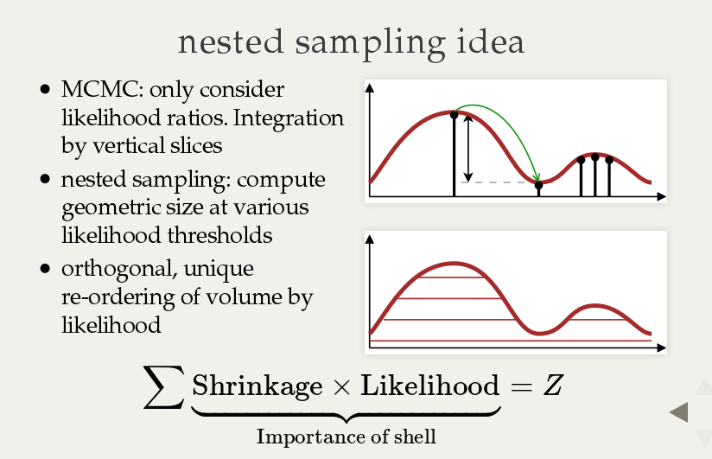

Slide 7
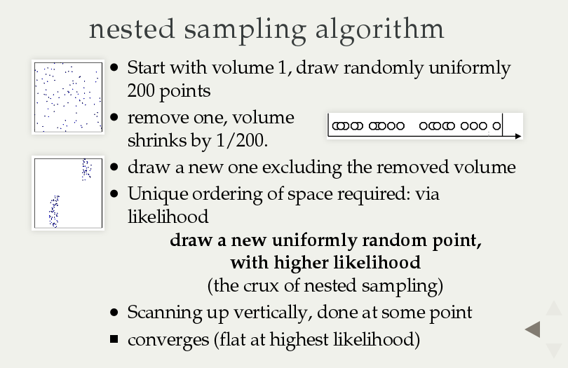

Slide 8
Missing ingredients
MCMC: Insert tuned transition kernel
NS: Insert constrained drawing algorithm
  General solutions: MultiNest, MCMC, HMCMC, Galilean, RadFriends, PolyChord

Slide 9
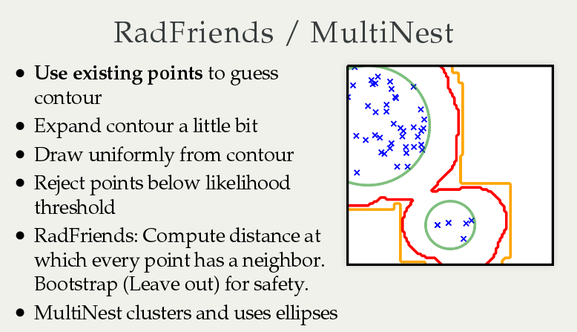
Buchner (2014)

Slide 10
Working with BXA
Do not need to abandon xspec/sherpa
Specify working parameter space
  log, linear, etc. ~ priors – or ML MCMC approach
Run once, be done!
  No stepping, no convergence worries
  No wondering about other solutions
Output: PDF of each parameter

Slide 11
BXA in practice (with pyxspec)
s = Spectrum('example-file.fak')
s.ignore("**"); s.notice("0.2-8.0")
m = Model("pow")
Set up spectrum & model
Set up parameter space
Run!
m.powerlaw.norm.values = ",,1e-10,1e-10,1e1,1e1" # 10^-10 .. 10
m.powerlaw.PhoIndex.values = ",,1,1,3,3" # 1 .. 3
# define prior
transformations = [
bxa.create_uniform_prior_for( m, m.powerlaw.PhoIndex),
bxa.create_jeffreys_prior_for(m, m.powerlaw.norm),
]
bxa.standard_analysis(transformations,
outputfiles_basename = 'simple-example')

Slide 12
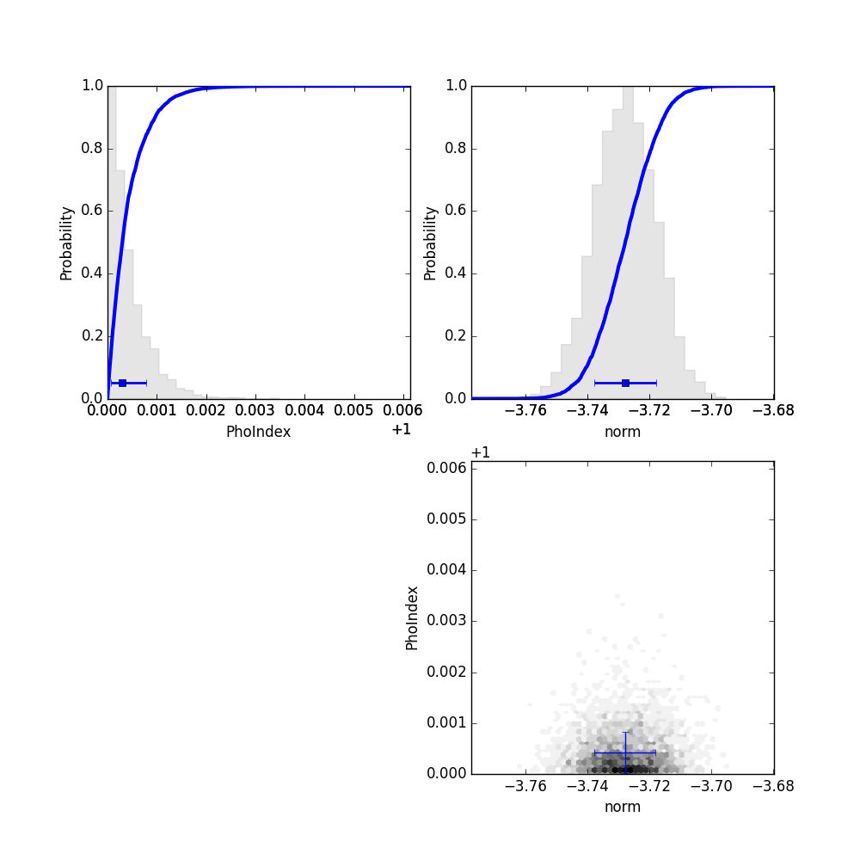
Parameter probability distributions
That was parameter estimation
– now for model comparison!
Parameter correlations

Slide 13
Model comparison
see Buchner+14
Z = p(D|M) =
    “marginal likelihood”, “evidence” …
    average likelihood over parameter space
Z1/Z2:
  Probability for model M1 compared to M2
Example:
  M1: wabs*pl – photo-el absorbed powerlaw
  M2: table{sphere}: includes Compton scattering
M1:
M2:
Z1/Z2 was 10
CDFS source 179

Slide 14
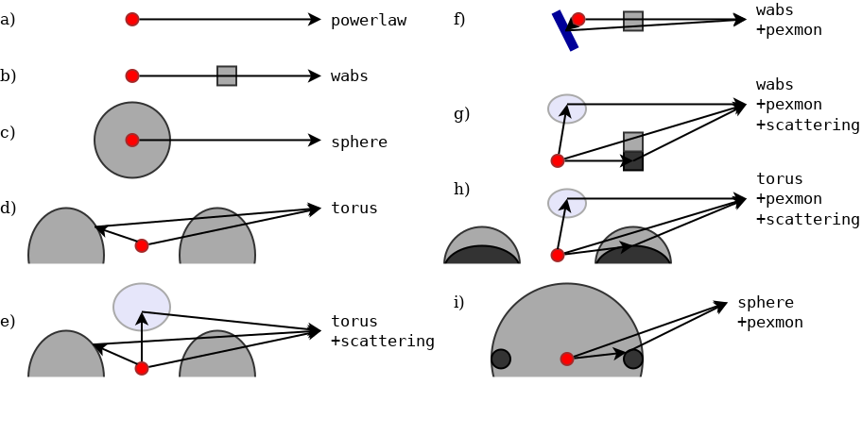
Comparison of several models
Z_{i} = p(M_{i}|D)
see Buchner+14
Model i
%

Slide 15
Example applications
Comparison between obscurer geometries (Buchner+14)
Identifying relativistic broad lines:
  Narrow line model vs.
  Relativistic broad line models (Baronchelli+in prep.)
Threshold for decisions? False selection rates?

Slide 16
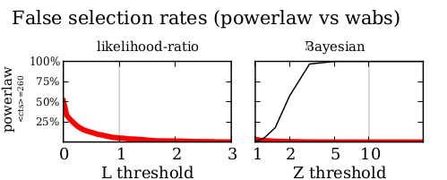
False selection rates
As with any other estimator!
  Simulate many times without effect
  measure false decisions
  Calibrate threshold
Feasible with BXA

Slide 17
Population inference
Example: Photon index, N_{H} distribution of population of LGRBs, AGN
sample statistics
(selection effects – see Buchner+15, A1)
Keep uncertainties, Upper limits
Don’t:
  Plot histogram of means
  Stack posteriors

Slide 18
Hierarchical Bayesian inference
Assume flexible population model
  Examples: Gaussian, Gaussian mixture, beta distribution
Fold in posterior samples for object i
Likelihood for population parameters!
Importance sampling from posteriors
  need flat priors, see Buchner+15 A1 for details
Product over objects
Mean over samples

Slide 19
Hierarchical Bayesian inference
Assume flexible population model
  Examples: Gaussian, Gaussian mixture, beta distribution
Fold in posterior samples for object i
Likelihood for population parameters - MCMC
Importance sampling from posteriors
  need flat priors, see Buchner+17a for details
Product over objects
Mean over samples

Slide 20
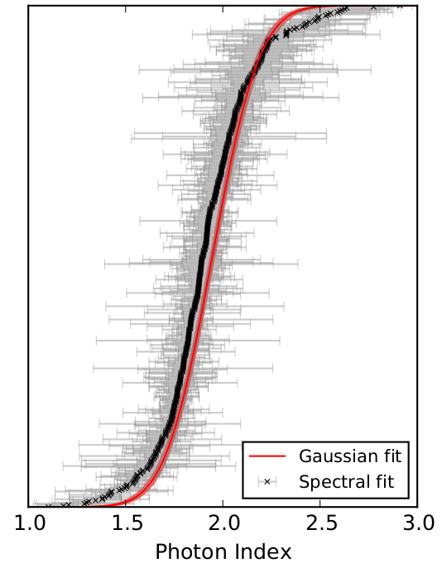
Population inference
Keeps uncertainties
  Fold in redshift uncertainties
  (unlike X-ray stacking!)
Population uncertainties
  Include limited sample size
  Model can be 1d,2d,3d,…
Special case of
luminosity function
analysis (Loredo2004)

Slide 21
Summary
BXA: a MultiNest plugin for xspec/sherpa
BXA: parameter estimation
  Robust to multiple solutions, convergence issues, etc.
BXA: Bayesian model comparison
  Sensitive; can be interpreted; calibrated to FDR
Population inference
  Understand the population from a limited sample
  Forward-fold all uncertainties
more in: Buchner+14, +15, +17a + their refs

