Slide 1
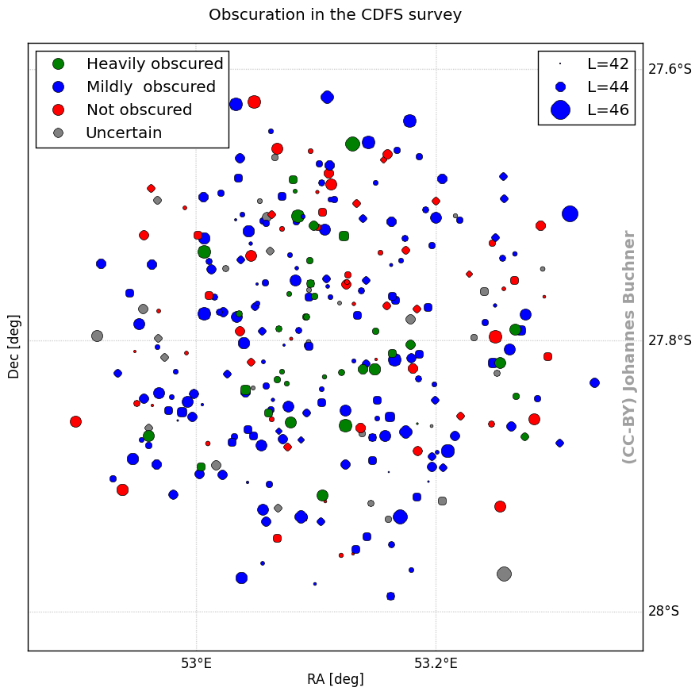
X-ray studies of AGN
github.com/JohannesBuchner/BXA
BXA – Bayesian X-ray Analysis
  Get most information out of
  low-count X-ray spectra
  Model selection between obscurer geometries (Buchner+14)
  Handle incomplete redshift information
    X-ray redshifts from obscured AGN –
    with Charlotte Simmonds
Non-parametric X-ray Luminosity Function of AGN (Buchner+15)
  Hierarchical Bayesian inference
Largest sample of heavily obscured AGN (100 CTAGN, z=0.5-3)
Obscuration by host galaxies?
GRB obscuration survey
  Buchner+16a
Translation to AGN hosts
  Buchner+16b

Slide 2
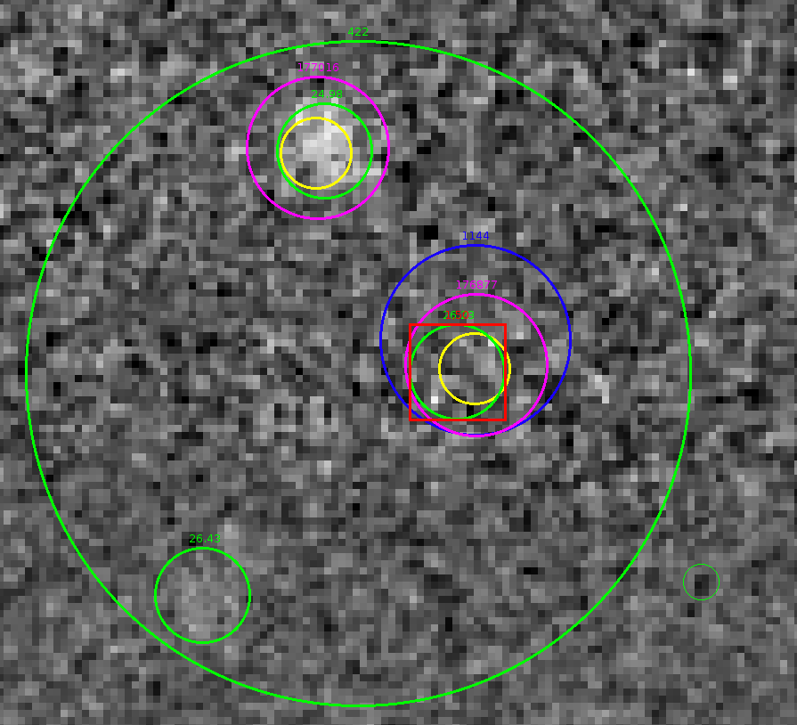
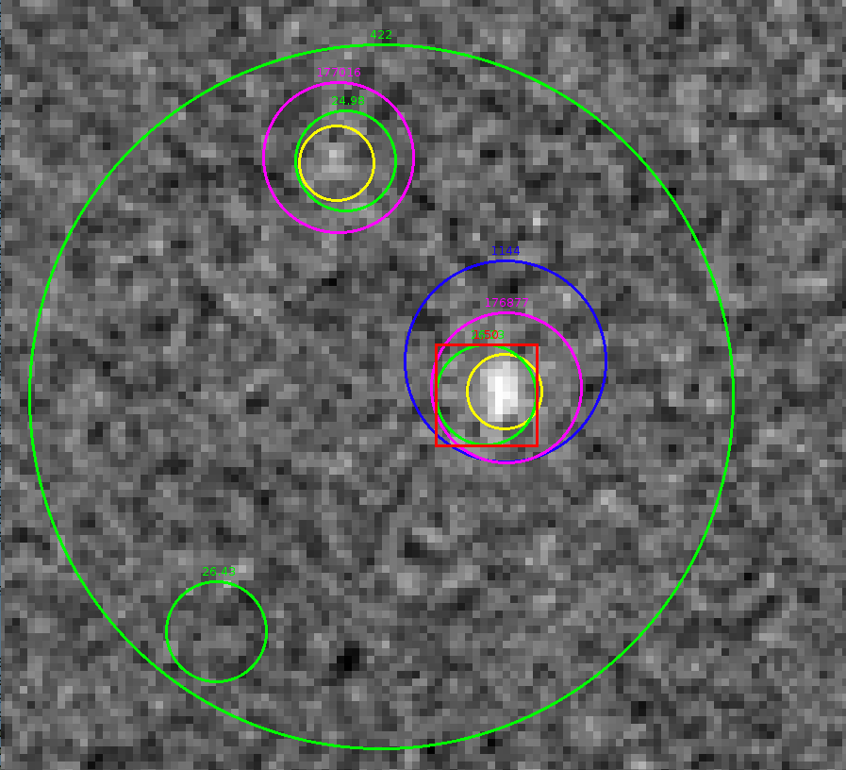
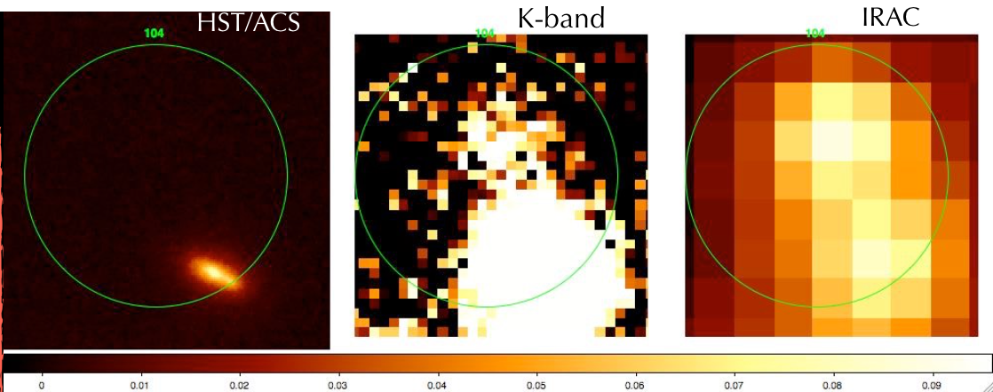
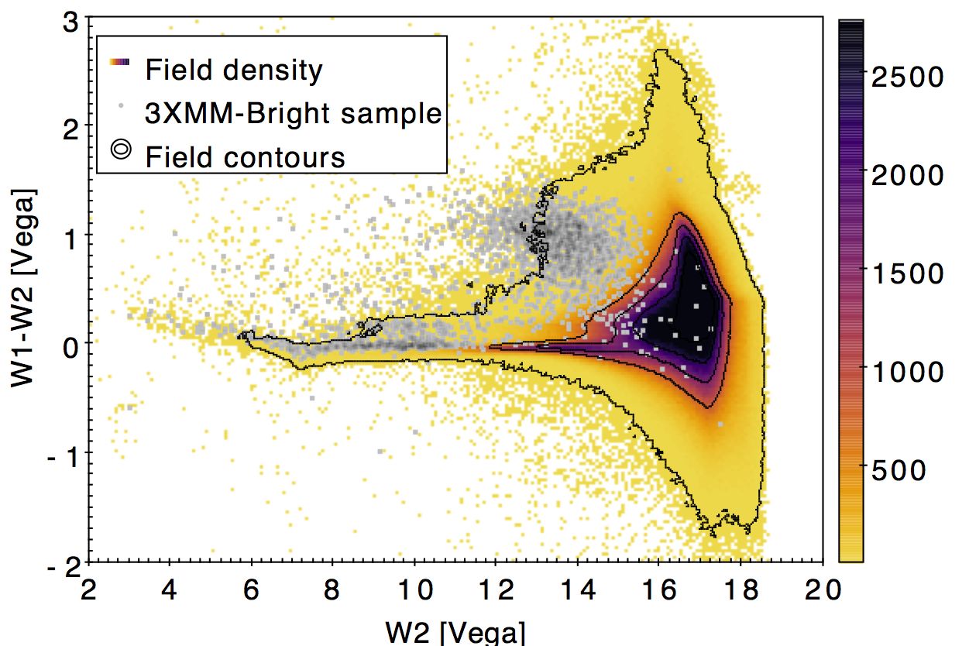
NWAY – multi-catalog association
z band
K band
26mag
21mag(?)
23mag

Slide 3
NWAY – multi-catalog association
Based on solid Bayesian statistics
Can process simultaneously N catalogs
Handles absent sources
Handles ambiguous cases
Can ingest prior information
  magnitude, color (SED information), or other
Fast and automatic
In collaboration with Mara Salvato, K. Nandra (MPE)
Preparation for eROSITA follow-up (Tom Dwelly)

