Slide 1
Comparison of
AGN absorption and reflection models in the Chandra Deep Field South
Thesis committee meeting
2013-05-07
Johannes Buchner

Slide 2
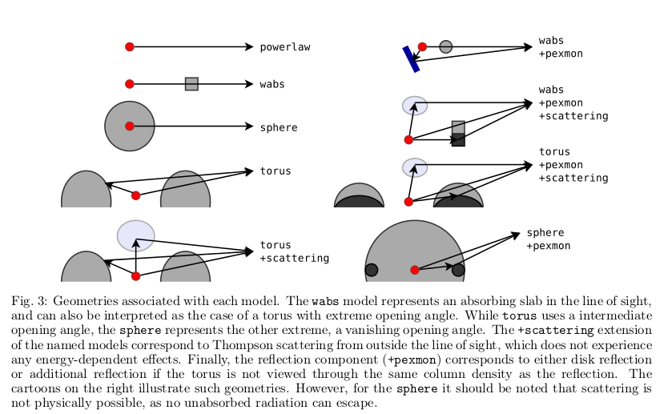
Motivation: Study geometry of the obscurer

Slide 3
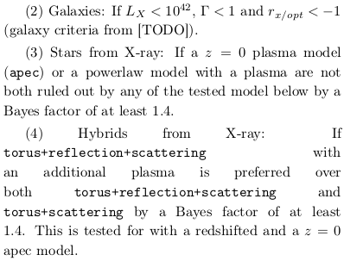
Sample & Data
CDF-S 4Ms: 567 sources
Redshifts compiled by Li-Ting
  Photometric: 347
  Spectroscopic: 283 of these
Remove
contamination
  Stars
  Galaxies
  Hybrids
→ 209 sources

Slide 4
Models
Obscurer
Features
Models
none
wabs
torus
sphere
powerlaw
powerlaw+reflection
wabs
wabs+scattering
wabs+reflection+
scattering
torus
torus+scattering
torus+reflection+
scattering
sphere...
scattering
reflection

Slide 5
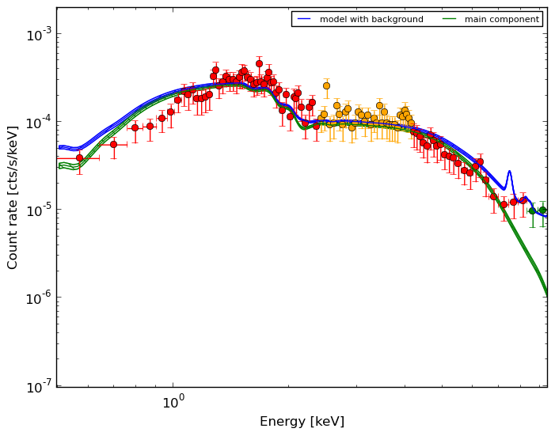
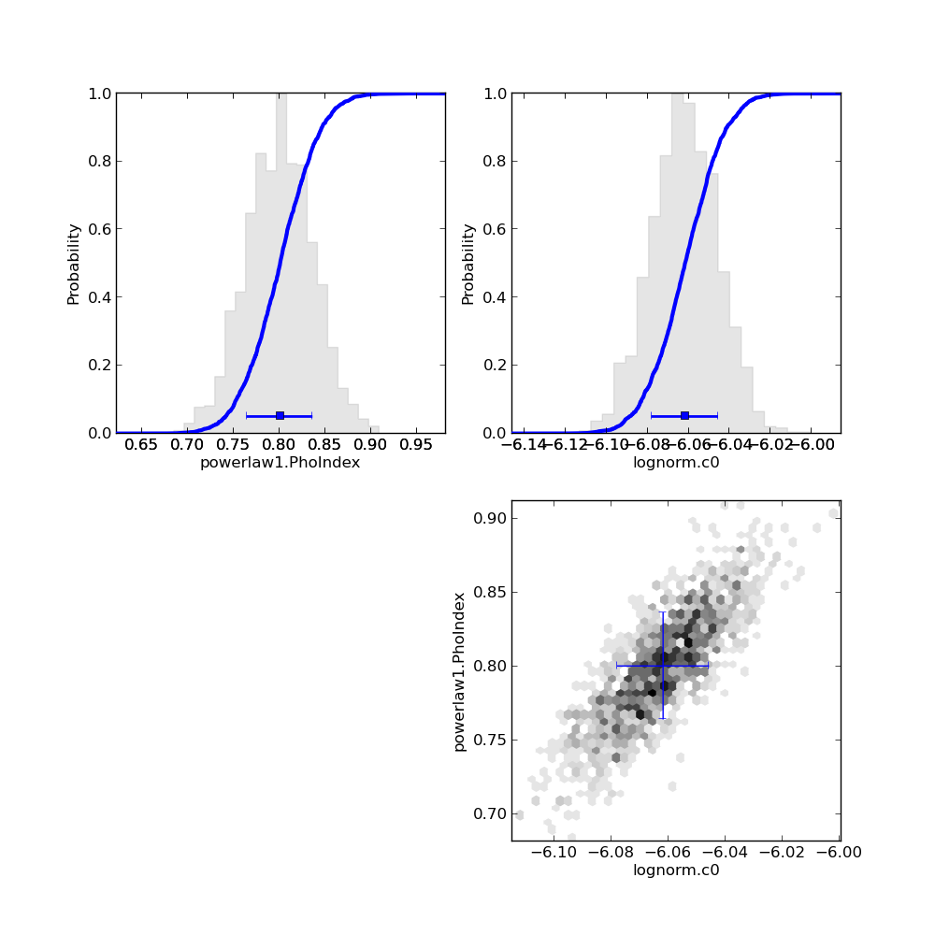
Result for one AGN – XID:179
powerlaw
z = 0.605
2485 counts 0.5-10keV.

Slide 6
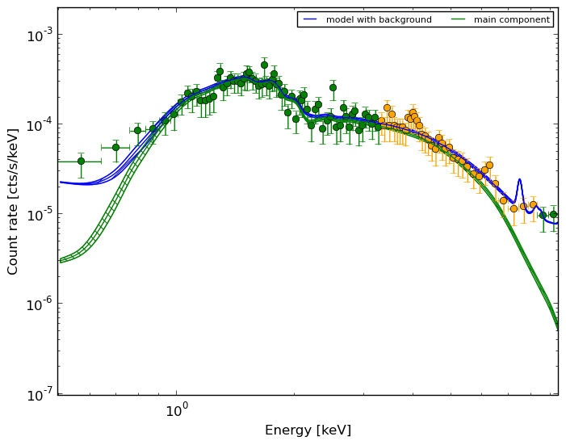
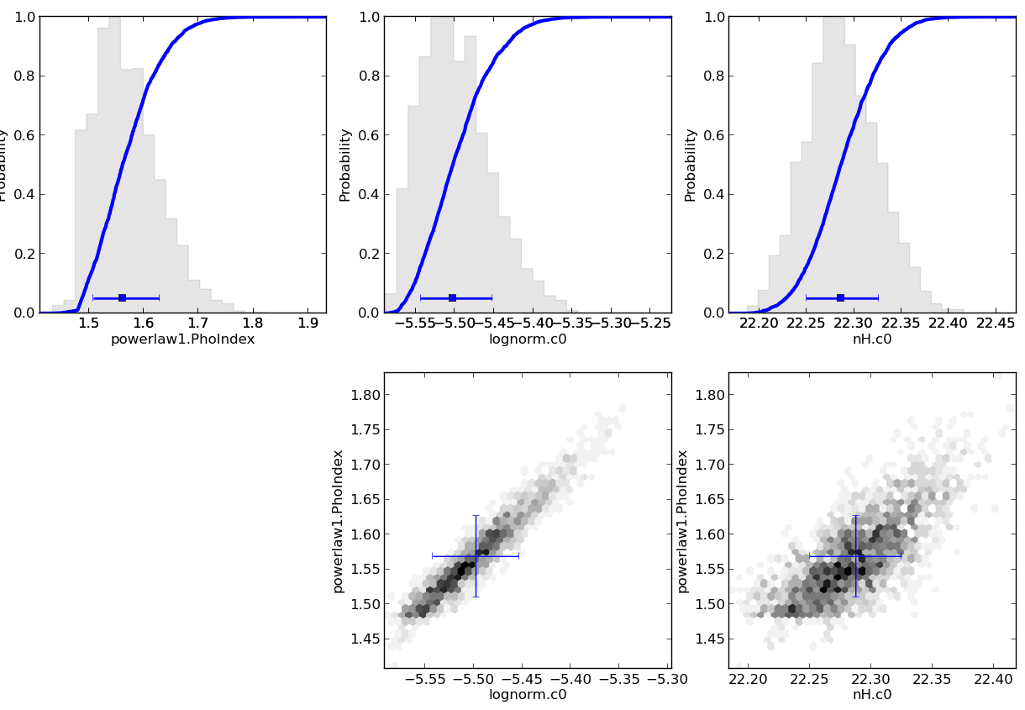
Result for one AGN – XID:179
wabs

Slide 7
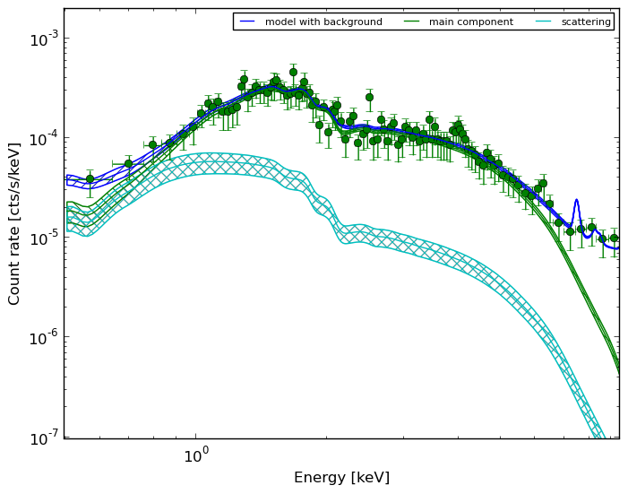
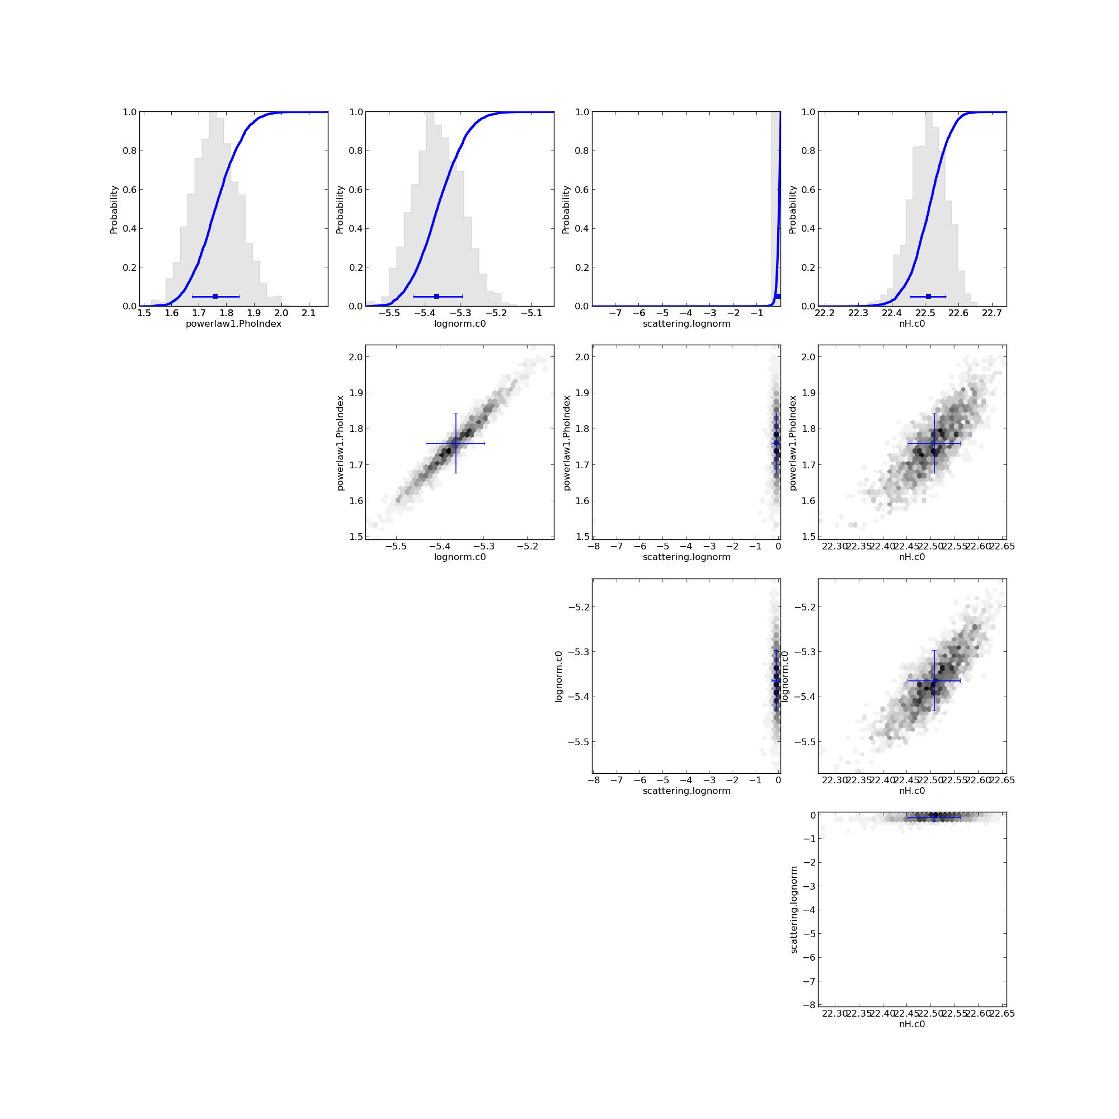
Result for one AGN – XID:179
wabs+scattering

Slide 8
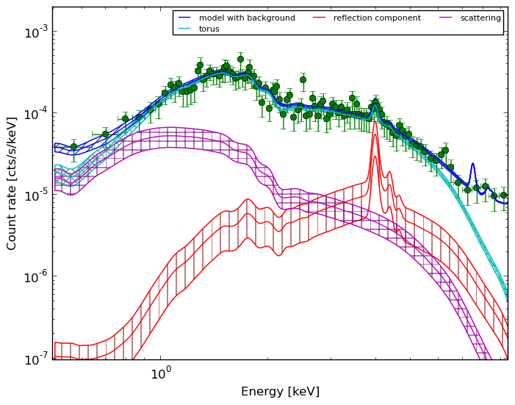
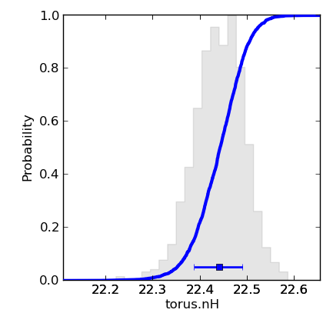
Result for one AGN – XID:179
torus+reflection+scattering

Slide 9
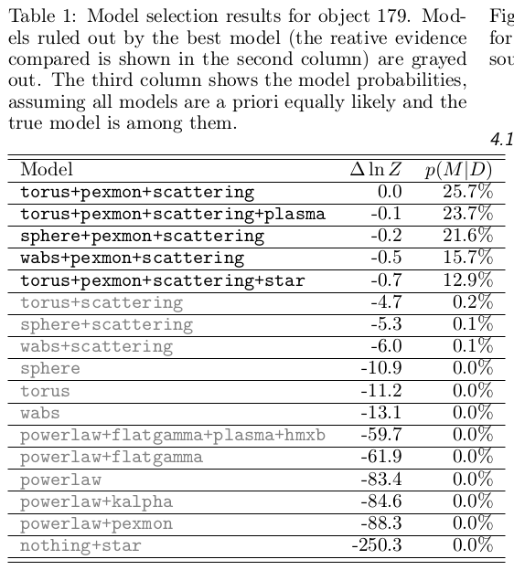
Result for one AGN – XID:179
Model comparison / selection
Priors to hypotheses/models?
a) pair-wise equal
b) over all equal

Slide 10
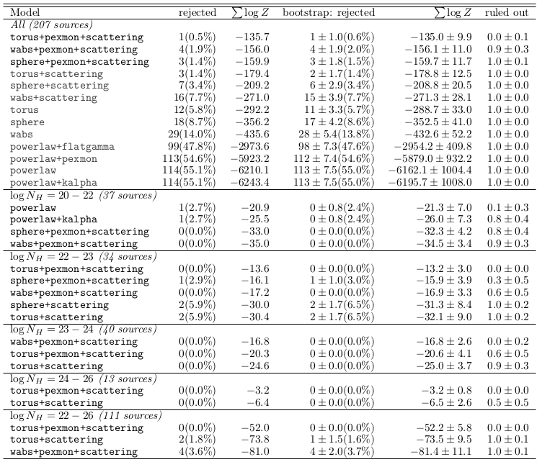
Reflection exists
In this sample, torus is right
obscurer geometry
Scattering exists
Only few objects make
the difference, not
robust against resampling
Obscurer exists
Power law is often good enough (simplicity)
In Compton-thin, there is something going on
Compton-thick prefer torus

Slide 11
Results
Three channels:
  LOS absorption
  Outside-LOS reflection (obscured)
  Outside-LOS soft scattering (unobscured)

Slide 12
Conclusions
Three channels:
  LOS absorption
  Outside-LOS reflection (obscured)
    from accretion disk – Unified picture – OK
    from torus
  Outside-LOS soft scattering (unobscured)
    Cone of ionized material
(2)
(1)
(3)
Torus is the best obscurer geometry, although opening angle can not be constrained.

Slide 13
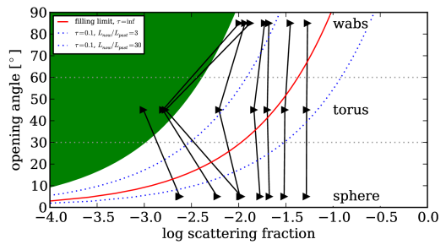
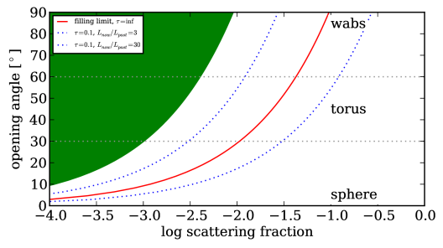
The soft scattering controversy
179: 5%-10%
Hard limit:
All radiation within cone
gets Thomson-scattered
For 90°: 10%, 45°: 2.4%
  Suggestions?
  (just take 2?)
Options:
  large opening angle,
  completely filled, ionized cone
  One, single power law
  Variability: High L in the past,
  delayed in cone (pc-scale)
  Foreground star, HMXB, stars
Not enough. No other indications. Not
particularly high luminosity (L=10^{43.3} erg/s for 179)
Ruled out by model selection
179 was in the first 1Ms sometimes brighter, by factor of 3.
other 3 sources do not show any sign of variation. need >30
  Ruled out by model selection / parameters,
some are z=1.5-2, faint optical counterparts

Slide 14
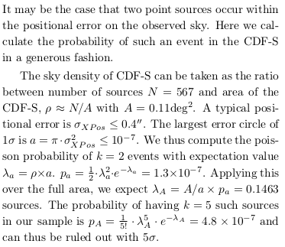
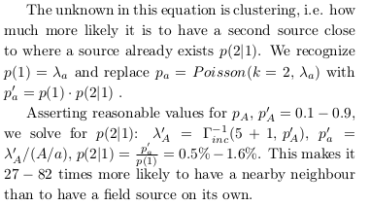
Two sources
179: bright; has a second blob, z=0.6
200: bright; cluster? Outside CANDELS, z=1.7
287: bright; cluster? not in CANDELS, z=0.6
4: very bright; Outside CANDELS, z=0.3, irregular structure/large arm

