Slide 1
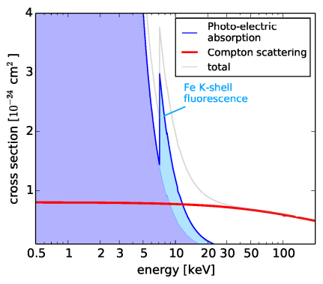
X-ray

Slide 2
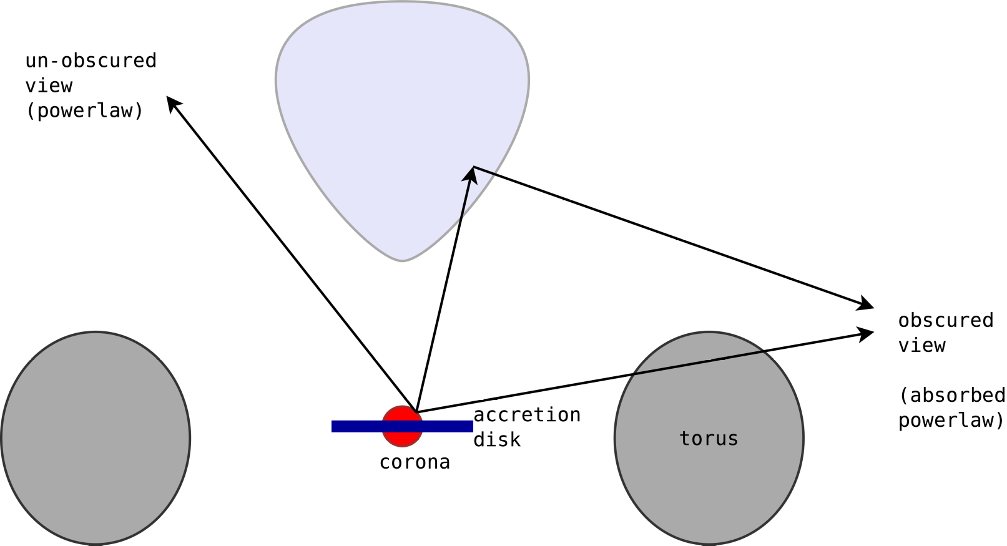
AGN primer
Accretion disk:
Ensemble of Black-body
→ Powerlaw in UV
Hot electron cloud “corona”:
Inverse Compton scattering →
→ Powerlaw in X-ray
Obscurer:
Photo-electric absorption,
Compton scattering (if very thick)
Obscurer

Slide 3
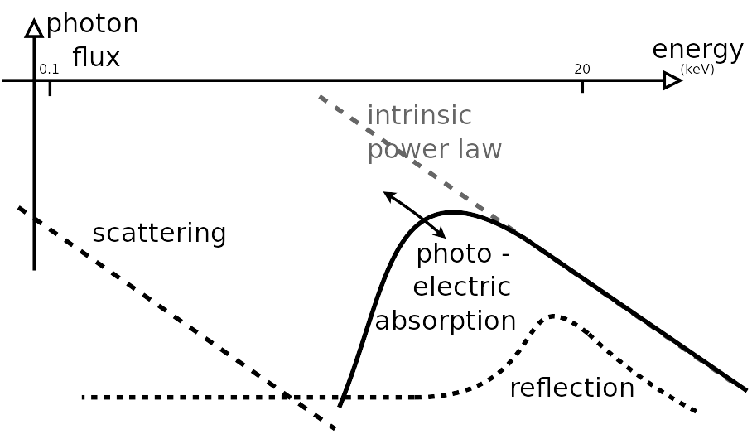
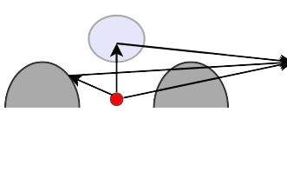
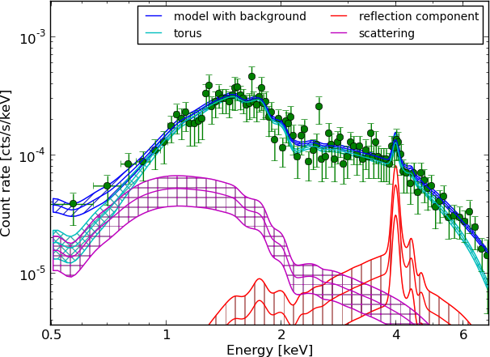
AGN in X-ray
Powerlaw,
Absorbed
Soft scattering Powerlaw
1
2
1
3
3
2

