Slide 1
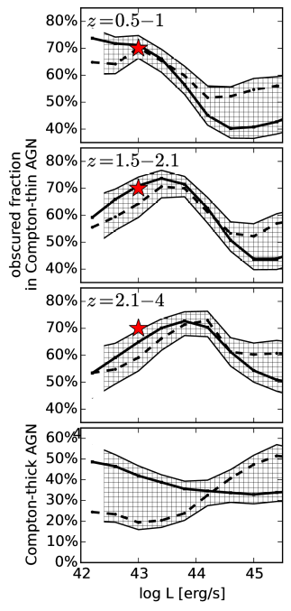
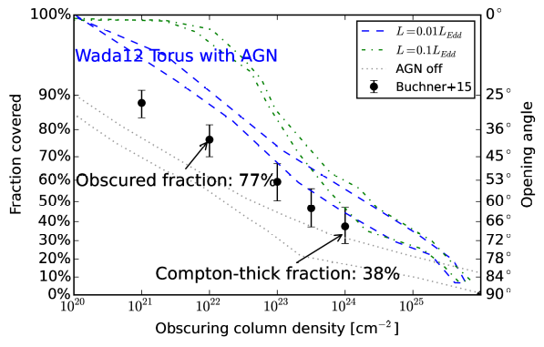
Constraints on the torus from X-ray
AGN population studies
Johannes Buchner (MPE/PUC)
A. Georgakakis, K. Nandra,
M. Brightman, M-L Menzel, Z. Liu,
L-T. Hsu, M. Salvato, C. Rangel, J. Aird, A. Merloni and N. Ross
Buchner et al. (2015)
Fraction of Obscured
AGN: 77⁺⁴₋₅%
Fraction of Compton-thick
AGN: 38⁺⁸₋₇%
Averaged over cosmic time, L_{X}>10⁴² erg/s
Data: ~2000 2-10keV detected AGN, >100 CT, mostly z=0.3-4
CDFS, AEGIS-XD, C-COSMOS, XMM-XXL (20deg²)
Full Bayesian spectral analysis Buchner+14
Non-parametric luminosity function & N_{H} distribution Buchner+15

