Slide 1
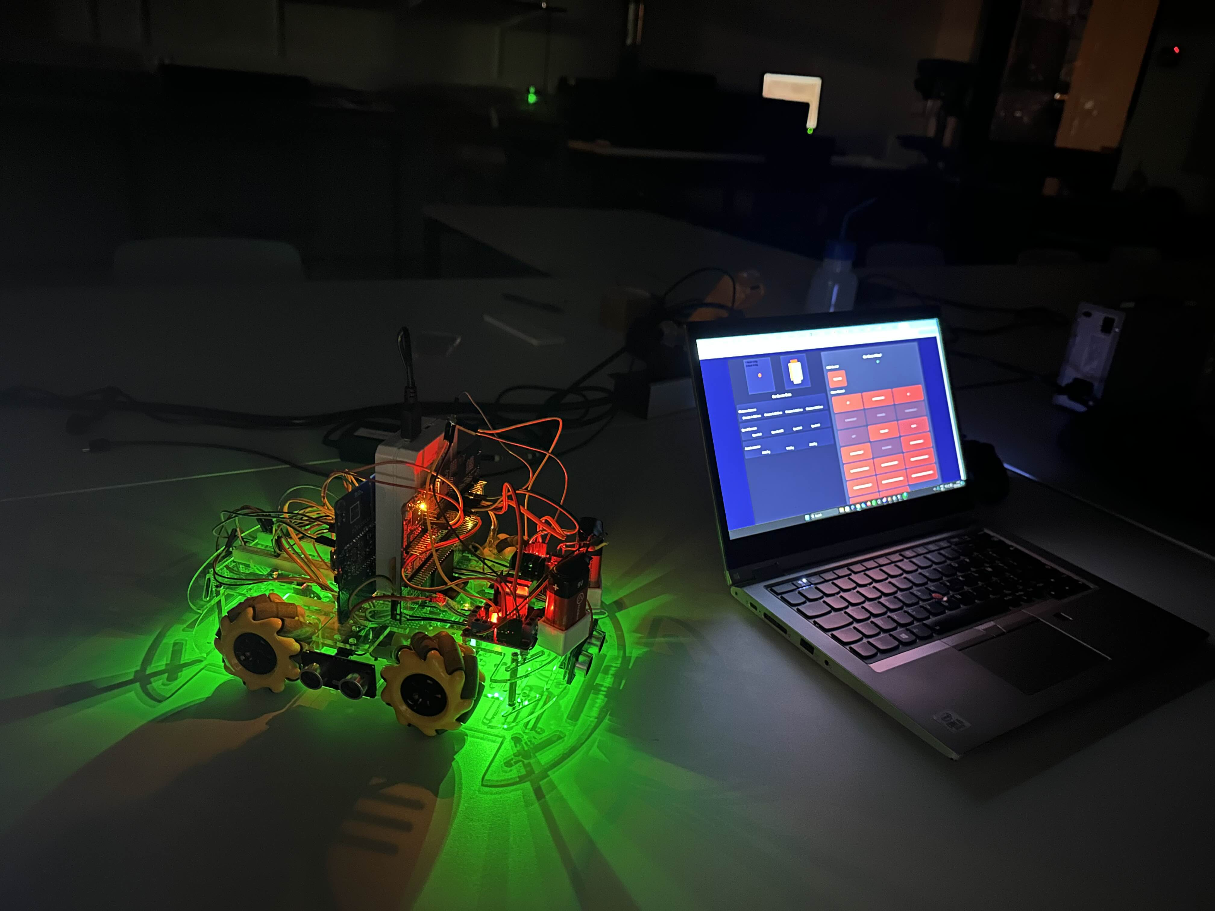
IoT Smart Car Psoc X5
Johannes Chopov, Laurence Jorissen, Mohammed Albayyouk

Slide 2
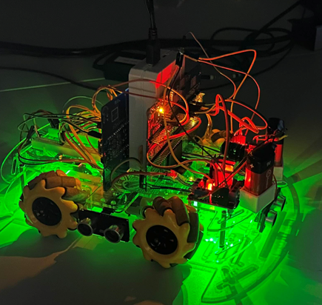
Project goals
Basis = Remote Controlled car
Data streaming
Acceleration
Wheel RPMs
Distance to obstacles
Collision avoidance
Autonomous driving

Slide 3
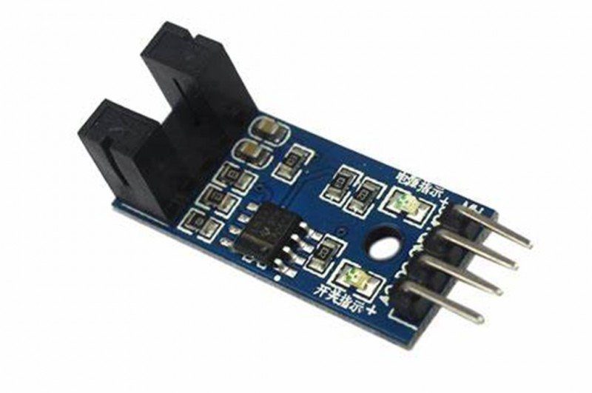
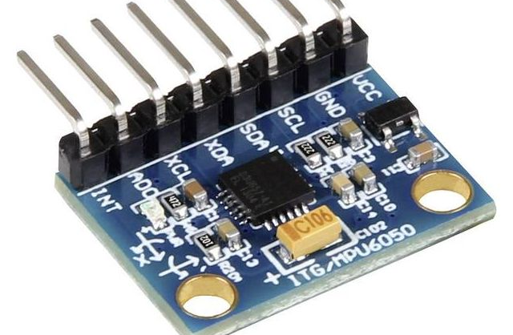
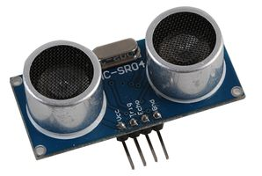
Sensors (inputs)
Distance
SR-04 Ultrasonic sensors
Logic level converters
RPM
Pulse counting module
Acceleration
MPU6050 (I2C)
Thermistor
On the PSoC itself.

Slide 4
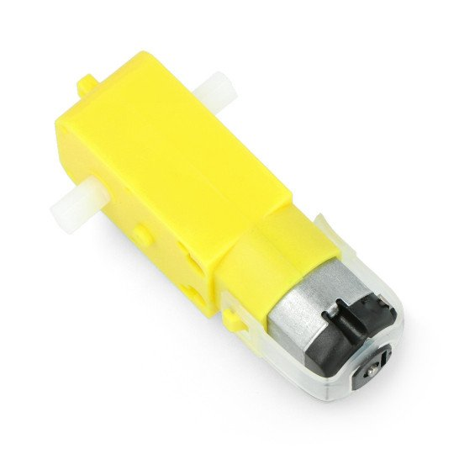
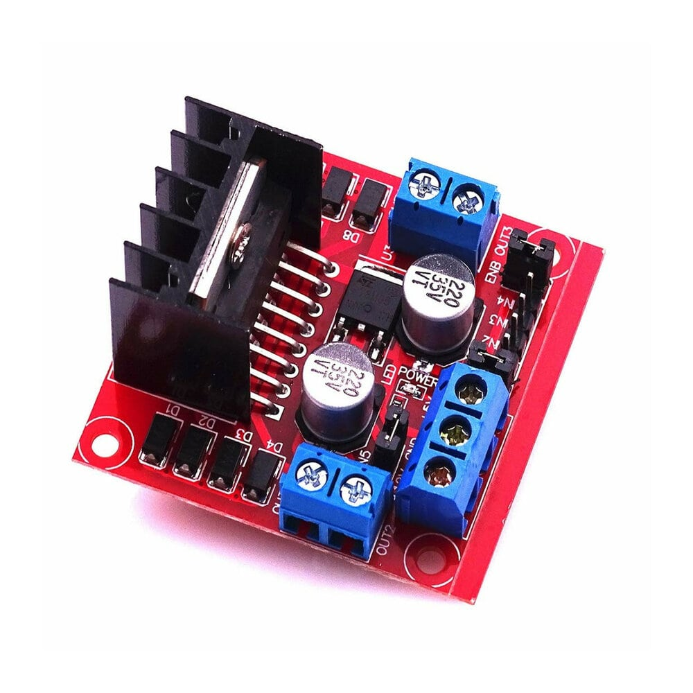
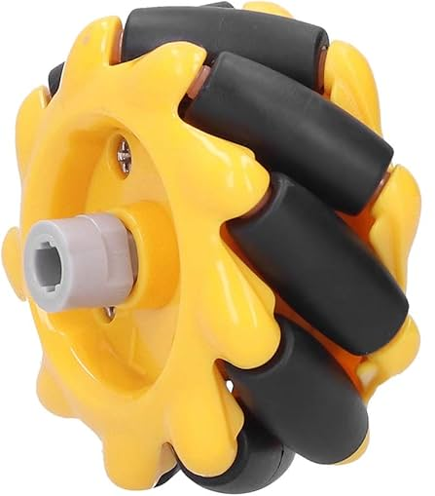
Motor components (outputs)
2 - Motor drivers
Activation pins for each wheel
Pwm output → rotation speed
4 - DC-motors
2 - 9V batteries
4 - Mecanum wheels

Slide 5
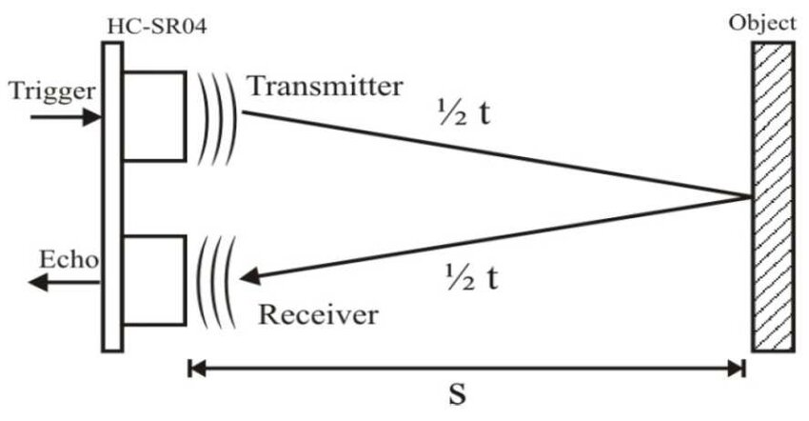

Distance calculation
SR-04 sends out a pulse
Receives that pulse after a certain amount of time
Time measured using a timer interrupt
$v=343 m/s$
$S=v ∗\frac{t_{pulse}}{2}$

Slide 6
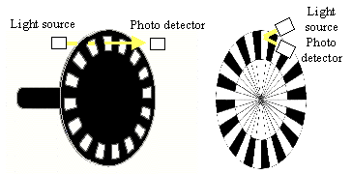

RPM counter
Count #pulses each second
20 holes per full rotation
$$RPM=\frac{pulsecount}{20}∗60$$

Slide 7
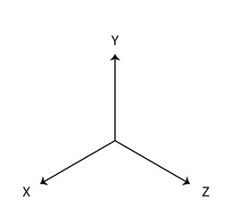
Accelerometer
Detect acceleration in X and Z directions.
Neglect Y direction: gravitational accelaration (1g)

Slide 8
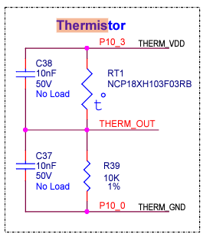
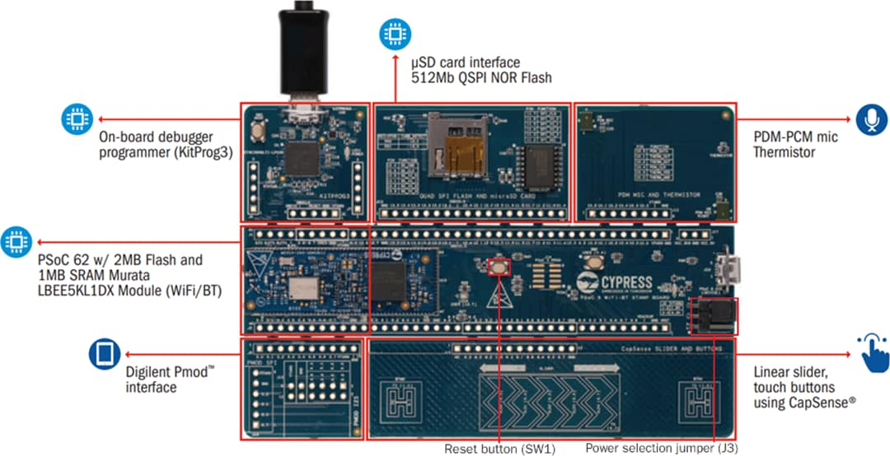

Slide 9
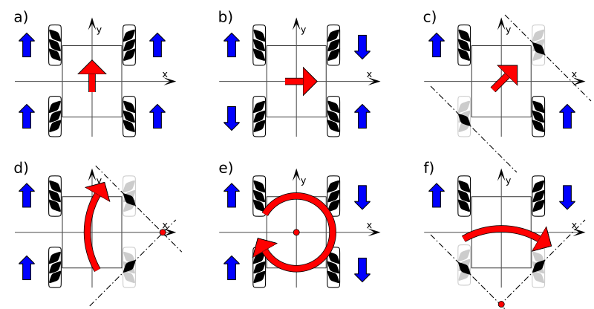
Motor control
Each command corresponds to 8 bits
2 bits/pins per wheel
Forward (10)
Backward (01)
Stationary (00)

Slide 10
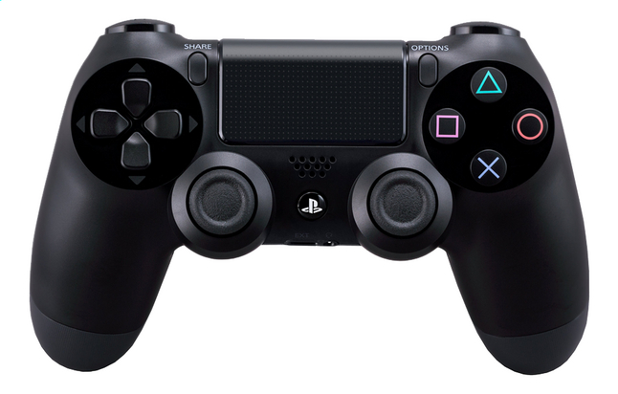
User interface
Controller
Website

Slide 11
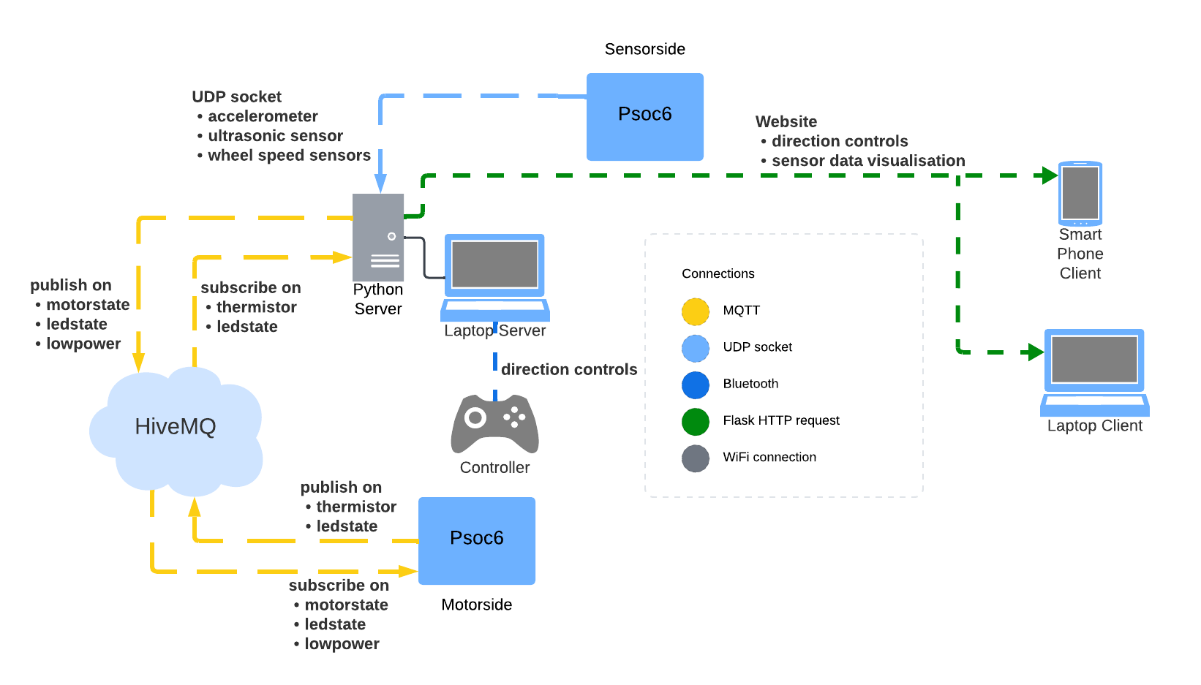
Connection schematic

Slide 12
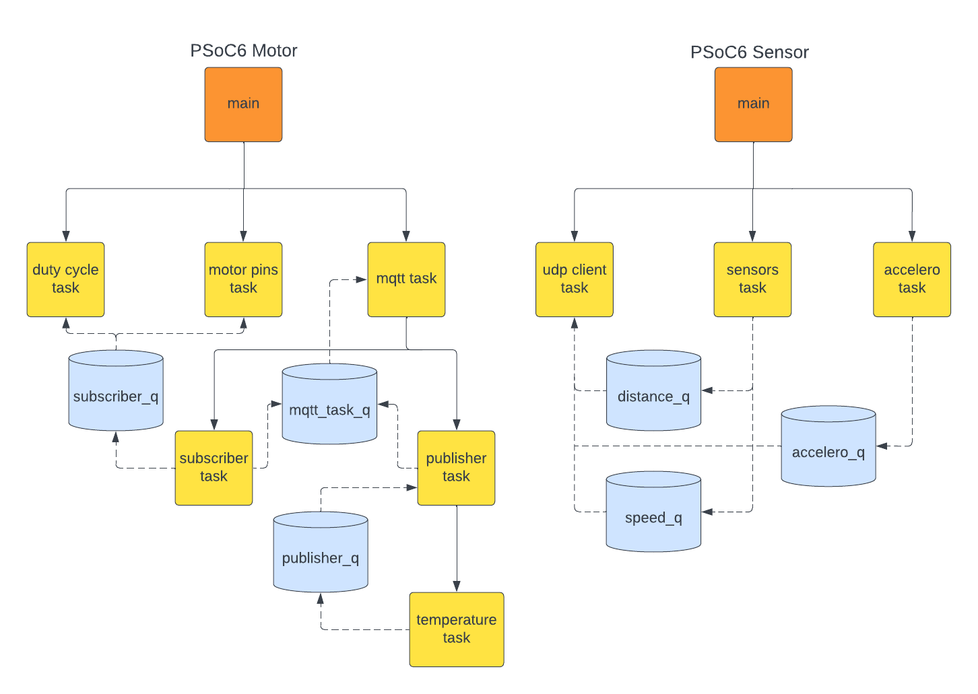
FreeRTOS code structure

Slide 13
Low power mode
PWM signal to limit power drawn by the motor drivers

Slide 14
Security
Using HiveMQ
Using tls on port 8883
Root CA needed for secure connections

Slide 15
Links
GitHub:
https://github.com/JohannesChopov/IoT_Project_Group1.git
YouTube:
https://youtu.be/tfyG1CX_znA

