Slide 1
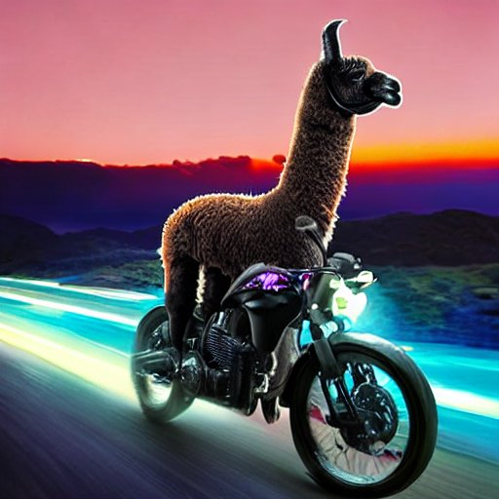
Llama.cpp GPU Acceleration

Slide 2
About Me
Currently writing my master’s thesis on experimental particle physics at KIT
Additional bachelor’s degree in informatics
kafe2 (Karlsruhe Fit Environment 2) developer
No prior experience with CUDA or language models

Slide 3

llama.cpp
Open-source C/C++
program for LLaMA
inference
Wide support across hardware and OSs
Very good CPU performance
I’m working on CUDA support

Slide 4
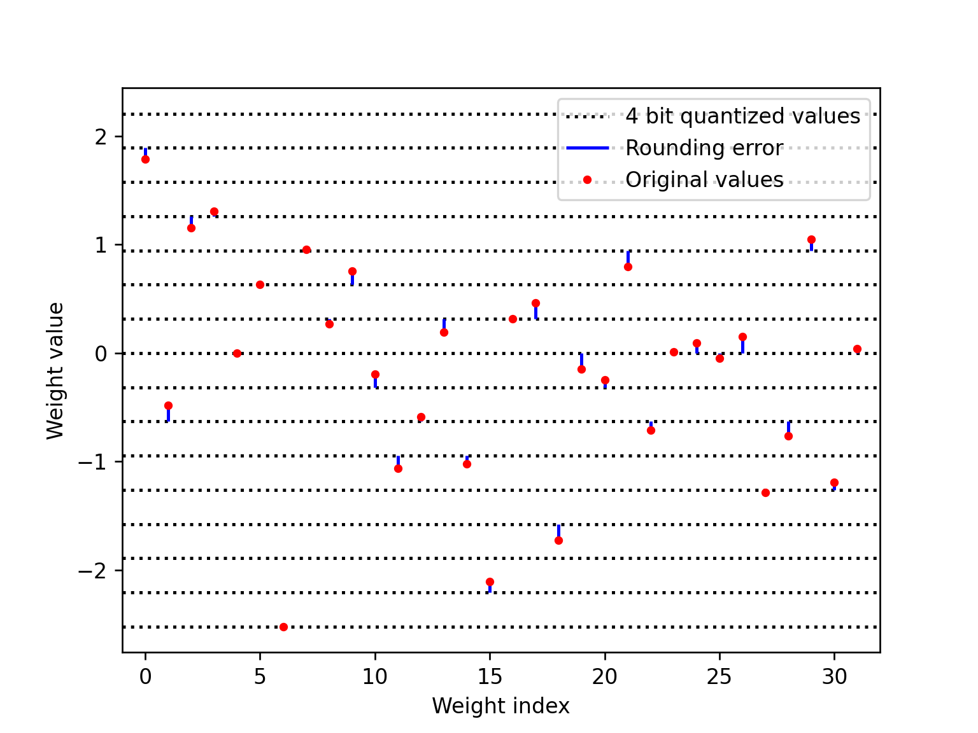
Weight Quantization
Original LLaMA weights are FP16
Can be quantized to 4 bit ints with moderate quality loss
int4 big model > FP16 small model

Slide 5
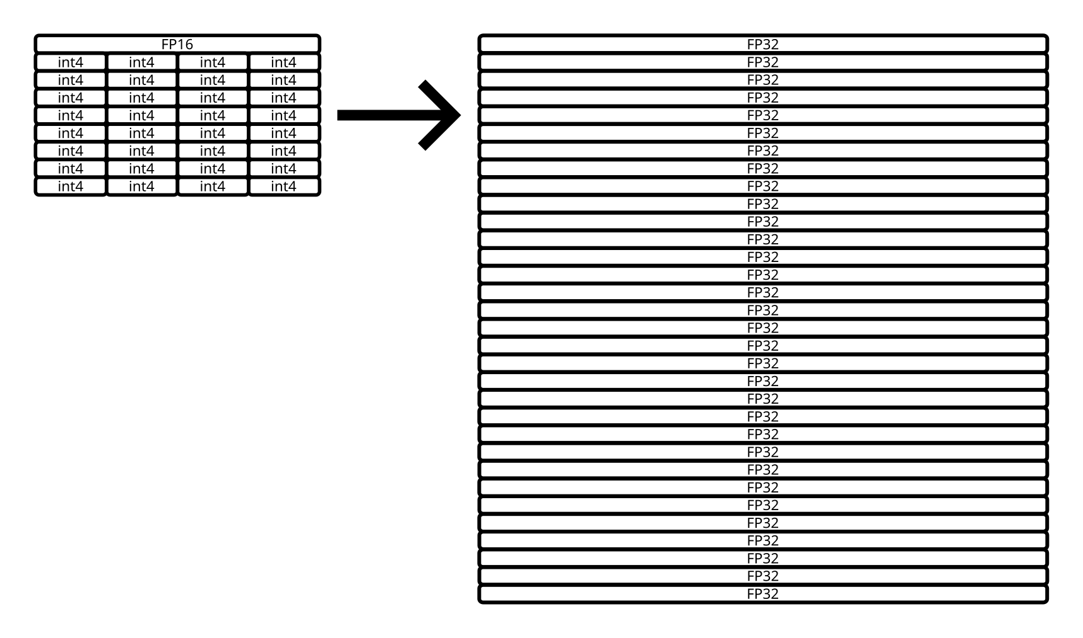
Initial CUDA Implementation
Dequantize
weights to
FP16/FP32,
then use cuBLAS GEMM
Performance only good
for large batches
Small batches: slower than CPU

Slide 6

Initial CUDA Implementation
Matrix mult. I/O vs. compute depends on shape
2x square matrix: data, compute
Square matrix + vector: data, compute
Prompt processing: compute bound
Token generation: I/O bound

Slide 7
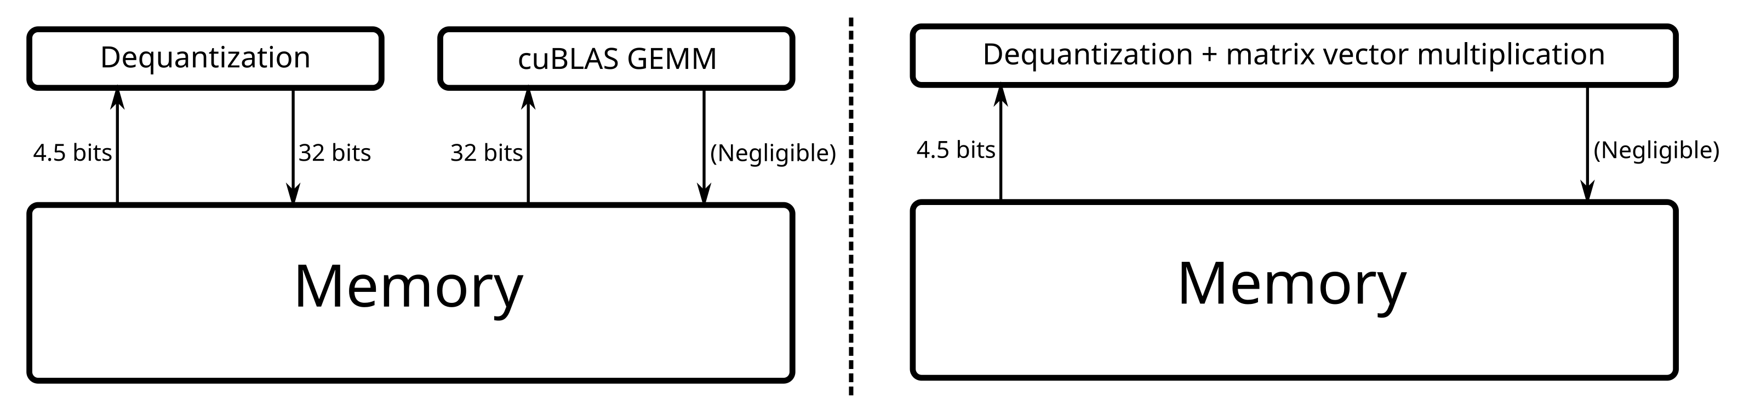
Better CUDA Implementation
Matrix vector multiplication + on-the-fly dequantization
Per weight:
36.5 bits read + 32 bits write => 4.5 bits read

Slide 8
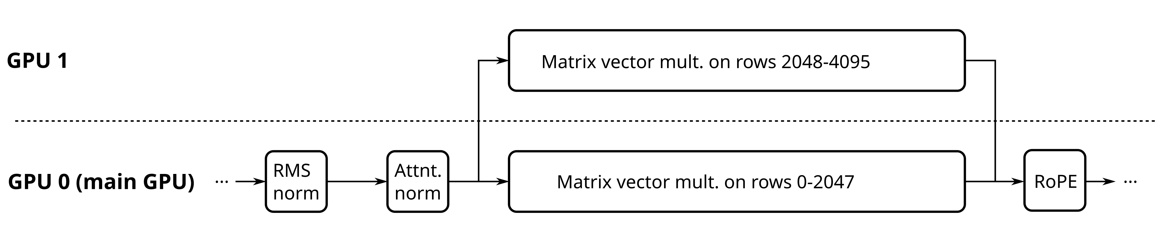
Better CUDA Implementation
Multi GPU: split weight matrices across GPUs by rows
Small tensors on main GPU only
KV cache parallelization not implemented

Slide 9
Current CUDA Implementation
Don’t dequantize matrix
Instead quantize hidden state to 8 bit
Use per-byte integer intrinsics (similar to CPU)

Slide 10


Current CUDA Implementation
blocks with 1 scale and values each
Dequantization:

Slide 11
Accessibility
Open-source is a positive sum game
Jevons Paradox: more efficiency => more use
Main goal: reduce hardware requirements, get more users

Slide 12
Memory Optimization
Move weights from RAM to VRAM
Can use total RAM + VRAM to fit model
Goal: 33b q4 with standard settings on 16 GB RAM + 8 GB VRAM

Slide 13
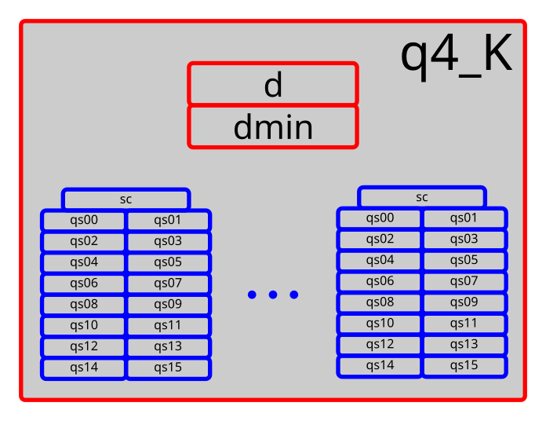
k-quants by I. Kawrakow
1 6 bit scale per block (size 16)
2 16 bit scales per superblock (size 256)
Lower size/quantization error
at the cost of more memory accesses
Different precision per tensor

Slide 14
Comparison to GPTQ
Backend | Model | Prompt t/s | Gen. t/s | VRAM [MiB] | Perplexity**
AutoGPTQ (webui v1.3.1*) | 7b q4 128g | Not measured | 24.42 | 6028 | 6.54688
ExLlama (webui v1.3.1*) | 7b q4 128g desc_act | 4076 | 78.59 | 5638 | 6.28790
Llama.cpp (webui v1.3.1*) | 7b q4_K_M | 739 | 53.27 | 6960 | 6.26391
Llama.cpp (CLI rev. 84e09a7) | 7b q4_K_M | 965 | 81.49 | 6554 | 6.26391
Hardware: Ryzen 3700X, 32 GB RAM @ 3200 MHz, RTX 3090
*https://github.com/oobabooga/text-generation-webui/releases/tag/v1.3.1
**Perplexities taken from https://oobabooga.github.io/blog/posts/perplexities/

Slide 15
WIP: Quantized GEMM
Currently for batches: dequantize, then cuBLAS GEMM
Try to write GEMM kernels that directly use quantized data
Potentially faster and less VRAM usage
Good GEMM kernels hard

Slide 16
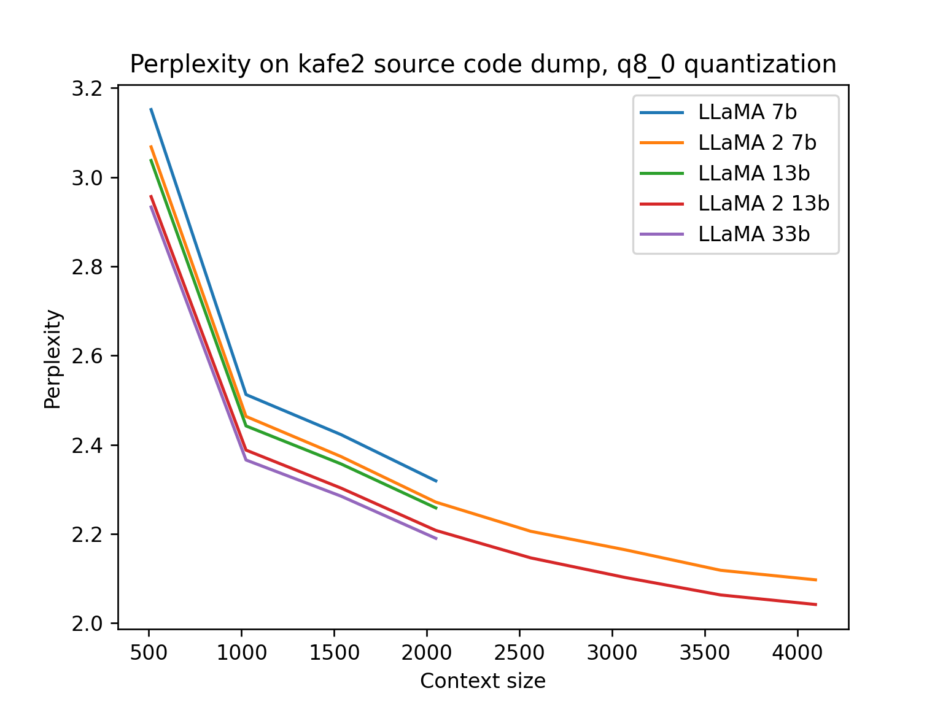
LLaMA vs. LLaMA 2
18.07.23: LLaMA 2 release
Quasi open-source
Trained on 2 trillion tokens
(up from 1/1.4 trillion)
Context: 2048 => 4096
Grouped-query attention
Chat finetunes included

Slide 17
Thank you for your attention!

Slide 18
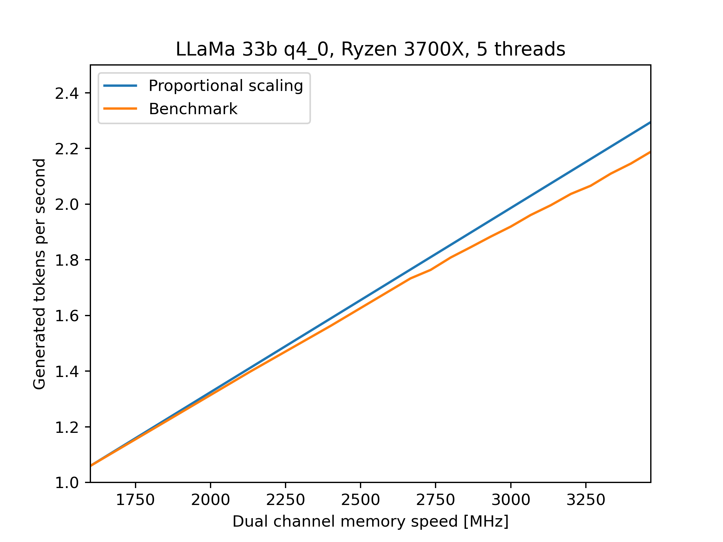
Appendix: Memory Scaling

Slide 19
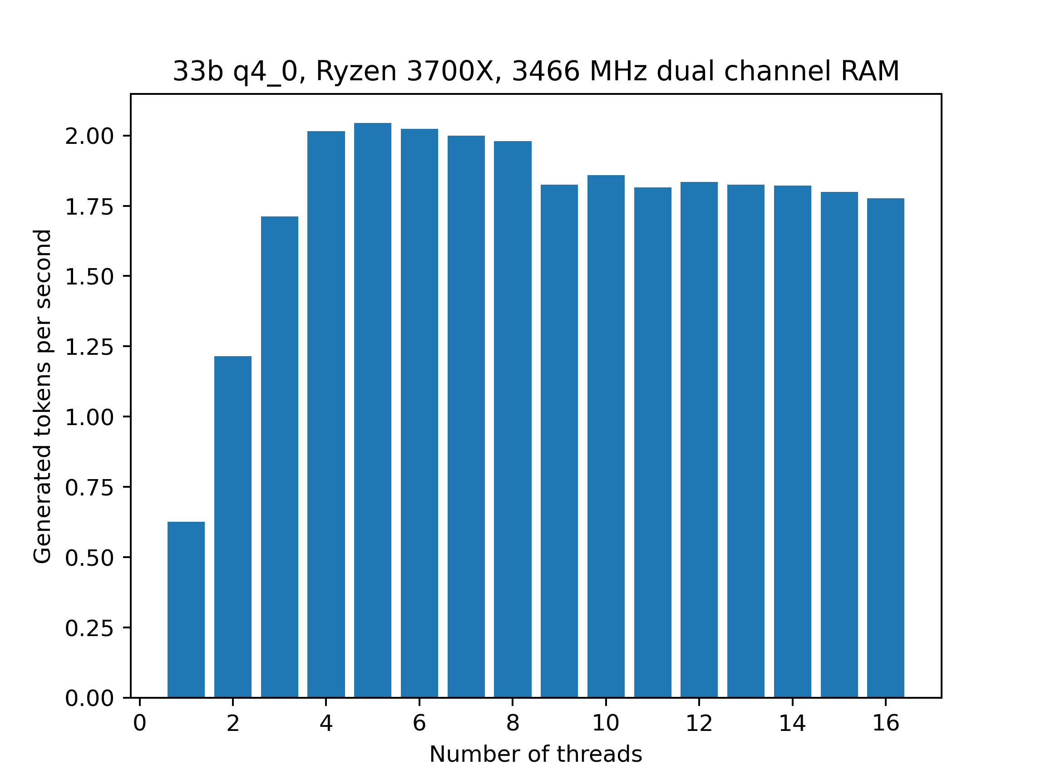
Appendix: Ryzen 3700X t/s

Slide 20
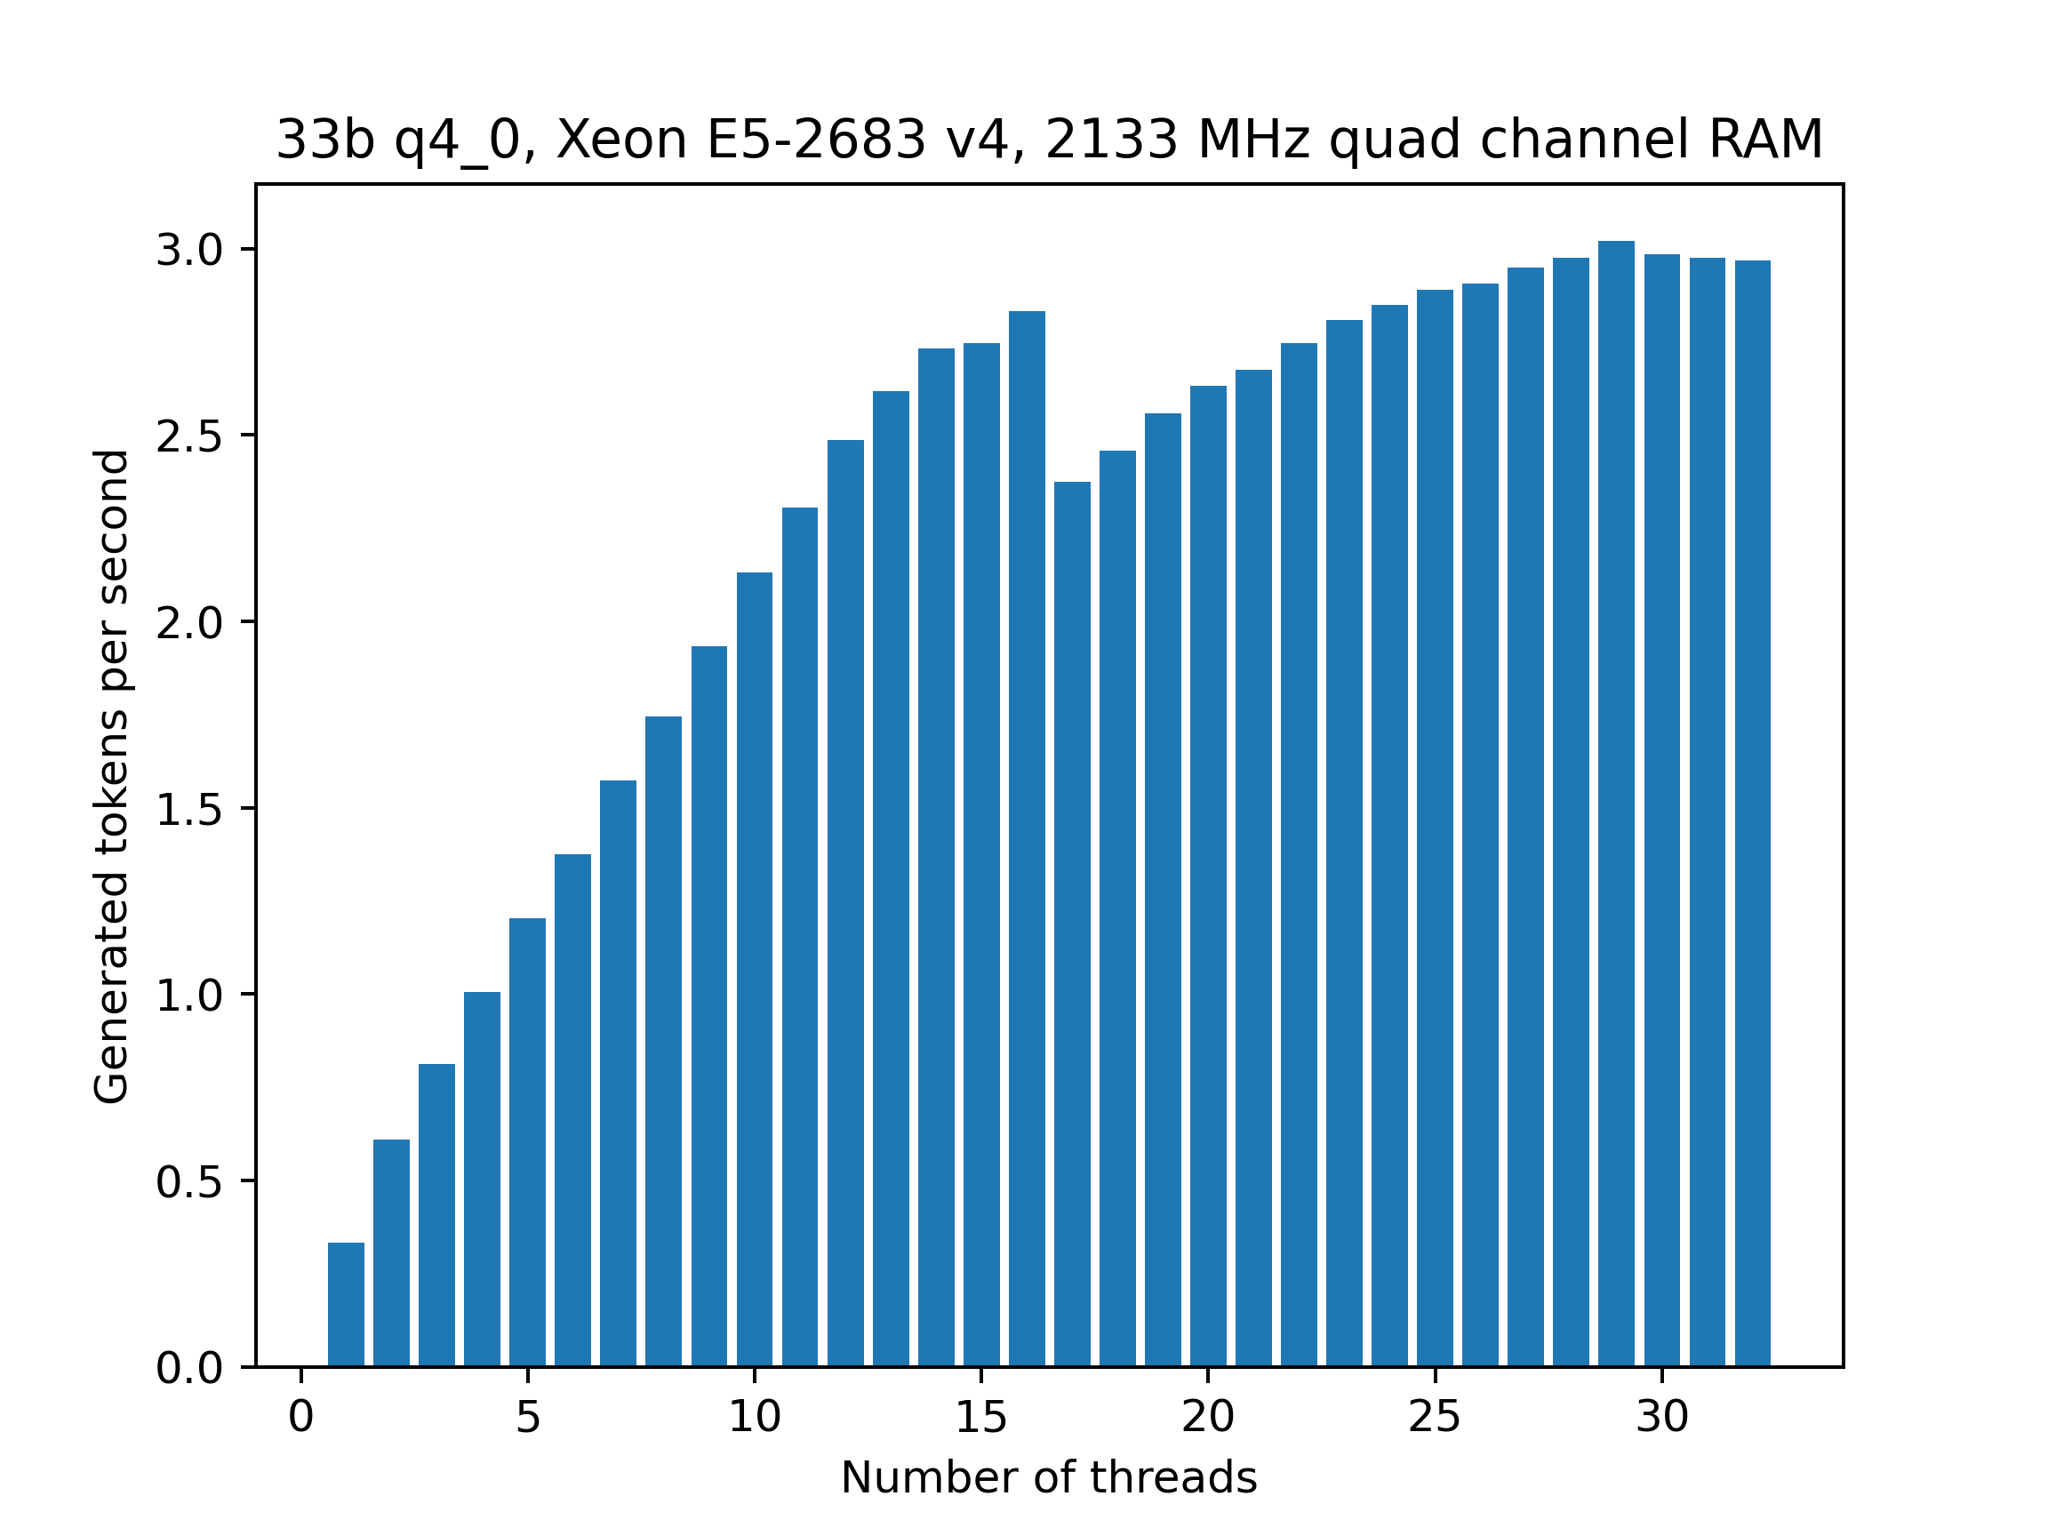
Appendix: Xeon E5-2683 v4 t/s

