Slide 1

Efficient Matrix Multiplication Algorithms for Quantized LLMs

Slide 2
About Me
Will soon start a PhD in experimental particle physics at KIT
Additional bachelor’s degree in informatics
Background in computing and statistics
One of the llama.cpp core developers
(mostly CUDA)

Slide 3

CUDA
NVIDIA’s first-party platform for general-purpose computing on GPUs
Massive parallelism
Suitable for artificial neural
networks, e.g. transformers

Slide 4

llama.cpp
Open-source C/C++
program for LLM
inference
Wide support across hardware and OSs
Quantization support for 2-8.5 bits per weight
(1.5 BPW is WIP)

Slide 5
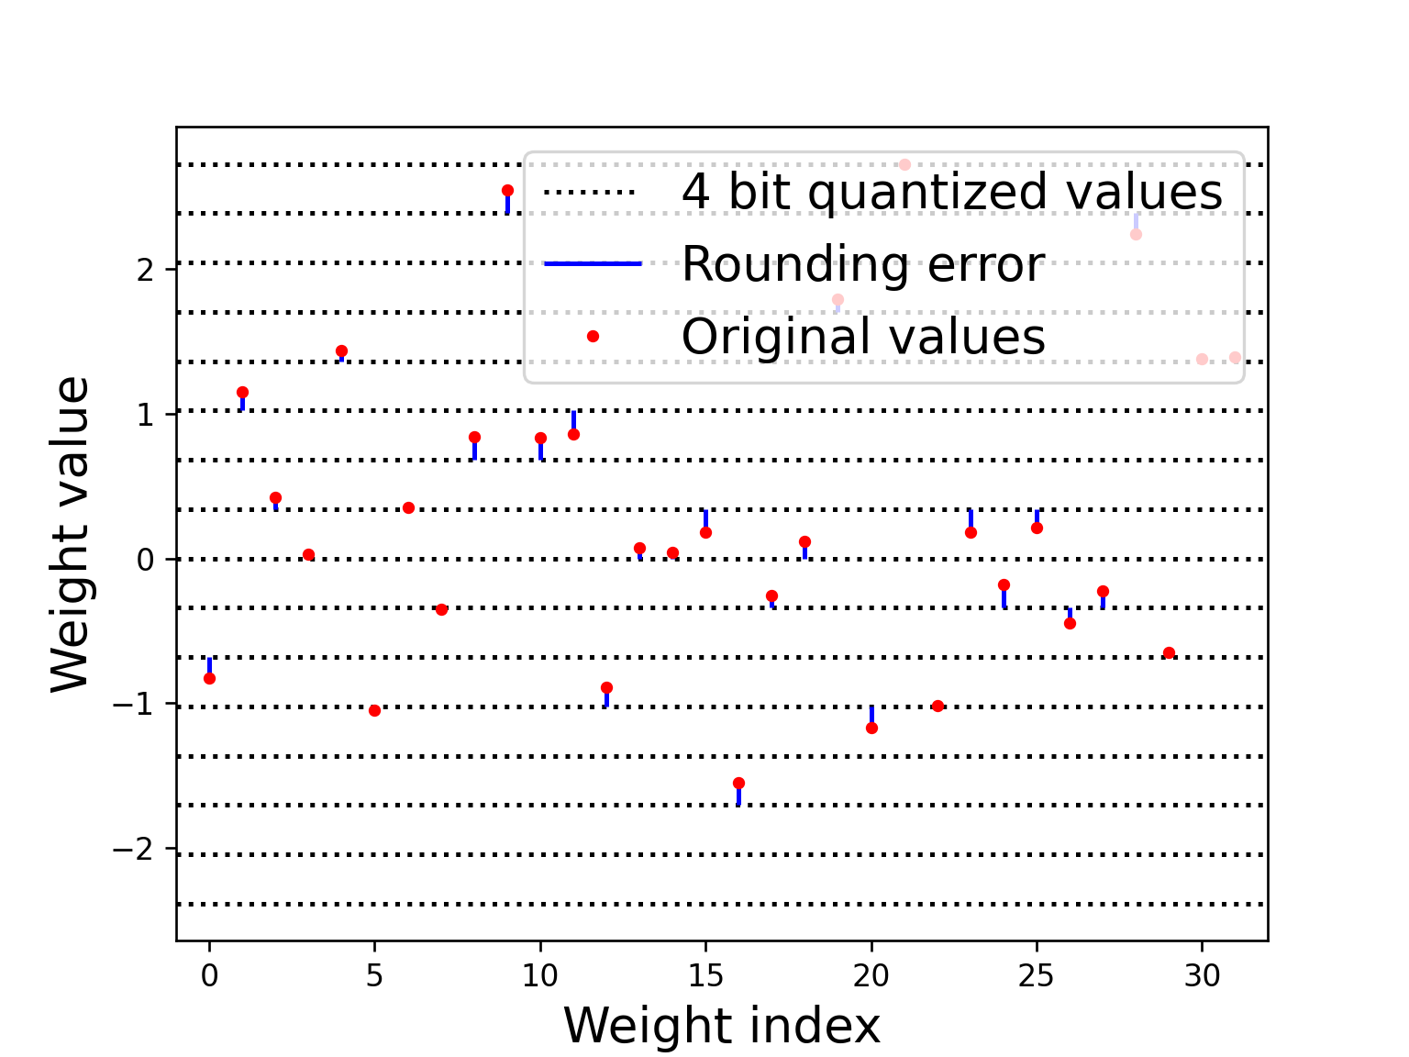
Weight Quantization
Original LLaMA weights are FP16
Can be quantized to 2-8 bit ints with some quality loss
Simple scheme:
round to nearest

Slide 6
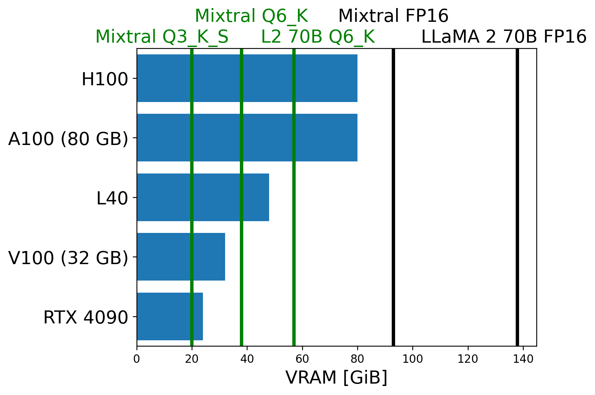
Weight Quantization
State-of-the-art models don’t fit on single GPU at FP16
But quantized models do

Slide 7
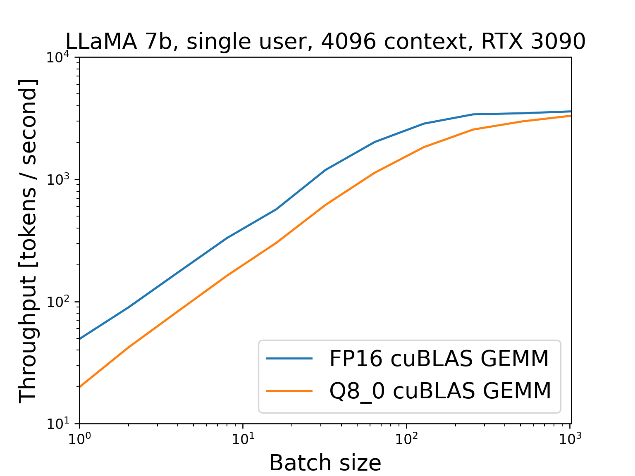
Simple Matrix Multiplication
Weights as blocks of ints
with per-block scale
FP16:
Can use FP16 GEMM
Decoding only half
as fast as FP16

Slide 8
Matrix Shape Matters
2x square matrix: data, compute
Square matrix + vector: data,
compute
Encoding: batch size >> 1, compute bound
Decoding: batch size 1, I/O bound

Slide 9
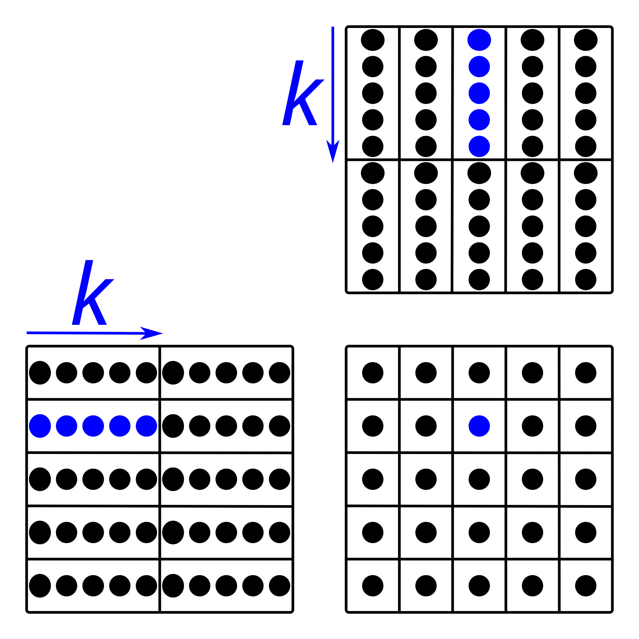


Fused Matrix Multiplication
Quantize hidden
state on-the-fly
Dot product of two
quantized blocks:
float
int8

Slide 10
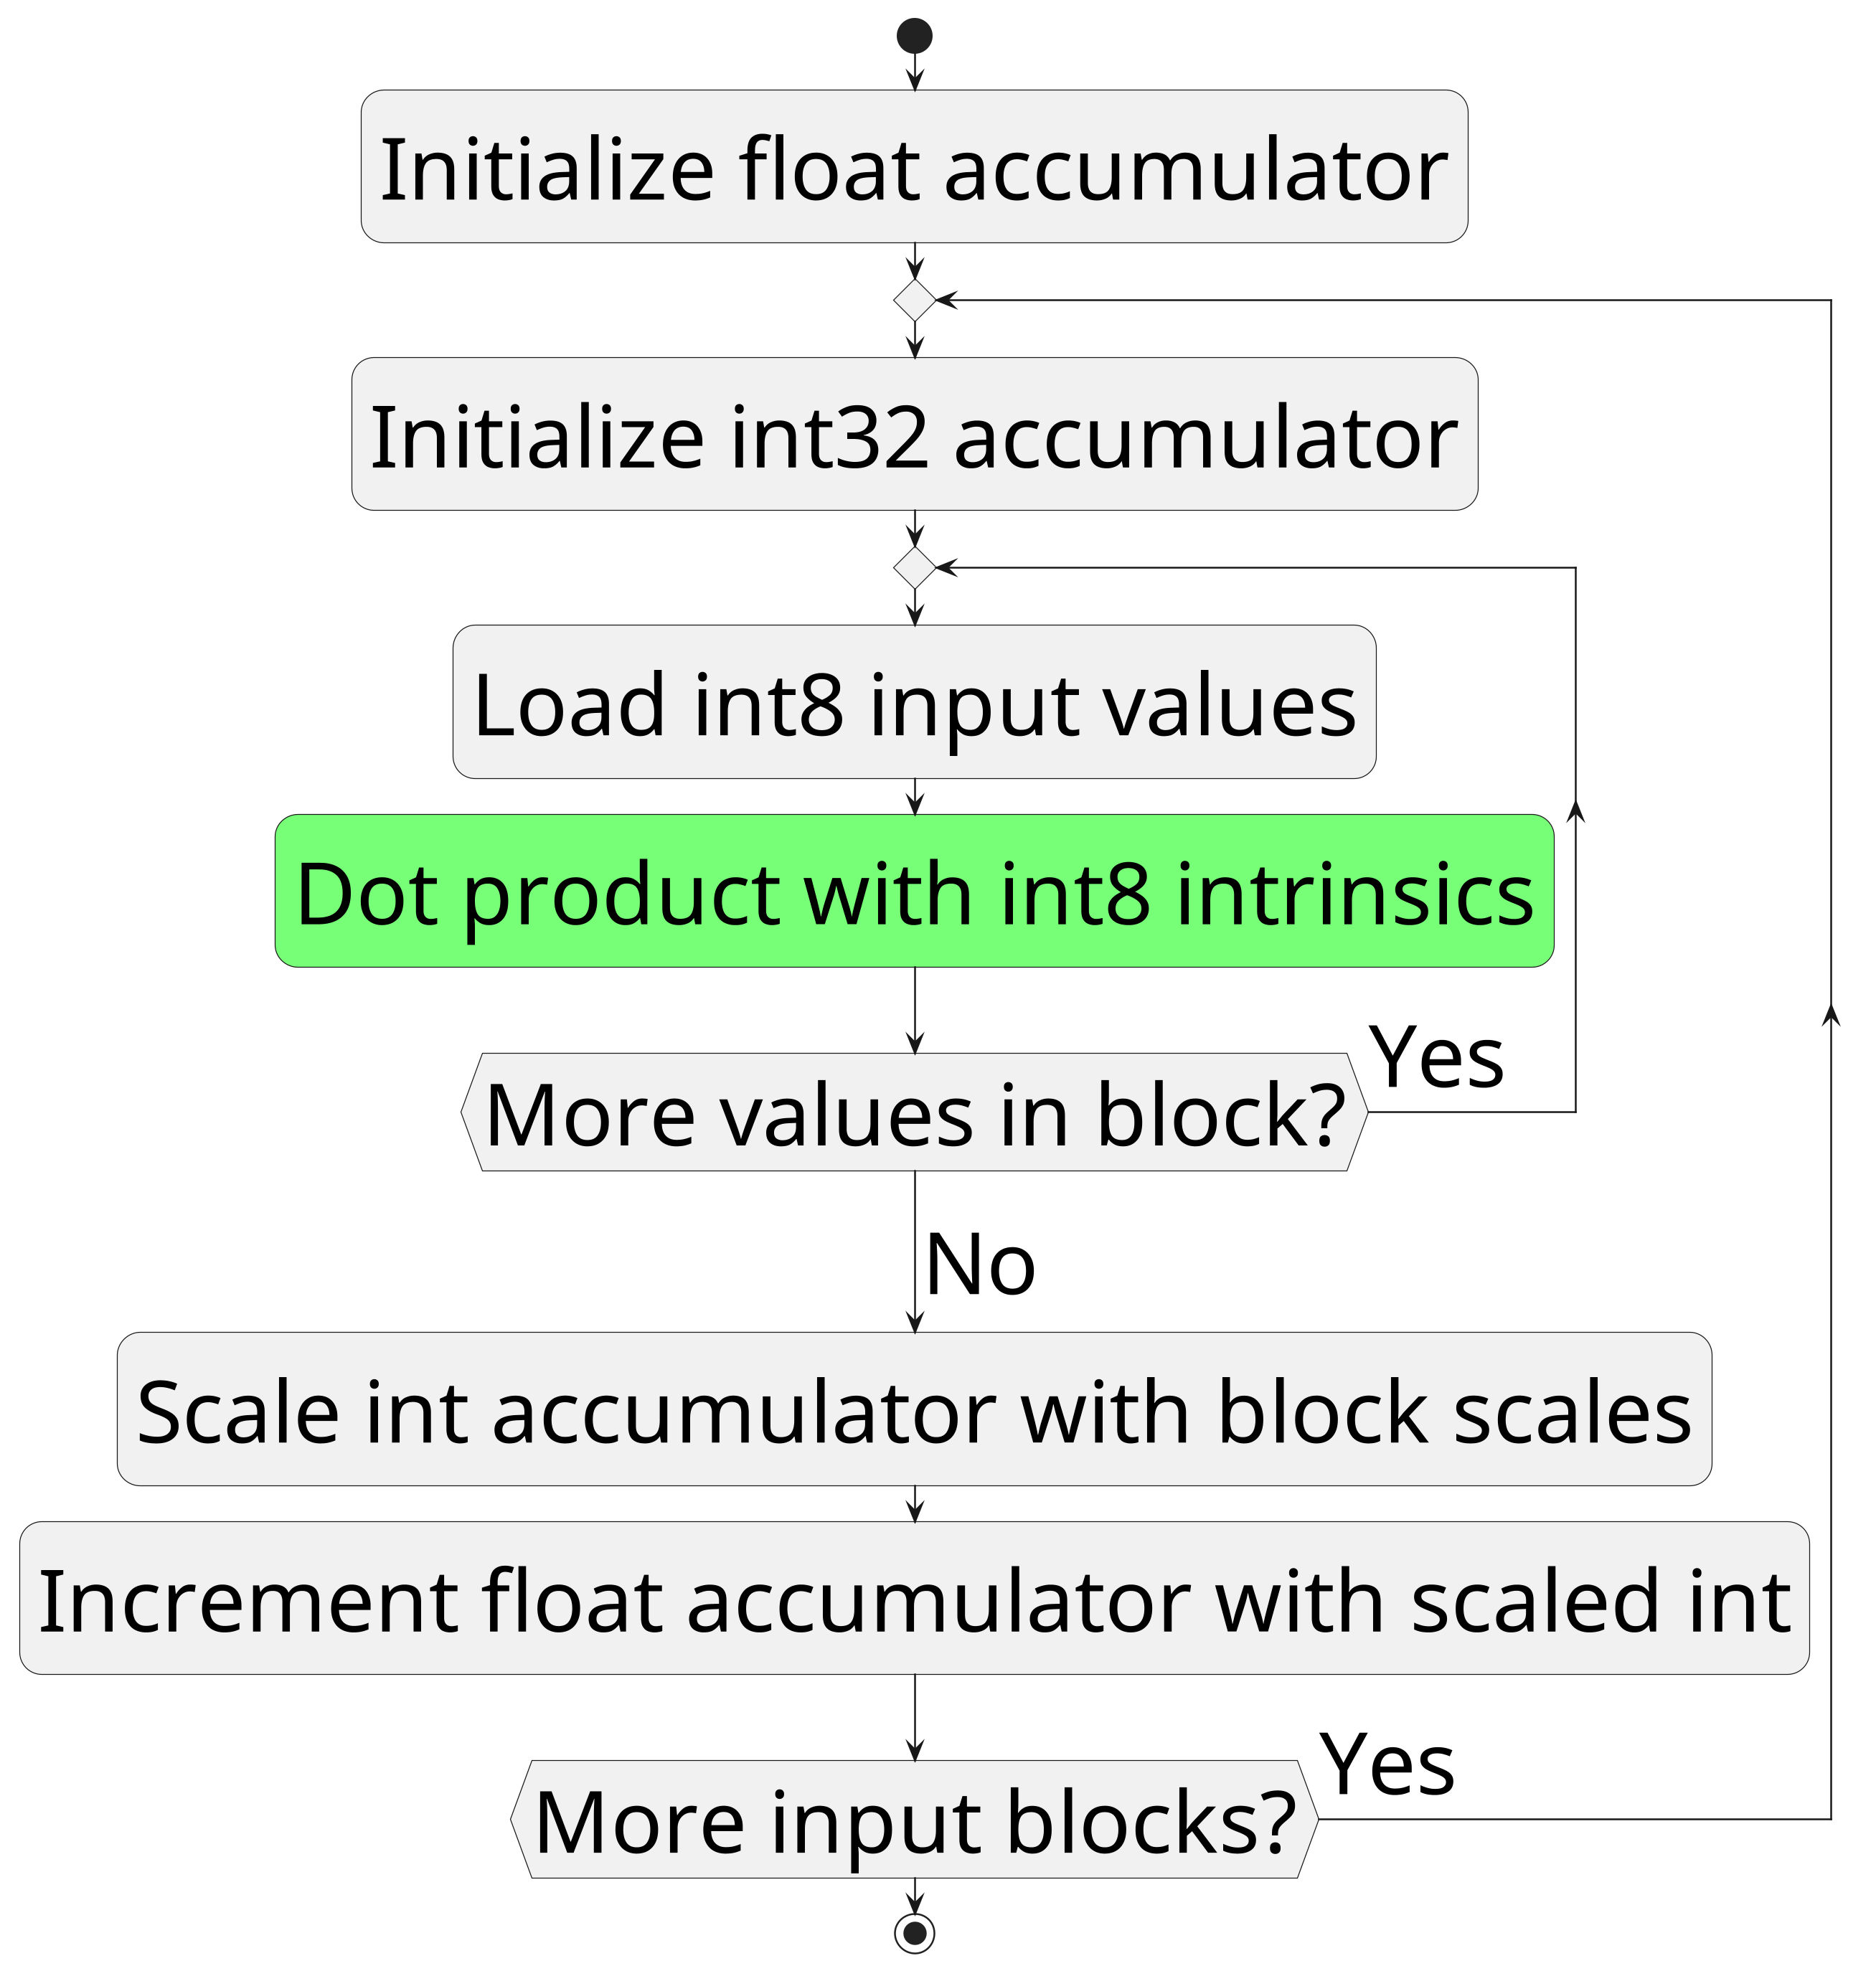
Fused Matrix Multiplication
Can do most operations as int8
Faster than float
Hardware support for
int8 intrinsics since
Pascal

Slide 11
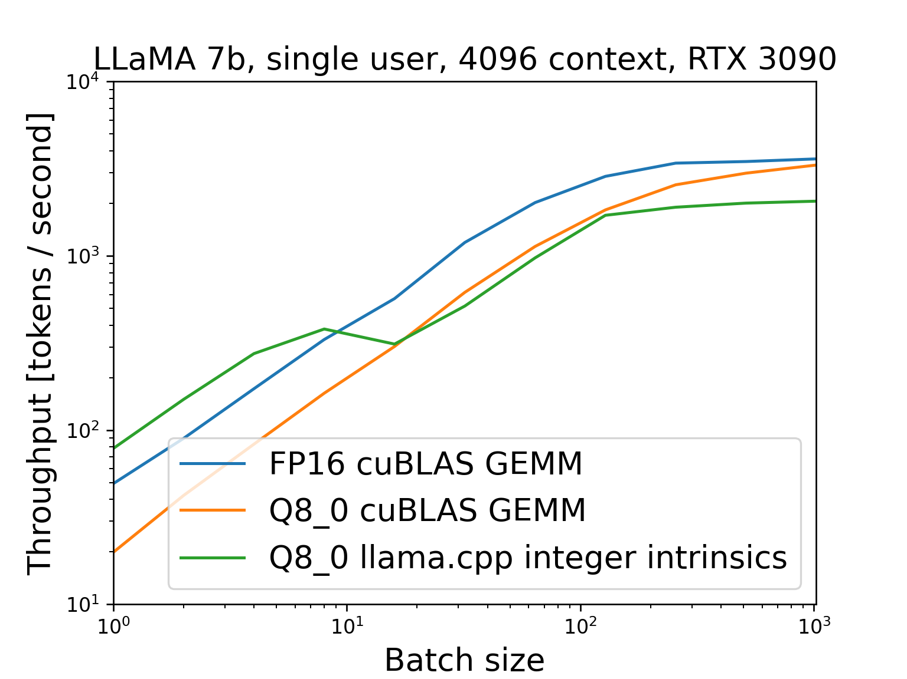
Fused Matrix Multiplication
Avoid dequantizing to FP16
to reduce I/O
Dequantize + FP 16 GEMM:
8.5 bits read + 16 bits write
+ 16 bits read per weight
Directly use quantized:
8.5 bits read per weight

Slide 12
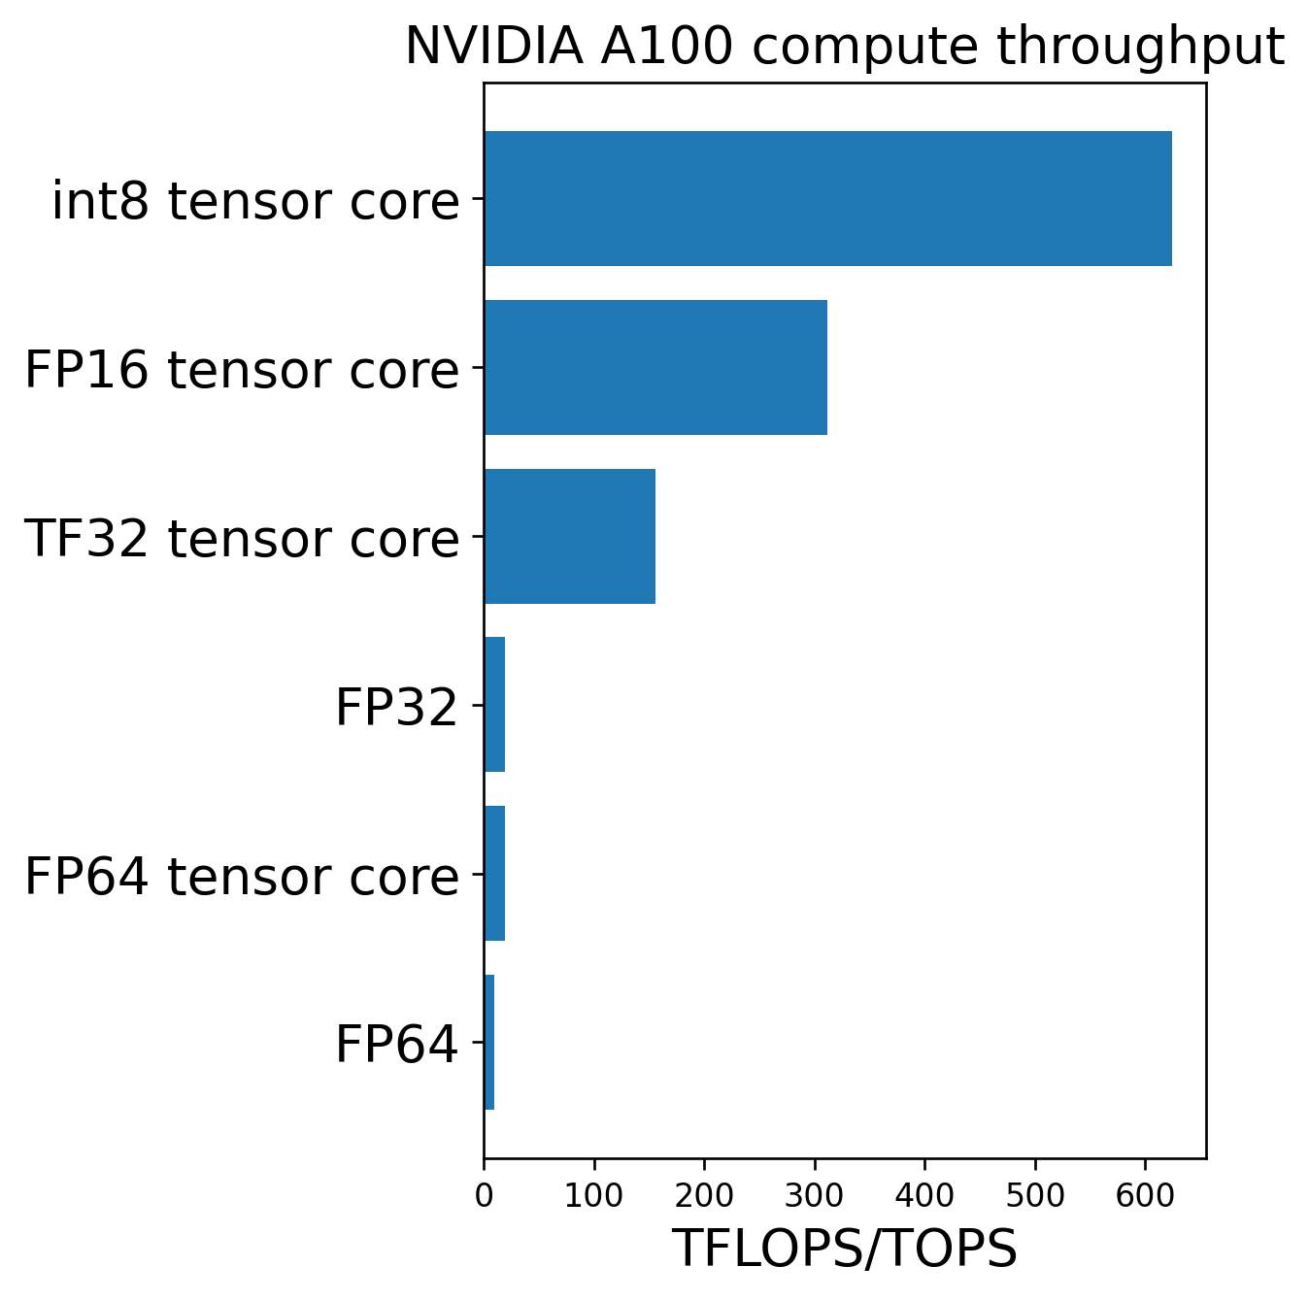
Tensor Cores Are Fast
int8 intrinsics only ~60%
throughput of FP16 GEMM
at 1024 batch size
Reason: FP16 tensor cores
But: int8 tensor cores
2x faster than FP16

Slide 13
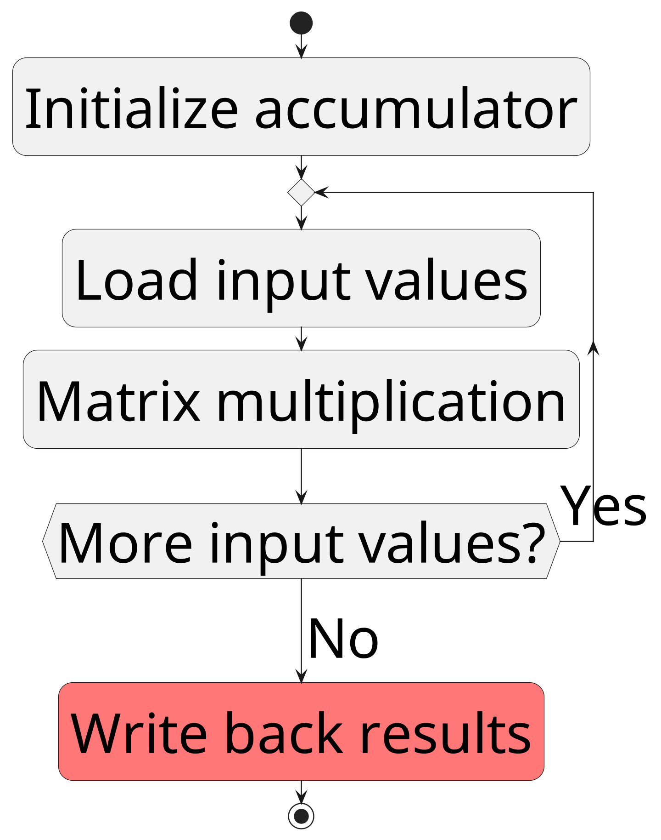
Tensor Core Usage Patterns
Tensor cores are fast
but restrictive
Fast: Initialize, load data,
matrix multiplication
Slow: Write back results

Slide 14
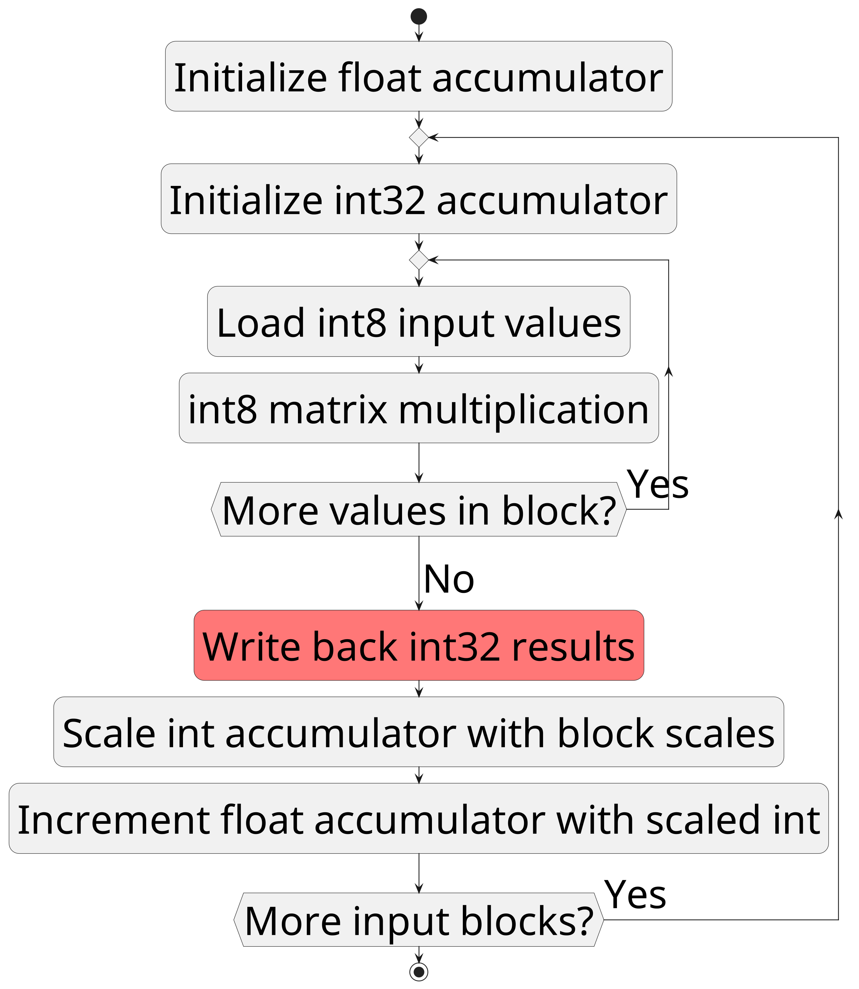
Problems With Quantized Blocks
Slow writeback for each block
Small blocks: bad performance
Big blocks: bad precision

Slide 15
Tensor Core Details
CUDA organizes threads as “warps” of size 32
Each thread holds 256/32 = 8 tensor core accumulator values
No guarantees for which 8 values thread holds
But can apply scalar operations

Slide 16
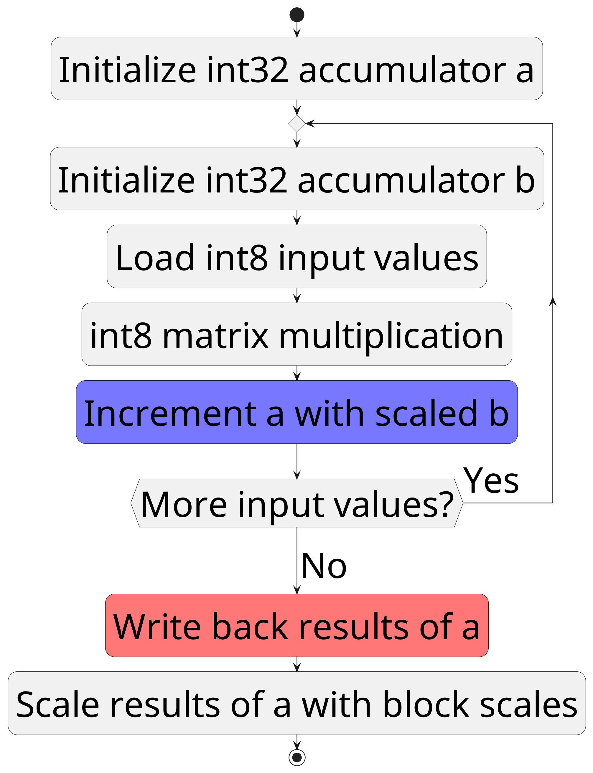
llama.cpp int8 Tensor Cores
Define additional scales for
tensor core fragments
Better precision for large blocks
Single float scale per row/column
Only need to write back results
once

Slide 17
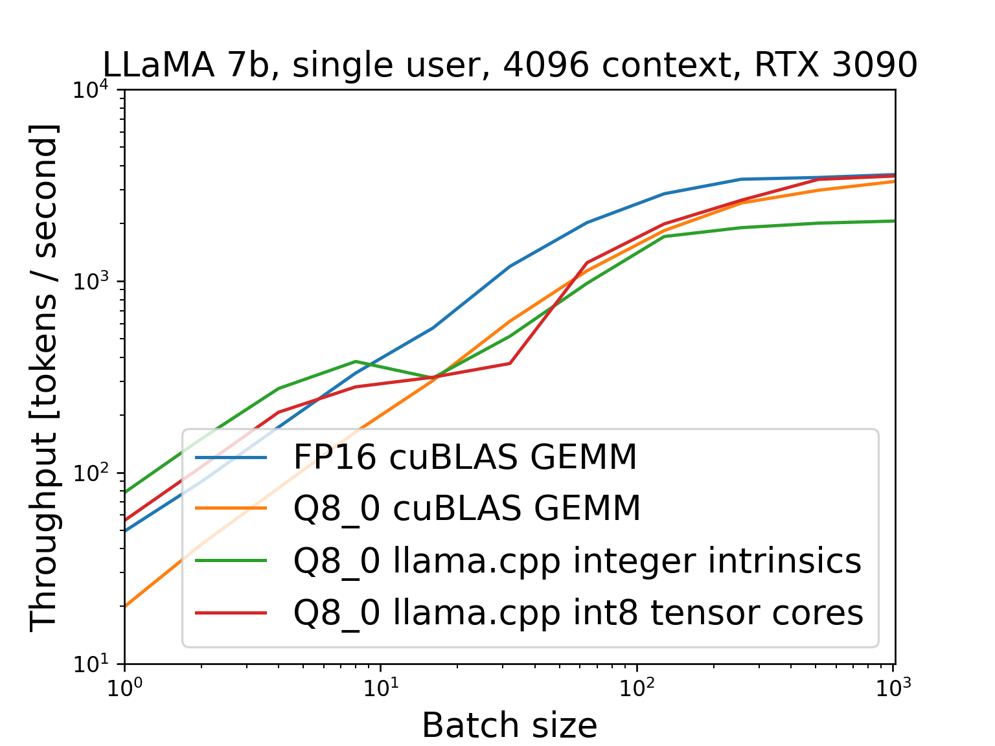
Llama.cpp int8 Tensor Cores
Llama.cpp int8 15%
faster than cuBLAS
FP16 GEMM
6-13% end-to-end
Negligible precision
loss

Slide 18
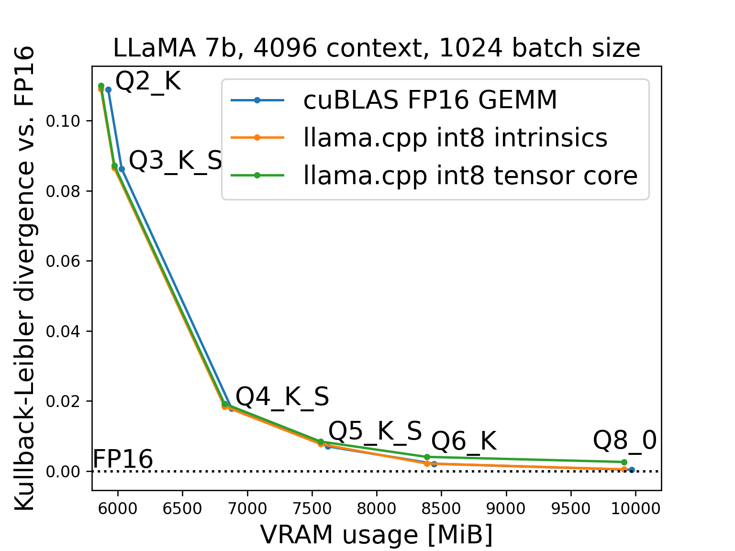
Precision/VRAM
Precision with int8
slightly worse
But memory usage
also slightly lower
Change to top token probabilities < 1%

Slide 19
Further Work
Only ~23% int8 tensor core utilization
=> More performance optimization
Fused operations (e.g. FlashAttention, mixture of experts)
Implement backwards pass (or training at all)

Slide 20
Live Demonstration (Hopefully)

Slide 21
Thank you for your attention!

Slide 22
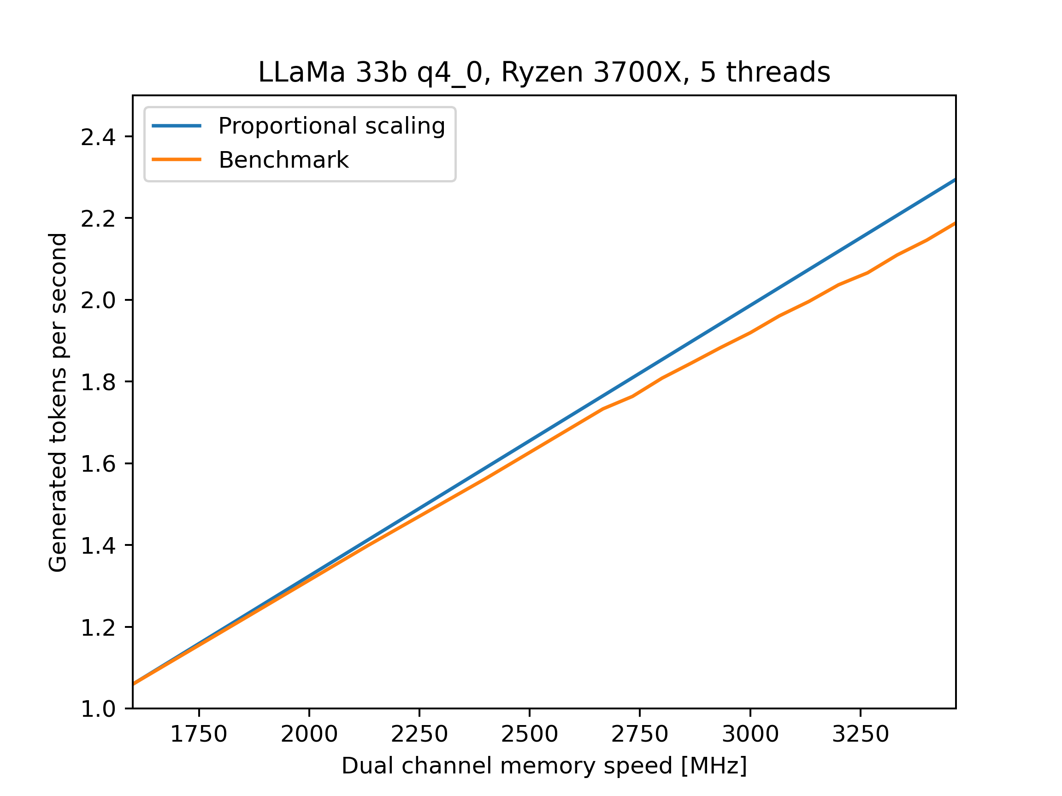
Appendix: Memory Scaling

Slide 23

Kullback-Leibler Divergence
Measures difference between probability distributions and
Definition:

Slide 24
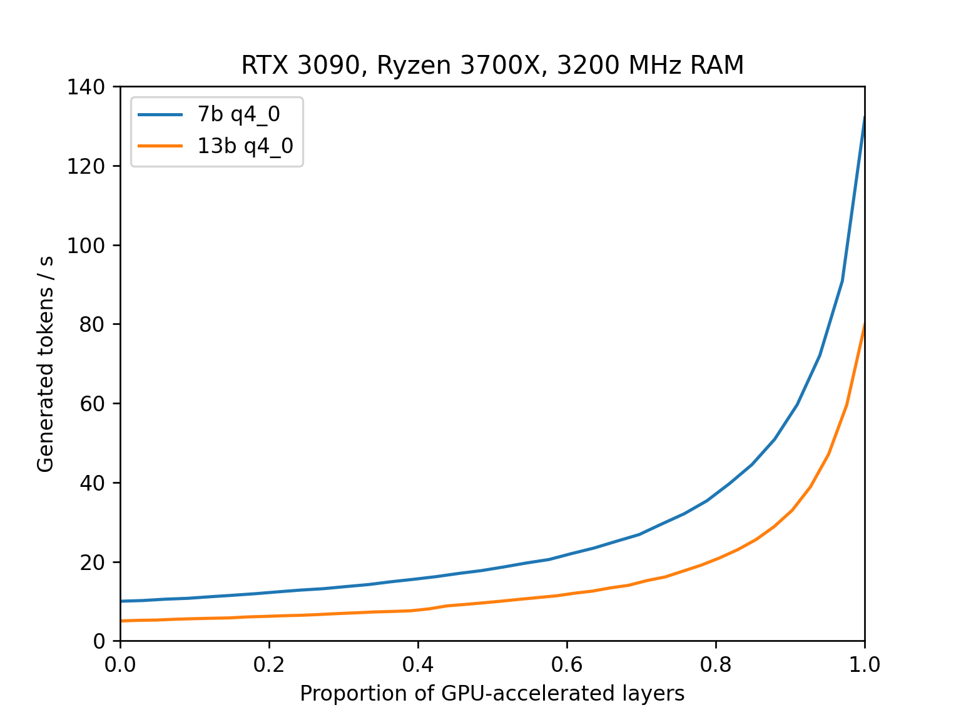
Appendix: CPU+GPU Scaling

Slide 25
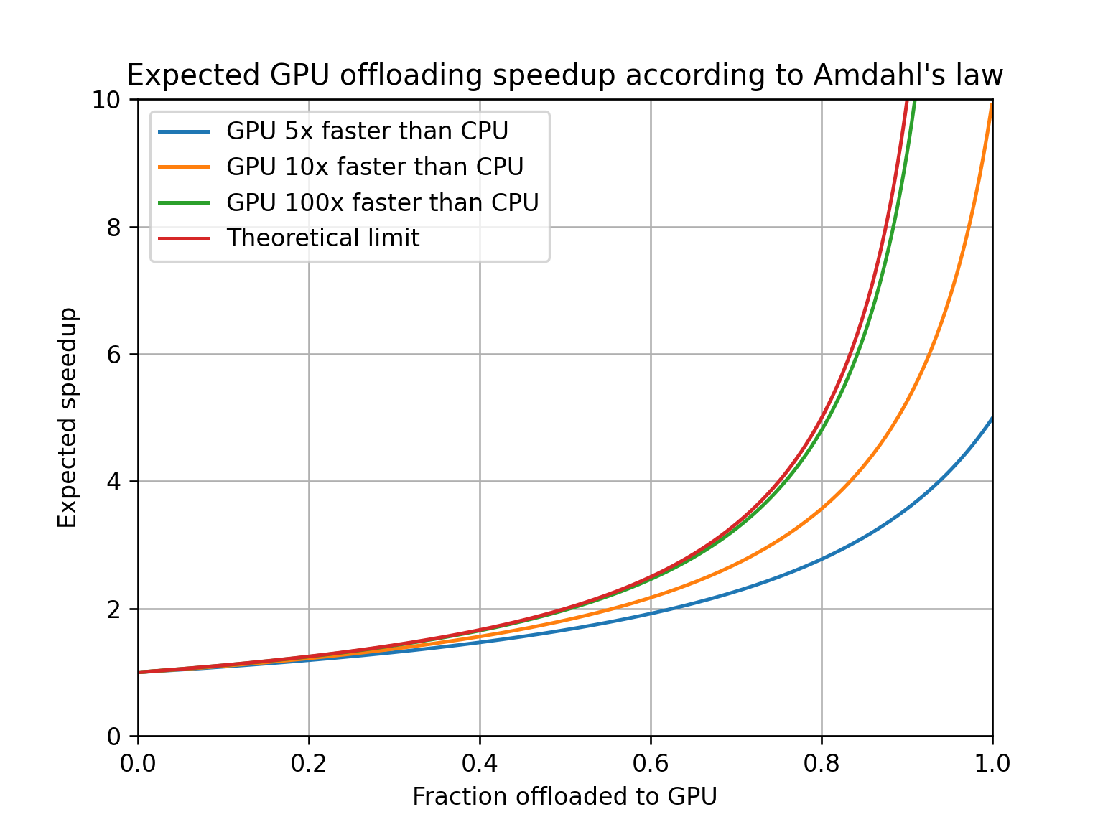
Appendix: CPU+GPU Scaling

