Slide 1

Monte Carlo Methods
Johannes Gäßler

Slide 2
What are Monte Carlo Methods?
Use random sampling for numerical result
Can be used for both stochastic and deterministic problems
Precision depends on number of events:
“Random” numbers from random number generator

Slide 3
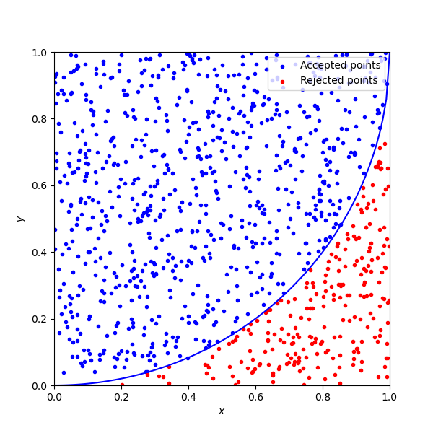

Hit-and-Miss Monte Carlo
Determine random points
Count points fulfilling criterion
Accepted points follow binomial distribution
Example: estimation of
Criterion:

Slide 4

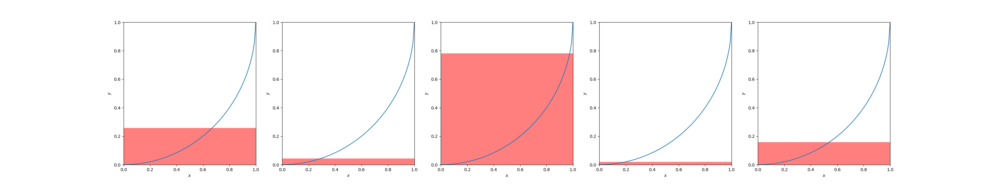
Crude Monte Carlo
Express as function of :
Randomly sample
Estimate integral by averaging :

Slide 5

Crude Monte Carlo
Calculate from integral:
Uncertainty depends on function variance :
Integral converges faster for flat functions

Slide 6

Importance Sampling
Variance reduction technique
Sample with non-uniform PDF
Regions with high sampled more frequently
Scale with to compensate
Function variance then becomes:

Slide 7

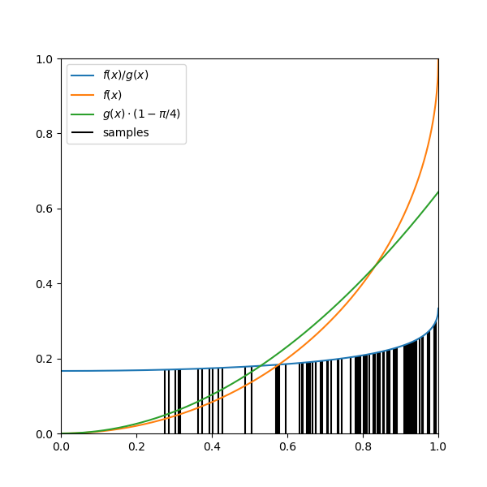

Importance Sampling
Reduce variance by choosing
Example:

Slide 8

VEGAS Algorithm
Automatic importance sampling
Split into equally-sized intervals:
Define step function as PDF to sample from:
Adapt to by iteratively adjusting

Slide 9
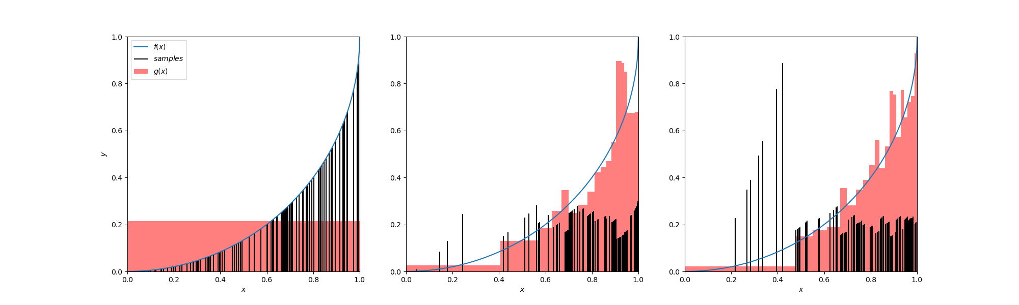
VEGAS Algorithm

Slide 10
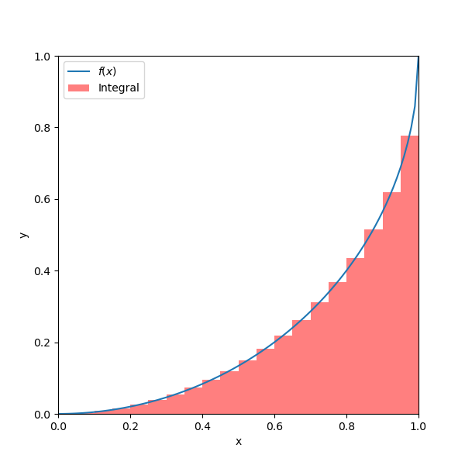

MC vs. Quadrature
For MC and integration are equivalent
Compare with simple Riemann sum:
Precision for :

Slide 11
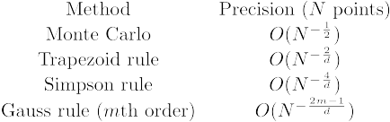
MC vs. Quadrature
Quadrature precision depends on dimension
MC precision does not depend on

Slide 12
MC Use Cases
MC suitable for problems with many coupled degrees of freedom (event generators, galaxy evolution, weather forecasts, ...)
Need large amount of computation time
Parallelization essential

Slide 13
Flynn’s Taxonomy
Computers execute instruction streams on data streams
Four computer architectures
Single instruction, single data: CPU core
Single instruction, multiple data: GPU
Multiple instruction, single data: Space Shuttle
Multiple instruction, multiple data: multi-core CPU

Slide 14
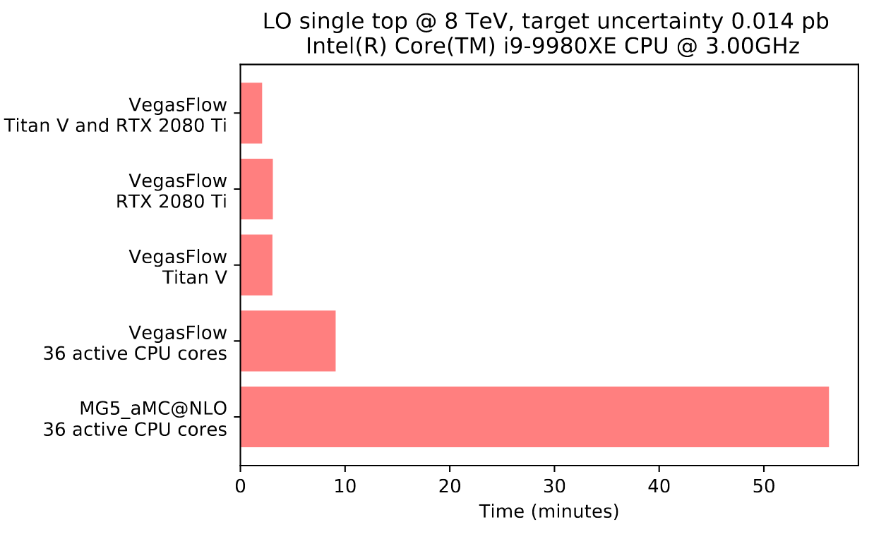
SIMD vs. MIMD
Computing cost roughly proportional to die area
Instruction streams and data streams both need die area
Fewer instruction streams per data stream is more efficient
SIMD therefore more efficient than MIMD
Stefano Carrazza, Juan M. Cruz-Martinez, 2020, VegasFlow: Accelerating Monte Carlo simulation across multiple hardware platforms

Slide 15
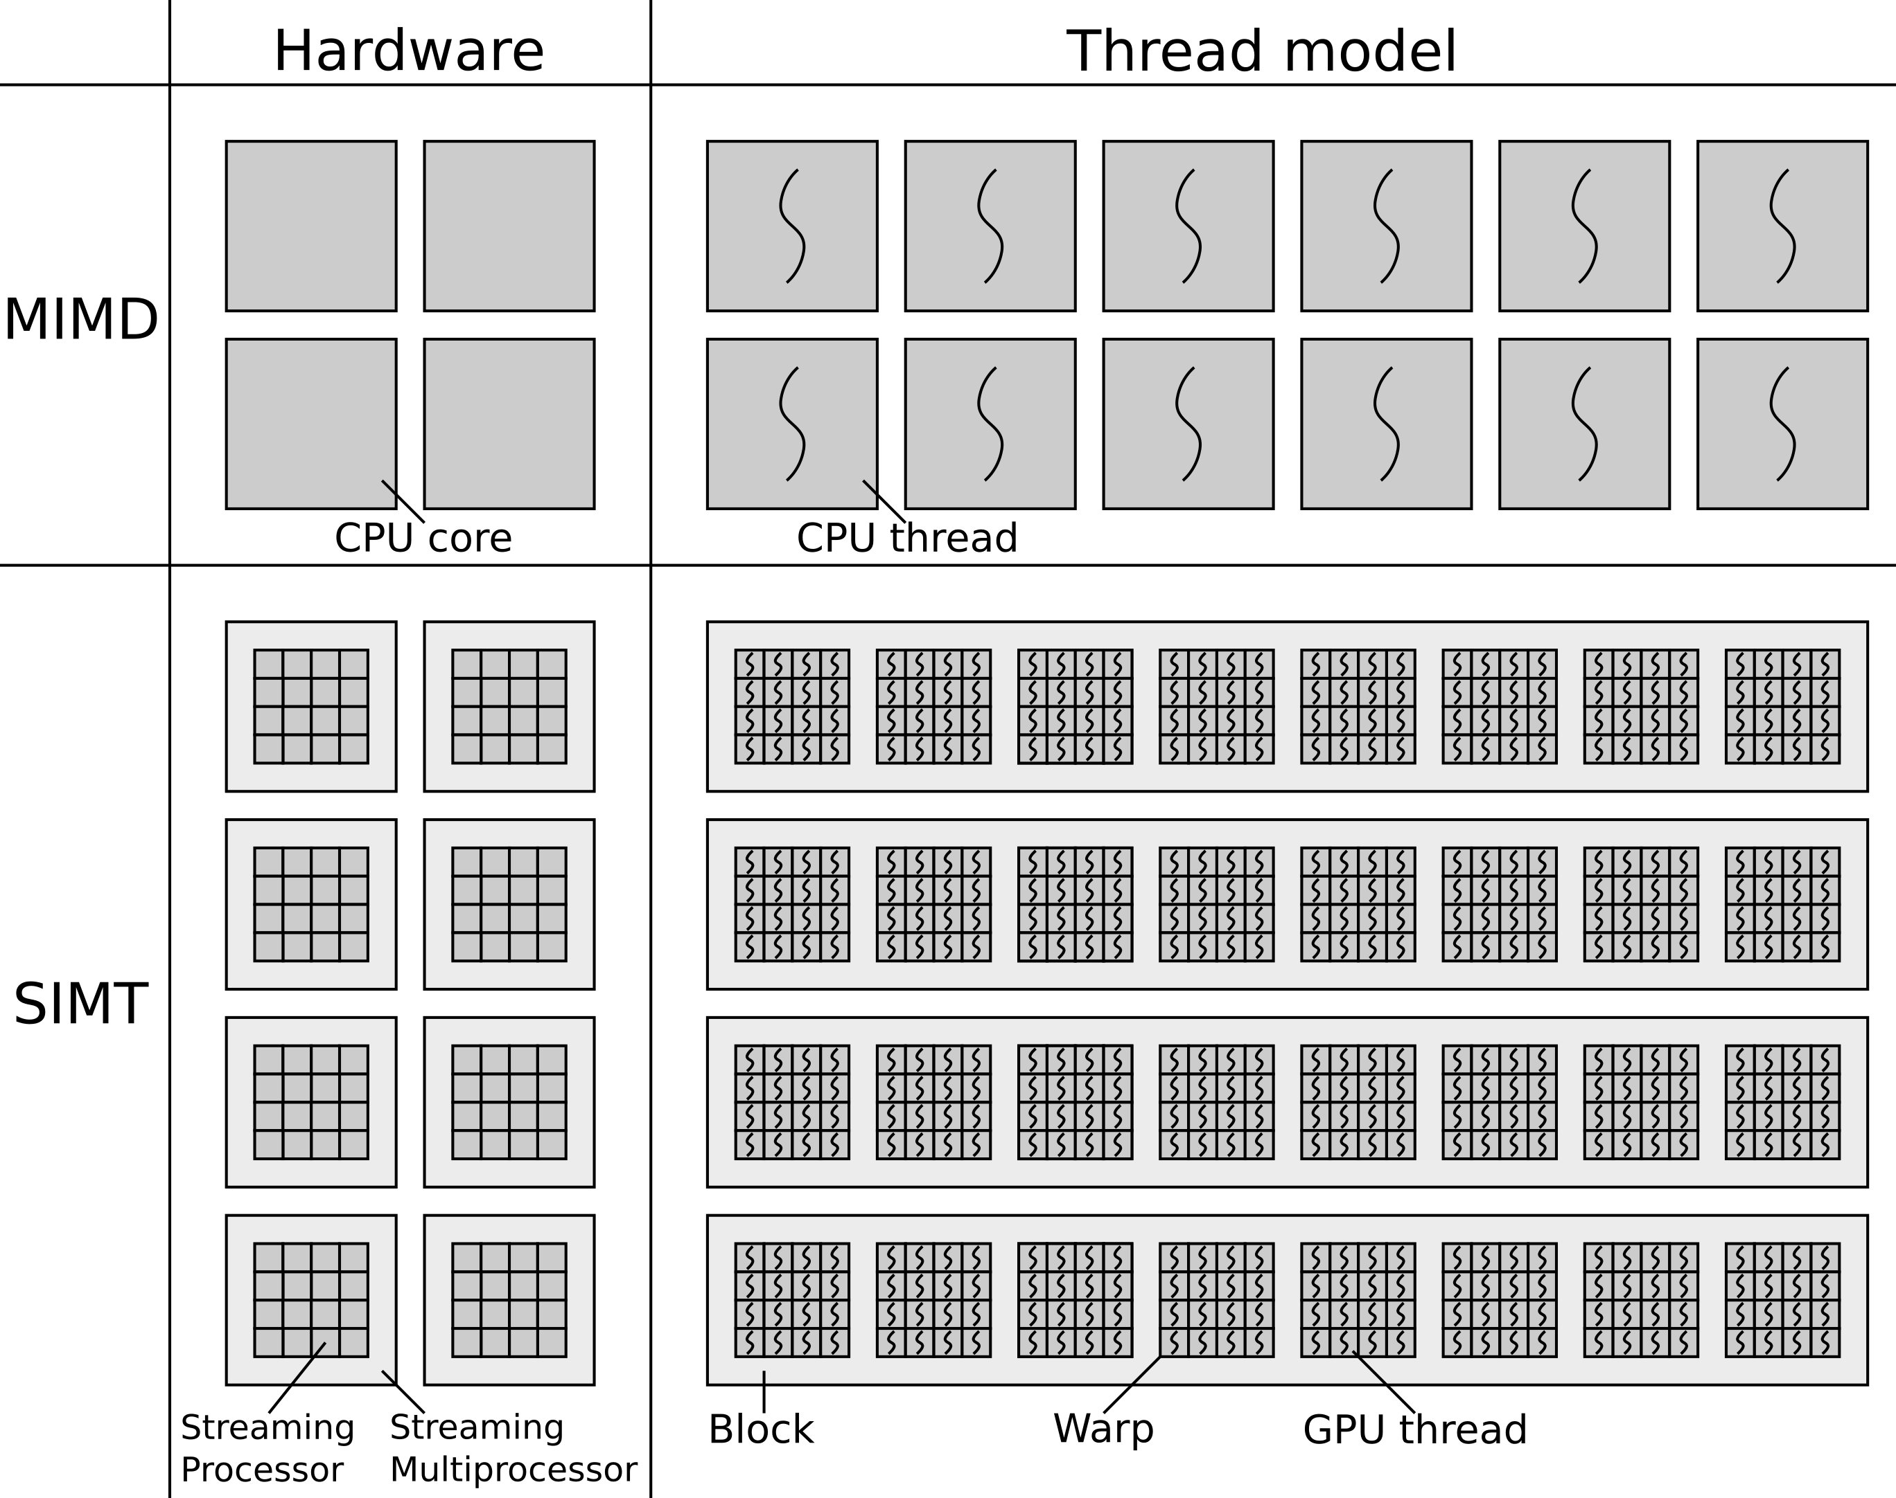
Single Instruction, Multiple Thread
Single instruction, multiple thread: subtype of SIMD
Multiple threads execute same instructions on different data at the same time
GPUs are SIMT

Slide 16
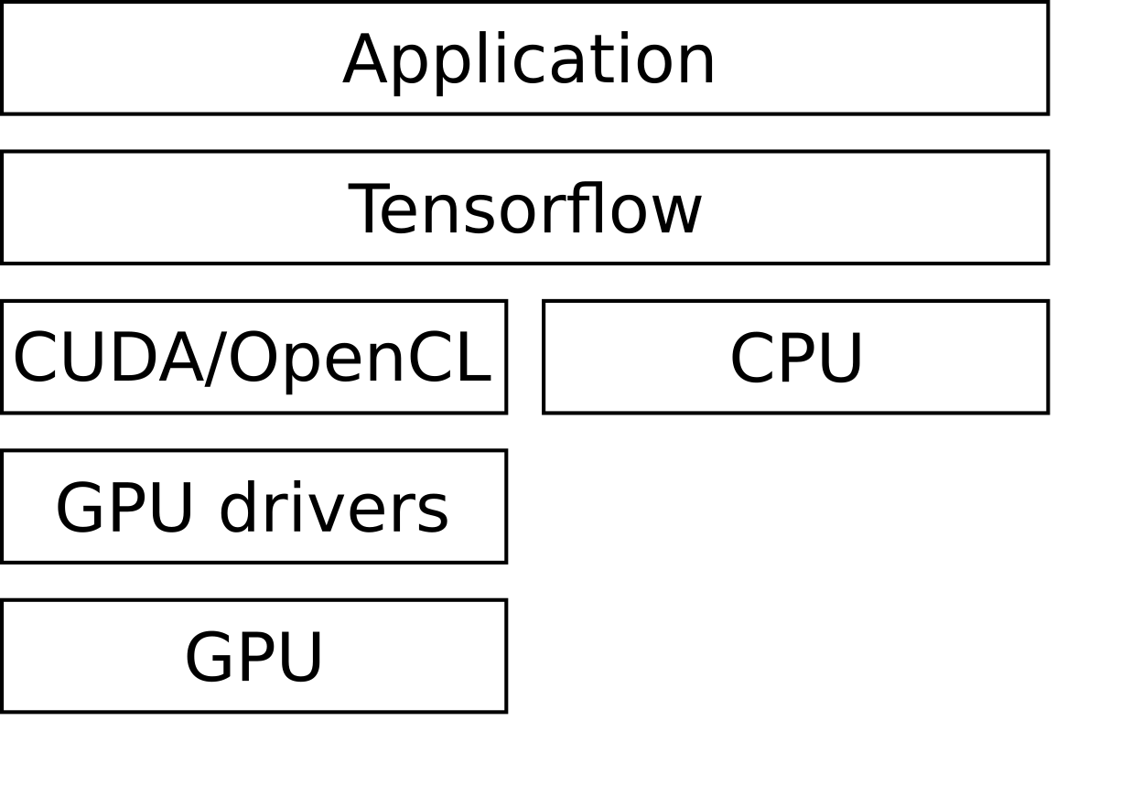
GPU Computing Frameworks
No framework: formulate problem as graphic primitives (e.g. triangles) and analyze framebuffer
Low-level framework: explicitly run code on CPU/GPU
High-level framework: perform high-level operations on vectorized data structures
Additional layer of abstraction

Slide 17

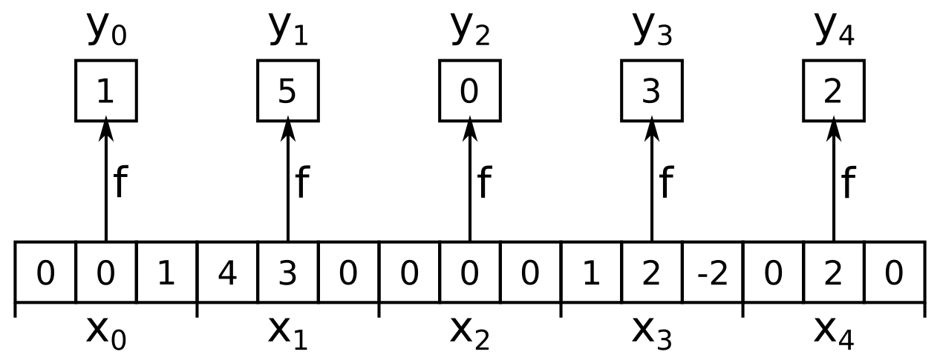
Operation: Map
Transform array with function
Transformation does not depend on other elements
Example: calculate length of 3-vectors

Slide 18
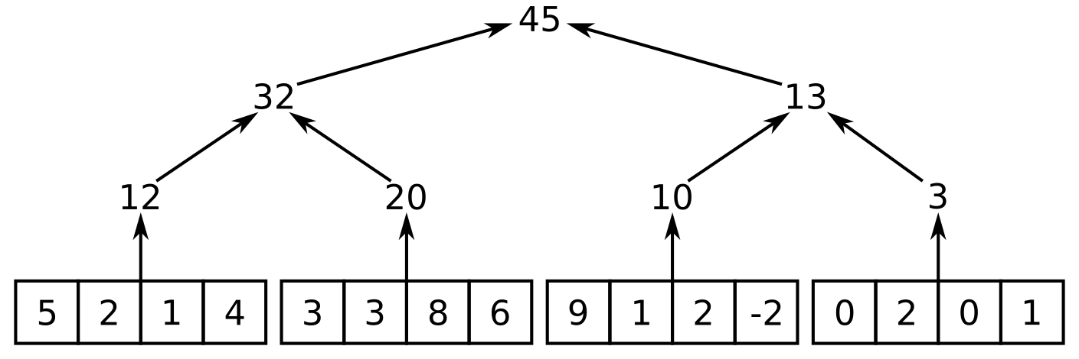
Operation: Reduce
Collapse array into single value with associative operator
Calculate partial results, then collapse partial results
Example: summing up integers

Slide 19
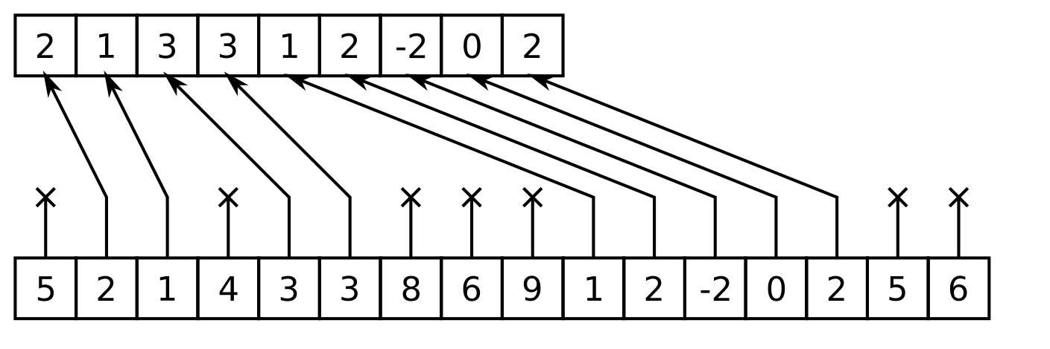
Operation: Filter
Function that maps array values to booleans:
Only keep values where
Example:

Slide 20
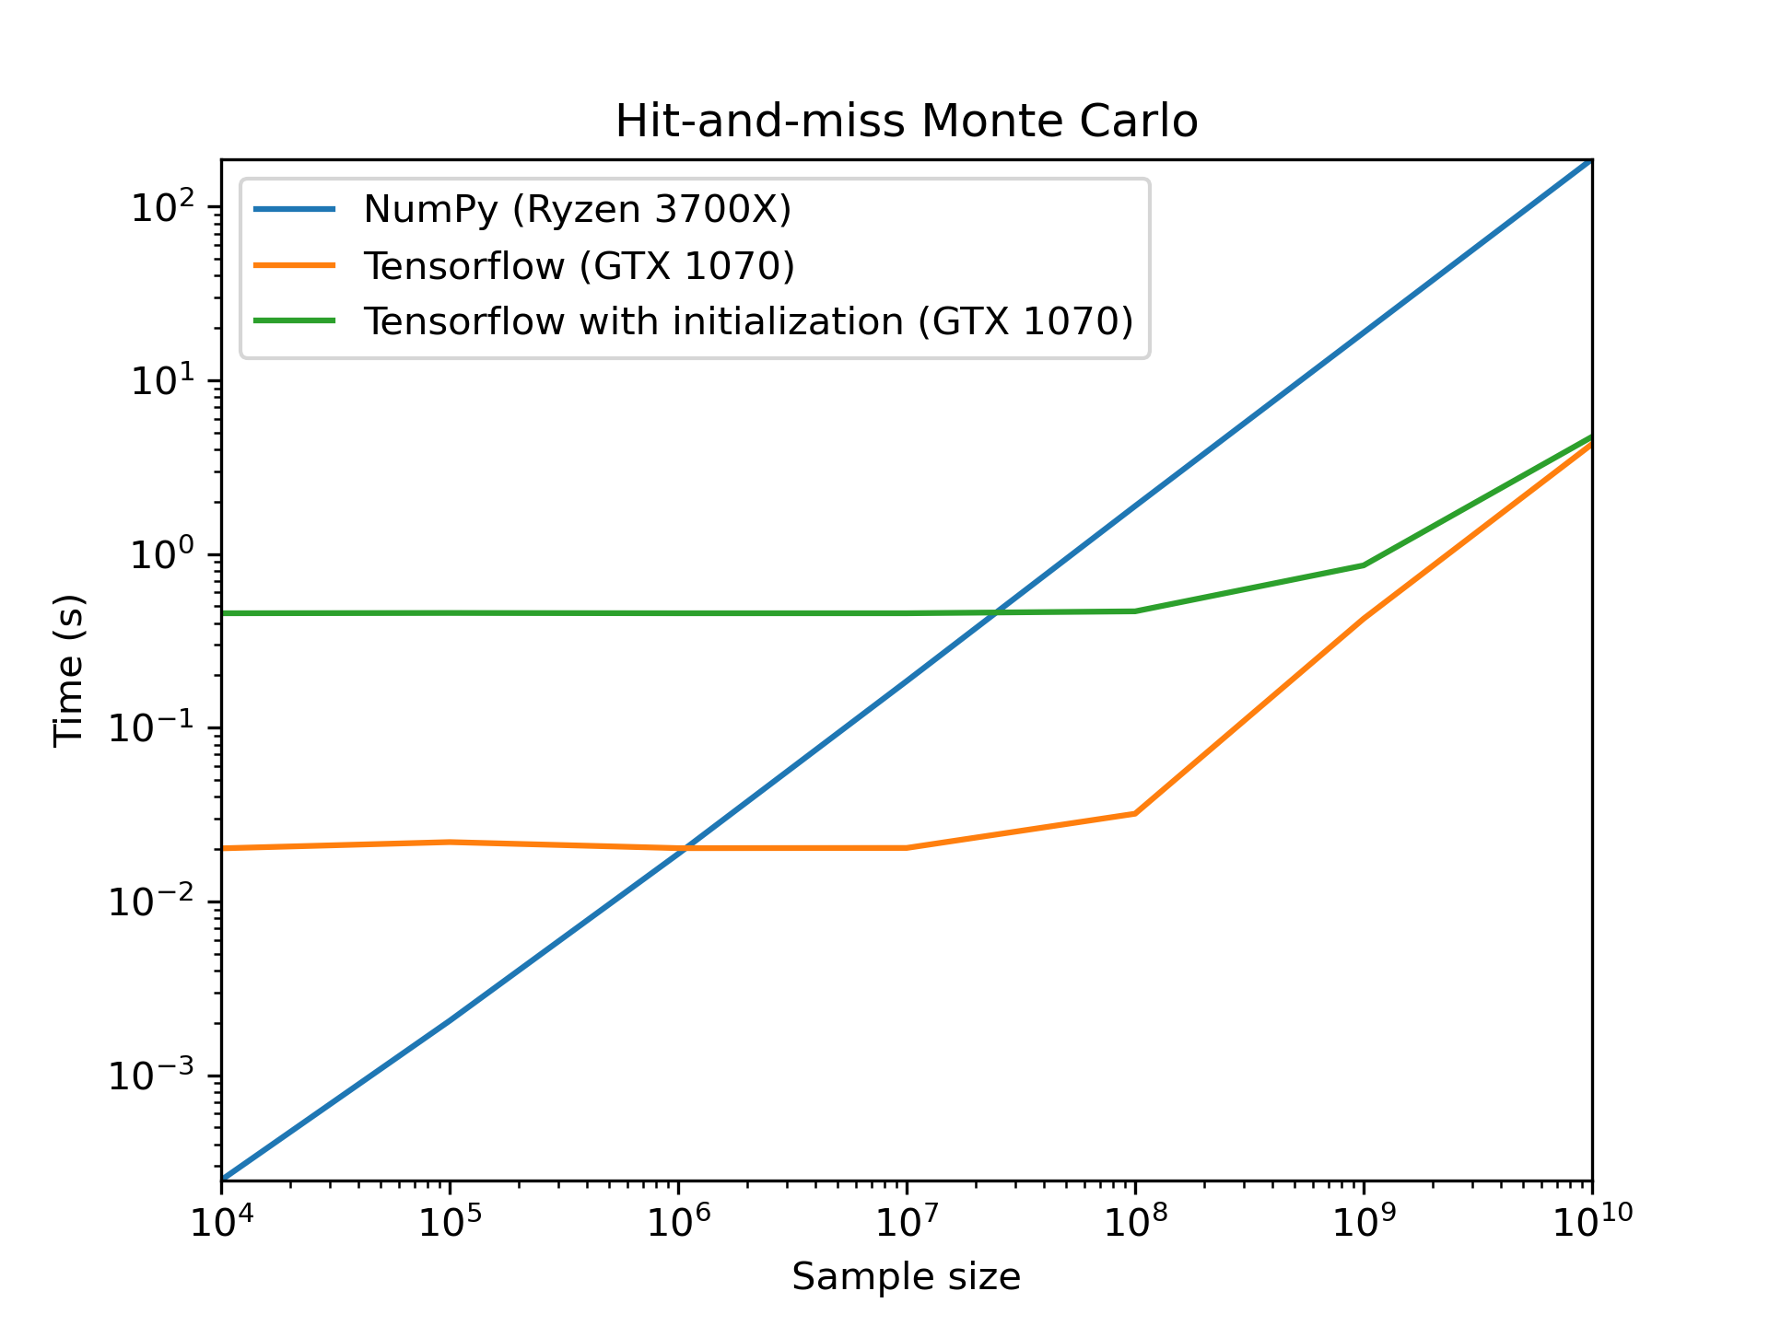
Hit-and-Miss MC with Tensorflow
@tf.function
def mc_tf(sample_size):
rand_xy = tf.random.uniform((sample_size, 2))
# Map:
in_circle = tf.square(rand_xy[:, 0]) \
+ tf.square(rand_xy[:, 1]) < 1.0
# Reduce:
mc_estimate = tf.math.count_nonzero(
in_circle) / sample_size
return 4 * mc_estimate

Slide 21
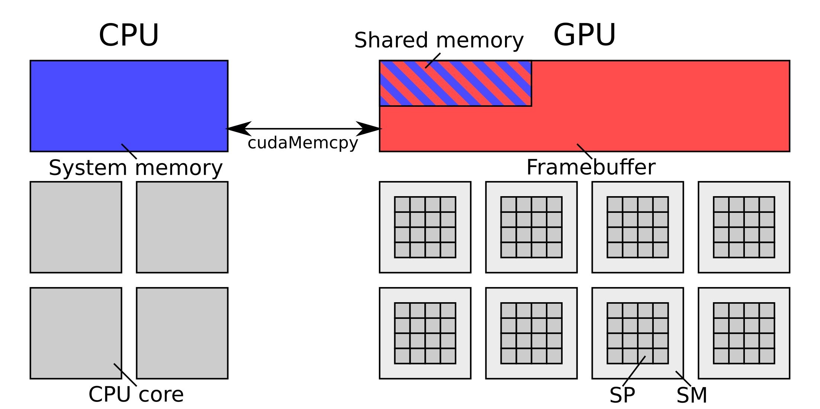
Memory Management
GPU and CPU use separate memory
Transfer with special functions
Introduces latency
Resizable bar: shared memory on framebuffer

Slide 22
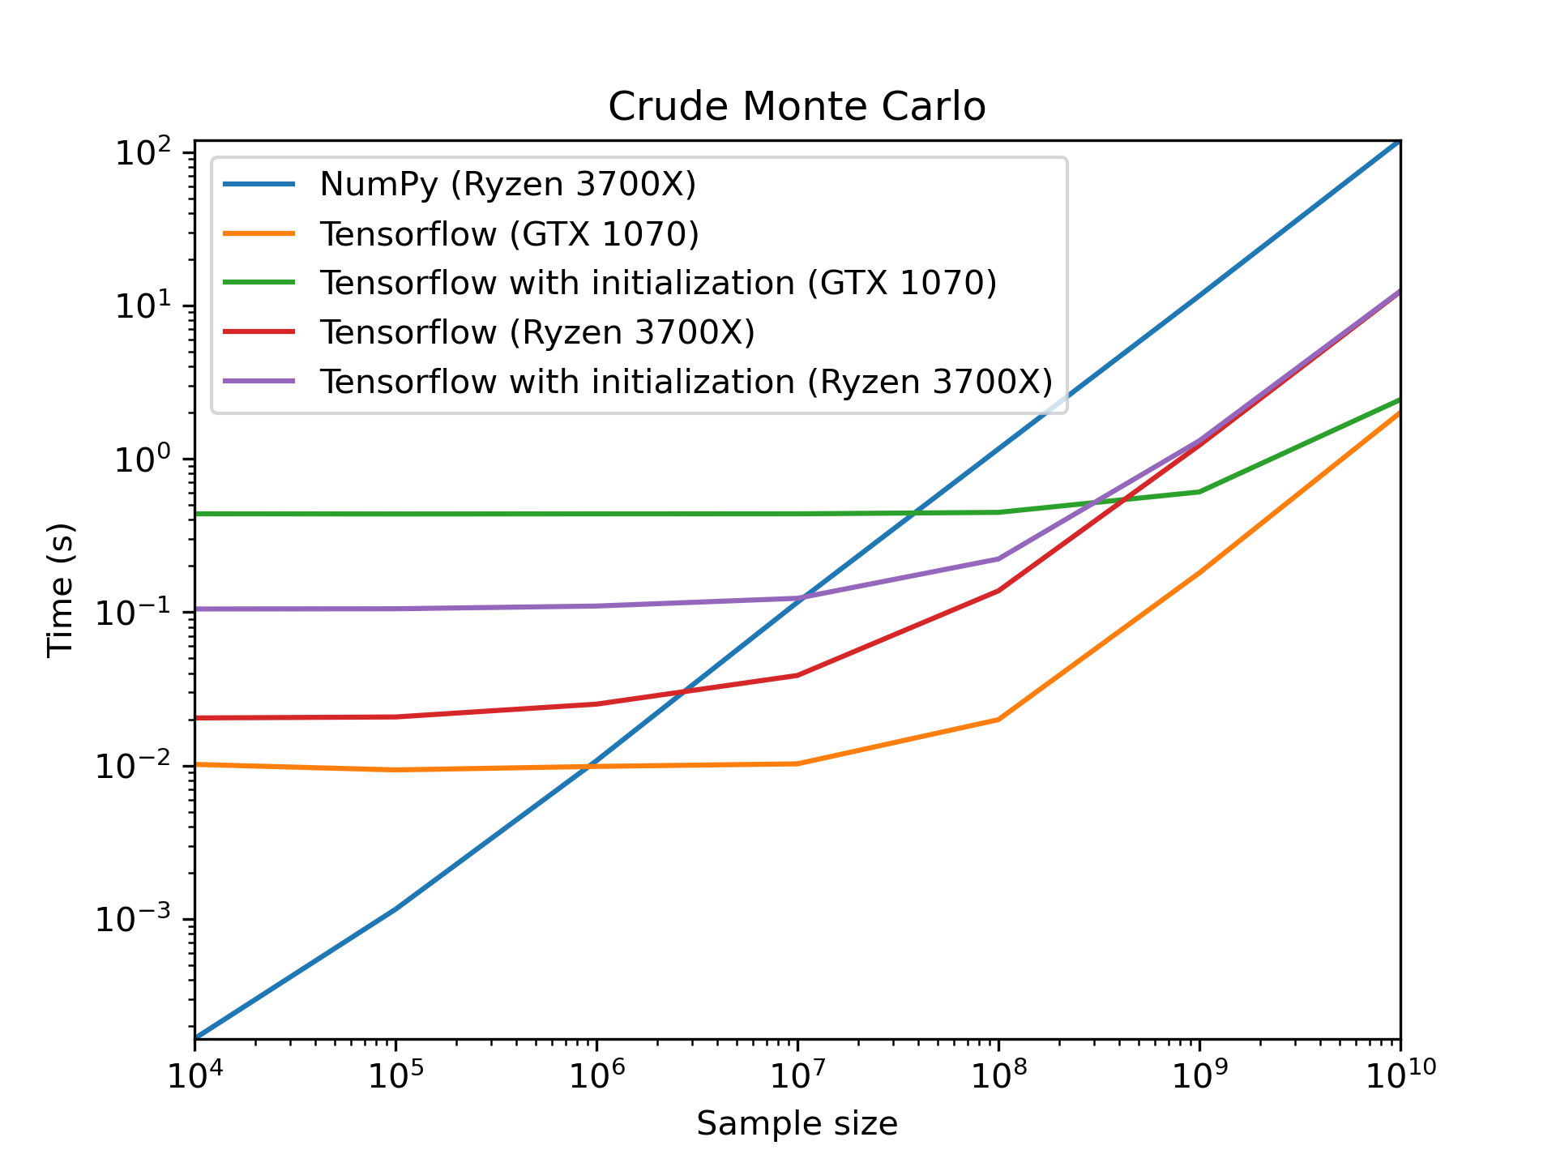
Crude MC with Tensorflow
@tf.function
def mc_tf(sample_size):
rand_x = tf.random.uniform((sample_size,))
# Map:
function_values = 1.0 – tf.math.sqrt(
1.0 - tf.math.square(rand_x))
# Reduce:
mc_estimate = tf.reduce_mean(function_values)
return 4 * mc_estimate

Slide 23
Summary
MC methods solve numerical problems through random sampling
Suitable for systems with many coupled degrees of freedom
Can be efficiently parallelized
Can be suitable candidate for GPU computing
Parallelization introduces overhead
Use design patterns (Map, Reduce, Filter, ...) for efficient parallelized code

Slide 24
Further Reading
Python code used for plots and calculations:
https://github.com/JohannesGaessler/presentation_mc
General MC: F. James, 1980, Monte Carlo Theory and Practice
VEGAS algorithm: G. Peter Lepage, 1977, A New Algorithm for Adaptive Multidimensional Integration
VegasFlow: Stefano Carrazza, Juan M. Cruz-Martinez, 2020, VegasFlow: Accelerating Monte Carlo simulation across multiple hardware platforms

Slide 25
Thank you for your attention!

Slide 26
Appendix
Generation of pseudo-random numbers
SIMT programming: conditional statements, context switches, latency hiding
VegasFlow parallelization details (annotated source code)
SIMT parallelization of artificial neural networks

Slide 27
Appendix: RNG
MC methods need large amounts of random numbers
Problem: computers are deterministic
Randomness from physical sources too slow for MC
Solution: calculate pseudo-random numbers instead
Ideally no discernable patterns in pseudo-random sequence

Slide 28
Appendix: RNG
Linear congruential generator:
Produces integers
Needs a seed to start
Choosing good values for integers is tricky
Interpret integers as significand to generate float
Can be parallelized efficiently with SIMT

Slide 29
Appendix: Conditional Statements
Evaluate condition for every thread to create mask
if block: part of the threads are idling due to mask
else block: invert mask
Loops: update mask between iterations
Idling threads bad for performance

Slide 30
Appendix: Thread Overhead
Both CPU and GPU have registers/cache for threads
GPU: registers/cache are not flushed on context switch
GPU threads cheap but few registers available
Performance optimization very different
CPU: num threads ~ num cores
GPU: num threads >> num cores
Latency hiding: try to always have threads that can be worked on when data needs to be fetched from memory

Slide 31
Appendix: Vegasflow Sampling
# Calculate x values to sample function with.
@tf.function
def digest(xn):
# xn: random numbers between 0 and BINS_MAX.
ind_i = tf.cast(xn, DTYPEINT) # Map, lower bin bounds indices.
ind_f = ind_i + ione # Map, upper bin bounds indices.
x_ini = tf.gather(divisions, ind_i, batch_dims=1) # Map, lower bin bounds.
x_fin = tf.gather(divisions, ind_f, batch_dims=1) # Map, upper bin bounds.
xdelta = x_fin - x_ini # Map, bin widths.
return ind_i, x_ini, xdelta
@tf.function
def compute_x(x_ini, xn, xdelta):
aux_rand = xn - tf.math.floor(xn) # Map, new uncorrelated random number.
return x_ini + xdelta * aux_rand # Map, final x value.

Slide 32

Appendix: Vegasflow Bin Weights
Calculate new bin weights:
Hyperparameter dampens changes to bins
# smeared_tensor: bin widths times bin heights averaged with left and right neighbors.
sum_t = tf.reduce_sum(smeared_tensor) # Reduce.
log_t = tf.math.log(smeared_tensor) # Map.
aux_t = (1.0 - smeared_tensor / sum_t) / (tf.math.log(sum_t) - log_t) # Map.
wei_t = tf.pow(aux_t, ALPHA) # Map.
ave_t = tf.reduce_sum(wei_t) / BINS_MAX # Reduce.

Slide 33
Appendix: Vegasflow New Bins
# Initialize varaibles before loop:
new_bins = [fzero] # first bin always starts with 0.
bin_weight = fzero # Running sum of bin weights.
n_bin = -1 # Bin index.
cur = fzero # Upper bin bound.
prev = fzero # Lower bin bound.
for _ in range(BINS_MAX - 1):
bin_weight, n_bin, cur, prev = tf.while_loop(
while_check,
while_body,
(bin_weight, n_bin, cur, prev),
parallel_iterations=1, # No parallelism.
)
bin_weight -= ave_t # Decrease bin weight sum.
# Decrease upper bin bound proportionally
# to excess bin weight:
delta = (cur - prev) * bin_weight / wei_t[n_bin]
new_bins.append(cur - delta)
new_bins.append(fone) # Last bin always ends with 1.
@tf.function
def while_check(bin_weight, *args):
"""True if bins have at least average weight."""
return bin_weight < ave_t
@tf.function
def while_body(bin_weight, n_bin, cur, prev):
"""Iterate bins and add up their weights."""
n_bin += 1 # Increase index.
bin_weight += wei_t[n_bin]
prev = cur # Lower bin bound.
cur = subdivisions[n_bin + 1] # Upper bin bound.
return bin_weight, n_bin, cur, prev

Slide 34
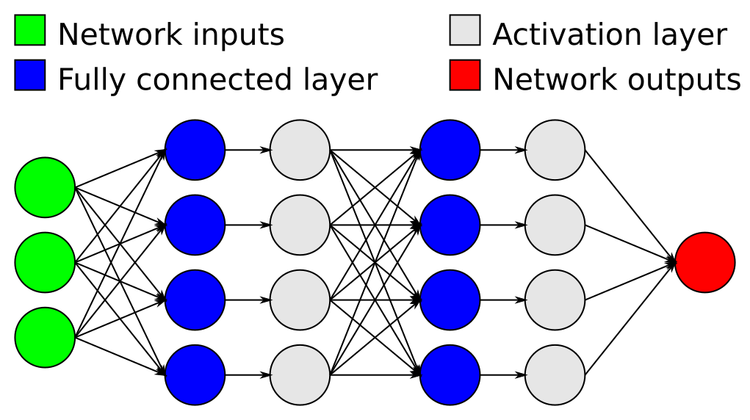

Appendix: ANN SIMT Implementation
Artifical neural networks are built from layers of “neurons”
Output of each neuron is linear combination of previous layer
Insert non-linear activation function between layers

Slide 35
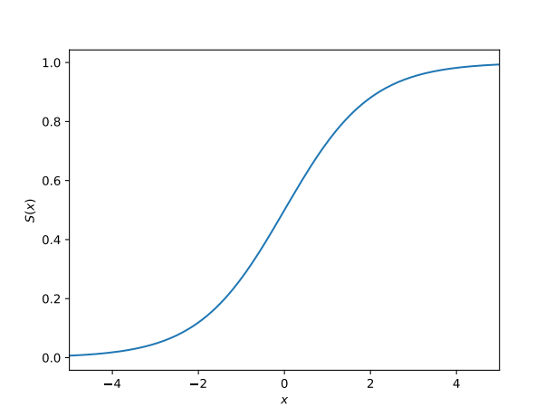


Appendix: ANN SIMT Implementation
Use MapReduce for fully connected layers
Use Map for activation layers with activation function

