Slide 1

PSE – Neural Network based Image Classification System on Heterogeneous Platforms
Colloquium Design Phase
Dimitrov, Drehwald, Guneshka, Häring, Stangel

Slide 2
Roadmap
Package design
Process of image classification
Class diagrams of the process in the controller
Sequence diagram for getting the image
Next steps

Slide 3
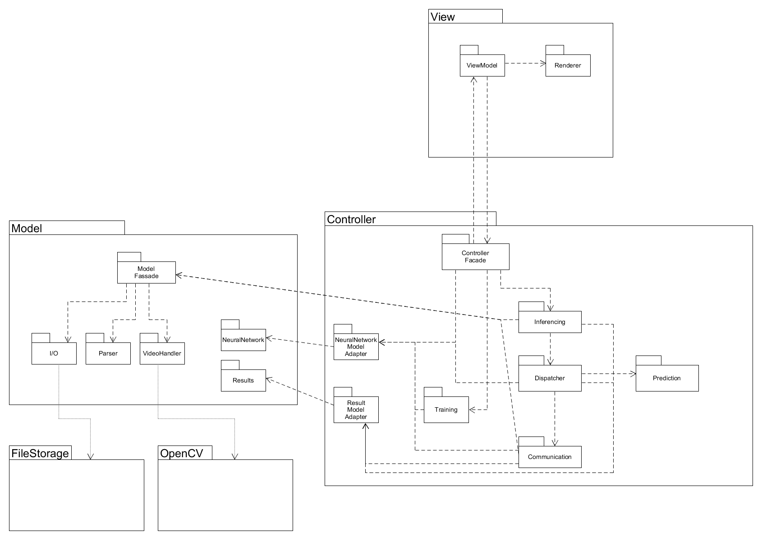
Package design
Stefi
Dimitar
Manuel
Paul
Johannes
Notes:
Who designed what…
6 eyes principle → 2 Reviewer
Pairprogamming
MVC
Observer pattern
Controller pushes to the view and pulls from the view
Controller pushes to the model and pulls from the model
FileStorage as external package to access files
OpenCV as external package to manipulate the camera and videos
QT as view framework

Slide 4
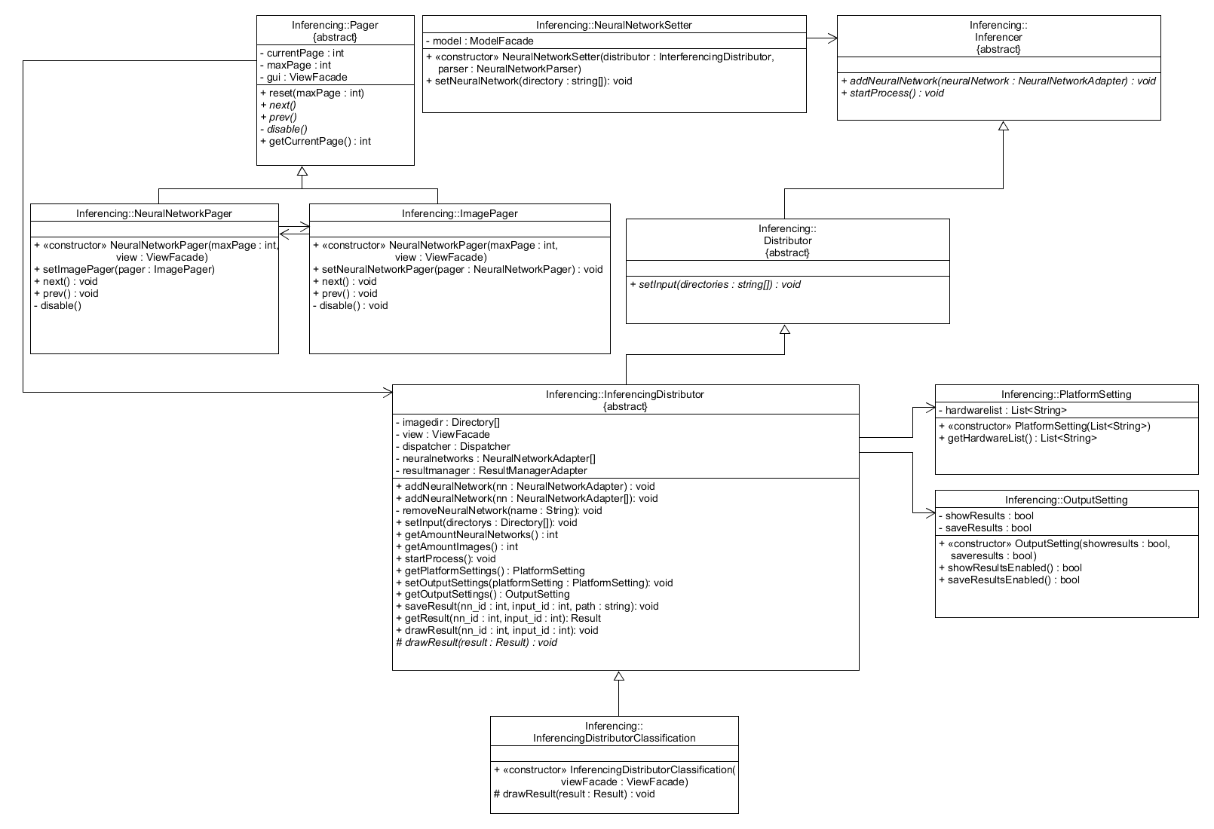
Process of image classification – class diagram of inferencing
Notes:
Pager for managing the results, can be skipped by neural network and image
Three setter
Distributor for acquire all needed data for the task: images, neural network, used devices, chosen mode

Slide 5
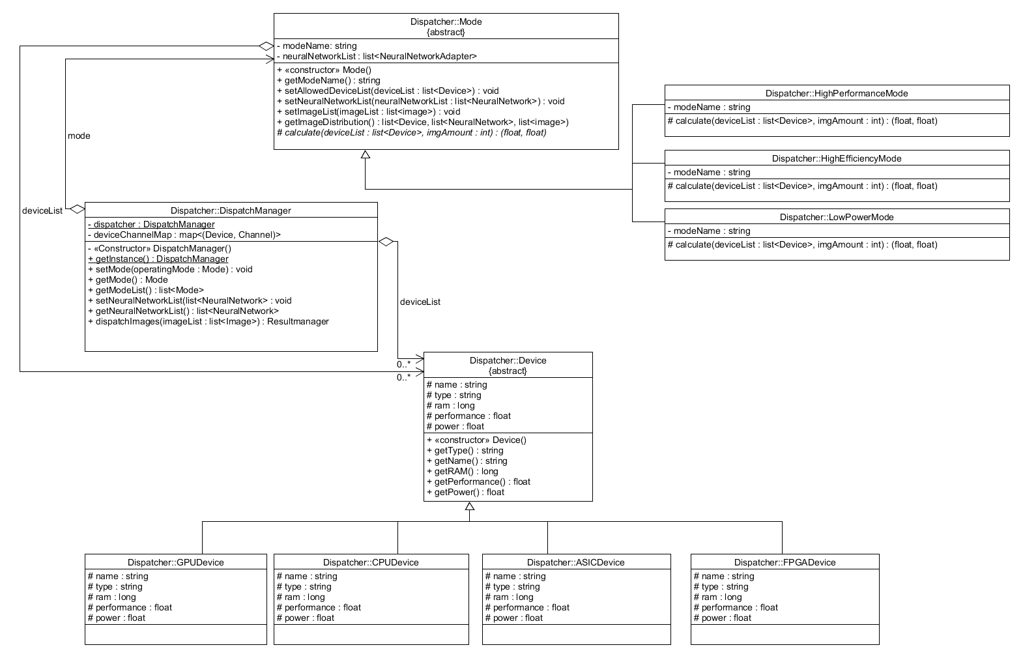
Process of image classification – class diagram of dispatcher
Notes:
Mode and device list for the current task is set
Then dispatch function is called
Acquires prediction of the devices

Slide 6
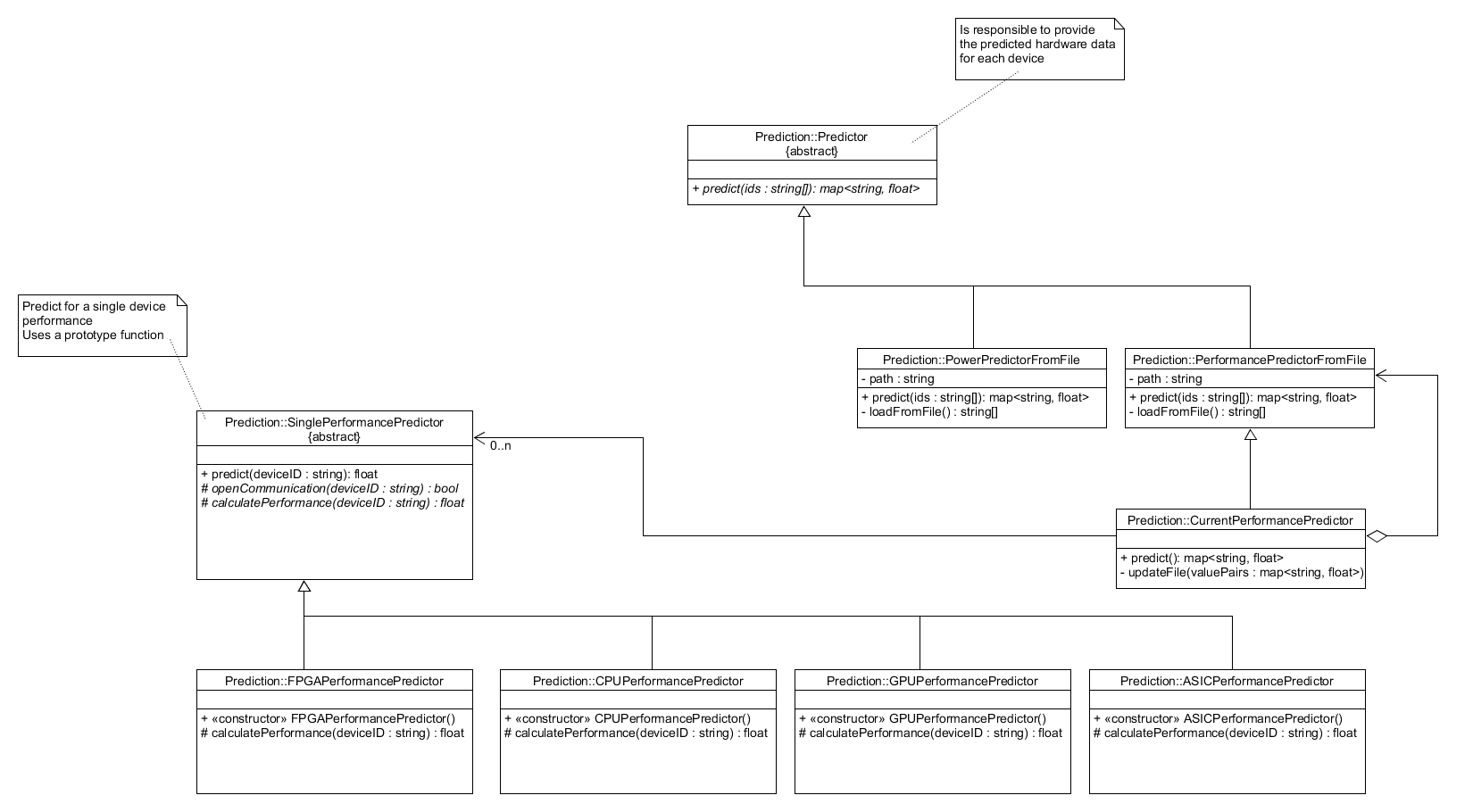
Process of image classification – class diagram of the predictor
Notes:
Prediction for power and performance by hard coded values in a .txt file
Performance prediction decorated with a current performance prediction by a test neural network and image

Slide 7
Process of image classification – class diagram of dispatcher
Notes:
Prediction are stored in device
Calls mode to getImageDistribution
Mode calculates the optimal distribution regarding the parameters power and performance

Slide 8
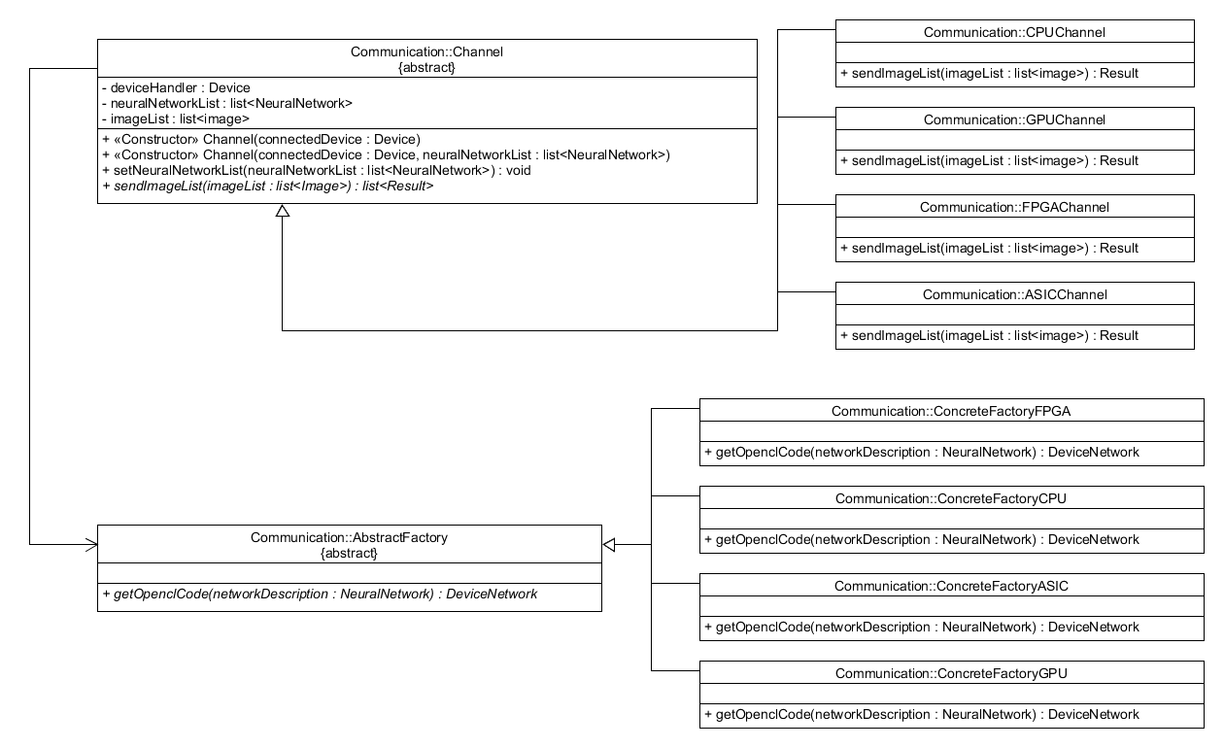
Process of image classification – class diagram of communication
Notes:
DispatchManager open communication channels according to the distribution

Slide 9
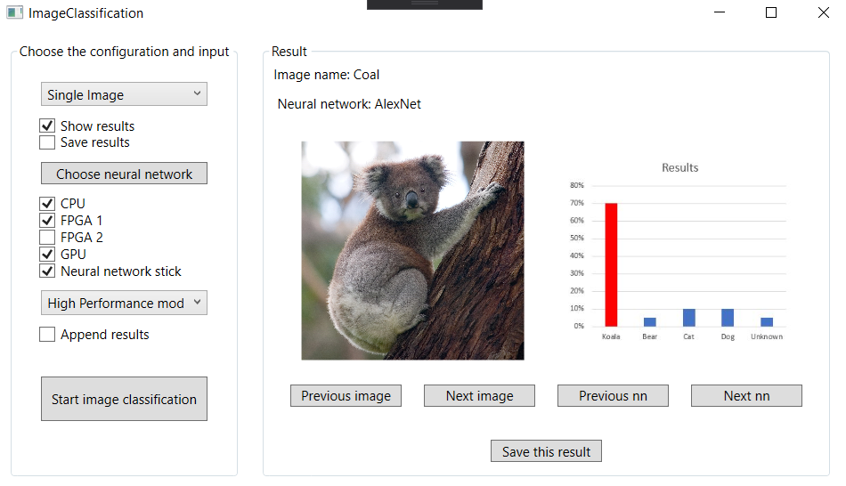
Process of image classification
Notes:
Voilá you have the result

Slide 10
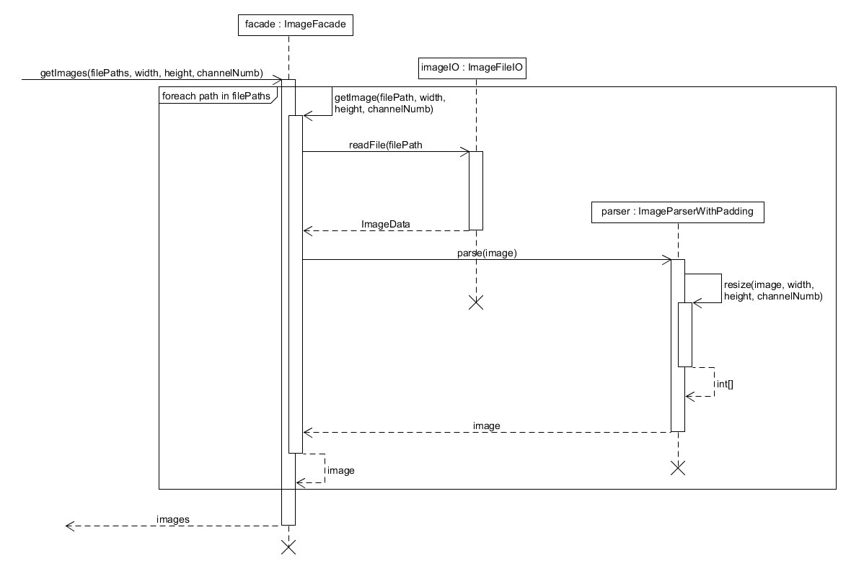
Process of image classification – getting images

Slide 11
Next steps
Christmas and holidays!
Implementation phase with Manuel as responsible person
Next ultimatum: 31. January

