Slide 1

PSE – Neural Network based Image Classification System on Heterogeneous Platforms
Colloquium Implementation Phase
Dimitrov, Drehwald, Guneshka, Häring, Stangel

Slide 2
What is working: GUI
Main Window, allows selecting Training/Inferencing Window
Training window: Allows training on MNIST, forwards accuracy.
Classification window: Allows classification with multiple NN + multiple images simultaneously

Slide 3
What is working: Backend
Training with following layers working:
Dense, Softmax, Sigmoid, ReLu, LeakyReLu
Usage (parsing) of MNIST dataset
Got openCL code running on CPU. Not yet included in „main“ software

Slide 4
Issues
Deadlines missed
Insufficient code quality (Share Github access?)
Imbalanced working contribution
Design changes necessary => „gunshot“ document
FPGA support issues => „gunshot“ document
Getting a working neural network implementation was hard
Main focus on own modules, bad inter-module cooperation
=> conflicts inside of team

Slide 5
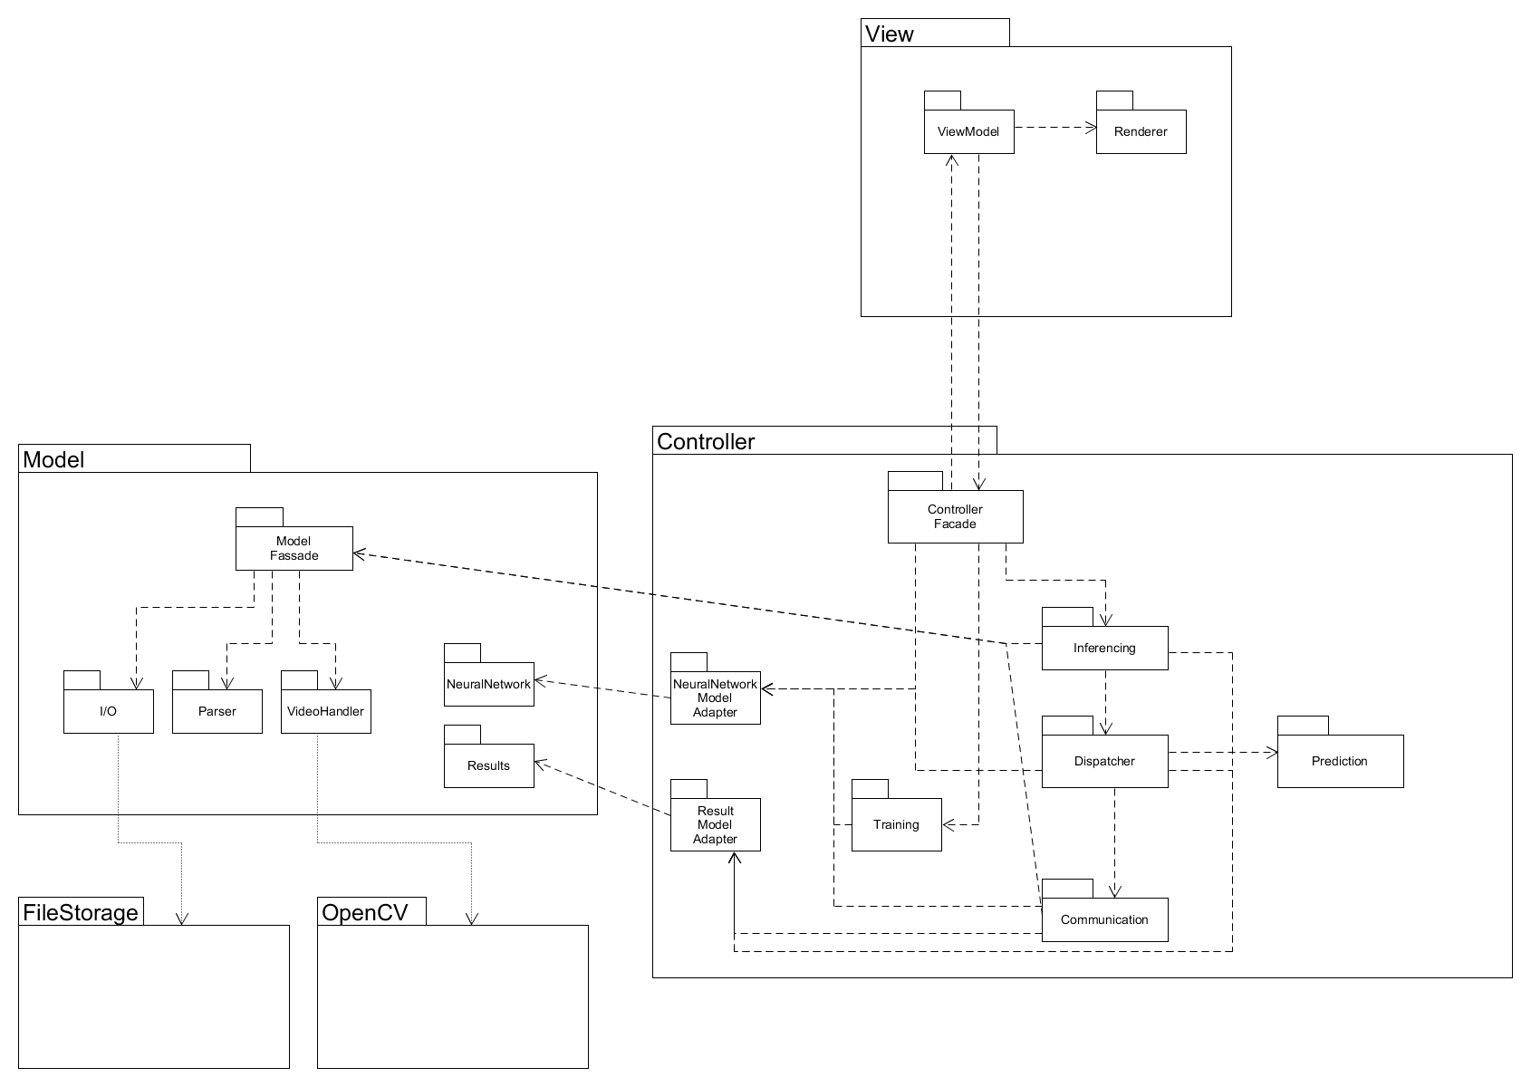
Package design
Stefi
Dimitar
Manuel
Paul
Johannes
Notes:
Who designed what…
6 eyes principle → 2 Reviewer
Pairprogamming
MVC
Observer pattern
Controller pushes to the view and pulls from the view
Controller pushes to the model and pulls from the model
FileStorage as external package to access files
OpenCV as external package to manipulate the camera and videos
QT as view framework

Slide 6
Package implementation
Stefi
Dimitar
Manuel
Paul
Johannes
Notes:
Who designed what…
6 eyes principle → 2 Reviewer
Pairprogamming
MVC
Observer pattern
Controller pushes to the view and pulls from the view
Controller pushes to the model and pulls from the model
FileStorage as external package to access files
OpenCV as external package to manipulate the camera and videos
QT as view framework

Slide 7
Secondary tasks:
CmakeLists.txt setup
Gtest setup
OpenCV setup
OpenCL setup for Devices
Merging of branches
Reviewing/fixing other modules
...

Slide 8
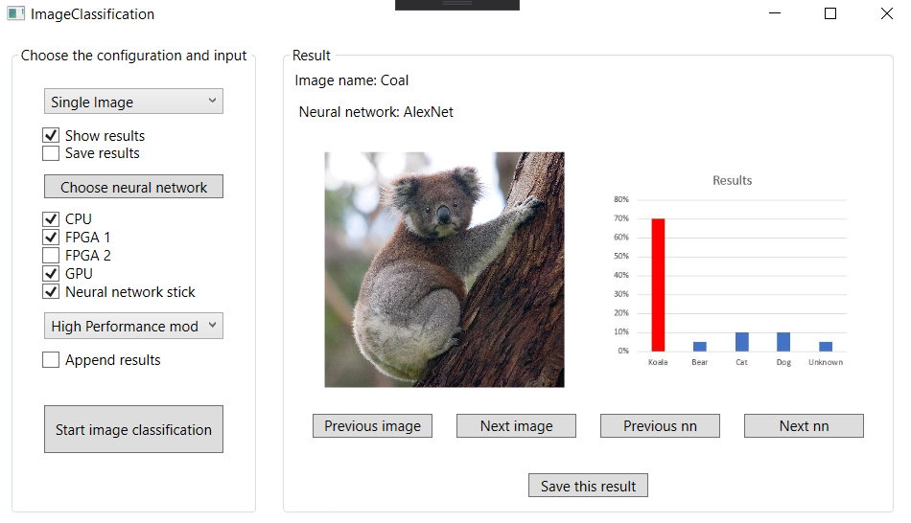
Process of image classification I
Notes:
Voilá you have the result

Slide 9
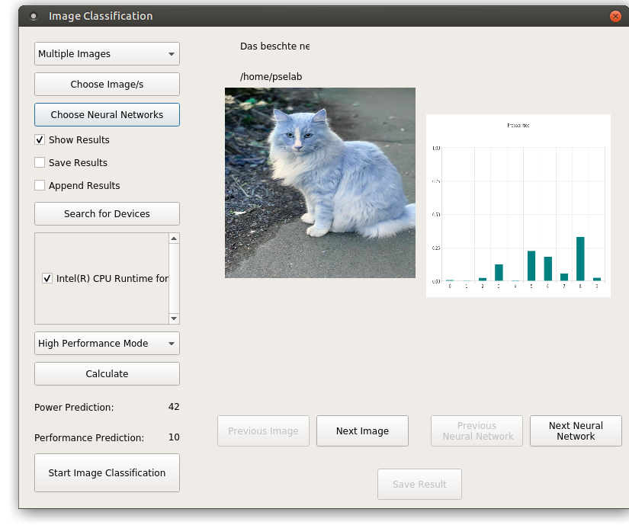
Process of image classification II
Notes:
Voilá you have the result

Slide 10
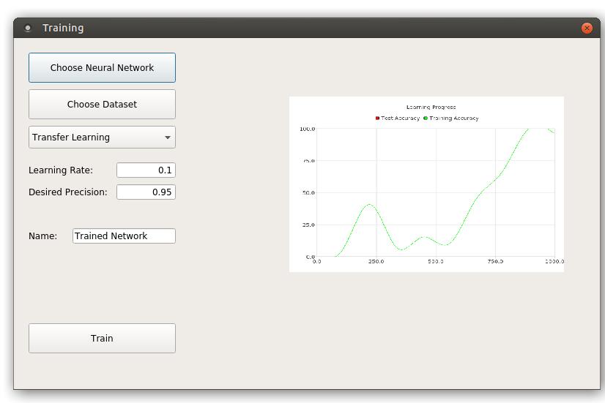
Process of image Training
Please join for a live demo :)

Slide 11
Discarded tasks:
Object Detection
Usage of some Devices

Slide 12
Unfinished tasks for quality assurance:
Training with MaxPool and Conv Layers
OpenCL usage
Gui Layout fixes
...

Slide 13
Next steps
One week free
Quality Assurance phase next

