Slide 1

PSE – Neural Network based Image Classification System on Heterogeneous Platforms
Colloquium Design Phase
Dimitrov, Drehwald, Guneshka, Häring, Stangel

Slide 2
Roadmap
Package design
Process of image classification
Class diagrams of the process in the controller
Sequence diagram for getting the image
Next steps

Slide 3
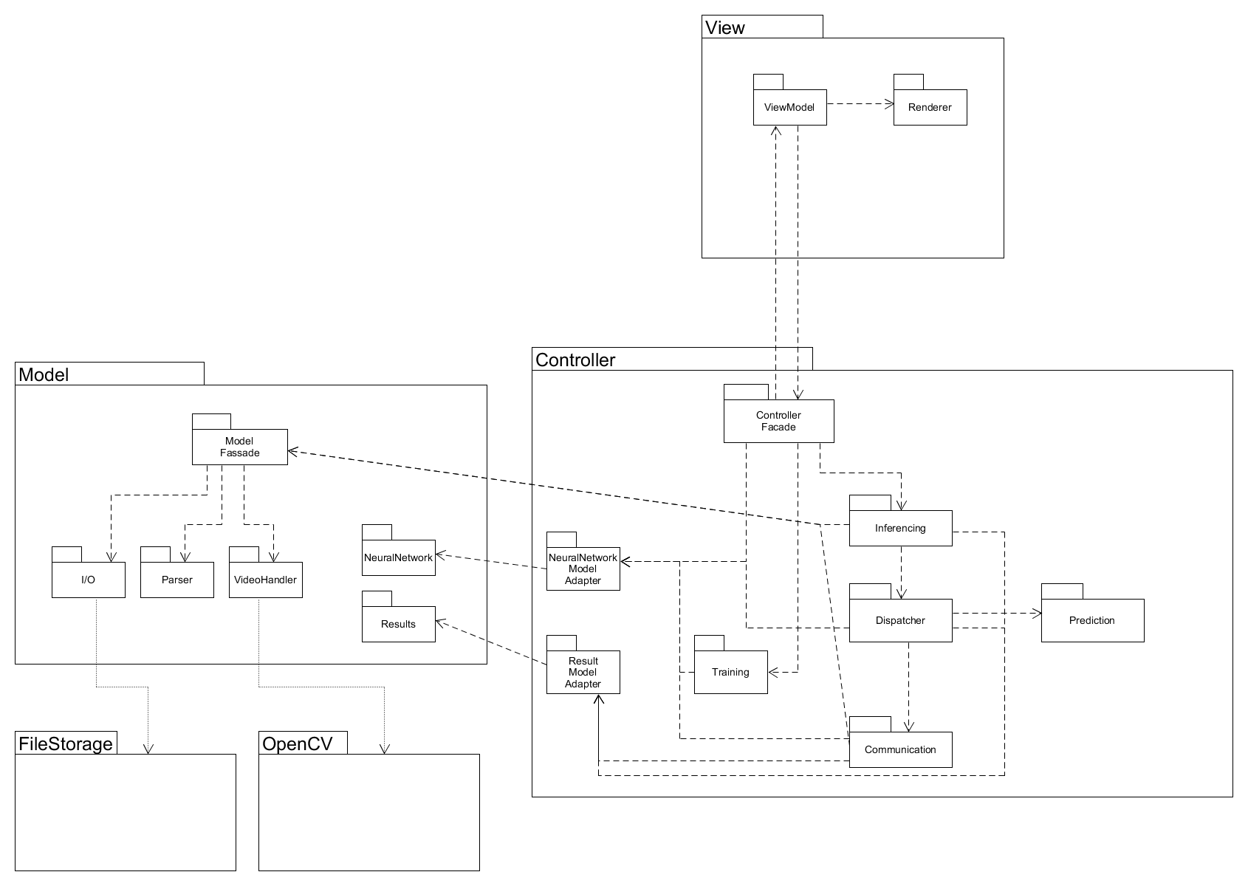
Package design
Stefi
Dimitar
Manuel
Paul
Johannes
Notes:
Who designed what…
6 eyes principle → 2 Reviewer
Pairprogamming
MVC
Observer pattern
Controller pushes to the view and pulls from the view
Controller pushes to the model and pulls from the model
FileStorage as external package to access files
OpenCV as external package to manipulate the camera and videos
QT as view framework

Slide 4
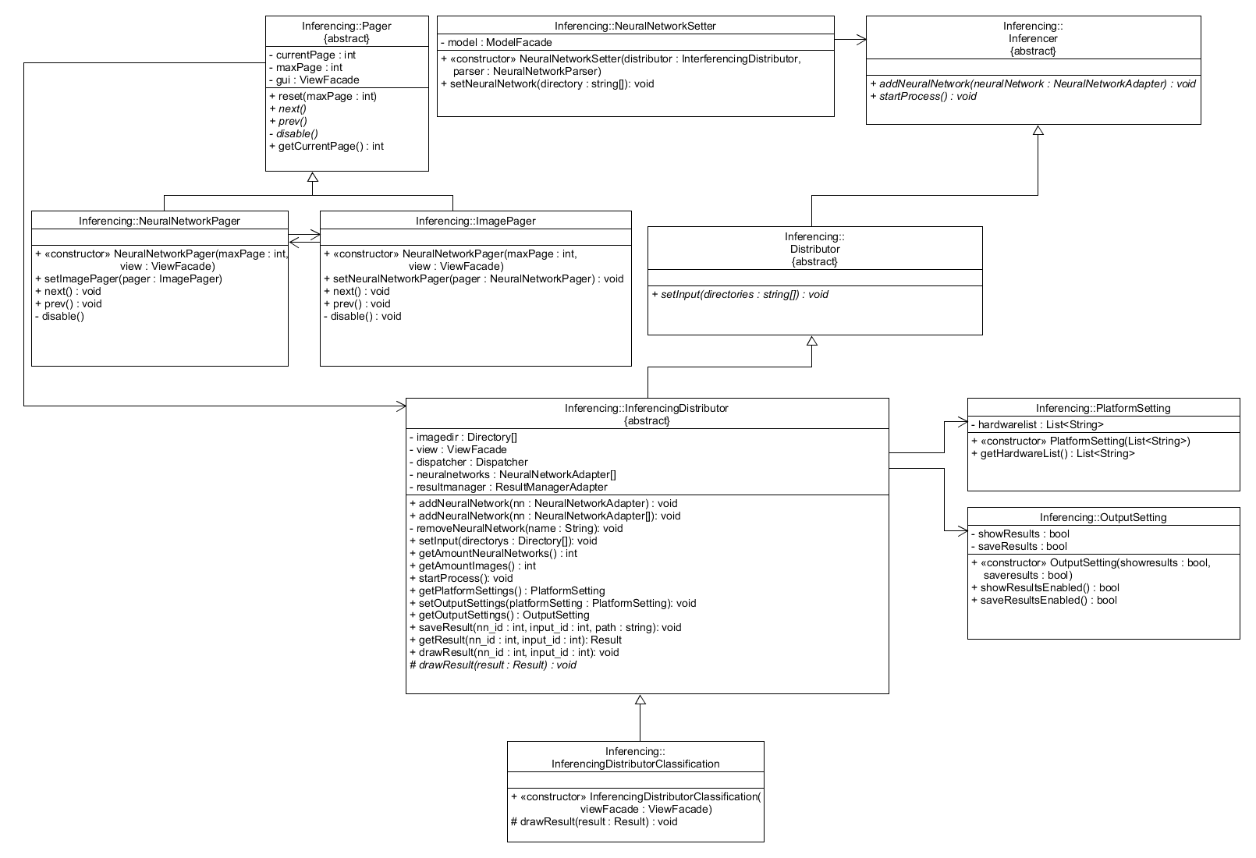
Process of image classification – class diagram of inferencing

Slide 5
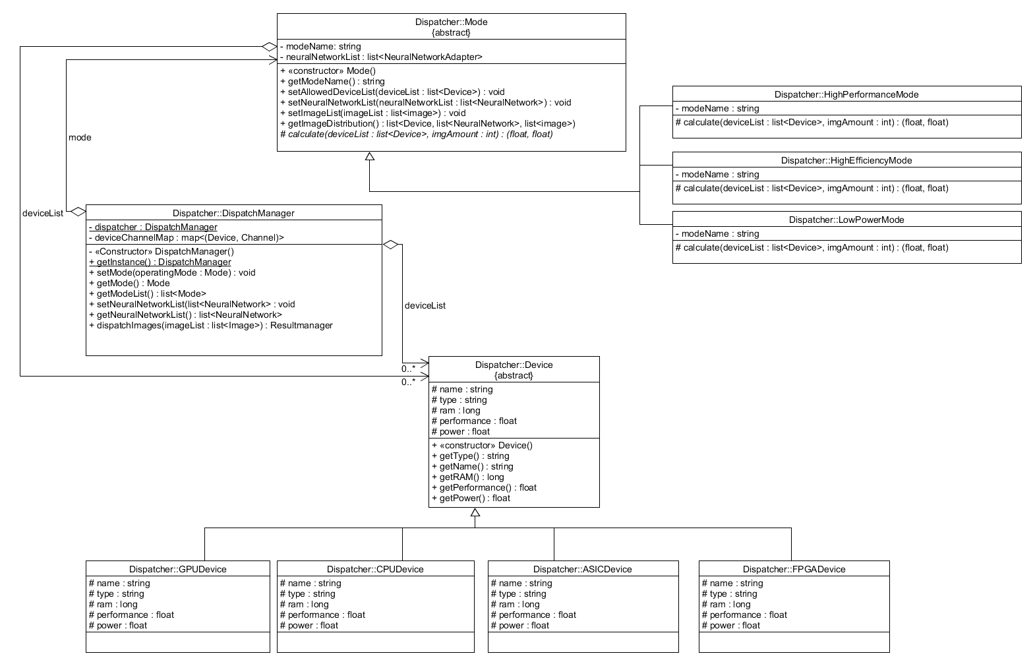
Process of image classification – class diagram of dispatcher

Slide 6
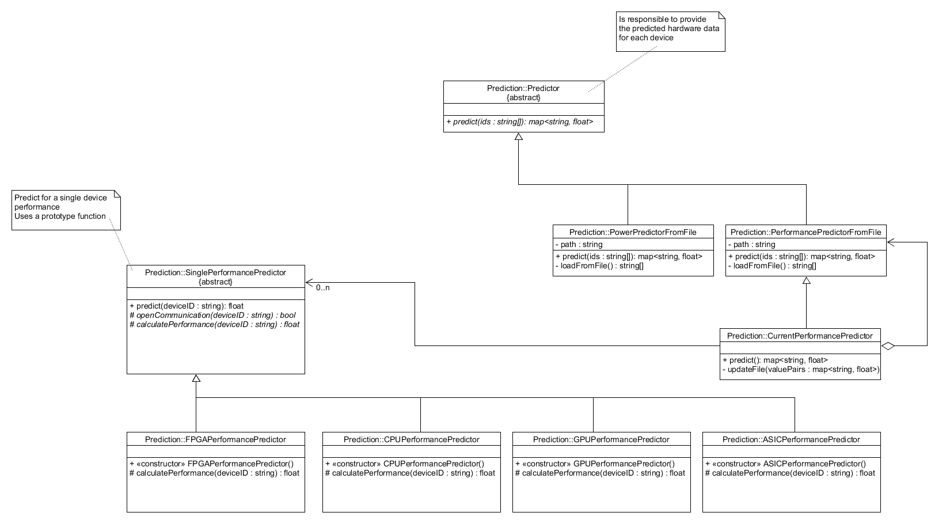
Process of image classification – class diagram of the predictor

Slide 7
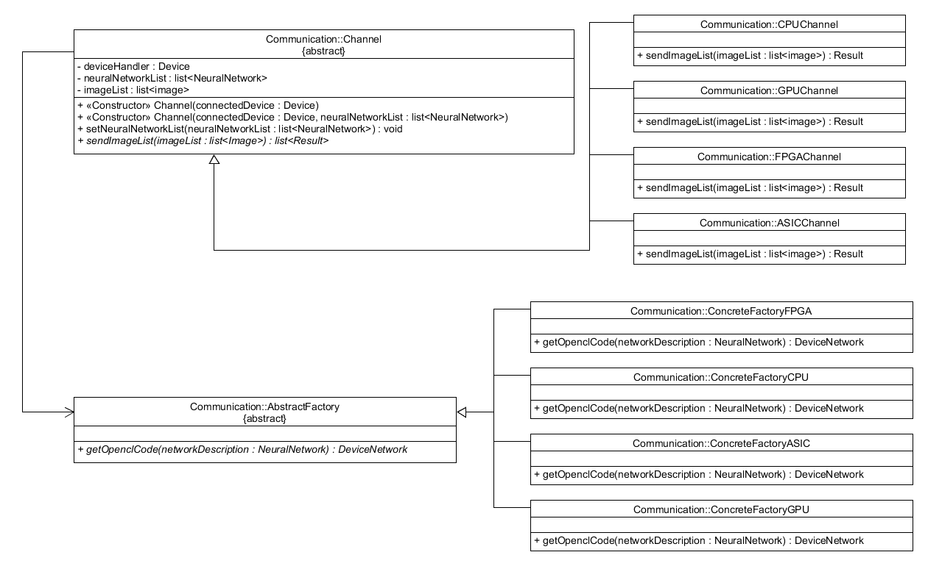
Process of image classification – class diagram of communication

Slide 8
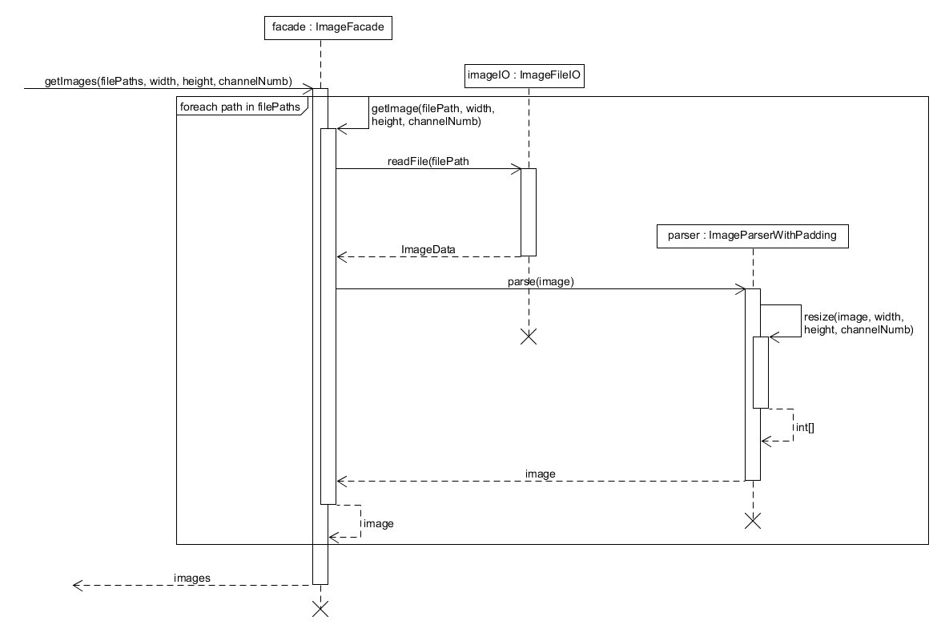
Process of image classification – getImages

Slide 9
Next steps
Christmas!
Implementation phase with Manuel as responsible person
Next ultimatum: 31.01.2020

