Slide 1

PSE – Neural Network based Image Classification System on Heterogeneous Platforms
Colloquium Design Phase
Dimitrov, Drehwald, Guneshka, Häring, Stangel

Slide 2
Roadmap
Package design
Process of image classification
Class diagram
Activity diagram

Slide 3
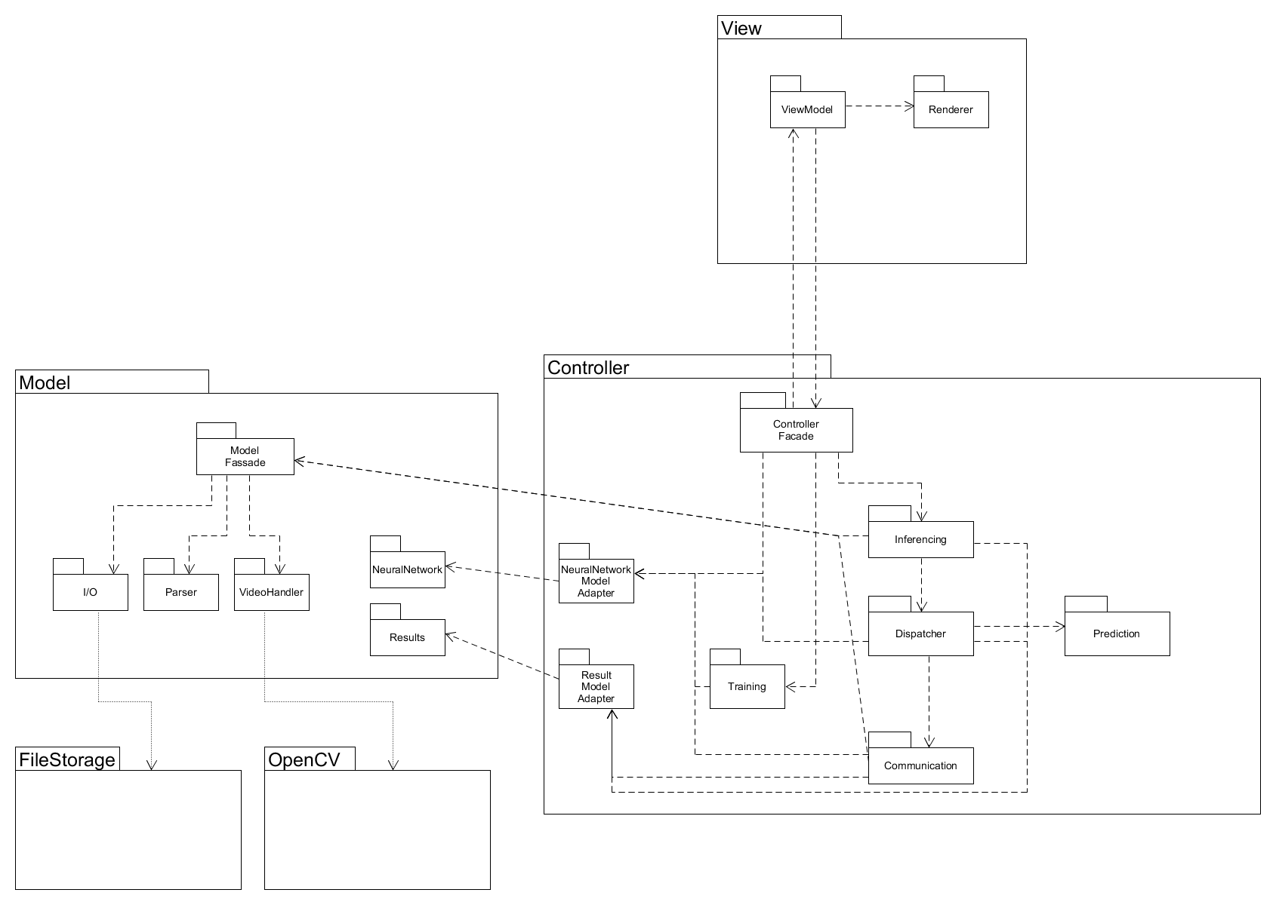
Package design
Stefi
Dimitar
Manuel
Paul
Johannes

Slide 4
Process of image classification – class diagram

Slide 5
Process of image classification – class diagram

Slide 6
Process of image classification – class diagram

Slide 7
Process of image classification – class diagram

Slide 8
Process of image classification – class diagram

