Slide 1
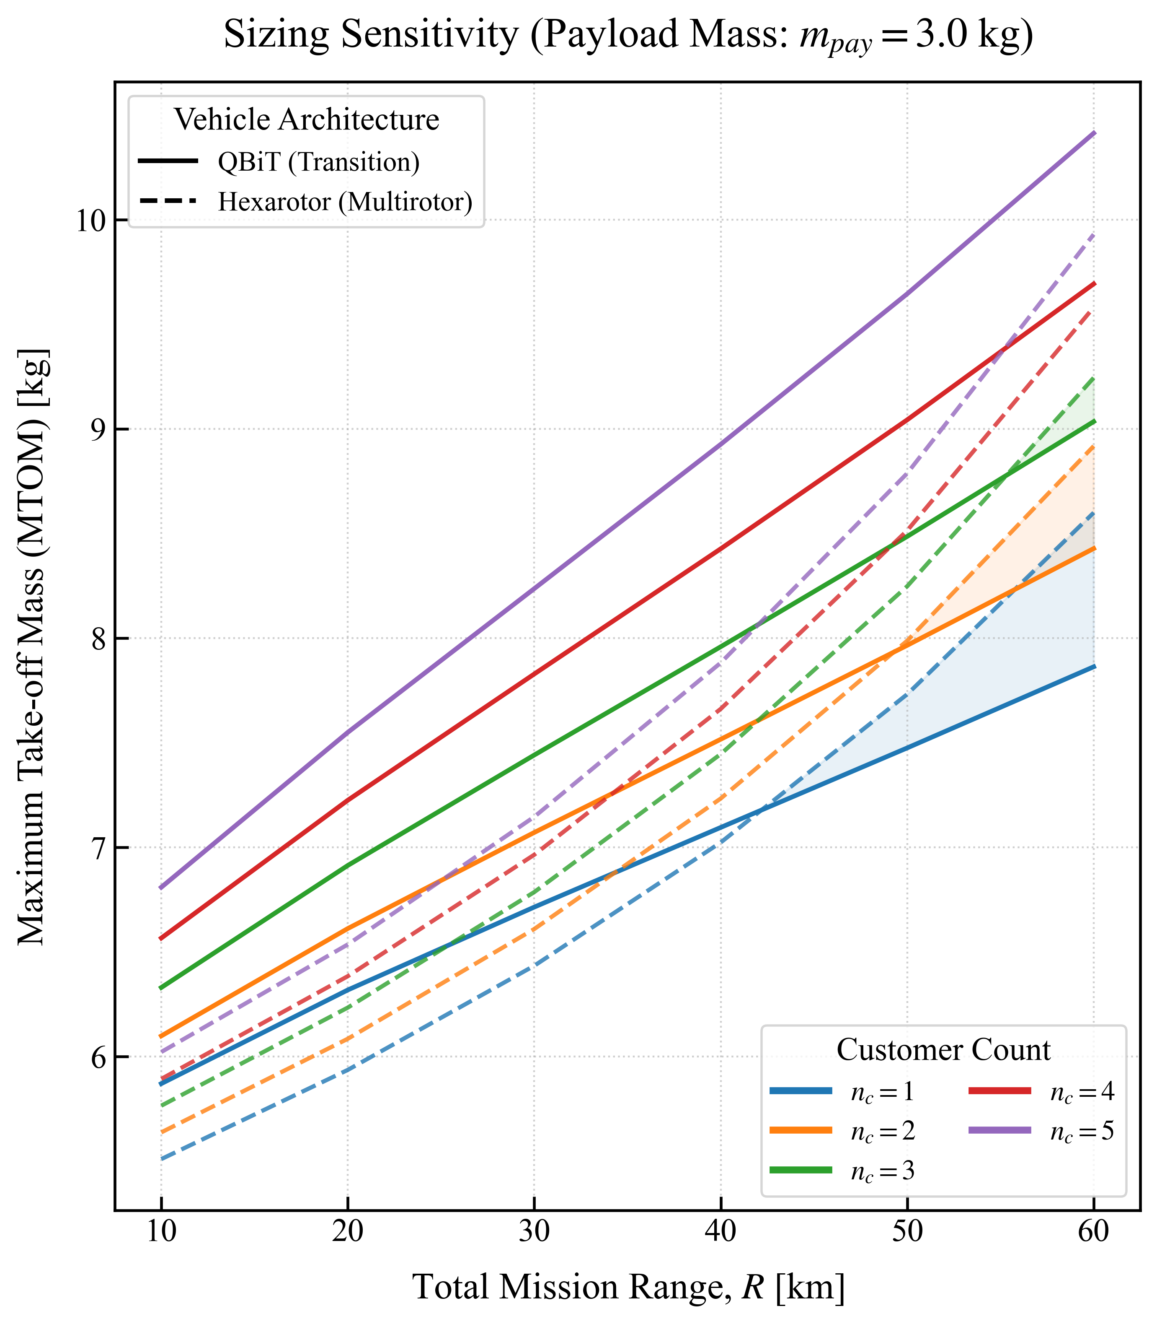
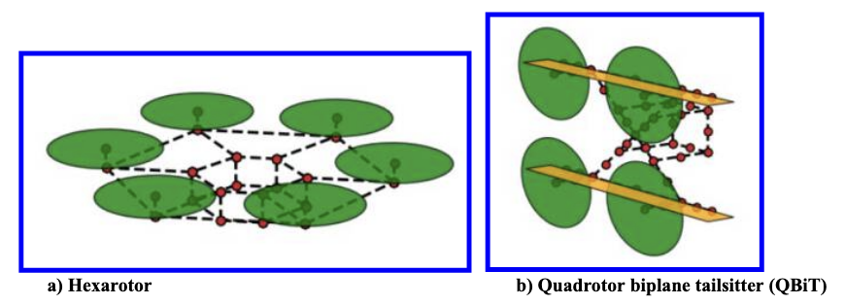
Replication Kaneko, S., Martins, J.R.R.A., 2023. Fleet Design Optimization of Package Delivery Unmanned Aerial Vehicles Considering Operations. Journal of Aircraft 60, 1061–1077. https://doi.org/10.2514/1.C036921
Replication of conceptual sizing models for min. $W_{total}$

Slide 2


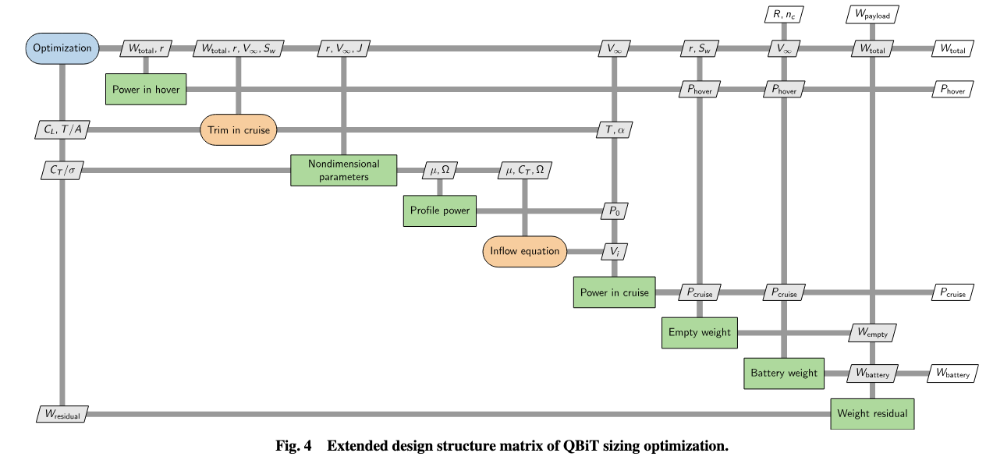
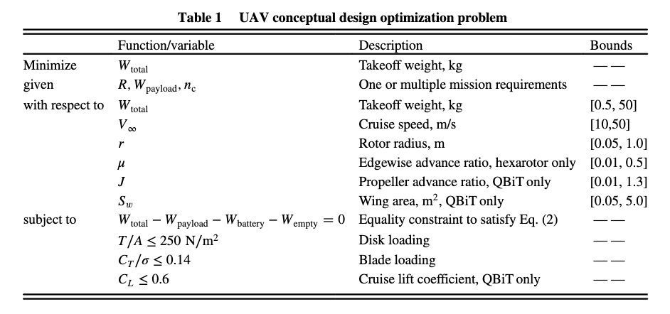
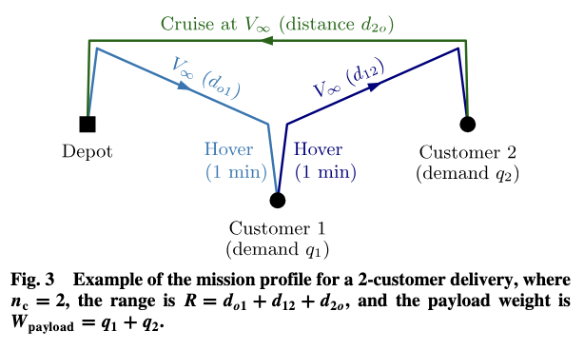
inputs and outputs of the sizing module
Mission energy req.
Govindarajan, B., and Sridharan, A., “Conceptual Sizing of Vertical Lift Package Delivery Platforms,” Journal of Aircraft, Vol. 57, No. 6, 2020, pp. 1170–1188.
Single Node Problem
R = R_bn + R_nb
Base
1.
4.
60s hover
60s hover
V_inf
V_inf
R_bn
R_nb
2.
3.
60s hover
60s hover
Node

Slide 3
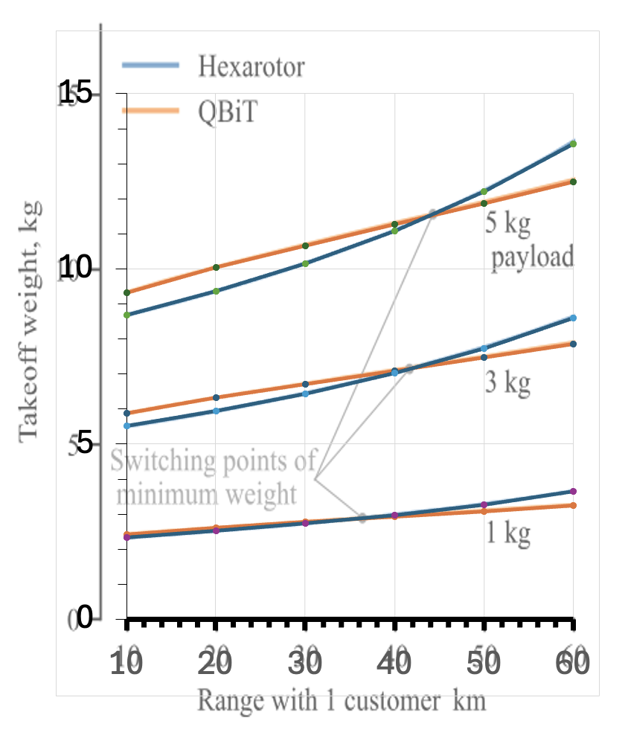
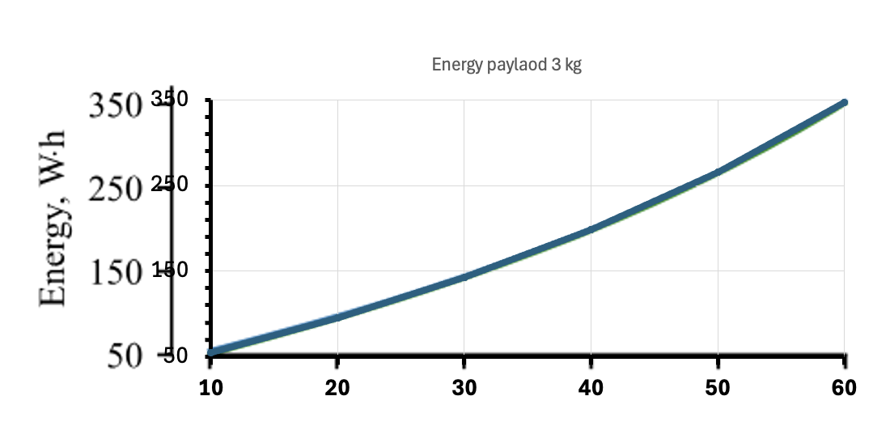
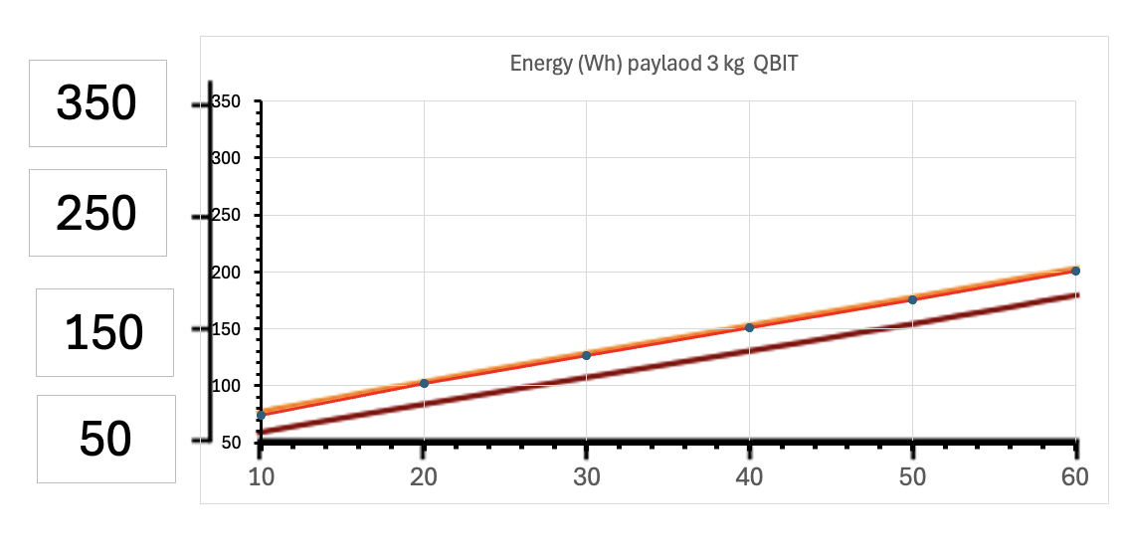
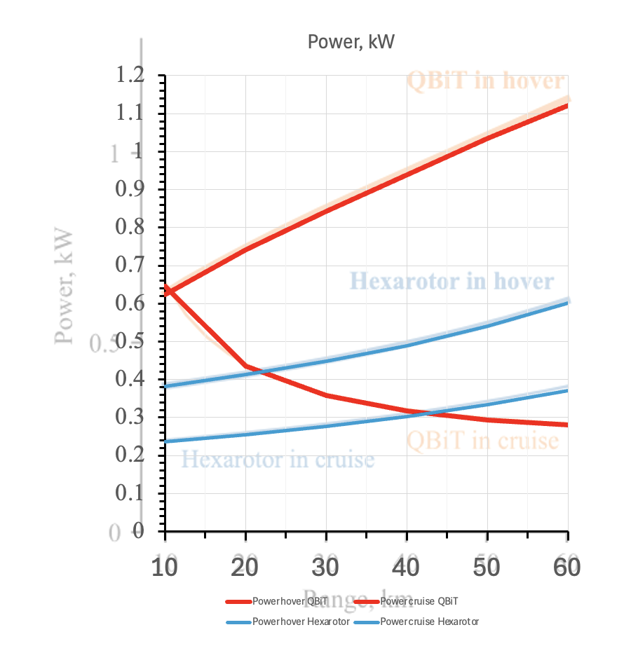
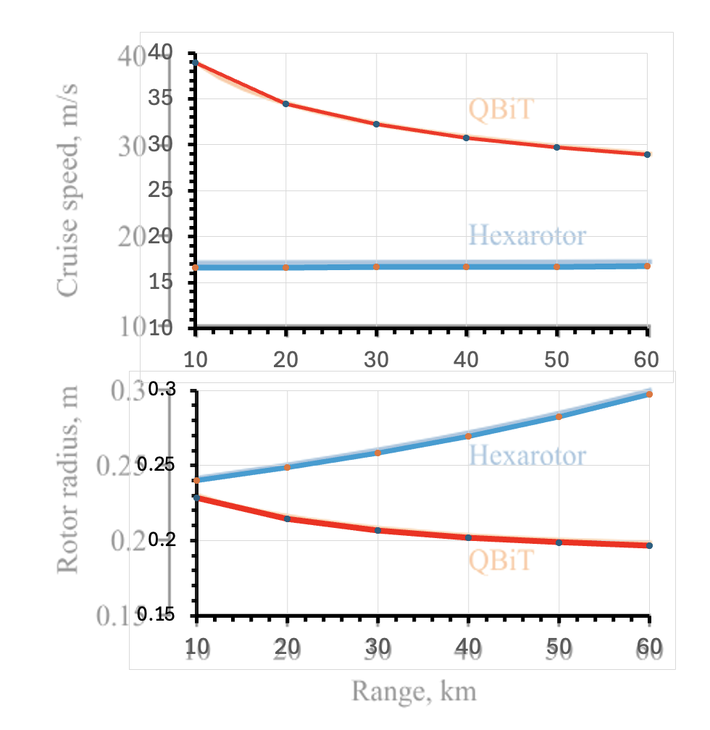
MDO-FSMVRP Model
06.05.2026
Model matching

Slide 4
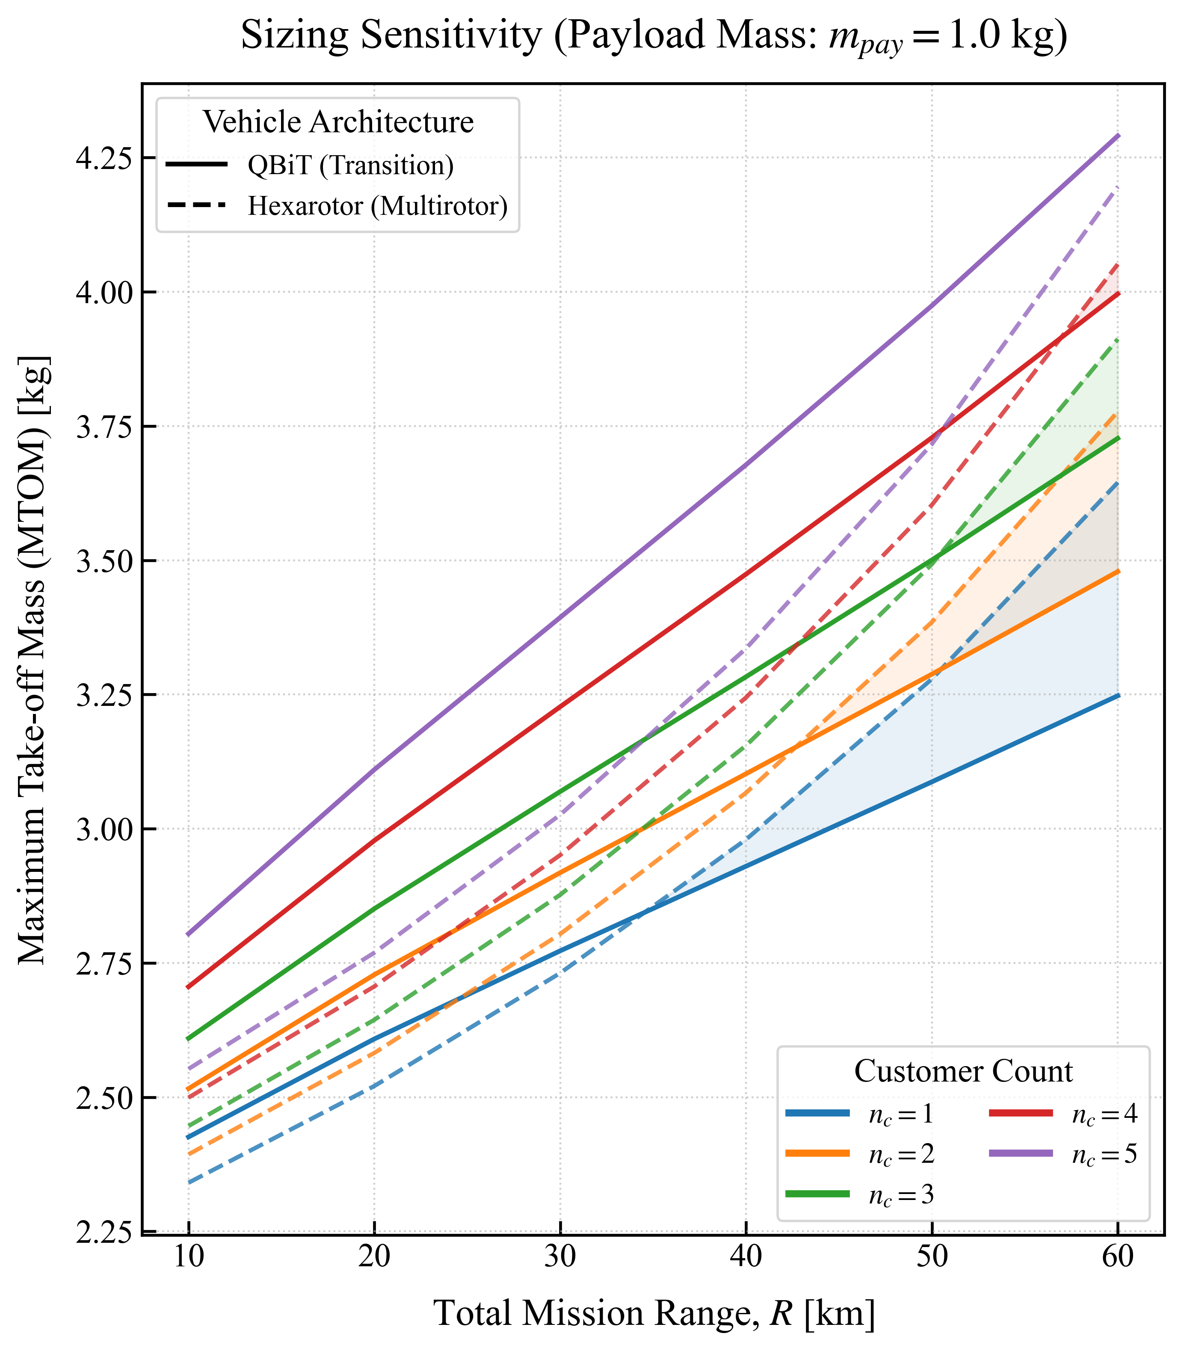
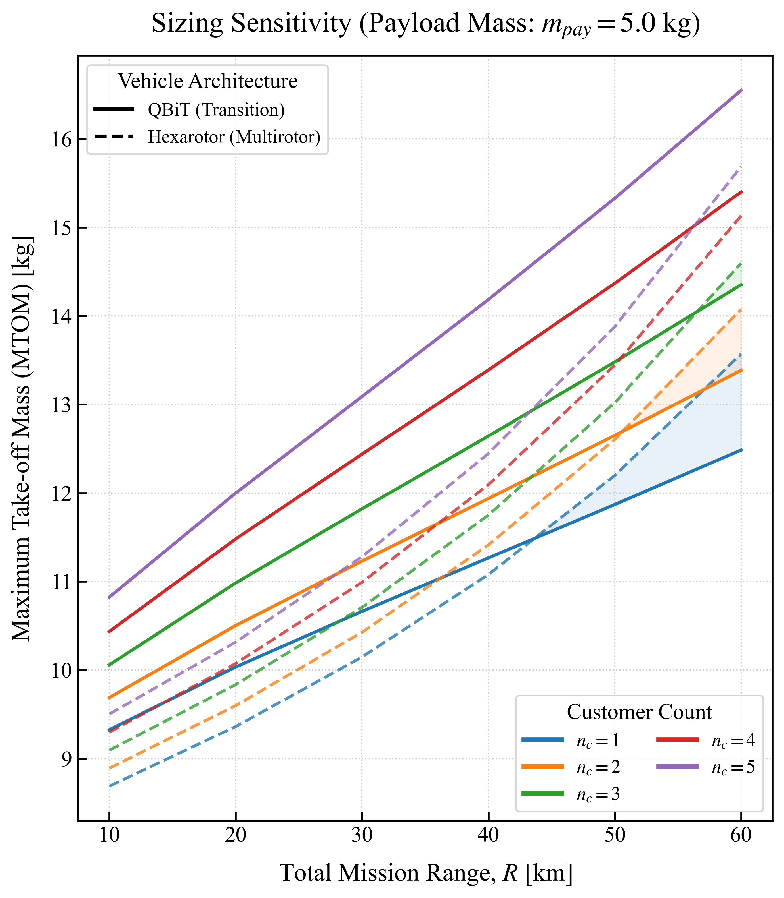
Breakeven for MTOM_QBiT < MTOM_Hexarotor
MTOM = f(R, n_c) for R [10;60], n_c [1;5]
n_c | MTOM_kg | Range_km
1 | 2.84 | 34.53
2 | 3.15 | 42.67
3 | 3.51 | 50.41
4 | 3.91 | 56.94
n_c | MTOM_kg | Range_km
1 | 7.18 | 42.18
2 | 7.93 | 49.28
3 | 8.78 | 55.32
n_c | MTOM_kg | Range_km
1 | 11.49 | 43.64
2 | 12.7 | 50.62
3 | 14.05 | 56.54
“For single-customer delivery, the “switch” of the takeoff weight occurred between a 30 and 50 km range, depending on the payload weight.”(1), p. 5
The Hexarotor “is preferable for short-range flights and multicustomer delivery.” (1), p. 5
“The QBiT is more efficient in cruise because of its wings, making it a viable option for long-range delivery with a few customers.” (1), p. 5
“The takeoff weight was smaller with hexarotors for shorter ranges, whereas the hexarotors became heavier than QBiTs on longer-range missions.” (1), p. 5
“For four-customer delivery, the hexarotor weight was smaller for all payload weights up to the 55 km range […]” (1), pp. 5-6
“the weight difference between the hexarotor and QBiT became smaller for longer-range missions.” (1), p. 6

Slide 5
“For single-customer delivery, the “switch” of the takeoff weight occurred between a 30 and 50 km range, depending on the payload weight.”(1), p. 5
The Hexarotor “is preferable for short-range flights and multicustomer delivery.” (1), p. 5
“The QBiT is more efficient in cruise because of its wings, making it a viable option for long-range delivery with a few customers.” (1), p. 5
“The takeoff weight was smaller with hexarotors for shorter ranges, whereas the hexarotors became heavier than QBiTs on longer-range missions.” (1), p. 5
“For four-customer delivery, the hexarotor weight was smaller for all payload weights up to the 55 km range […]” (1), pp. 5-6
“the weight difference between the hexarotor and QBiT became smaller for longer-range missions.” (1), p. 6

