Slide 1
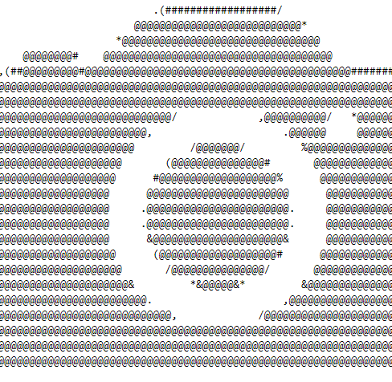
CamerAscii

Slide 2
Team
Buchsbaum Lukas (Angewandte Informatik)
Ladurner Johannes (Angewandte Informatik)

Slide 3
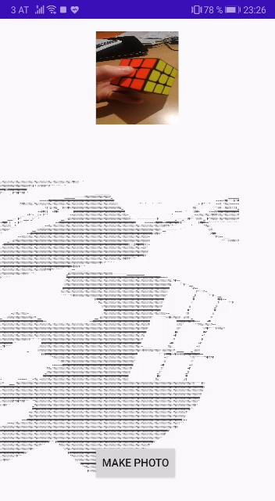
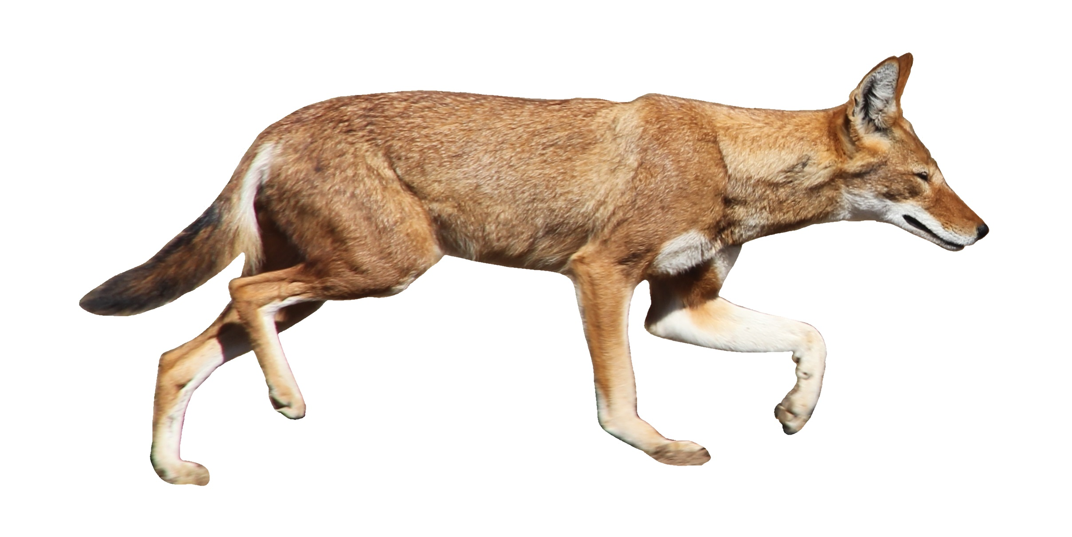
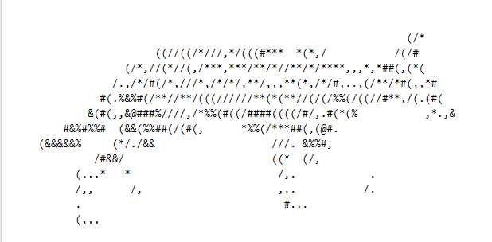
Idea & Prototype

Slide 4
Features
App to convert images to ASCII art
Live conversion what the camera sees
Choose pictures from the gallery
Change quality/size of the output
Change brightness
Save the images to the clipboard

Slide 5
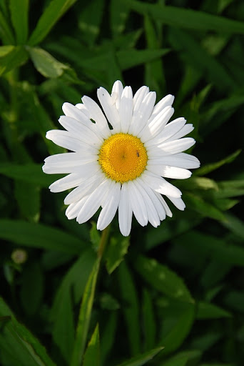
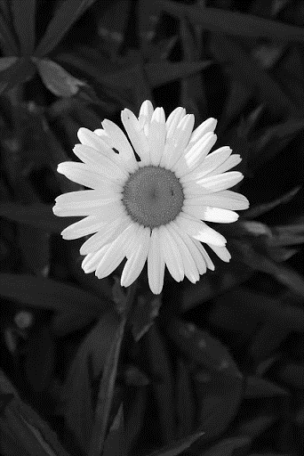
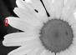
How the conversion works
215 0
230 = 0 = `_`
70 1

