Slide 1


Predicting RNA Molecular Specific Hybridization via Random Forest
Authors: Weijun Zhu, Xiaokai Liu, Zhenfei Wang*, Yongwen Fan ...
Oral presentation: Xiaokai Liu
2019.3.22@Hangzhou

Slide 2
Content
Introduction
The new method
Simulated experiments
Conclusion

Slide 3

Introduction
With the development of molecular computer, RNA and DNA can be used to deal with the large scale of computing.

Slide 4
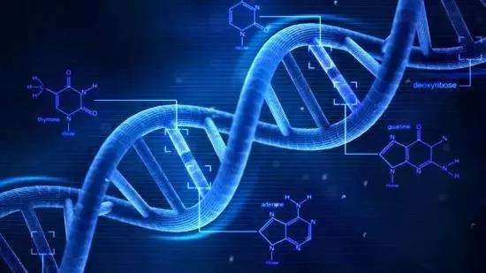
Introduction
The biological hybridization effectiveness is often directly related to the success or failure of computing.

Slide 5
Introduction
The real molecular biological experiment is important and time-consuming.
Simulated software for biological processes is in great need.

Slide 6
Introduction
However, the complexity of the simulation computing in terms of RNA hybridizations is exponential.
How to better simulate RNA hybridization?
Machine learning....

Slide 7
The new method

Slide 8
The new method
New model

Slide 9
Simulated experiments
Simulation Platform
（1）CPU: Intel(R) Core(TM) i7-4790 CPU @3.40GHz.
（2）RAM: 8.0G RAM.
（3）OS: Windows 10.
（4）NUPACK: for designing RNA molecules and analyzing hybridizations.
（5）GraphLab: for implementing RF and K-Nearest Neighbor (KNN)

Slide 10
Simulated experiments
Simulation Procedures
(1) Design the RNA molecules
(2) Perform RNA hybridization:
(3) Record keeping and parameter calculation:
(4) Compute the average NUPACK analytical time
(5) Training and classification
(6) Results analysis and comparisons

Slide 11
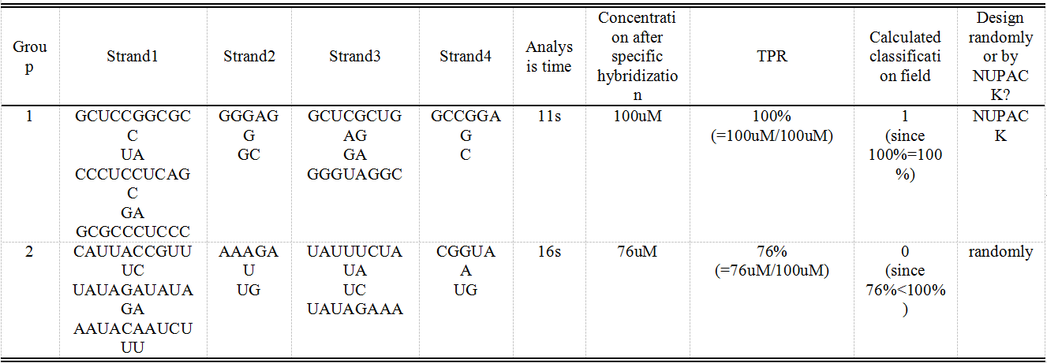
Simulated experiments
Sample Experiments via NUPACK

Slide 12
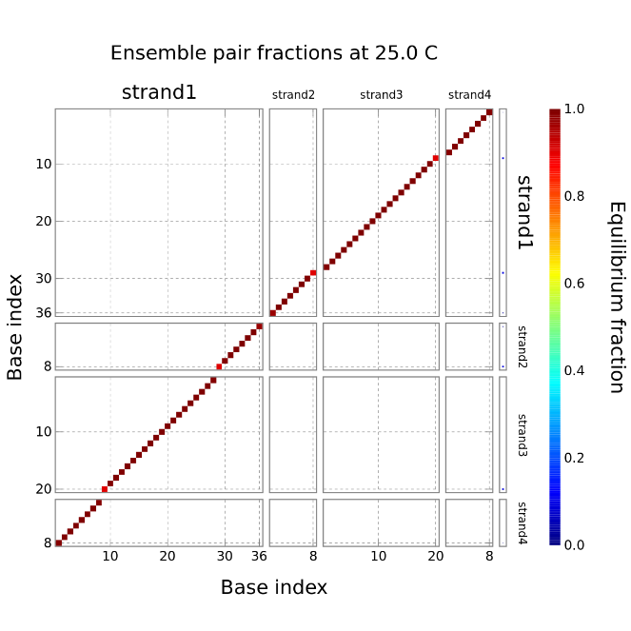
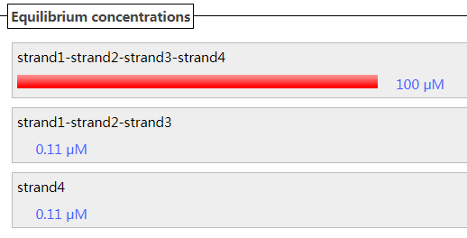
Simulated experiments
NUPACK Experiment Results
(a) Base pairing among molecules:
positions and probabilities.
(b) Molecular concentration of the different
products after hybridization.

Slide 13
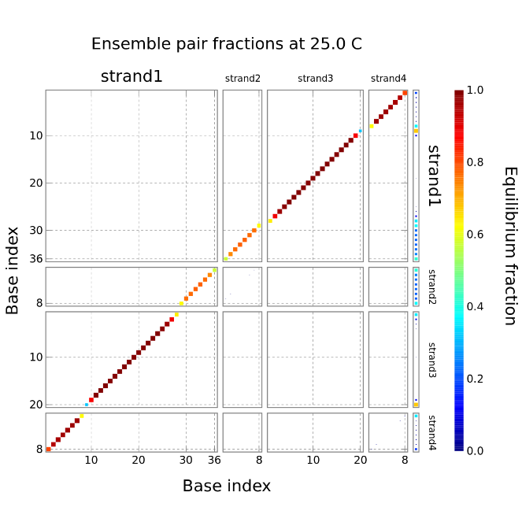
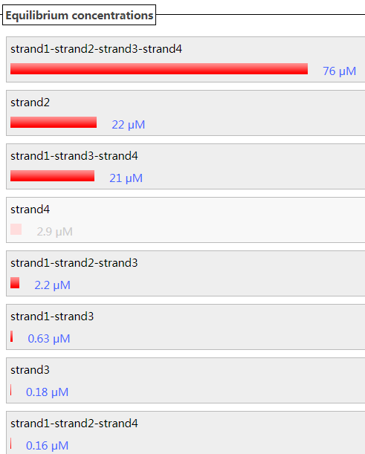
Simulated experiments
NUPACK Experiment Results
(a) Base pairing among molecules:
positions and probabilities.
(b) Molecular concentration of the different
products after hybridization.

Slide 14
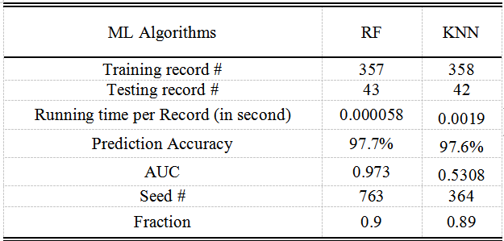
Simulated experiments
Graphlab Experiment Results

Slide 15
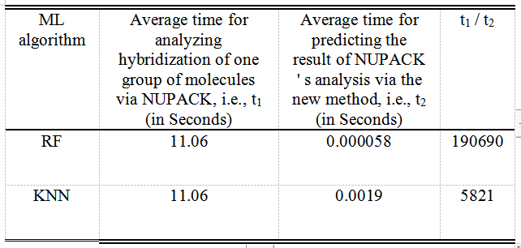
Simulated experiments
Graphlab Experiment Results

Slide 16
Conclusion
Compared with the old method, our new method greatly improves the prediction efficiency, and the cost is a small loss of accuracy.

Slide 17
Thank you for your attention!

