Slide 1



LeKAN: Extracting Long-tail Relations via
Layer-Enhanced Knowledge-Aggregation Networks
Huazhong University of Science & Technology
Xiaokai Liu, Feng Zhao*, Xiangyu Gui, Hai Jin

Slide 2
Outline
Background
Related Works
Approach
Experiments
Conclusion

Slide 3
Relation Extraction
Relation Extraction (RE)
Extracting the relation between two annotated entities based on the context.
[Huazhong University of Science & Technology]
is in Wuhan, [China].
(Huazhong University of Science & Technology, locatedIn, China)

Slide 4
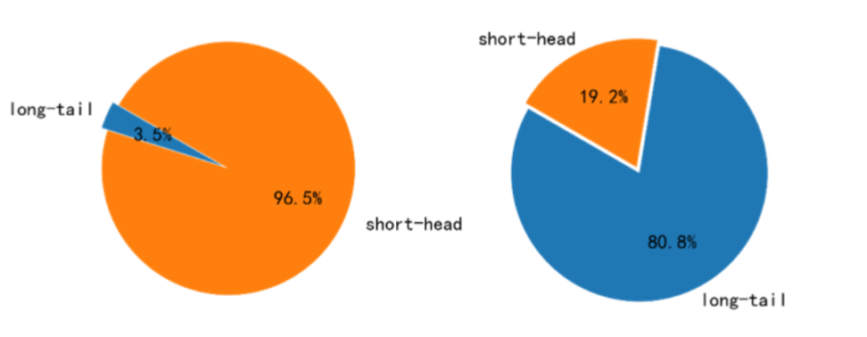
Long-tail Relation Extraction
About 80% of the total relations (number of training instance is less than 1200) have only 3.5% of the total instances available.
Proportions of instances (left) and classes (right) of short-headed and long-tailed relations
without NA labels in the NYT-10 dataset

Slide 5
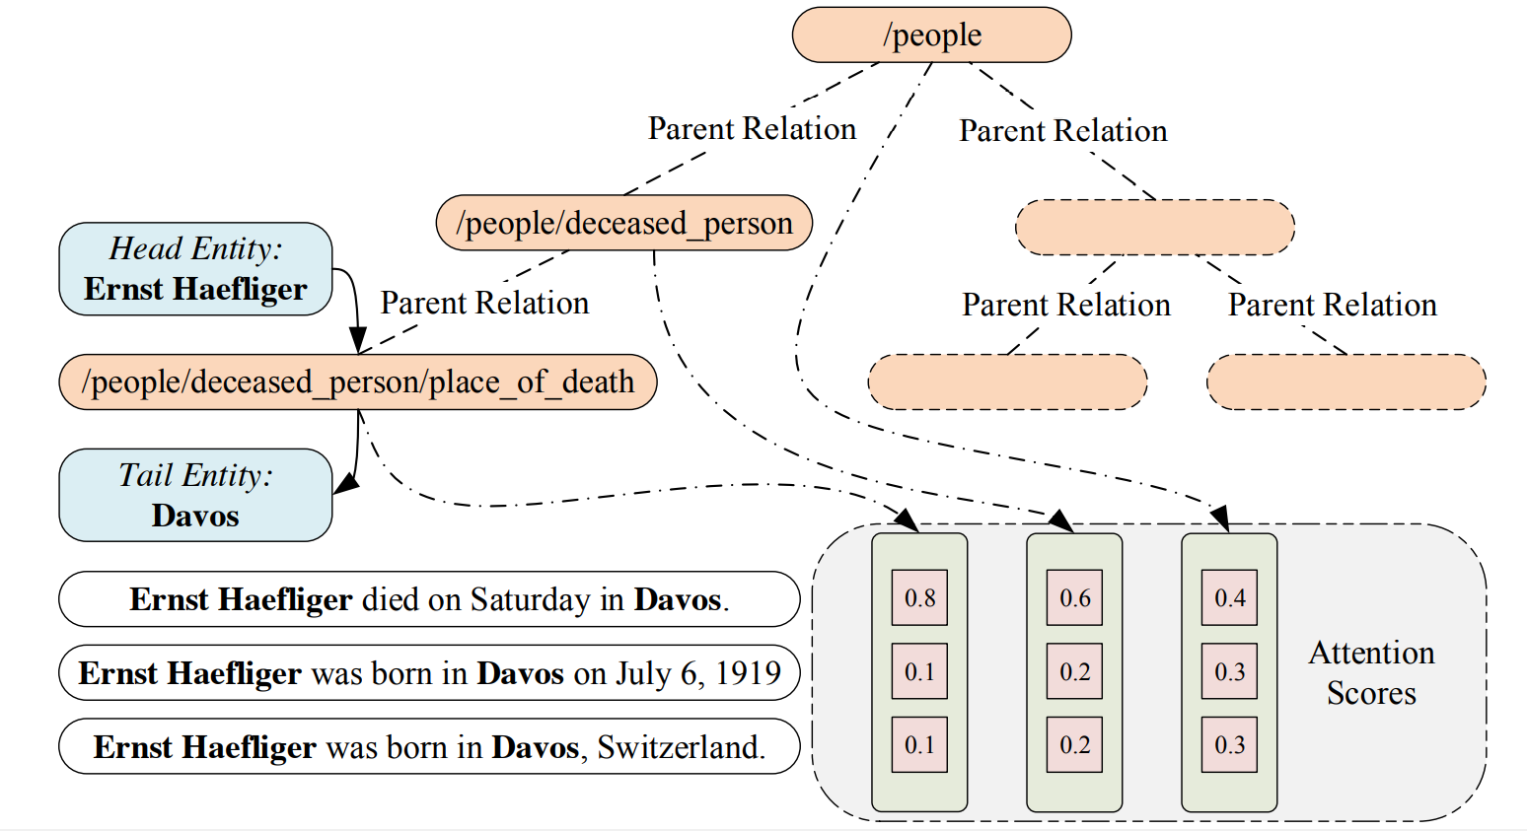
Related Works
X. Han, P. Yu, Z. Liu, et al. “Hierarchical relation extraction with coarse-to-fine grained attention.” Proceedings of EMNLP. 2018.

Slide 6
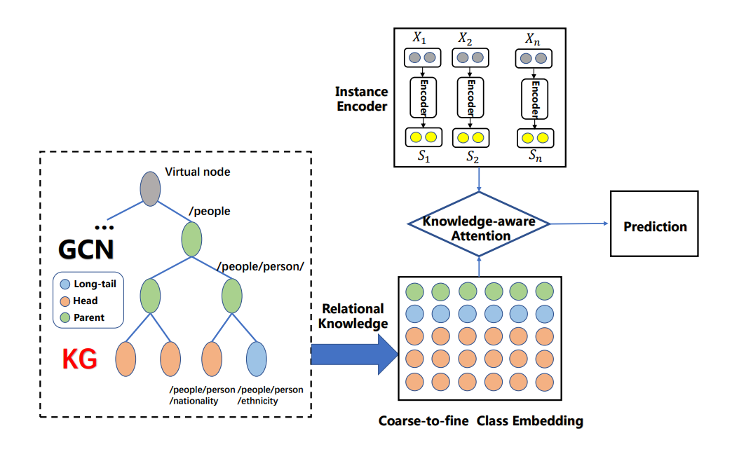
Related Works
Zhang N, Deng S, Sun Z, et al. Long-tail Relation Extraction via Knowledge Graph Embeddings and Graph Convolution Networks[C]//Proceedings of NAACL-HLT. 2019.

Slide 7
Approach
How to alleviate the imbalanced relation hierarchy？
Use pruning and completing method to adjust the hierarchy relation tree.
Aggregate high-level relation nodes to help avoid the base-level long-tailed relations from being ignored.
How to transfer knowledge from KG?
Class embeddings to represent classes.
Use TransE to transfer knowledge from KG.
Use inductive GraphSAGEs of different sampling steps to represent relational knowledge accounting for relation distance.
Aggregate high-level relation nodes to share general knowledge.
How to leverage relational knowledge?
Coarse-to-fine layer-enhanced knowledge-aggregation attention mechanism.

Slide 8
Knowledge Aggregation
Long-tail relation (4 samples) | /film/film_festival/location/
footnotes the 10-day 34th [international_film_festival_rotterdam] , opening today in [rotterdam] , the netherlands , will show three films by theo van gogh , the dutch filmmaker slain in apparent reprisal for his documentary '' submission , '' about the mistreatment of muslim women , agence france-presse reported .
Long-tail relation (8 samples) | /broadcast/content/location/
Aggregate Relation Nodes
To Transfer Knowledge
she said the state 's division of special revenue was investigating the incident , which took place at the studios of [wtic] television in [Hartford] , where the drawing is televised .

Slide 9
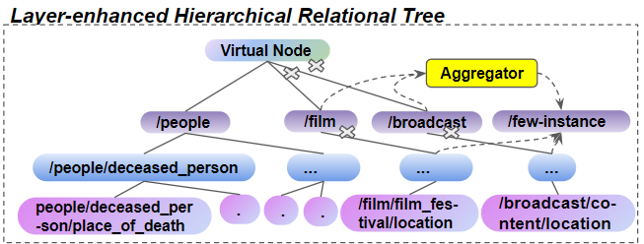
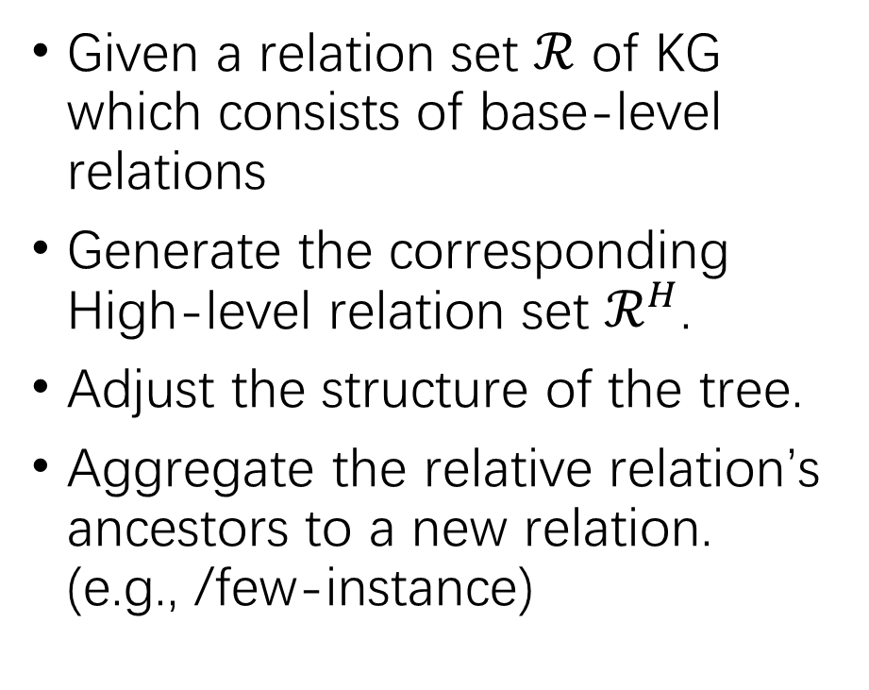
Layer-enhanced Hierarchical Relational Tree Construction
Given a relation set $ℛ$ of KG which consists of base-level relations
Generate the corresponding High-level relation set $ℛ^{H}$.
Adjust the structure of the tree.
Aggregate the relative relation’s ancestors to a new relation. (e.g., /few-instance)

Slide 10
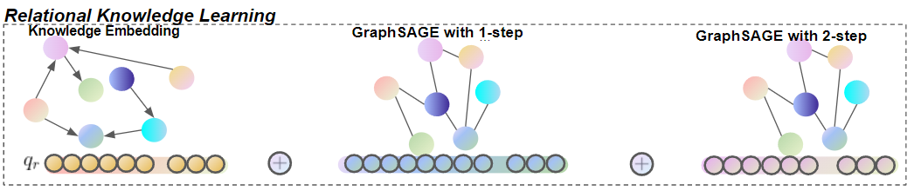
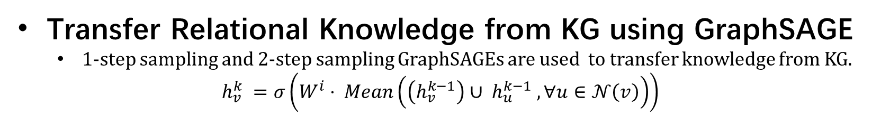
Transfer Relational Knowledge using KG Embeddings and Inductive GraphSAGE
Transfer Relational Knowledge from KG using TransE
The vectors of each node in the bottom layer of the knowledge-aggregation graph are
initialized through pretrained TransE.
Transfer Relational Knowledge from KG using GraphSAGE
1-step sampling and 2-step sampling GraphSAGEs are used to transfer knowledge from KG.
$$h_{v}^{k} =σ\left(W^{i}⋅ Mean\left(\left(h_{v}^{k−1}\right)∪ h_{u}^{k−1} , ∀u∈𝒩\left(v\right)\right)\right)$$

Slide 11
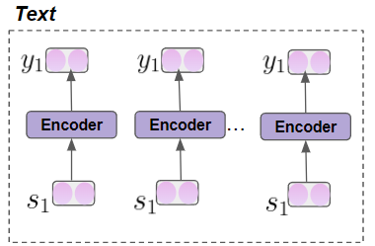
Instance Encoder
Embedding Layer
Skip Gram
Pos Embedding
Encoding Layer
CNN
PCNN

Slide 12
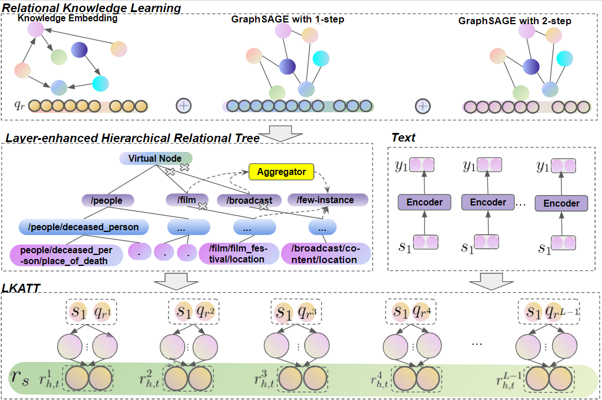
Overall Architecture

Slide 13
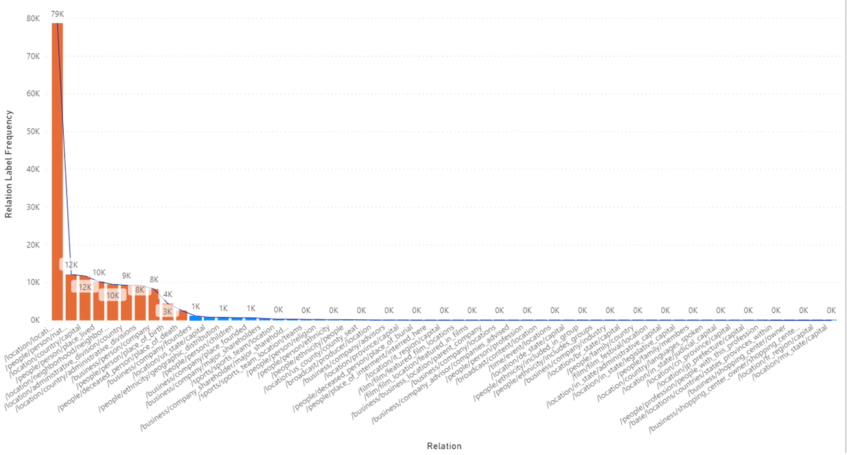
Experiments
NYT dataset
53 relations include
the NA relation
Train
522611 sentences
281270 entity pairs
18252 relational facts
Test
172448 sentences
96678 entity pairs
1950 relational facts

Slide 14
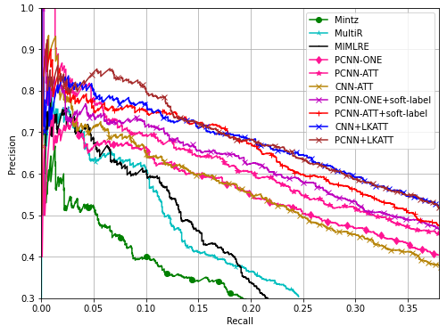
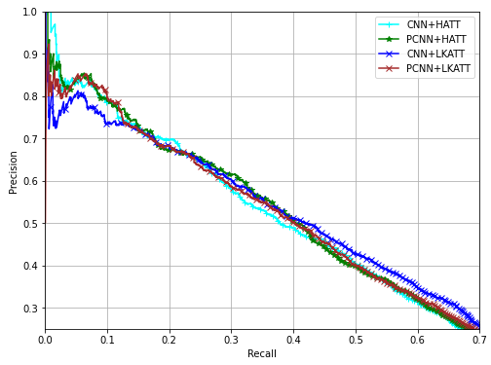
Overall Evaluation Results

Slide 15
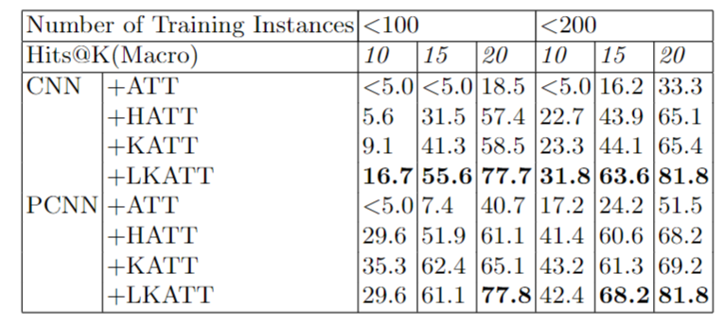
Evaluation Results for Long-tail Relations

Slide 16
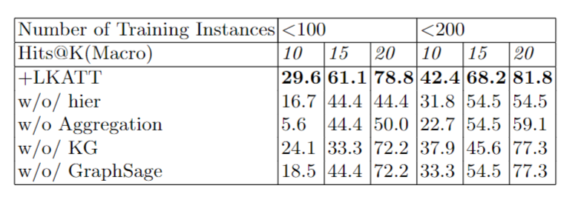
Ablation Study

Slide 17
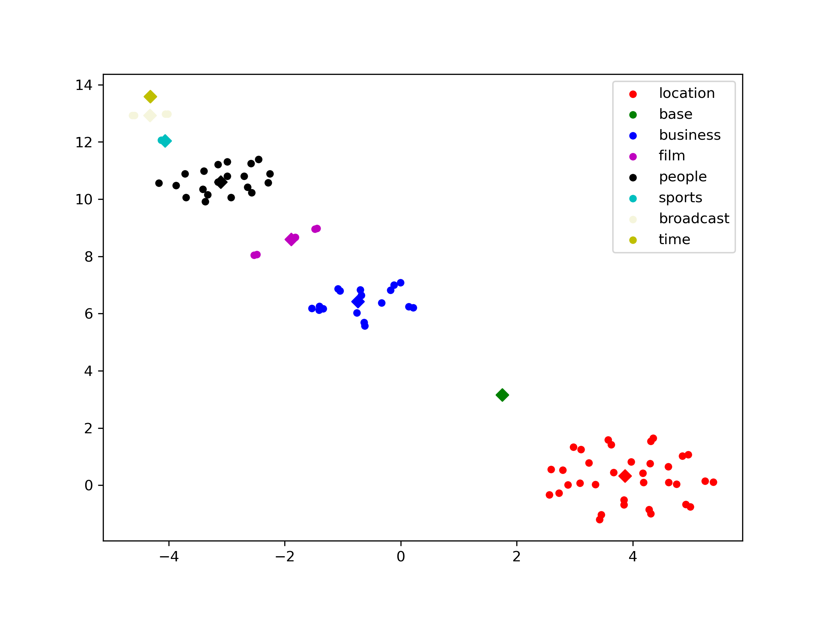
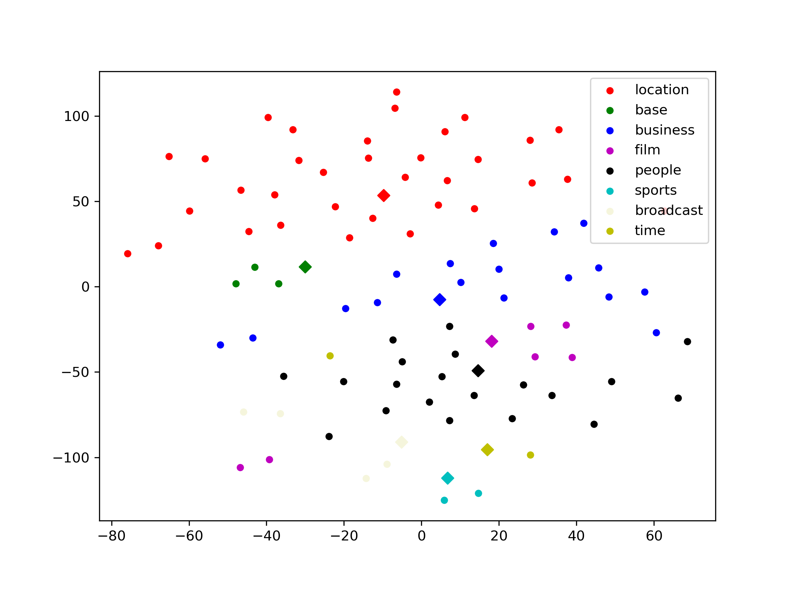
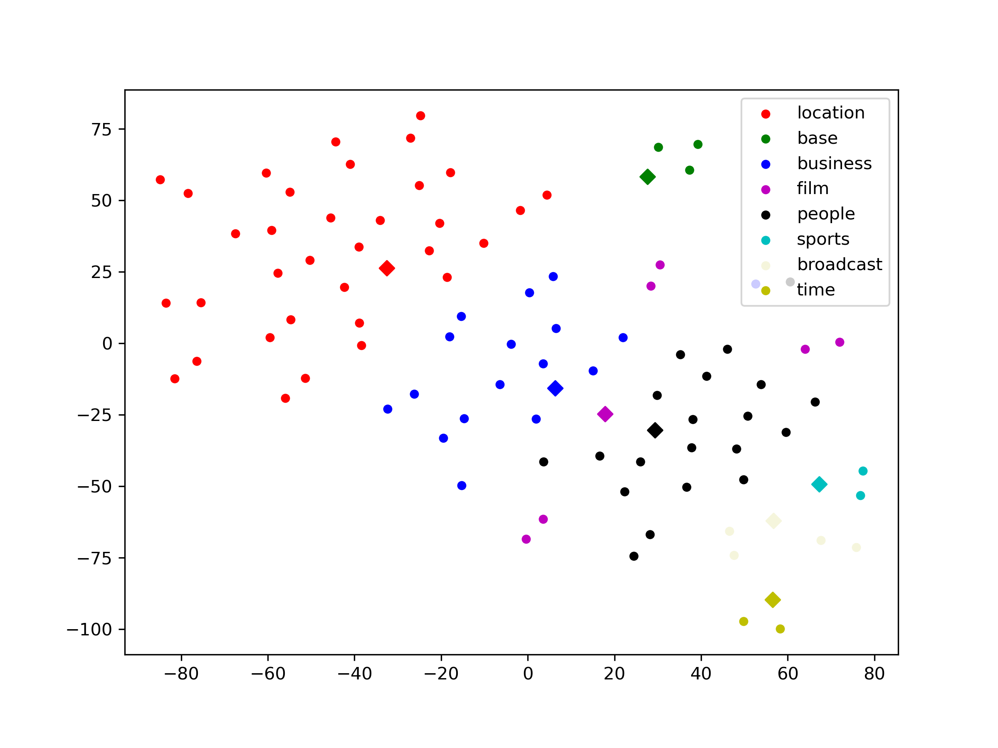
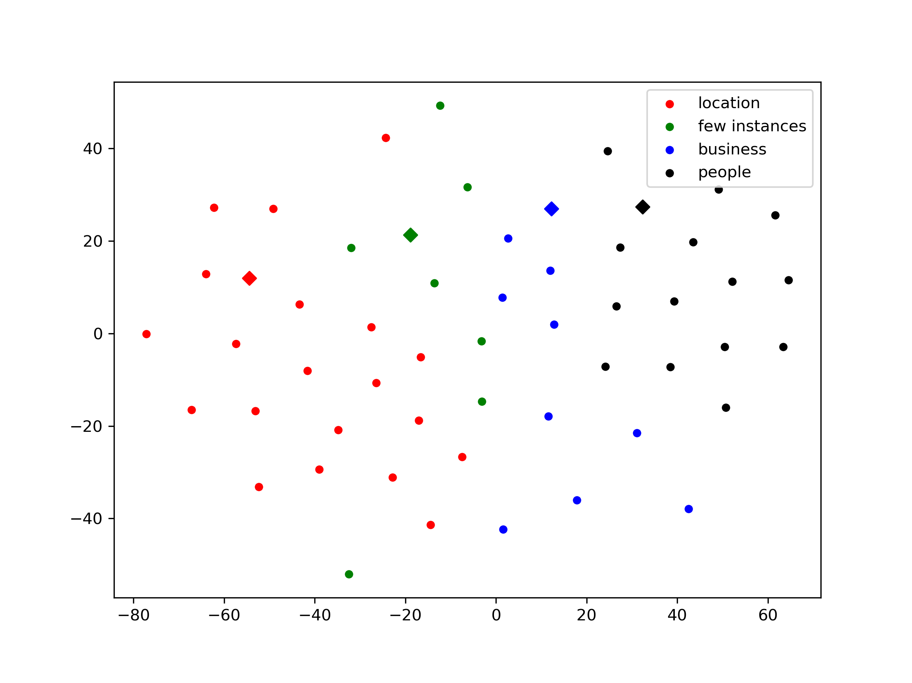
Visualizations of Class Embeddings
(a) +KATT
(b) +GraphSAGE
(c) +KG & GraphSAGE
(d) +LKATT

Slide 18
Conclusion
The LeKAN can leverage the relational knowledge from relations at the head of their distribution and uses semantically similar relational instances in different branches to boost the performance of the low-resource RE.
Our approach efficiently transfer relational knowledge from KG using TransE and GraphSAGE. The inductive GraphSAGE can take the distances between different relations into account and generalize the relation representations in an evolving KG.
The knowledge aggregation method can be implemented in the hierarchy-based relation extraction research, not limited to LeKAN.
In the future, we may evaluate the effect of GraphSAGE on RE tasks across knowledge graphs and explore the effect of a more complex short-headed relation decoupling and long-tailed relation aggregation scheme on RE tasks.

Slide 19
QA
liuxk@hust.edu.cn

