Slide 1
Introduction to Generative AI
2023.11.09
Dissecting a GPT2-Like Reference Implementation

Slide 2
Jupyter What? Please Help!
Jupyter Hub / multiple notebooks on TUWEL / local environments
Issues, issues and more issues

Slide 3
Agenda | Part 1
01
02
03
Dissecting a GPT2-Like Reference Implementation
Mini-Recap Architecture
Recap Homework 1
Attention Mechanism
Code will be provided (after the homework deadlines)

Slide 4
01
Mini-Reacp Architecture
Why actually a decoder is all you need.

Slide 5
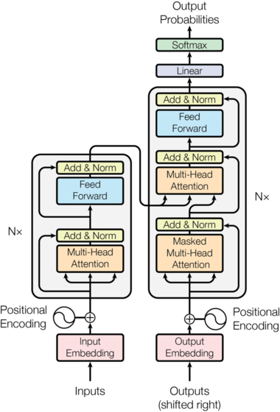

Slide 6
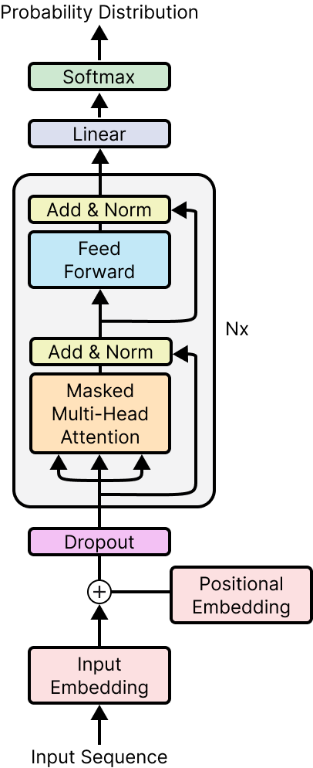

Slide 7
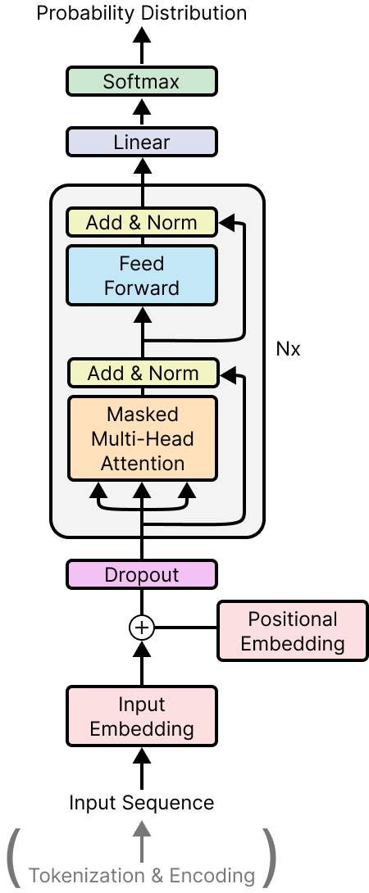
Tokenization / Encoding / Word Embeddings
Head To Notebook of Homework 1

Slide 8
Word Embedding Visualization
Head To Notebook of Homework 1

Slide 9
Positional Encoding & Putting it together
Head To Lecture Notebook

Slide 10
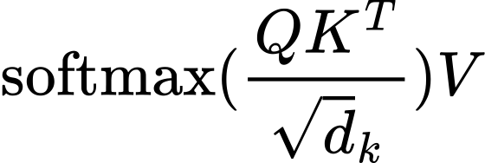
Multi-Head Masked Scaled Dot Product Self-Attention

Slide 11
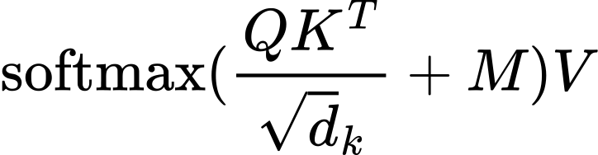
Multi-Head Masked Scaled Dot Product Self-Attention

Slide 12
QKV What?

Slide 13
Multi-Head Masked Scaled Dot Product Self-Attention
Head To Lecture Notebook

