Slide 1
Introduction to Generative AI
2023.11.30
Administrative Questions (incl. test outlook) / Theory Recap

Slide 2
What about theses slides / the code?
These slides will go online till EOD.
The example solution for homework 3 will go online till EO tomorrow.

Slide 3
Agenda | Part 1
01
02
03
Administrative Questions (incl. test outlook) / Theory Recap
Administrative Questions
Theory Recap
RL / PPO
Hand-Over to Bernhard 👋
What about the test?

Slide 4
01
Administrative Questions

Slide 5
Test Characteristics
Date & Time: 07.12.2023 | 13:20 – 13:50 (30min) | Lecture afterwards
Online on TUWEL (both in presence as well as at home, but only at this exact time)
Multiple Choice:
100% for a question only if all selected answers are correct
0% awarded for any incorrect or incomplete responses
no negative points for wrong answers
Closed Booked

Slide 6
Test Content
Birds Eye View of the Architecture of a Large Language Model
Overview of the purpose of the different layers (till MHA)
Overview of how the layers transform their input (till MHA)
High-Level Overview of the training steps from nothing to RLHF
Basics of RL and PPO (we will do a recap of the most relevant parts today)
Depending on how much time is left for Bernhard, 1,2 questions about today's lecture

Slide 7
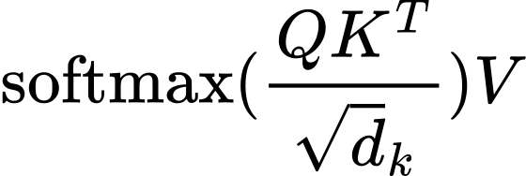
Exemplary Question
What conceptual analogy describes the dot product in the best?
A) The dot product produces the attention score and describes how much tokens should pay attention to each other in a given sequence; one can call it the affinity for each word with each other word in a given sequence.
B) The dot product measures the syntactic similarity between tokens, focusing on grammatical and structural parallels rather than contextual relevance.
C) The dot product represents the literal position of each token in the sequence, assigning a unique spatial value to each word that determines its order in the sequence.
D) The dot product is used to directly modify the inherent meanings of a given token based on their interactions within the sequence.

Slide 8
Homework Grading
Homework 1 is graded
By the end of this week, it will be visible in TUWEL.

Slide 9
02
Recap RL & PPO
Where is J in my homework?

Slide 10
The Roles in PPO
An agent interacts with an environment by taking actions.
The agent uses a policy (a strategy/rule system) to decide which action to take based on the current state of the environment.
A judge then rewards/penalises the agent for its actions.
It is our goal to find a policy that maximizes the cumulative reward J

Slide 11
Objective Function: Where we left off

Slide 12
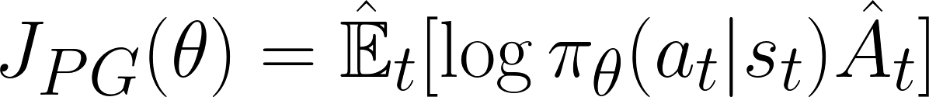
Objective Function: Where we started

Slide 13
So What?
A step-by-step guide for the objective function

Slide 14
Objective Function: Where we started

Slide 15
What does the objective function return, what does it mean, and where is it in our homework?
A scalar value [-∞, ∞]
Indicator of how well a policy performs on average across a range of states and actions
Code: loss = -torch.log(agent_output[word_index]) * advantage (Go to Notebook)
What is θ, what does it mean, and where is it in our homework?
A set of variables that define our policy
i.e. the parameters of our LLM
Code: Under the hood of our Agent class (Go to Notebook)

Slide 16
What is E_{t}, what does it mean and where is it in our homework?
A weighted average of all t values
Code: Not existing
What is π_{θ}, what does it mean, and where is it in our homework?
A policy that selects an action a_{t} given the state s_{t}
The forward function (i.e. the brain) of our LLM
Code: Under the hood of our Agent class (Go to Notebook)

Slide 17
What is A, what does it mean and where is it in our homework?
The Advantage Function returns a scalar value [-∞, ∞]
Measures how much better / worse a given action a_{t} state s_{t} is compared to the average action in that state under the current policy.
Code: (We cheated) advantage = critic_score - baseline.get() (Go to Notebook)

Slide 18
Objective Function: Where we started | Recap

Slide 19
But what about the test though?
Do I have to calculate the objective value on the board in front of the whole class?

Slide 20
But what about the test though?
Understand the different components of a PPO system (agent, policy, environment, …)
Understand the simplified objective function (just discussed) and its components (i.e. what is on the slides)
Discussed last time: Understand the potential issues of the simplified objective function and what is done to counteract them. (This will be the 1,2 hard questions in the test)
Clipping to avoid overaggressive updates
Penalty term with Kullback-Leibler to penalise overaggressive updates

Slide 21
Exemplary Question
What is the role of π_{θ} in PPO, and how is it represented in RL of an LLM?
A) π_{θ} is the learning rate in PPO that determines how quickly an LLM adapts to new states. In RL, this is represented by the rate at which the loss function of the LLM decreases.
B) π_{θ} is the policy that decides on a specific action the agent should take at a given state s. In the context of RL for LLMs, it is represented by the LLM itself or, more precisely, the forward function.
C) π_{θ} refers to the discount factor that quantifies future rewards’ importance. In the RL framework for LLMs, it is represented by the activation function in the neural network layers.
D) π_{θ} is the reward function that assigns a value to each action taken by the agent. For LLMs in RL, this reward function is encapsulated in the backpropagation algorithm.

Slide 22
Questions / Concerns / Fears / Whishes?

Slide 23
👋

