Slide 1
Subsurface Scattering
Interdisciplinary project in Remote Sensing [194.060]
Supervisor: Dr. Martin Schobben
Johannes Pfennigbauer | 19902046
www.tuwien.at

Slide 2
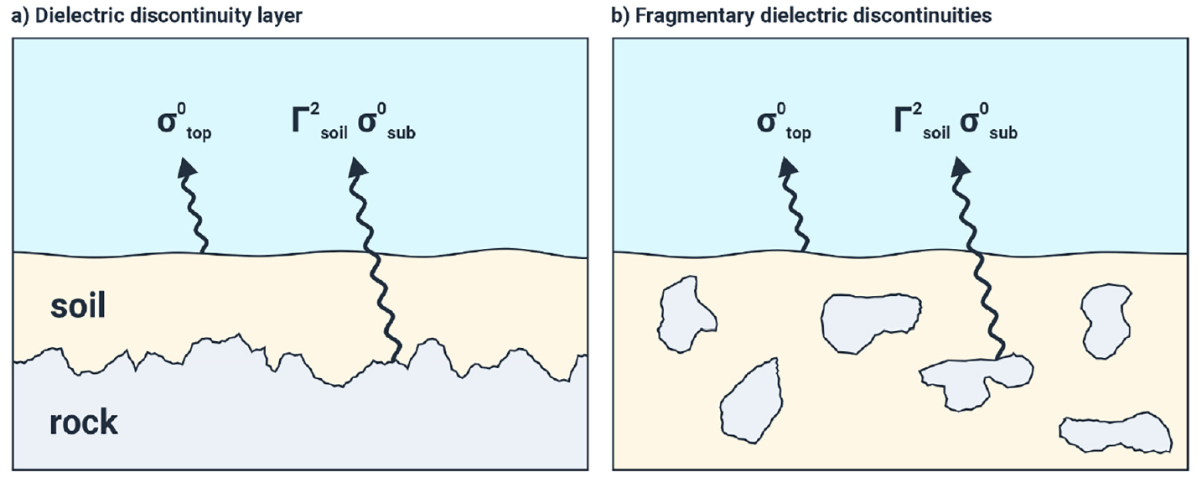
Background
Microwave backscatter signals are a reliable estimate of soil moisture content and are generally positively correlated with it.
Among other factors, subsurface scattering causes anomalous behaviour resulting in an inverse relationship.
Rock surfaces beneath the top soil layer (a) and dispersed stones (b) are the main causes of the phenomenon.
Source: W. Wagner et al. Widespread occurrence of anomalous c-band backscatter signals in arid environments caused by subsurface scattering, 2022.
Research Question
What are the main drivers of the subsurface backscattering anomaly in dry, arid regions under the presence of rocks or distinct horizons?
(Wagner et al, 2022)

Slide 3
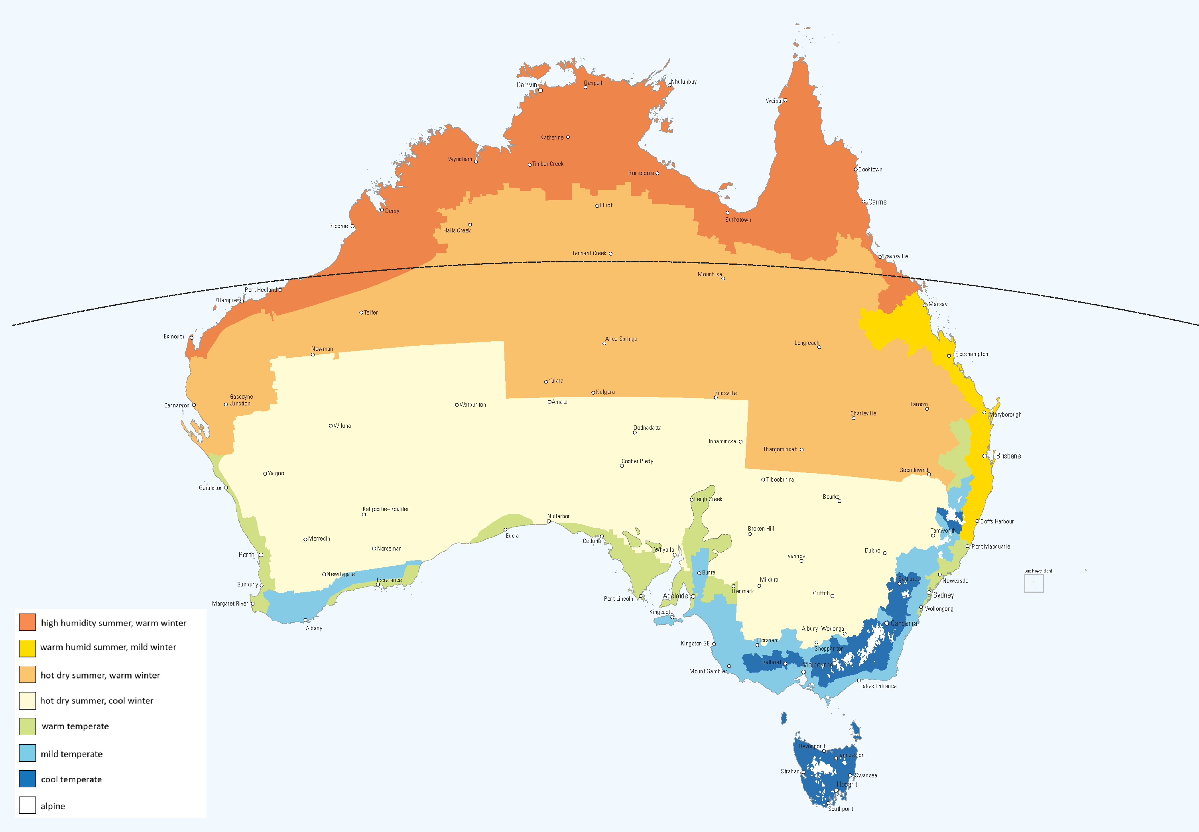
Data
Target variable
rsub: correlation of Sentinel-1 backscatter and reference soil moisture data (ERA5Land)
Input data
soil composition, coarse fragments, soil moisture, organic content from ERA5Land
terrain elevation and slope (DEM)
precipitation (CHIRPS) and land surface temperature (MODIS)
The study area is a strip along the 21 southern latitude spanning across Australia, covering climatic zones from wet at the coast and dry in the interiors.
Source: Australian Building Codes Board. Climate zone map, 2024.
(Copernicus Climate Change Service (C3S), 2020)

Slide 4
Methods
}
Comparison of coefficients:
Multiple regression
Ridge regularisation
Partial Least Squares analysis
Evaluation of models: RMSE, R2, MAE
Well suited for highly correlated data!
(Filzmoser, 2023)

Slide 5
Challenges
Collecting and merging geospatial data
Handling large datasets in memory
Scalability of code
Evaluation of feature importance

Slide 6
Attention-layer based crop yield prediction
Individual project in Applied Deep Learning [194.077]
Supervisor: Dr. Alexander Pacha
Johannes Pfennigbauer | 19902046
www.tuwien.at

Slide 7

Research Question
Background
Deep Learning methods are well-established in crop yield prediction. While CNNs handle connected data well, they might not dynamically adjust to the changing relevance of attributes across different plant growth stages. An attention layer might be beneficial to guide its focus.
The available data and original model used focuses on soybeans.
Source: Plantura Magzine. Soybean: growing, harvest & uses, 2019.
How can an attention mechanism improve the CNN-RNN models ability to predict crop yield?
(Khaki et al, 2020)

Slide 8
Data
Target variable
yield: average outcome per location and year
Input data
Environment: weekly average of min/max temperature, precipitation, solar radiation, snow-water equivalent and vapor pressure
Soil: bulk density, pH, soil organic density, total nitrogen, soil composition and more at 6 levels of depth (0-120cm)
Management: weekly cumulative percentage of planted fields per state
(Khaki et al, 2020)

Slide 9
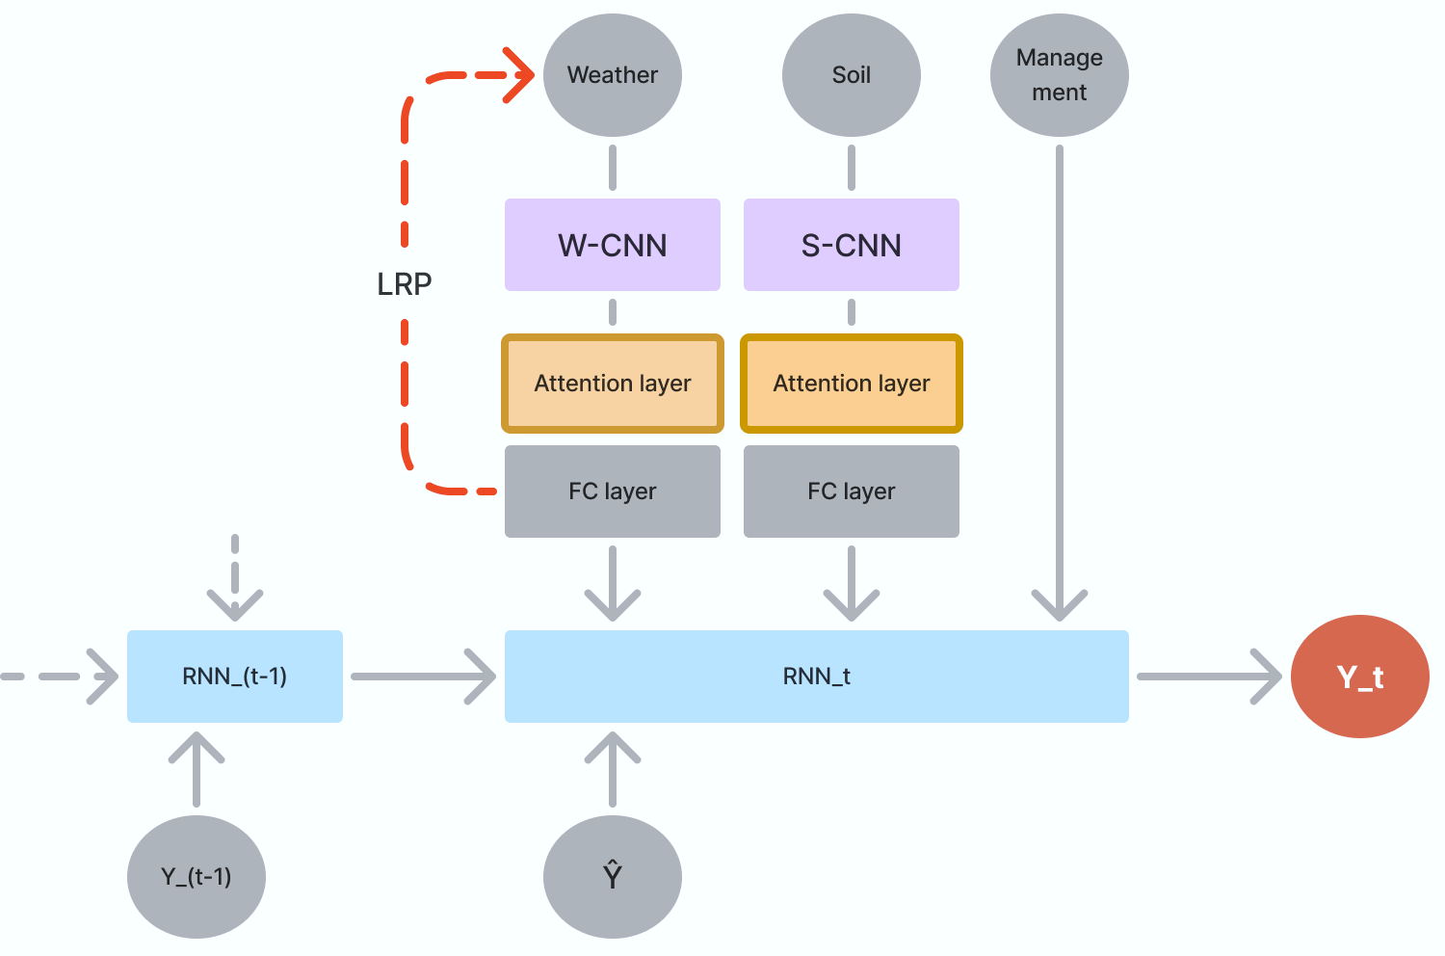
Methods
Existing CNN-RNN framework
Enhanced by Attention Layer
Extended by Layer-wise Relevance Propagation
Comparison of performance before and after enhancement.
LRP used for explainability.
Proposed model architecture.
(Yi-Ming and Hao, 2023)

Slide 10
Challenges
Outdated code: Requires significant updates for TensorFlow 2.x compatibility
Updated dataset: Newly added features are not handled in original code
Implementation of Attention Layer while ensuring compatibility
Dockerization and deployment of a performant web app

Slide 11
References
W. Wagner et al. Widespread occurrence of anomalous c-band backscatter signals inarid environments caused by subsurface scattering. Remote Sensing of Environment, 276:113025, Jul 2022.
Copernicus Climate Change Service (C3S). ERA5-Land monthly data from 1950 to present. Climate Data Store (CDS), 2020.
P. Filzmoser. Advanced Methods for Regression and Classification. Lecture Notes, 2023.
S. Khaki et al. A CNN-RNN Framework for Crop Yield Prediction. Frontiers in Plant Science, 2020.
Z. Yi-Ming and W. Hao. Multi-head attention-based probabilistic CNN-BiLSTM for day-ahead wind speed forecasting. Energy, 2023.

