Slide 1

Predicting Hotel Booking Cancellations with Machine Learning
A data-driven solution to help hotels identify high-risk reservations before arrival
Johannes Vidal

Slide 2

The Problem:
Cancellations Create Uncertainty
Hotel cancellations affect more than one reservation.
They create uncertainty in:
• Revenue forecasting
• Occupancy planning
• Staffing decisions
• Pricing strategy
• Overbooking management
If hotels can identify high-risk bookings earlier, they can make better operational and commercial decisions.

Slide 3
From Reservation Data to Cancellation Prediction
Dataset:
Hotel Reservations Classification Dataset
36,275 hotel bookings
19 original variables
Target: Booking_status
Not_Canceled: 67.2%
Canceled: 32.8%
Prediction task:
Will this booking be cancelled?
Input
Booking details available before arrival
Output
Canceled / Not_Canceled
Booking Information
Moderately imbalanced
Machine Learning Model
Canceled / Not Canceled

Slide 4
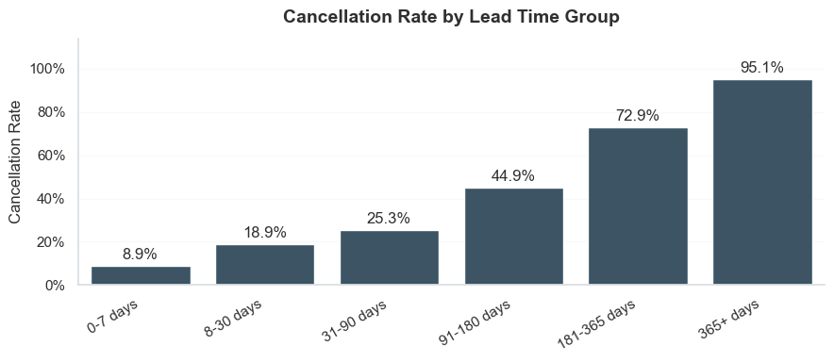
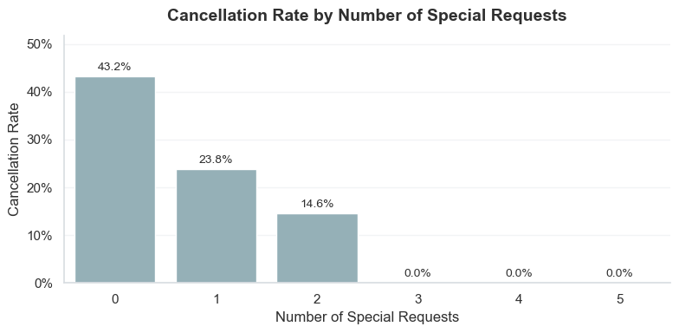
What Drives Booking Cancellations?
EDA revealed clear patterns across booking timing and guest commitment.
Lead Time
365+ days
95.1% cancellation rate
Bookings made further in advance are much more likely to cancel.
Special Requests
0 requests: 43.2%
2 requests: 14.6%
More special requests are linked to lower cancellation risk.
Cancellation risk is strongly linked to booking timing and guest commitment.

Slide 5

Building a Reliable Cancellation Model
All models were compared using the same preprocessing pipeline and test set.
1. Data Split
80% training / 20% testing
Stratified split to preserve cancellation balance
2. Preprocessing Pipeline
Numerical features → StandardScaler
Categorical features → OneHotEncoder
Booking_id removed
3. Models Compared
• Logistic Regression • Random Forest
• Gradient Boosting • Decision Tree
• KNN Classifier
4. Evaluation & Optimization
Main metric: F1-score
Precision, recall and confusion matrix reviewed
GridSearchCV used for model tuning
Fitting only with training data

Slide 6
Comparing Model Performance
Model | Accuracy | Precision | Recall | F1 Score
Random Forest | 0.9068 | 0.8882 | 0.8187 | 0.8520
Decision Tree Tuned | 0.8841 | 0.8328 | 0.8086 | 0.8205
KNN Tuned | 0.8816 | 0.8401 | 0.7888 | 0.8136
Decision Tree Baseline | 0.8744 | 0.8109 | 0.8044 | 0.8076
KNN Baseline | 0.8567 | 0.7996 | 0.7505 | 0.7743
Gradient Boosting | 0.8584 | 0.8296 | 0.7148 | 0.7679
Logistic Regression | 0.8143 | 0.7537 | 0.6437 | 0.6943
Random Forest delivered the strongest balance between detecting cancellations and avoiding false alerts.

Slide 7
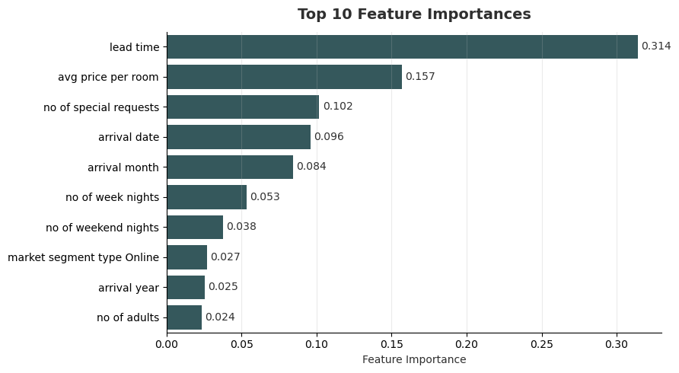
Top Predictive Signals
Lead time dominates the model: Bookings made further in advance carry much higher cancellation risk.
Guest commitment matters:
Special requests are an important signal of lower cancellation risk.
Price and timing add context:
Room price and arrival timing help refine the prediction.
The strongest model signals are consistent with the patterns found during EDA.

Slide 8
From Prediction to Hotel Decisions
Business Impact How hotels can use StayGuard
• Flag high-risk reservations
• Improve occupancy planning
• Support overbooking decisions
• Prioritize guest communication
• Reduce revenue uncertainty
Limitations What the model does not solve
• Predicts risk, not certainty
• No external data included
• Threshold depends on hotel strategy
• Results depend on dataset context
StayGuard gives hotel managers an early risk signal, not an automatic decision.

Slide 9
Final Takeaway
Cancellation risk is predictable when booking behavior is translated into data.
• Lead time: strongest cancellation signal
• Guest commitment: reduces cancellation risk
• Random Forest: delivered the best model performance
StayGuard helps hotels move from reacting to cancellations to anticipating them.

Slide 10
Thank You
Johannes Vidal
GitHub Repository:
github.com/JohannesVidal/stayguard-hotel-cancellation-prediction
Questions?

