Slide 1

Delivery Delay Risk Prediction for E-Commerce Operations
An end-to-end analytics and machine learning project to monitor delivery performance and prioritize high-risk orders.
Johannes Vidal

Slide 2
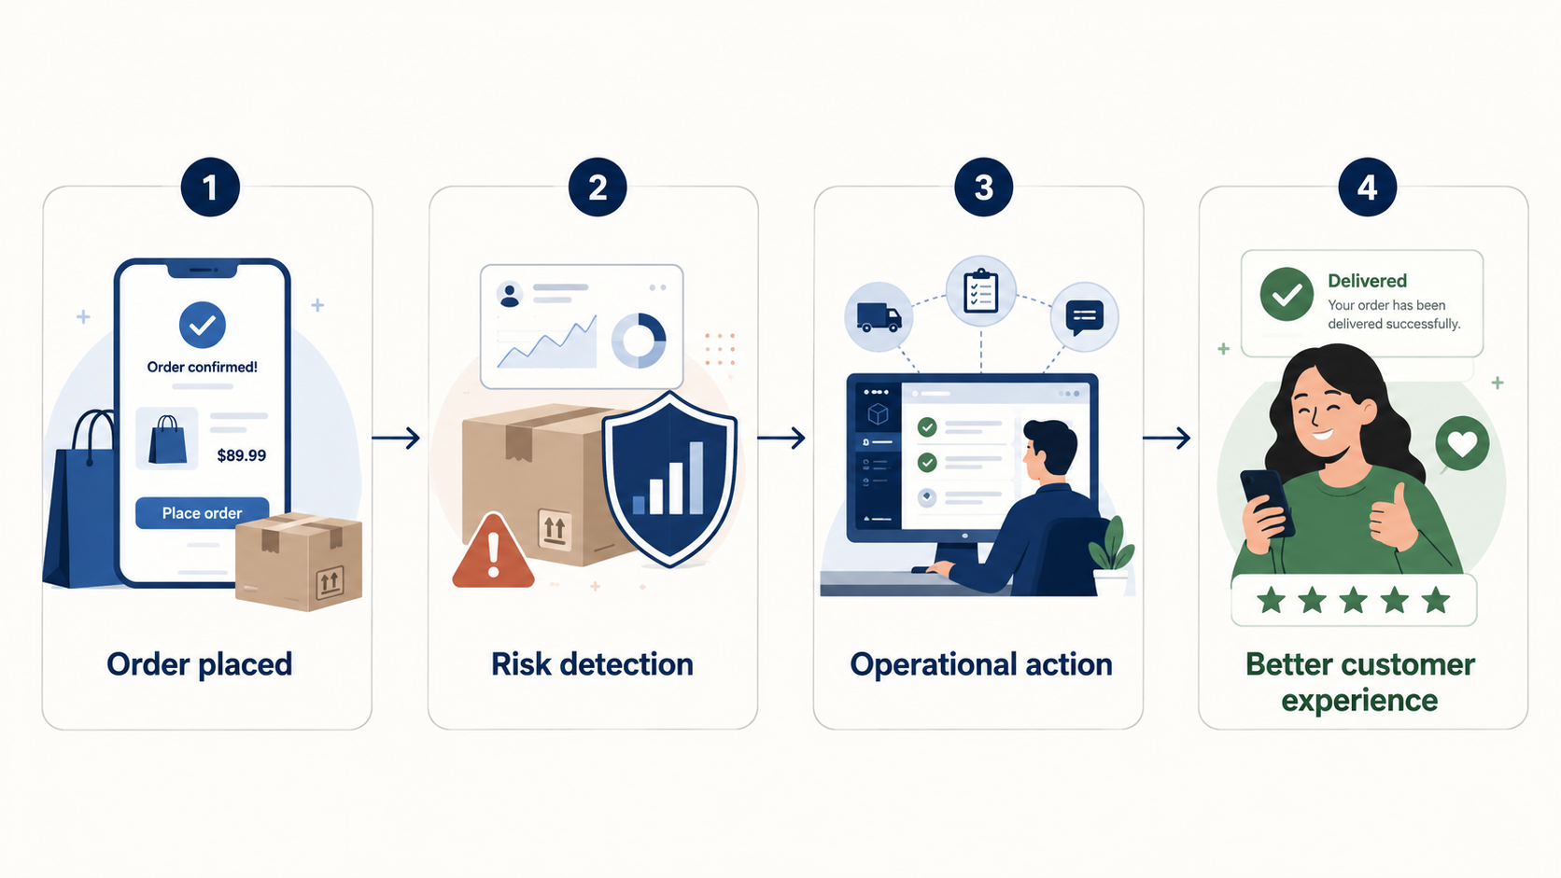
The Problem:
Late deliveries create operational pressure and damage customer satisfaction
E-commerce companies need to know:
• Where late deliveries are concentrated
• Which order profiles are more exposed to delay
• Which orders need earlier operational attention
Can we identify orders with higher late-delivery risk before the customer is affected?

Slide 3
Project Approach:
From raw data to operational decision support
The project follows an end-to-end analytics workflow:
Prepare and structure the data
Analyze delivery performance and risk patterns
Build a leakage-safe prediction model
Deliver business tools through Tableau and Streamlit
Main principle
Predict late-delivery risk using only pre-delivery information.
Data Understanding
Data Cleaning
SQL Layer
EDA
ML Model
Tableau + Streamlit

Slide 4
Target Definition: What counts as a late delivery?
Late delivery was defined at calendar-date level:
delivered_date > estimated_delivery_date
Orders delivered on the estimated delivery date are not considered late.
Why this matters:
The estimated delivery field represents a promised delivery date, not an exact timestamp deadline.
Timestamp-based logic would have incorrectly classified 1,292 same-day deliveries as late.
Delivered orders analyzed
96,470
Late orders
6,534
Late delivery rate
6.77%

Slide 5
Delivery Performance Insights:
Late delivery is not random
Late delivery concentrates by geography, route type and peak periods, and clearly impacts customer satisfaction.
Same-state vs cross-state late rate
4.52% vs 8.04%
SP → RJ
14.17% late rate
8,131 orders
Peak-month late rate
15.15%
Review score impact (On-time vs late)
4.29 vs 2.27

Slide 6
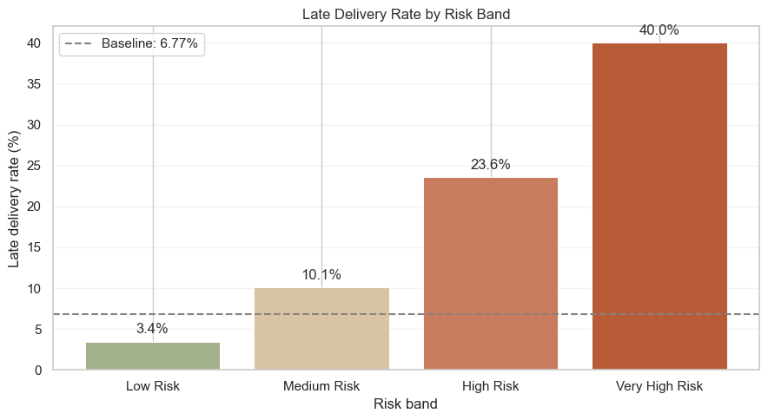
From prediction to prioritization
The model converts delivery patterns into an operational risk-prioritization tool.
Final model:
• Random Forest • Threshold: 0.16 • PR-AUC: 23.84% • Recall: 34.20%
Flagged order share
7.95%
Flagged late rate
29.14%
Lift vs baseline
4.3x
The model is not a perfect detector. It helps operations focus on orders with higher-than-average risk.

Slide 7
From Analysis to Business Tools
Tableau monitors performance. Streamlit supports order-level action.
Tableau Dashboard
Monitoring & reporting layer
• Historical delivery performance
• Geographic and route risk
• Risk-band monitoring
• Executive overview
Open Tableau Dashboard
Streamlit App
Operational scoring layer
• Score individual orders
• Upload batch orders
• Assign risk bands
• Flag high-risk deliveries
• Recommend action
Open Streamlit App

Slide 8
Thank You
Johannes Vidal
GitHub Repository:
https://github.com/JohannesVidal/supplyguard-late-delivery-risk-prediction
Questions?

