Slide 1
INFIX, PREFIX, & POSTFIX
EXPRESSIONS
Md. Rabiul Islam
ID: 201810176
Dept.: CSE
Fall - 2019

Slide 2
Infix Notation
Infix notation: X + Y
  Operators are written in-between their operands. This is the
  usual way we write expressions. An expression such as
  A * ( B + C ) / D is usually taken to mean something like:
  "First add B and C together, then multiply the result by A,
  then divide by D to give the final answer."

Slide 3
  Infix notation needs extra information to make
  the order of evaluation of the operators clear: rules built into the language about operator precedence and associativity, and brackets ( ) to allow users to override these rules. For example, the usual rules for associativity say that we perform operations from left to right, so the multiplication by A is assumed to come before the division by D.

Slide 4
Similarly, the usual rules for precedence say that we perform multiplication and division before we perform addition and subtraction.

Slide 5
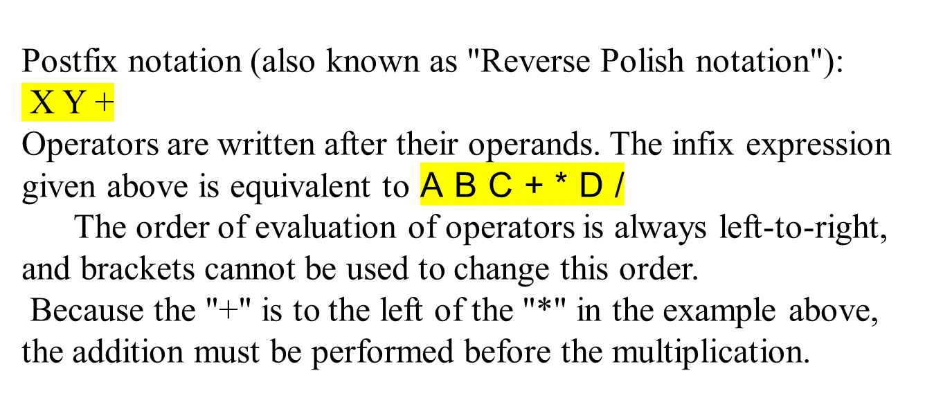
Postfix Notation

Slide 6
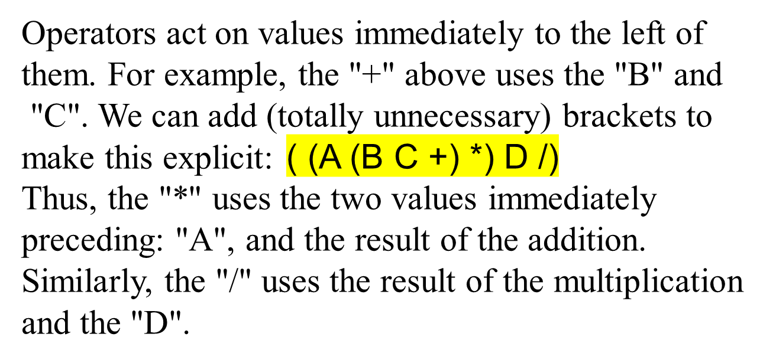

Slide 7
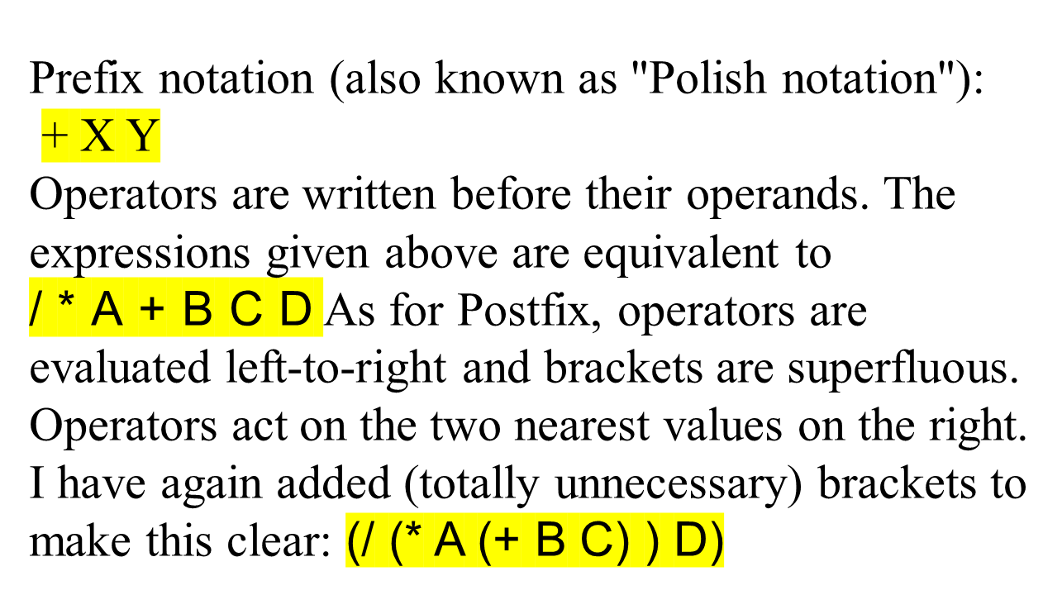
Prefix Notation

Slide 8
Although Prefix "operators are evaluated left-to-right", they use values to their right, and if these values themselves involve computations then this changes the order that the operators have to be evaluated in. In the example above, although the division is the first operator on the left, it acts on the result of the multiplication, and so the multiplication has to happen before the division (and similarly the addition has to happen before the multiplication).

Slide 9
Because Postfix operators use values to their left, any values involving computations will already have been calculated as we go left-to-right, and so the order of evaluation of the operators is not disrupted in the same way as in Prefix expressions.

Slide 10
Conclusion
In all three versions, the operands occur in the same
order, and just the operators have to be moved to keep
the meaning correct. (This is particularly important
for asymmetric operators like subtraction and
division: A - B does not mean the same as B - A;
the former is equivalent to A B - or - A B, the latter
to B A - or - B A).

Slide 11
Examples:
Infix | Postfix | Prefix | Notes
A * B + C / D | A B * C D / + | + * A B / C D | multiply A and B, divide C by D, add the results
A * (B + C) / D | A B C + * D / | / * A + B C D | add B and C, multiply by A, divide by D
A * (B + C / D) | A B C D / + * | * A + B / C D | divide C by D, add B, multiply by A

Slide 12
Converting between these notations
The most straightforward method is to start by inserting all the implicit brackets that show the order of evaluation:
Infix | Postfix | Prefix
( (A * B) + (C / D) ) | ( (A B *) (C D /) +) | (+ (* A B) (/ C D) )
((A * (B + C) ) / D) | ( (A (B C +) *) D /) | (/ (* A (+ B C) ) D)
(A * (B + (C / D) ) ) | (A (B (C D /) +) *) | (* A (+ B (/ C D) ) )

Slide 13
You can convert directly between these bracketed
forms simply by moving the operator within the
brackets e.g. (X + Y) or (X Y +) or (+ X Y).
Repeat this for all the operators in an expression,
and finally remove any superfluous brackets.

Slide 14
Example
infix postfix prefix
(a + b) * c a b + c * * + a b c
a + (b * c) a b c * + + a * b c
Infix form : <identifier> <operator> <identifier>
Postfix form : <identifier> <identifier> <operator>
Prefix form : <operator> <identifier> <identifier>

