Slide 1
Technical Support (420-1N6-AB)
Understanding CPUs
Lecture from Fall 2022 Adapted for Fall 2024

Slide 2
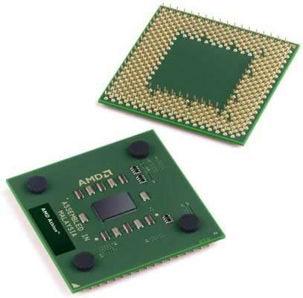
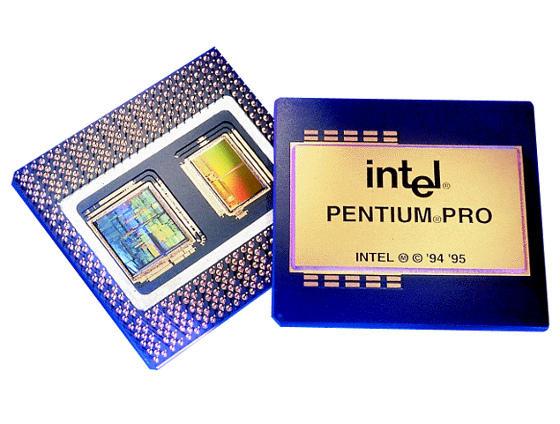
Processor (CPU) (review of Lecture 3)
CPU (Central Processing Unit)
A complex collection of electronic circuits on one or more integrated circuits (chips) which:
Executes the instructions in a software program.
Communicates with other parts of the computer system, especially RAM and input devices.
Let’s have a deeper look.

Slide 3
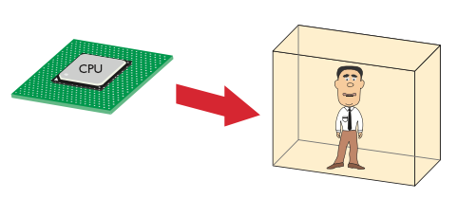
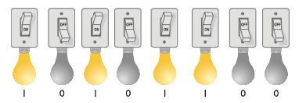
CPU Core Components
Analogy: CPUs are a “Guy-in-a-box”
Clever guy who can perform any mathematical function quickly.
They live in a closed-up box so direct communication is impossible.
We have 16 light bulbs: 8 for the guy, and 8 for us.

Slide 4
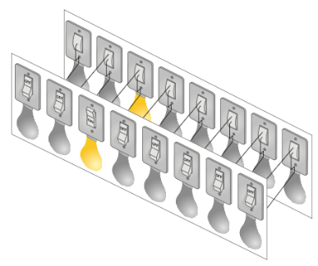
CPU Analogy: “Guy in a Box”
The light bulbs:
can be controlled (turned on or off) by us and by the guy-in-the-box
Are synchronized (bulb 1 for us has the same value as bulb 1 for the guy)
We can share messages by setting the light bulbs on/off, as long as we:
Agree on schedule (not changing the lightbulbs at the same time)
Agree on meaning (share the same interpretation of lightbulb being on/off)
This arrangement is called a data bus: a method for transporting data from one component to another using electrical circuits

Slide 5
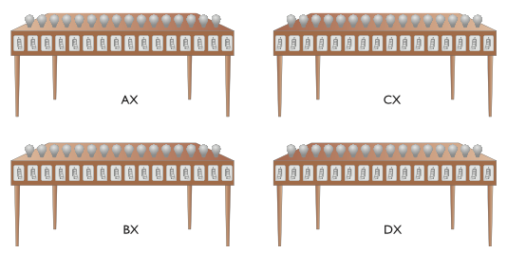
Registers
Registers
So far, we can send/receive “messages” from the light bulbs
But, in order to “remember” a message, the guy needs at least a few workstations (registers) to copy our messages, otherwise the messages will be lost every time the data bus updates.
Registers are places to store a very small amount of data temporarily
Registers are usually the around the 1-4x the size of the data bus
We can give the registers names to distinguish them (AX, BX, CX, DX for example)

Slide 6
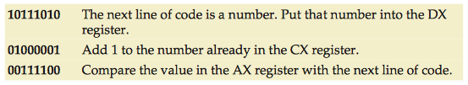
Codebook: Agreeing on meaning
Codebook
It’s important to have common definitions for the meaning of the lightbulbs being on/off to understand messages sent by this method
CPUs are designed with a codebook (instruction set) that defines the commands that we can give to the guy in the box

Slide 7
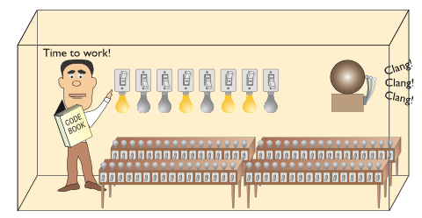
Clock: agreeing on schedule
Now we are ready to communicate with the guy in the box We can send them the first command by lighting up the bulbs on the data bus.
But how do they know when we have finished setting up the light bulbs?

Slide 8
Clock: agreeing on schedule
We can use a bell activated by a button.
A real computer uses a special wire called the clock wire (CLK). The CLK wire is turned on and off on a precise and regular schedule. This is called a clock cycle.
Each time the clock turns on, the state of our lightbulbs is shared with the guy in the box
The guy then has until the clock turns off to send a message back
The next time the clock turns on, a new message is sent to the CPU
The time between each clock cycle is the speed that a CPU can perform a given task
The maximum number of clock cycles a CPU can handle in given period of time is called the clock speed.

Slide 9
Clock speed: how to measure?
Let’s say our guy can perform 4 tasks in one second (that’s pretty fast for some guy!). How can we compare this with other CPUs?
Unit of Measurement: Hertz, usually written as Hz.
1Hz: once time per second
4Hz: four times per second (our guy in the box!)
How fast are modern CPUs compared to this? (Hint: much faster)

Slide 10
Clock speed: how to measure?
We can use SI Prefixes (International System of Unit Prefixes) to compare magnitudes easily.
You will see many of these in computer science over and over again -- get to know them well!
Unit | Meaning | Numeric Definition | Examples
Hz | Once per second | 1/s, or 1Hz | 1-2Hz: human heart-rate at rest (1Hz = 60 beats per minute, 2Hz = 120 bpm) 24Hz: framerate of historic cinema 20-60Hz: frequency range for bass notes (C0 = 16.35Hz to C2 = 65.4Hz) 60-144Hz: framerate of most monitors
kHz | Thousand times per second | 1000 Hz | 0.1-2kHz: frequency range for midrange notes (A2=0.110kHz, C7=2kHz) 20kHz: maximum frequency audible to human ear 740 kHz: Intel 4004 processor clock speed (1971)
MHz | Million times per second | 1000000 Hz | 8MHz: fastest CPU clock speed in the 70s 35MHz: fastest CPU clock speed in the 80s 500-1000MHz: fastest CPU clock speed in the 90s)
GHz | Billion times per second | 1000000000 Hz | 2-5GHz: Almost all consumer CPUs in 2024 have base clock speeds in this range 9.117 GHz: fastest CPU clock speed ever recorded (2024)

Slide 11
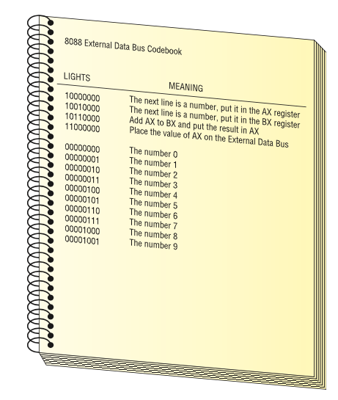
CPU Core Components: Activity
Using the following codebook, ask the “Guy in a box” to calculate 2+3
You must send a series of commands to the CPU. The CPU will act on each command and give you an answer.
Your answer should be a sequence of numbers you could send to the guy in the box to get the right answer.

Slide 12
CPU Core Components: Activity (cont.)
10000000 The next line is a number, put it in the AX register 00000010 The number 2 10010000 The next line is a number, put it in the BX register 00000011 The number 3 10110000 Add AX to BX and put the result in AX 11000000 Place the value of AX on the external data bus
A set of commands such as this is called a program. A program is a series of command sent to a CPU in a specific order for the CPU to perform work.

Slide 13
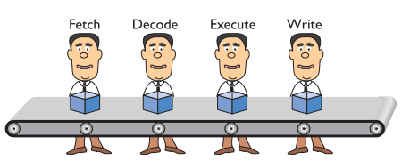
Pipelining
Almost all CPU instructions feature a set of 4 stages:
Fetch: retrieve the instruction, address, and data, write them to registers
Decode: search for instruction code in codebook, verify it is a real instruction, and that data/address are valid
Execute: perform the instruction, update registers with results
Write: write to databus to share results
Rather than have each instruction repeat all of these steps, we can organize CPUs further by specializing our “guy in a box” for each stage
This is called pipelining, and it allows for greater efficiency in CPU programming

Slide 14
CPU Power: Speed and bus width
CPU power is measured by both speed and the amount of data it can process.
Speed: is rated in cycles per second, e.g. megahertz (MHz) or gigahertz (GHz).
The amount of data processed at a time depends on the “number of lightbulbs” or the width of the data bus
Bus width is measured in bits, e.g. 8-bit (our example), 16-bit, 32-bit, 64-bit, etc.

Slide 15
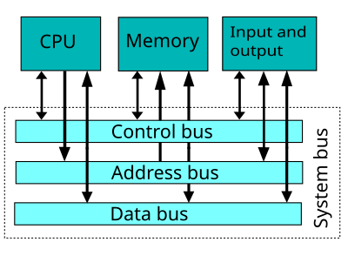
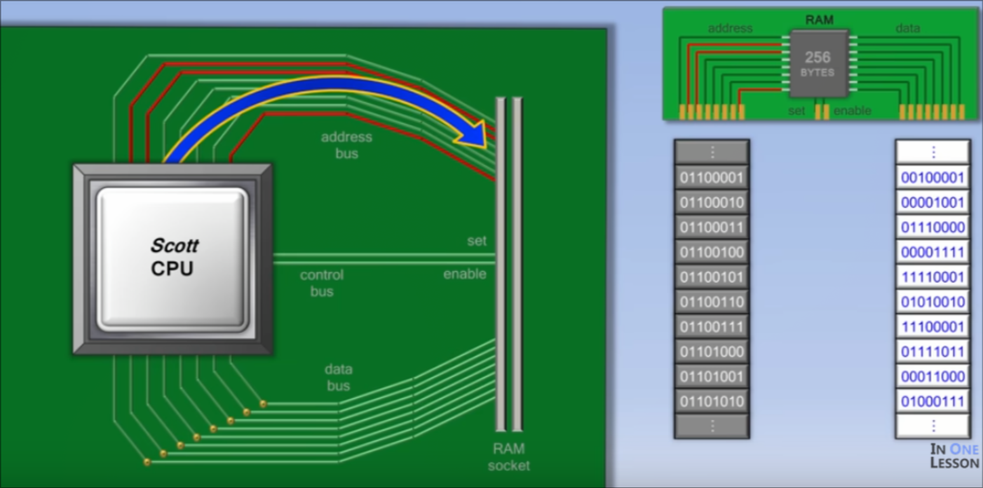
Data bus: how the CPU gets/sends data
In actual computers, the CPU receives instructions, addresses memory, and data on separate buses.
This allows the CPU to send AND receive the following information at the same time:
What command to perform
Where in memory the result should be stored
What data to use to perform the command
Figure from In One Lesson on Youtube (nice visualization)

Slide 16
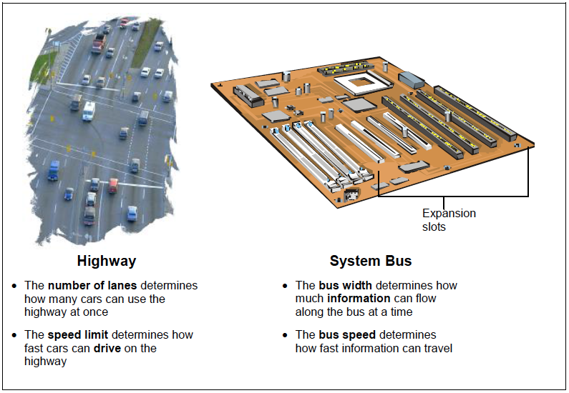
Data Bus: understanding speed vs width
You can double check that you understand a scientific concept by checking what units of measurement that concept is measured by:
Highway
Number of lanes: (a number)
Speed limit: (unit distance per time elapsed, e.g. km/h)
System bus
Bus width: (a number of bits, eg a 32-bit processor)
Bus speed: (unit information per time elapsed, e.g. bits/second)

