Slide 1


Slide 2
Keyword
Function name
(optional)
Parameters
def sum(num1, num2):
value = num1 + num2
return value
Semi-colon
Expression
Indentation
(“TAB”)
(Optional) Keyword
Return value

Slide 3
Parameter types
def sum(num1 : float, num2 : float) -> float :
value = num1 + num2
return value
Return type

Slide 4
def sum(num1, num2):
return (num1 + num2)
def keyword
Semi-colon and indentation
name of the function
Argument 1
Argument 2
- return keyword
- Returned value or expression

Slide 5
Assignment operator
2
1
variable_name = some_expression
left
right

Slide 6
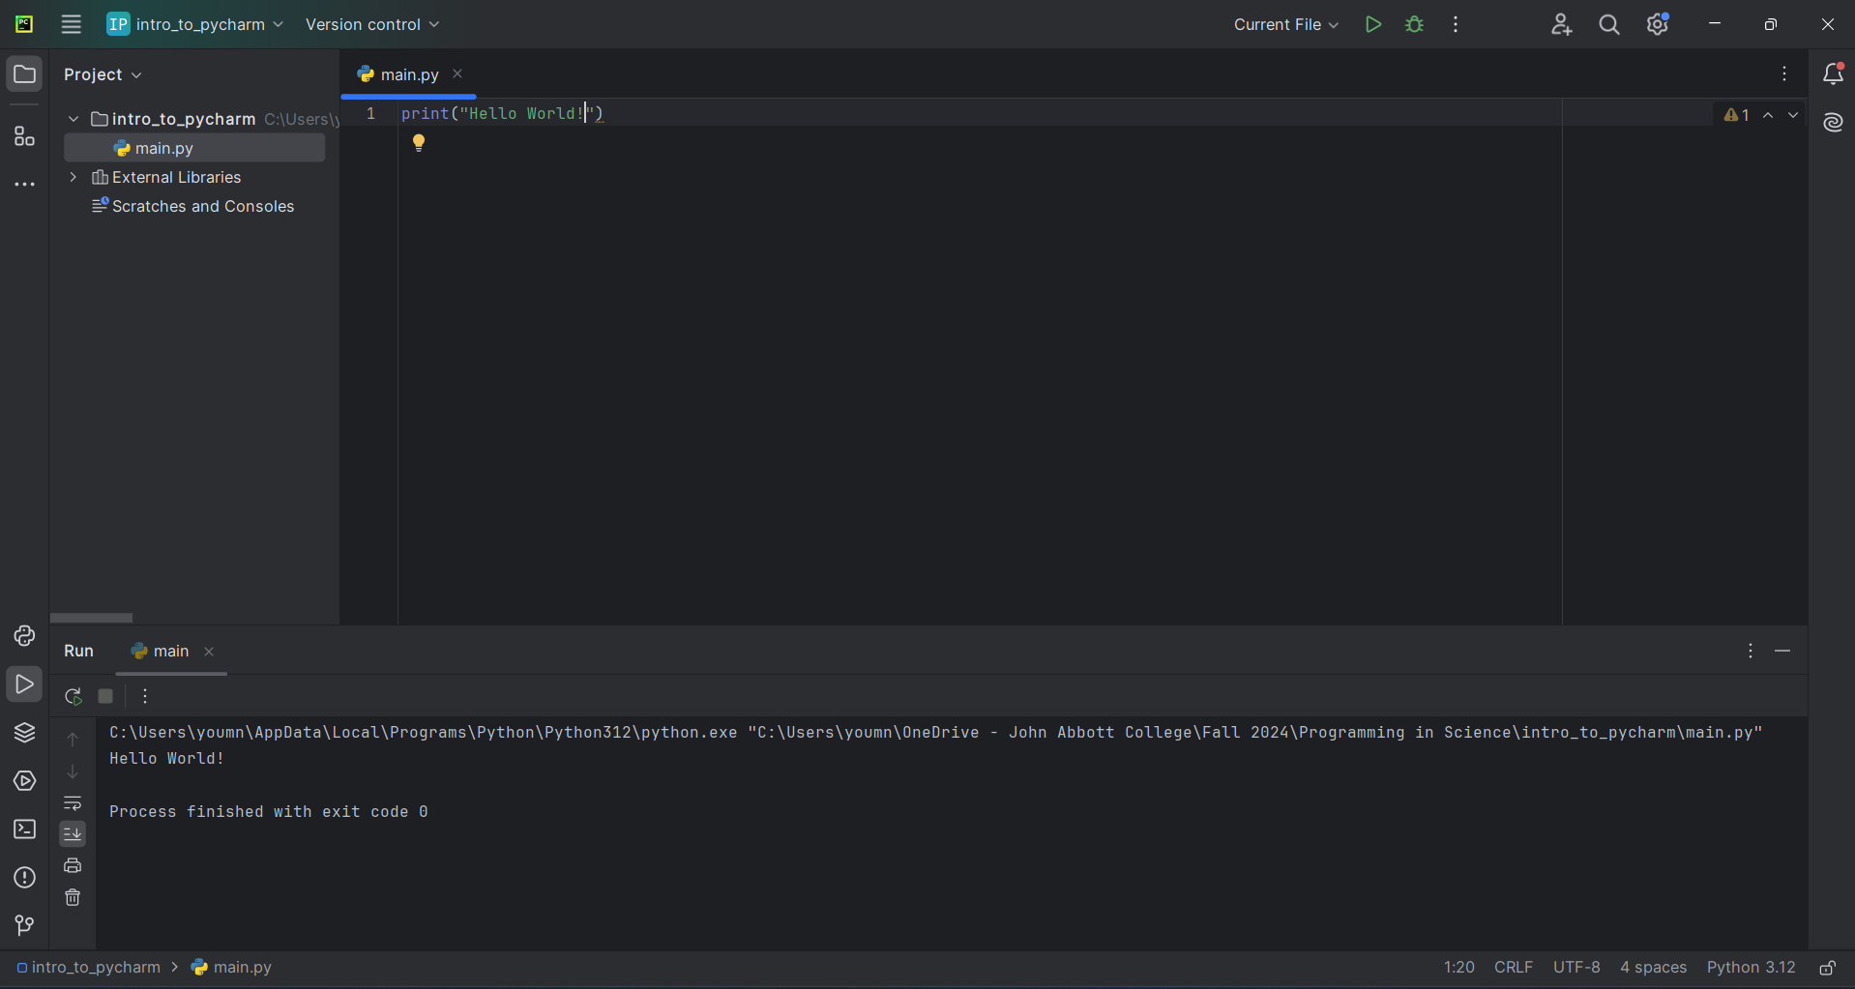
Run buttons
Project explorer
Editor
Output window

Slide 8
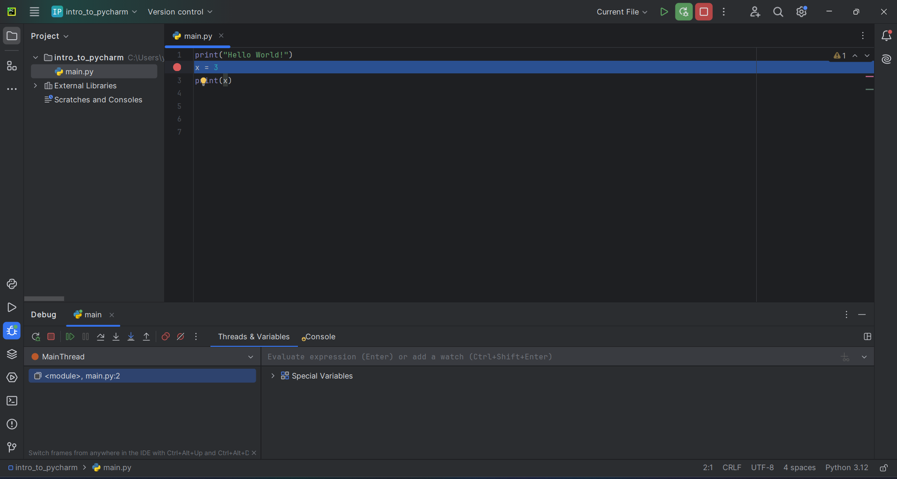
Restart debugging
Breakpoint
Debug Menu

Slide 9
