Slide 1
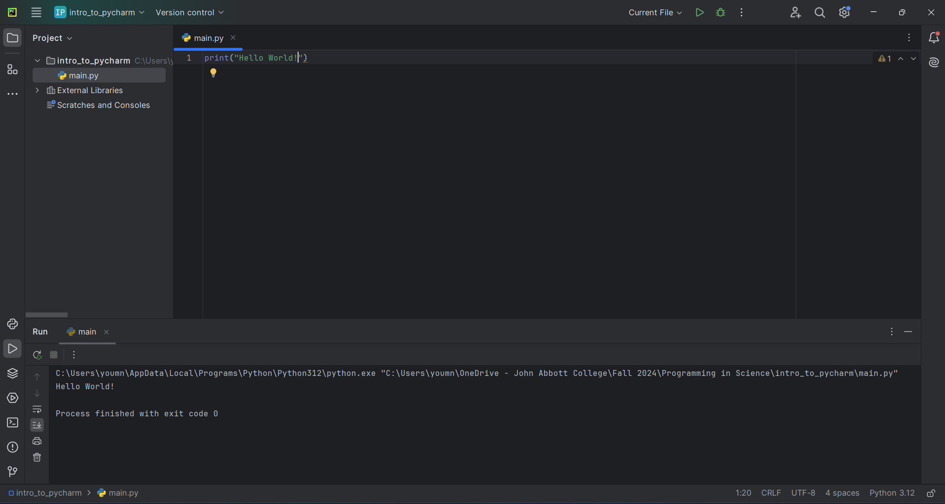
Run buttons
Project explorer
Editor
Output window

Slide 3
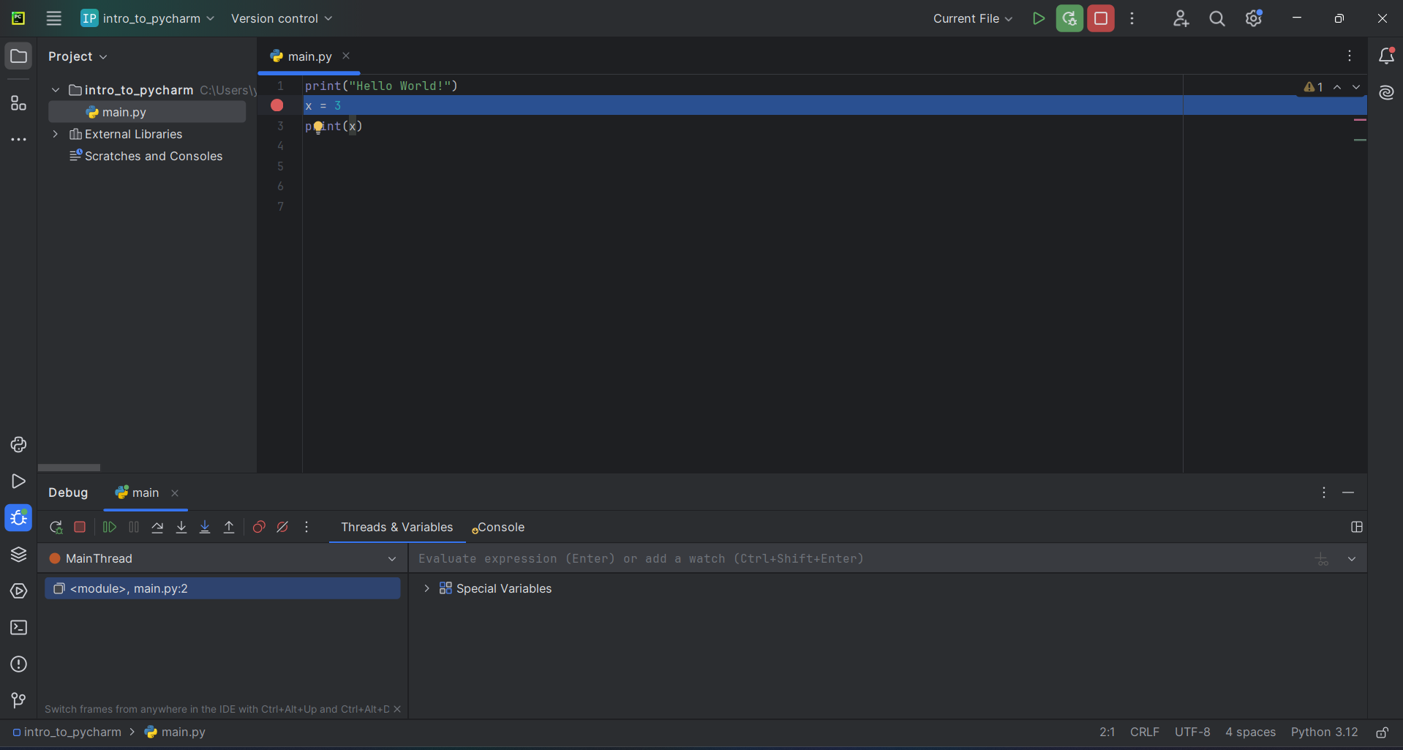
Restart debugging
Breakpoint
Debug Menu

Slide 4
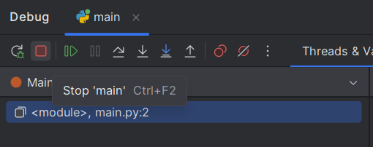
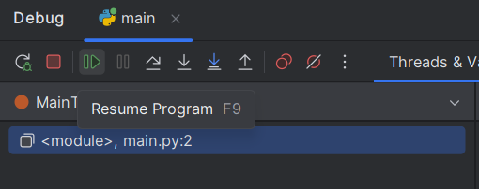
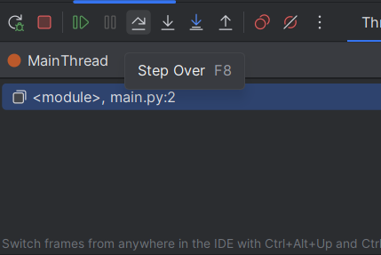

Slide 5


Slide 6
Index | 0 | 1 | 2 | 3 | 4 | 5 | 6 | 7 | 8 | 9 | 10
Character | H | e | l | l | o |  | W | o | r | l | d

Slide 7



Program lab1
print(‘hello!’)
name =
input(“What is your name?”)
Hello!
What’s your name? > Bob
“Bob”
Programmer (you)
Bob (a user)

Slide 8
Program lab1
print()
Hello!
What’s your name? > Bob
“Bob”
input()
Bob (a user)

Slide 9
f"{pi:10.8f}"
Index | 0 | 1 | 2 | 3 | 4 | 5 | 6 | 7 | 8 | 9
Character | 3 | . | 1 | 4 | 1 | 5 | 9 | 2 | 6 | 5
f"{pi:10.6f}"
Index | 0 | 1 | 2 | 3 | 4 | 5 | 6 | 7 | 8 | 9
Character | 3 | . | 1 | 4 | 1 | 5 | 9 | 3

Slide 10
Index | 0 | 1 | 2 | 3 | 4 | 5 | 6 | 7 | 8 | 9
Character | 3 | . | 1 | 4 | 1 | 5 | 9 | 3
f"{pi:<10.6f}"
Index | 0 | 1 | 2 | 3 | 4 | 5 | 6 | 7 | 8 | 9
Character |  |  | 3 | . | 1 | 4 | 1 | 5 | 9 | 3
f"{pi:>10.6f}"
Index | 0 | 1 | 2 | 3 | 4 | 5 | 6 | 7 | 8 | 9
Character |  | 3 | . | 1 | 4 | 1 | 5 | 9 | 3
f"{pi:^10.6f}"

Slide 11
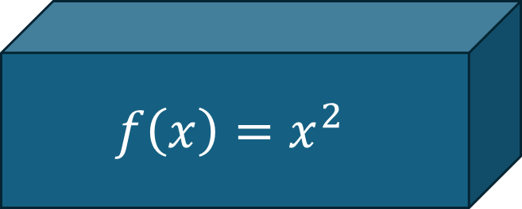
Input
3
2
4
$$f\left(x\right)=x^{2}$$
9
4
16
Output

Slide 12



Slide 13
Input
3
2
4
Function
9
4
16
Output

Slide 14


Input
abc
“abc”
Function

Slide 15
Keyword
Function name
(optional)
Parameters
def sum(num1, num2):
value = num1 + num2
return value
Semi-colon
Expression
Indentation
(“TAB”)
(Optional) Keyword
Return value

Slide 16
Parameter types
def sum(num1 : float, num2 : float) -> float :
value = num1 + num2
return value
Return type

Slide 17
def sum(num1, num2):
return (num1 + num2)
def keyword
Semi-colon and indentation
name of the function
Argument 1
Argument 2
- return keyword
- Returned value or expression

Slide 18
Assignment operator
2
1
variable_name = some_expression
left
right

Slide 19
[expression for val in collection ]
[expression for val in collection if condition]
[expression for val1, val2 in zip(collection1, collection2 ) ]

Slide 20
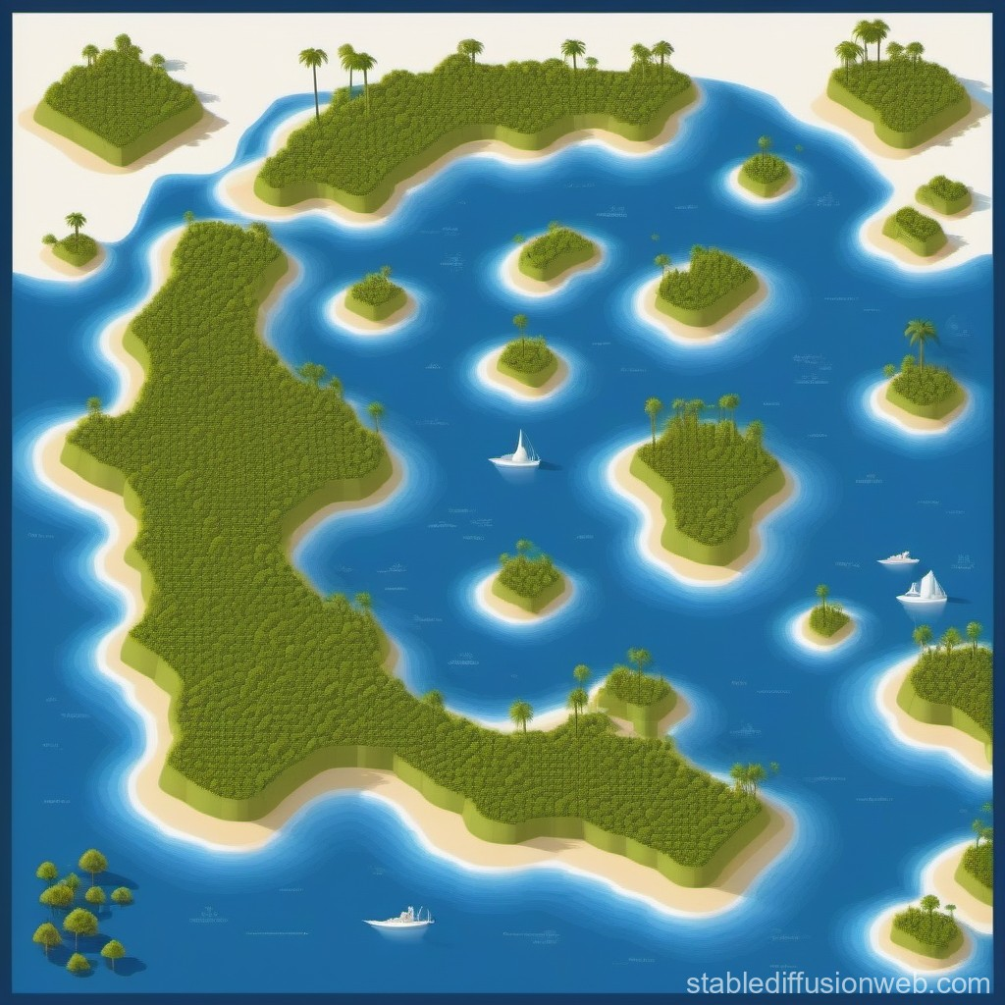



y
x
N
W
E
S

Slide 21


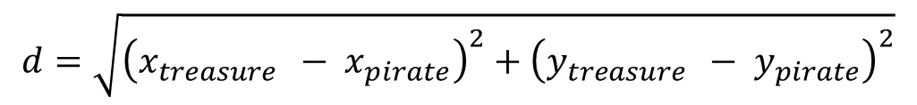
d
$$y_{treasure } − y_{pirate}$$
$$x_{treasure } − x_{pirate}$$
$$d=\sqrt{{\left(x_{treasure } − x_{pirate}\right)}^{2}+{\left(y_{treasure } − y_{pirate}\right)}^{2}}$$

Slide 22

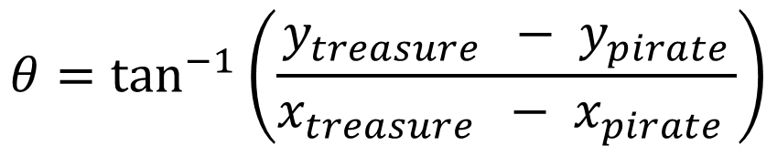
$$θ=\tan^{−1}\left(\frac{y_{treasure } − y_{pirate}}{x_{treasure } − x_{pirate} }\right)$$
d
$$y_{treasure } − y_{pirate}$$
$$θ$$
$$x_{treasure } − x_{pirate}$$

Slide 23
Ring:
outer radius = 25 cm
Inner radius = 15 cm
Thickness = 5cm
Square:
Side 5 cm
height = 35cm
Width = 45cm

