Slide 1
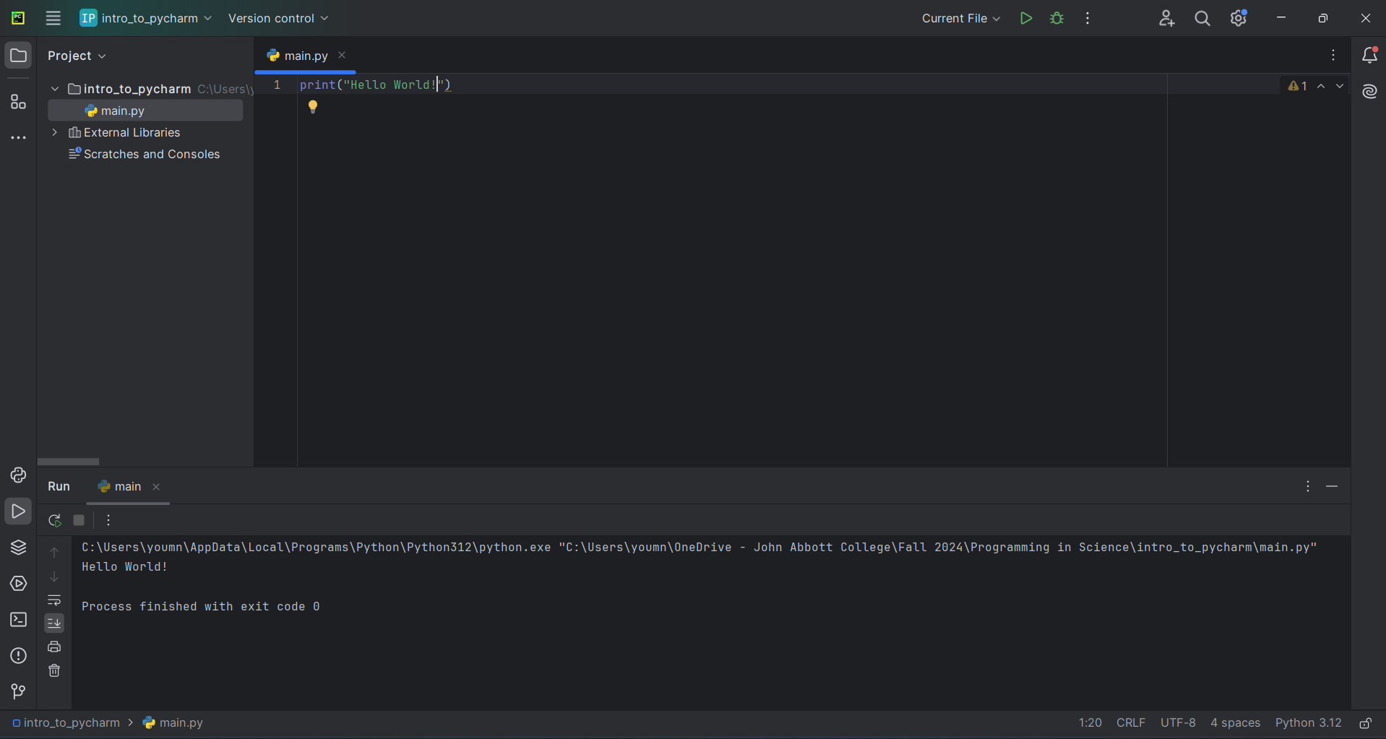
Run buttons
Project explorer
Editor
Output window

Slide 3
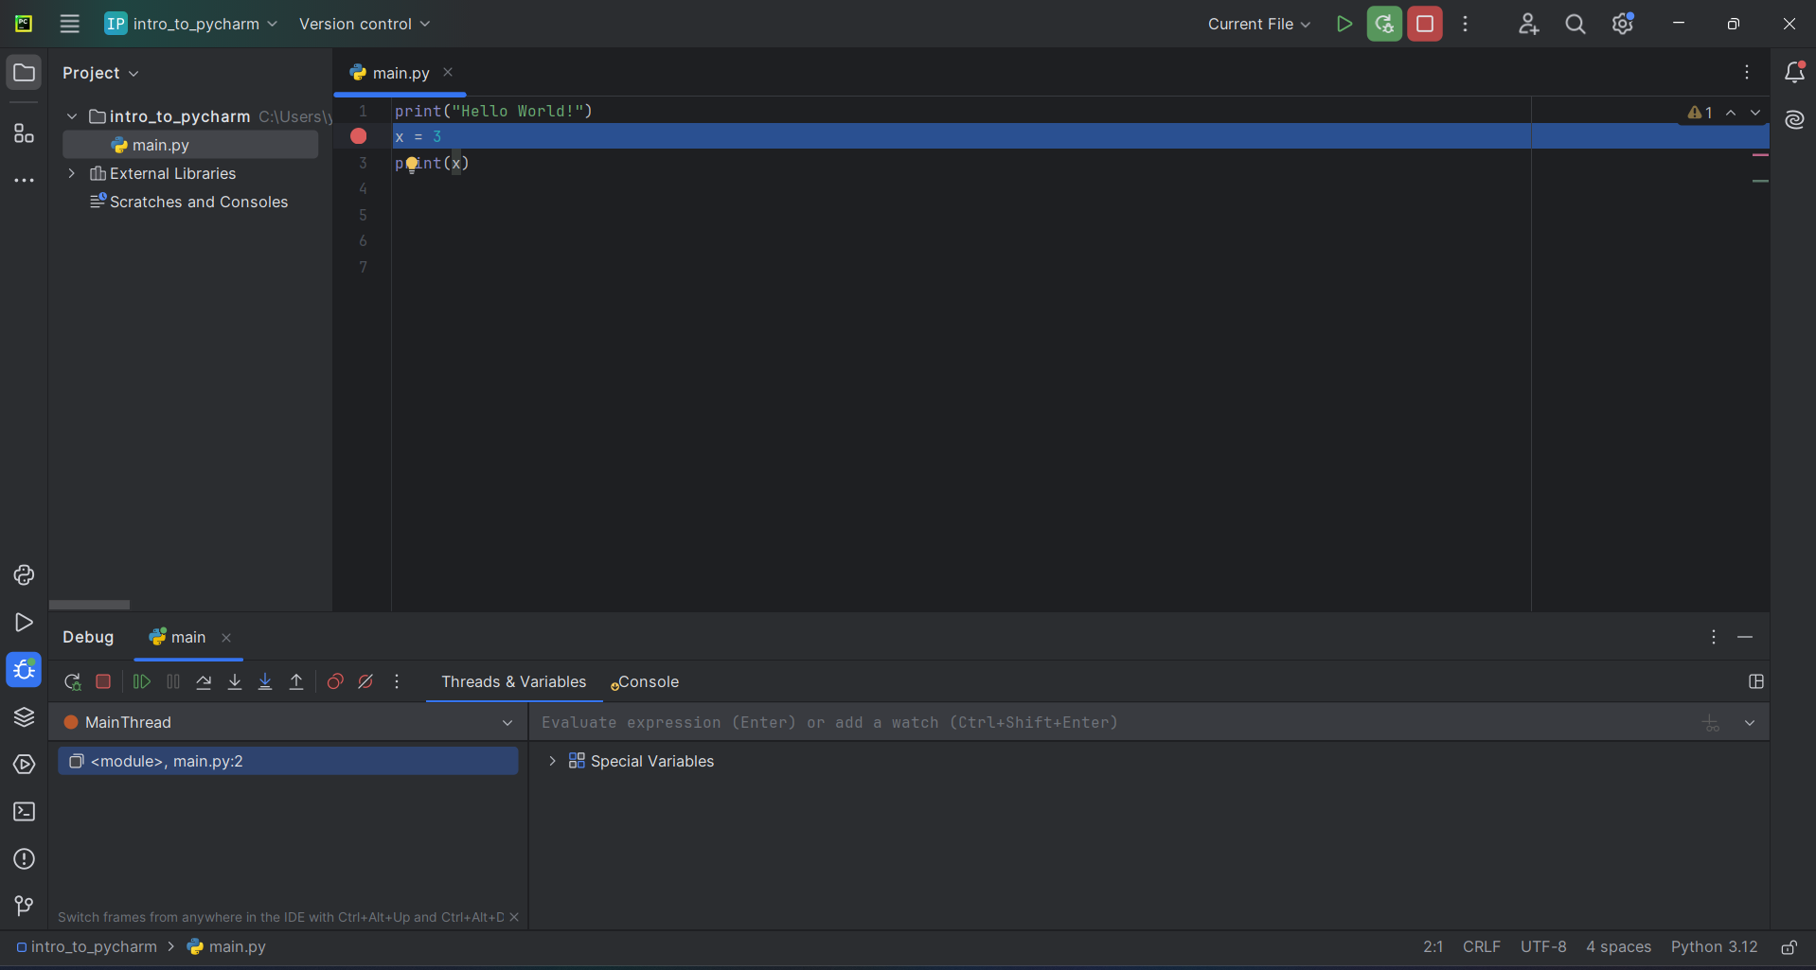
Restart debugging
Breakpoint
Debug Menu

Slide 4
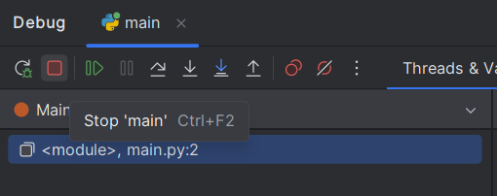
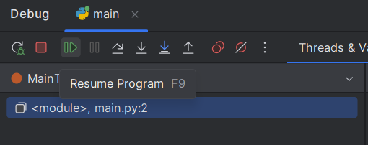
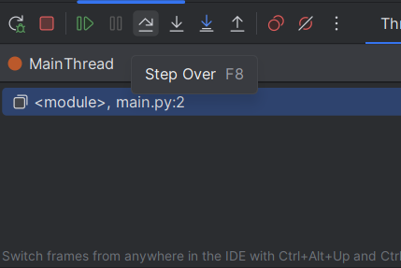

Slide 5


Slide 6
Index | 0 | 1 | 2 | 3 | 4 | 5 | 6 | 7 | 8 | 9 | 10
Character | H | e | l | l | o |  | W | o | r | l | d

Slide 7
Input
3
2
4
Function
9
4
16
Output

Slide 8


Input
abc
“abc”
Function

Slide 9
Keyword
Function name
(optional)
Parameters
def sum(num1, num2):
value = num1 + num2
return value
Semi-colon
Expression
Indentation
(“TAB”)
(Optional) Keyword
Return value

Slide 10
Parameter types
def sum(num1 : float, num2 : float) -> float :
value = num1 + num2
return value
Return type

Slide 11
def sum(num1, num2):
return (num1 + num2)
def keyword
Semi-colon and indentation
name of the function
Argument 1
Argument 2
- return keyword
- Returned value or expression

Slide 12
Assignment operator
2
1
variable_name = some_expression
left
right

Slide 13
[expression for val in collection ]
[expression for val in collection if condition]
[expression for val1, val2 in zip(collection1, collection2 ) ]

