Slide 1

COVID-19 Impact on ABC Company
PRESENTED BY
JOHN ADEDOYIN AND
EBOSELUIMEN EHIZOJIE

Slide 2
Objective
To quantify how COVID-19 changed overall parcel volumes and revenue for ABC Company between 2019 and 2020.
To compare the impact of COVID-19 across customer segments (Enterprise, Large, Medium, Small) and identify which groups drove the most growth.
To translate these findings into clear strategic recommendations for post-COVID customer and segment strategy.

Slide 3
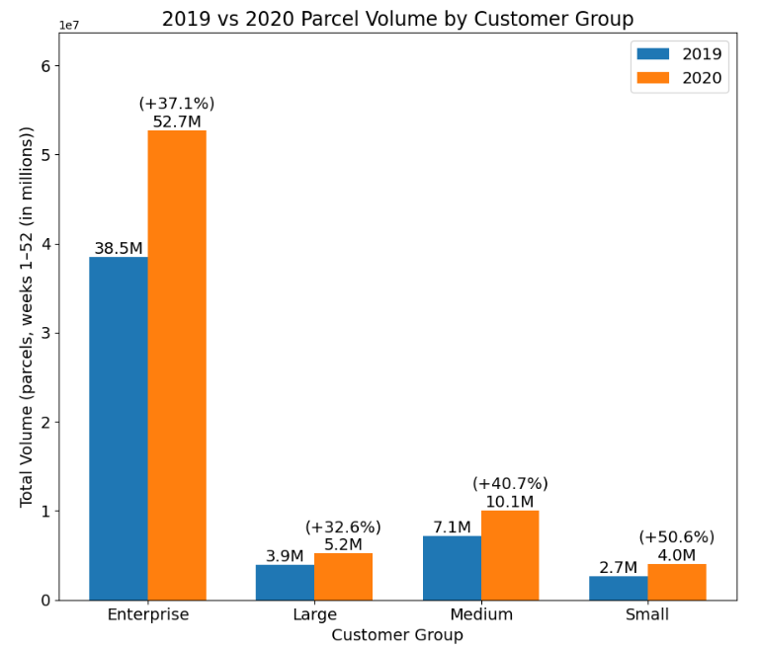
How has COVID affected different customer groups?
All groups grew, but Medium and Small outpaced the network, while Enterprise delivered the largest absolute lift.
Evidence
  Enterprise: +37%
  Large: +33%
  Medium: +41%
  Small: +51%
Implication
Segment strategy should diversify focus beyond Enterprise.

Slide 4
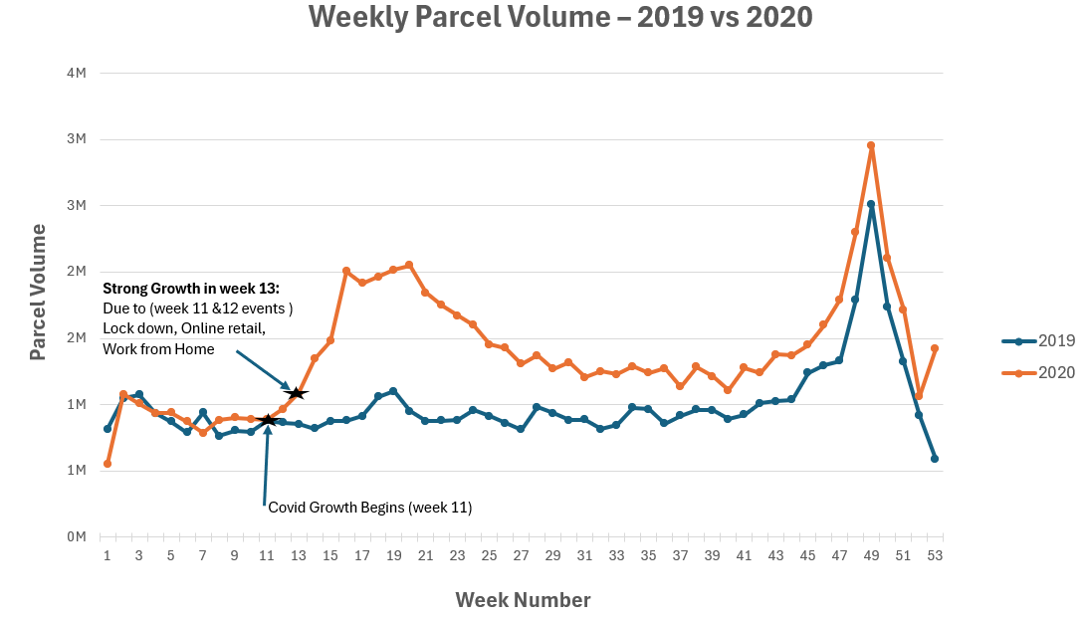
When were customer volumes first impacted?

Slide 5
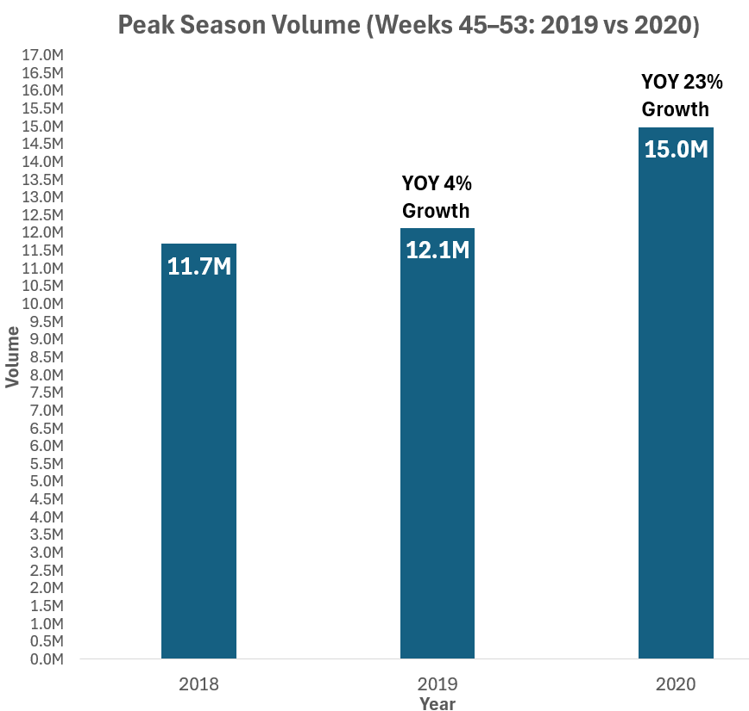
How did COVID impact peak season in 2020?
Peak season volumes were higher in 2020 than in 2019 (November–December).
Evidence
  Peak volume week 2019 vs 2020 peak
  Peak Weeks 45–53
  High demand sustained from COVID + holiday
Implication
Requires earlier capacity planning and peak readiness going forward.

Slide 6
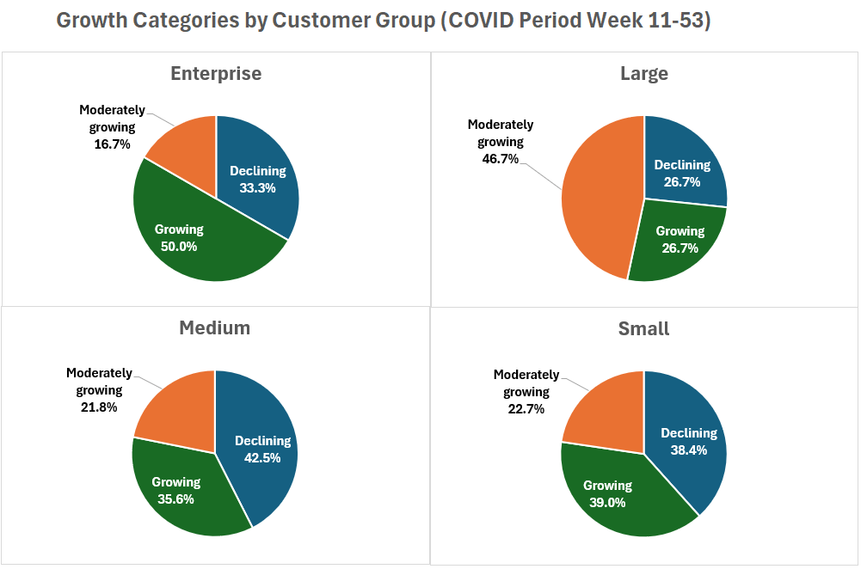
% Growing vs Stable vs Declining
Customer distribution shows balanced performance, with the majority growing or moderately growing, and a smaller share declining.
Evidence
  High-growth customers: outsized gains (> network)
  Moderate growth: align with network growth
  Declining: small minority with lower 2020 volume
Implication
Customer performance is uneven and requires targeted playbooks.

Slide 7
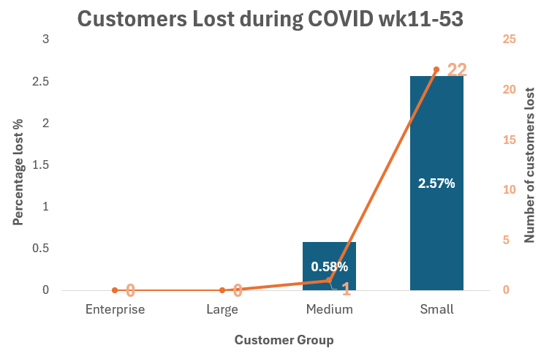
% New Customers and Lost Customers During COVID
0% of customers were new
Customer loss was negligible during the COVID period
Implication
COVID expanded engagement.

Slide 8
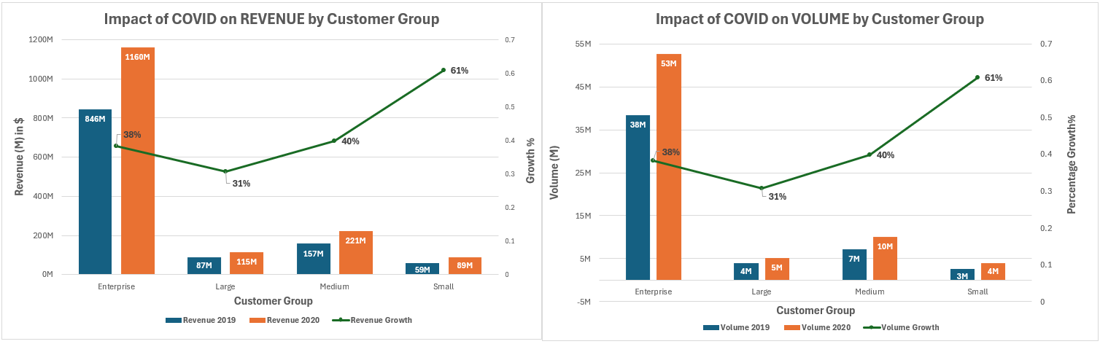
Impact on Volumes and Revenue by Group
COVID-19 increased both parcel volume and revenue across every customer group.
Enterprise drove the largest total gains, while Small and Medium showed the highest growth rates.

Slide 9
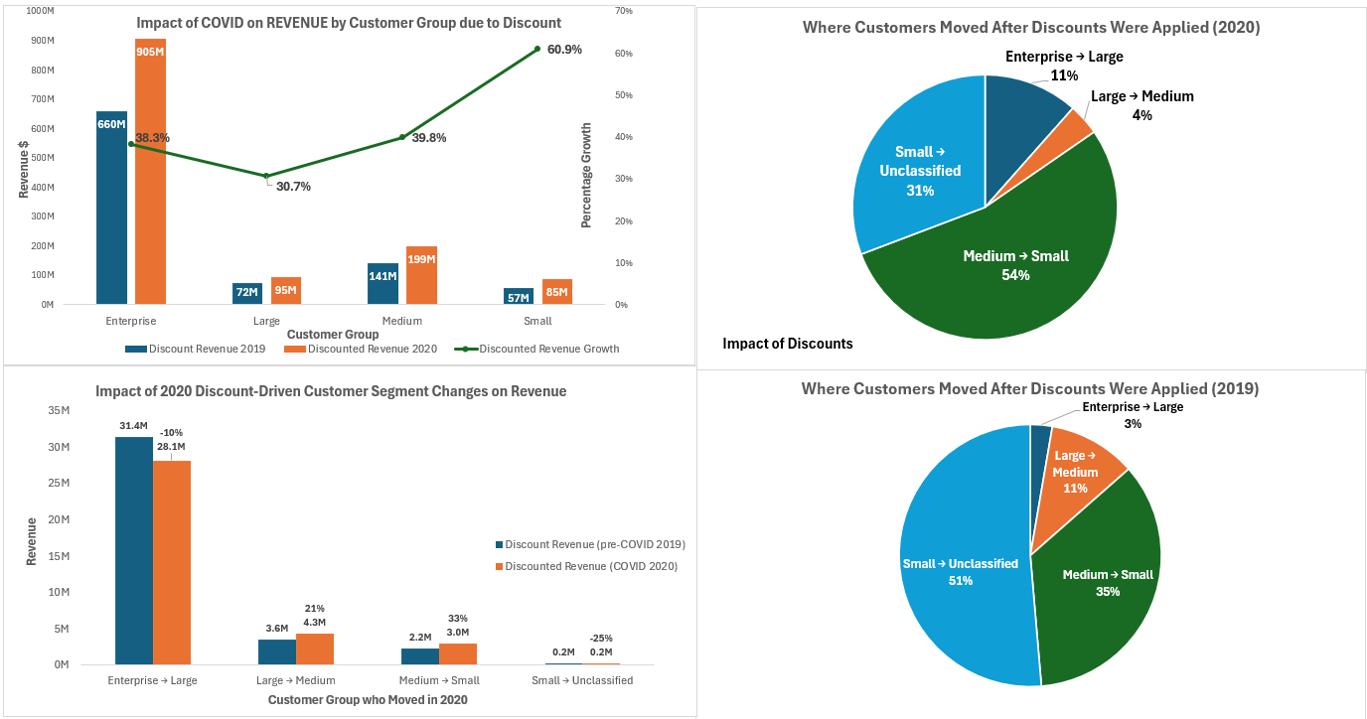
Impact on Volumes and Revenue by Group (Discount Applied)

Slide 10
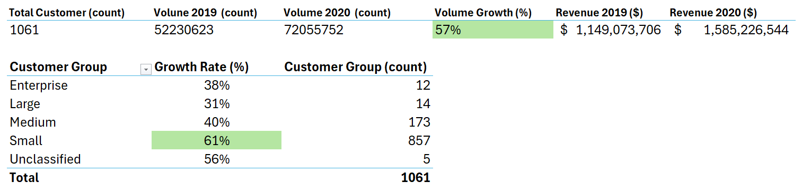




📦 Executive Summary: COVID Impact on ABC Parcel Business (2019→2020)
+38% Total Volume Growth
2019 → 2020 (existing customers only)
growth came only from current base
Enterprise: largest scale
(core engine)
Medium + Small: fastest growth
(emerging growth engine)
Strategy
Focus: Protect Enterprise • Grow Medium/Small e-commerce shippers

Slide 11




📦 Executive Recommendations
🏢 Enterprise — Protect & Lock In
Protect revenue with long-term contracts, tailored SLAs, and automation.
🏭 Large — Optimize & Retain
Improve reliability and use volume incentives to drive consistency.
🚀 Medium — Accelerate Growth
Scale fast using digital onboarding, tiered pricing, and flexible logistics.
📦 Small — Convert & Simplify
Convert pandemic users with simple bundles, self-service, and clear pricing.

Slide 12
📦 Conclusion
COVID-19 drove a major parcel surge from existing customers only.
Enterprise delivered the biggest total volumes, while Medium/Small posted the fastest growth, and churn during the COVID observation period was negligible.
Discounting changed the mix: it protected activity but pushed many customers into lower tiers, so post-COVID strategy must balance retention incentives with long-term revenue protection.

Slide 13
Thank You

