Slide 1
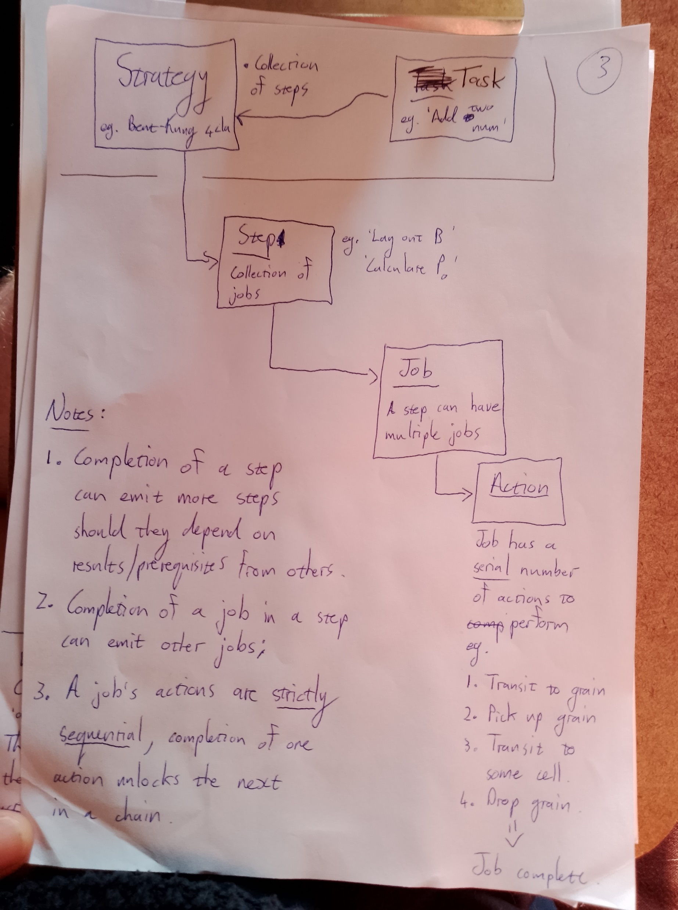
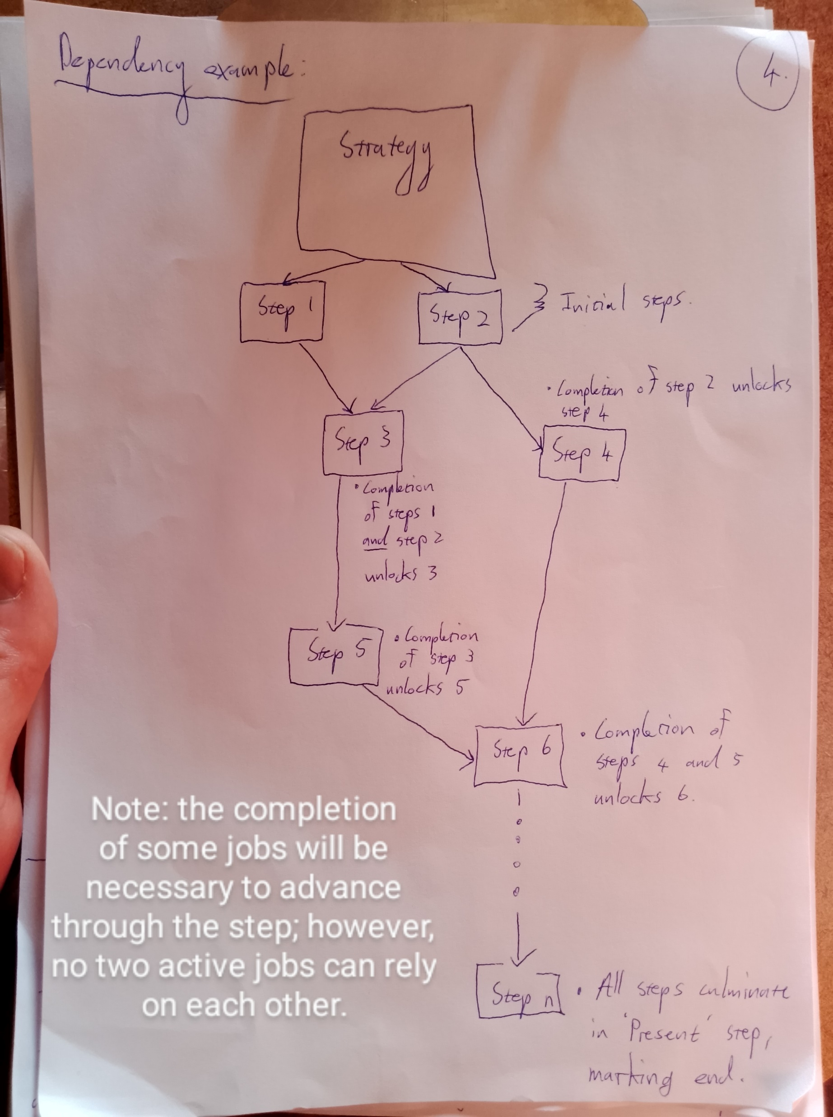

Slide 2

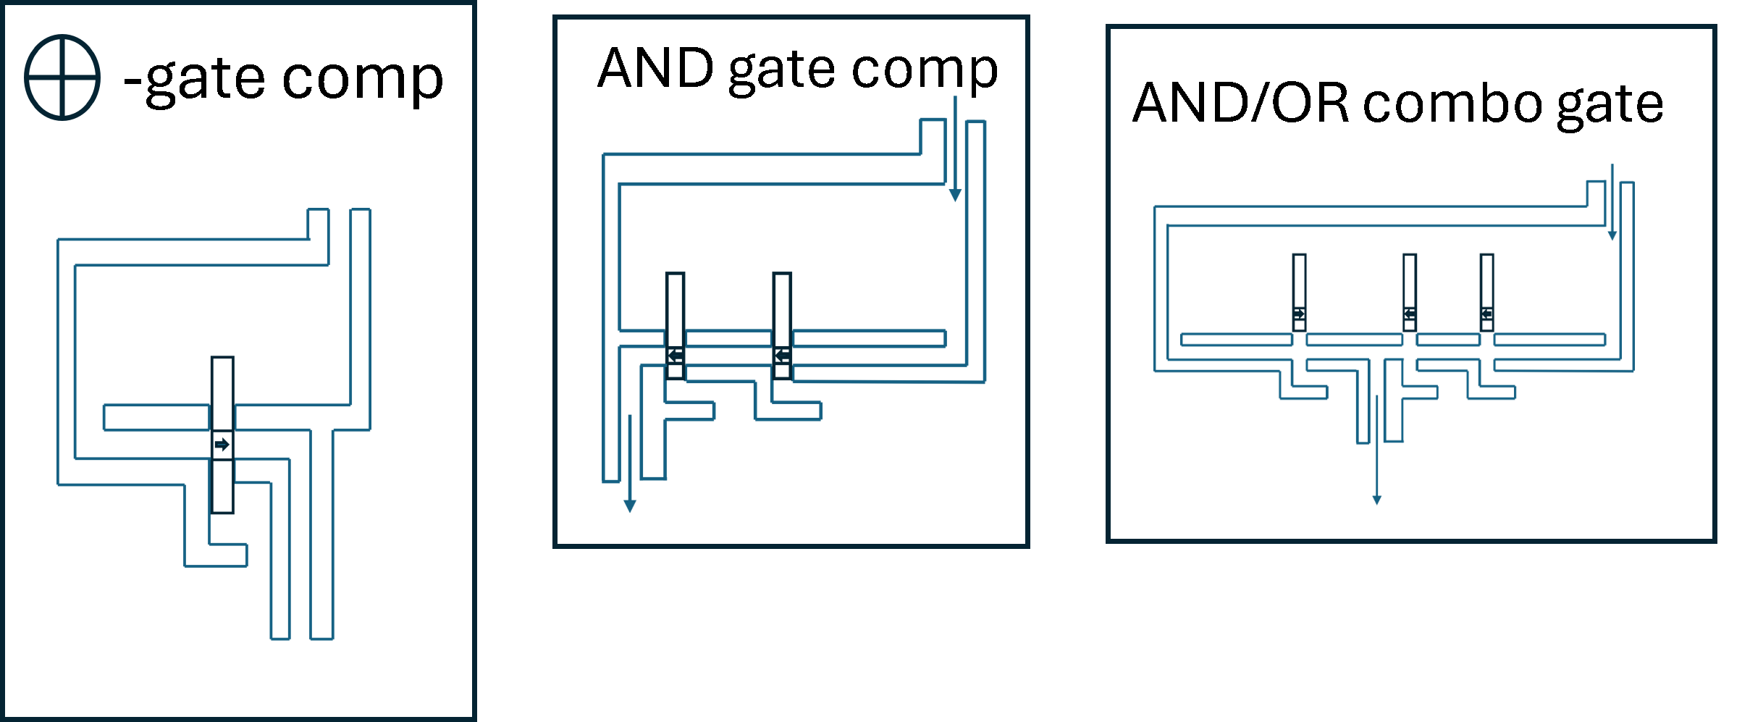
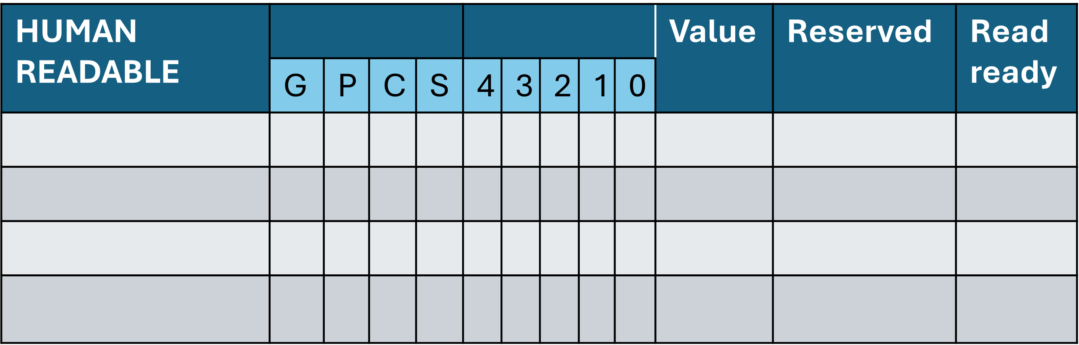
Example of Task progression:
Component: Job Board
Board snapshot 1 (not started)
Component: Decimal input display
A | ~
B | ~
Idle
Idle
Component: Input tracks
Idle
Steps available:
None
Steps complete:
None
Idle
Idle
Idle
Component: Memory Table
Component:
Grain repo

Slide 3
Example of Task progression:
Component: Job Board
1. Place grain in A₀ (assigned)
2. Place grain in A₁ (assigned)
3. Place grain in A₃ (assigned)
4. Place grain in B₀ (assigned)
5. Place grain in B₁ (assigned)
Board snapshot 2 (numbers submitted)
Job 1
Job 2
Component: Decimal input display
A | 11
B | 3
Job 3
Job 4
Job 5
Steps available:
Lay out input A
Lay out input B
Steps complete:
None
Component: Input tracks
Idle
Component: Memory Table
Component:
Grain repo

Slide 4
Example of Task progression:
Steps available:
Lay out input A
Lay out input B
Calculate P_{i} values (a pair (A_{i} , B_{i} available)
Steps complete:
None
Component: Job Board
3. Place grain in A₃ (assigned)
5. Place grain in B₁ (assigned)
6. Place grain in Row 1 ‘reserved’
7. Place grain in XOR input 1
8. Place grain in XOR input 2
Board snapshot 3 (calculation in progress)
Component: Decimal input display
A | 11
B | 3
Idle
 | Component: Input tracks
A
B
Idle
Idle
Idle
Job 3
Job 5
Component: Memory Table
Component:
Grain repo

Slide 5
Example of Task progression:
Steps available:
Lay out input A
Calculate P₀ (pair (A₀ , B₀) available)
Other P values…
Steps complete:
Lay out input B
Component: Job Board
3. Place grain in A₃ (assigned)
6. Place grain in Row 1 ‘reserved’ (assigned)
7. Place grain in XOR input 1 (assigned)
8. Place grain in XOR input 2 (assigned)
Board snapshot 4 (calculation in progress)
Job 3
 | Component: Input tracks
A
B
Idle
Idle
Job 6
Component: Memory Table
Job 7
Component:
Grain repo
Job 8

Slide 6
Example of Task progression:
Steps available:
Calculate P₀ (pair (A₀ , B₀) available)
Other avail P val…
Steps complete:
Lay out input B
Lay out input A
Component: Job Board
8. Place grain in XOR input 2 (assigned)
9. Place grain in Row 1 ‘P’ slot (assigned)
10. Place grain in Row 1 ‘0’ slot (assigned)
Board snapshot 5 (calculation in progress)
 | Component: Input tracks
A
B
Idle
Idle
Idle
Job 9
Job 10
Component: Memory Table
Component:
Grain repo
Job 8

Slide 7
Example of Task progression:
Steps available:
Calculate P₀ (pair (A₀ , B₀) available)
Other avail P val…
Steps complete:
Lay out input B
Lay out input A
Component: Job Board
10. Place grain in Row 1 ‘0’ slot (assigned)
Board snapshot 6 (calculation in progress)
 | Component: Input tracks
A
B
Idle
Idle
Idle
Idle
Idle
Job 10
Component: Memory Table
Component:
Grain repo

Slide 8
Example of Task progression:
Steps available:
Calculate P₀ (pair (A₀ , B₀) available)
Other avail P val…
Steps complete:
Lay out input B
Lay out input A
Component: Job Board
11. Operate XOR gate (assigned)
Board snapshot 7 (calculation in progress)
Idle
 | Component: Input tracks
A
B
Idle
Idle
Idle
Idle
Component: Memory Table
Component:
Grain repo
Job 11
P₀

Slide 9
Example of Task progression:
Steps available:
Calculate P₀ (pair (A₀ , B₀) available)
Other avail P val…
Steps complete:
Lay out input B
Lay out input A
Component: Job Board
12. Record XOR result -> 0; place grain in Row 1 ‘read ready’ as value = 0 means no grain in ‘value’ column (assigned) (result 1 would place grain in ‘value’ and only then read-ready)
13. Clear XOR input 1 (assigned)
14. Clear XOR input 2 (assigned)
Board snapshot 8 (calculation in progress)
Idle
 | Component: Input tracks
A
B
Idle
Idle
Component: Memory Table
Job 12
Component:
Grain repo
Job 14
Job 13
P₀

Slide 10
Example of Task progression:
Steps available:
Other avail P val…
P₀ read-ready; calculate G₀
Steps complete:
Lay out input B
Lay out input A
Calculate P₀ (pair (A₀ , B₀) available)
Component: Job Board
14. Clear XOR input 2 (assigned)
15. Reserve…
16. Another job…
17. etc…
Board snapshot 9 (calculation in progress)
 | Component: Input tracks
A
B
Idle
Job y
Job z
Job 14
Job x
Component: Memory Table
Component:
Grain repo
P₀

