Slide 1
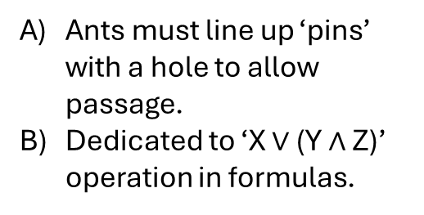
In
Combination
AND/OR gate
Procedure:
Ants load up needed inputs
Three gates are closed; if correct inputs are present , ant can ‘walk through’ with its grain and is taken as output = 1
Else, output is = 0
Grains in gate must be cleared out to reset gate.
Ants must line up ‘pins’ with a hole to allow passage.
Dedicated to ‘X $∨$ (Y $∧$ Z)’ operation in formulas.
1. Maybe
grain
1. Maybe
grain
1. Maybe
grain
Out, if ant can make it here, output = 1
Ant can ‘pass through’ to return ‘1’ when the following gate configurations are present , ‘0’ otherwise.
1
(
0
0
(
)
1
1
0
(
)
OR
AND
OR
AND
)
0
OR
1
1
AND

Slide 2
-gate
Output 1
Output 0
Output 0
1 grain
will open gate
and output 1
2 grains,
no passage,
output 0
no grains,
no passage,
output 0
1
0
1
1
0
0

Slide 3
AND Gate
In
In
(
1
1
AND
(
1. Maybe
grain
1. Maybe
grain
Out, if ant can make it here, output = 1
Ant can only pass through if 2 grains loaded

Slide 4
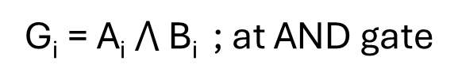
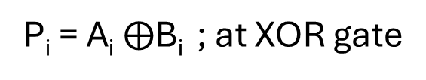
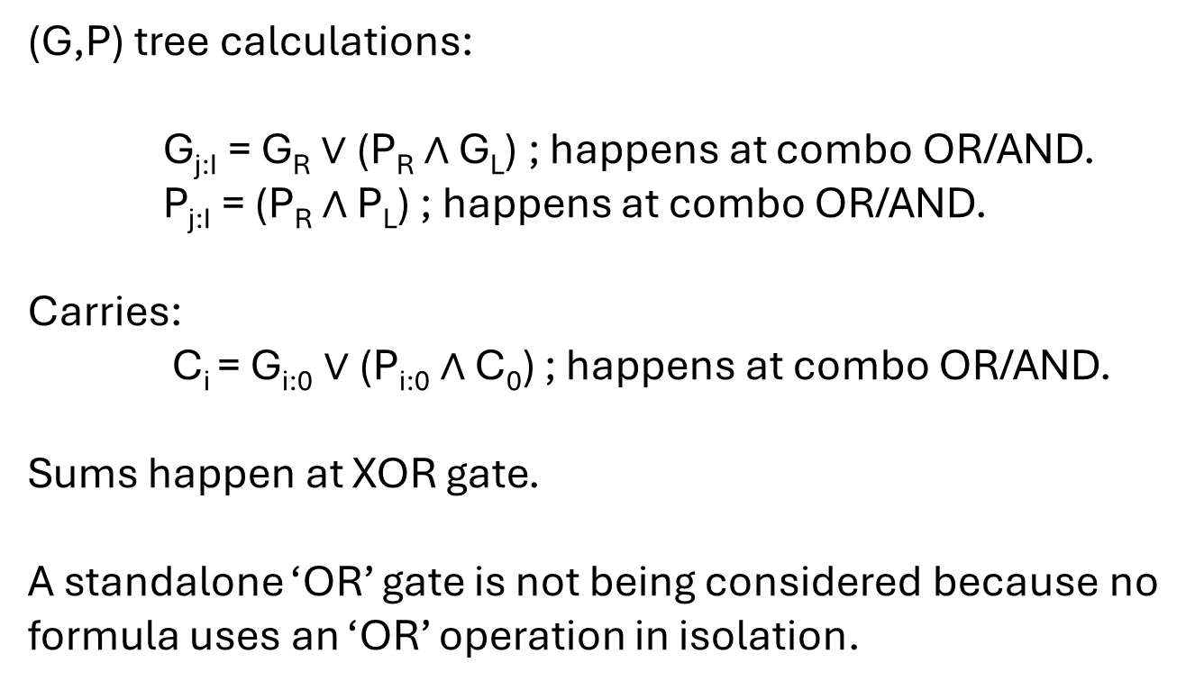
Equations and where their calculations happen:
P_{i} = A_{i} $⨁$B_{i} ; at XOR gate
G_{i} = A_{i} $⋀$ B_{i} ; at AND gate
(G,P) tree calculations:
G_{j:I} = G_{R} $∨$(P_{R} $∧$ G_{L}) ; happens at combo OR/AND.
P_{j:I} = (P_{R} $∧$ P_{L}) ; happens at combo OR/AND.
Carries:
C_{i} = G_{i:0} $∨$(P_{i:0} $∧$ C₀) ; happens at combo OR/AND.
Sums happen at XOR gate.
A standalone ‘OR’ gate is not being considered because no formula uses an ‘OR’ operation in isolation.

Slide 5
Memory cells
HUMAN READABLE | Variable |  |  |  | Index |  |  |  |  | Value | Reserved | Read ready
 | G | P | C | S | 4 | 3 | 2 | 1 | 0
Etc . . . . .
Formula values are stored in a table with its identity encoded by essentially ticking boxes with grains.
Procedure:
Ant picks next available memory row.
It ‘reserves’ the row by placing a grain in ‘Reserved’.
Cells are tagged to describe variable identity (see examples).
When variable has been encoded, ‘Read Ready’ receives a grain and is then available to be read by other ants.
Row will remain until ‘Reserved’ grain is removed; grains in that row will then be marked as needing to be cleared.

Slide 6
Memory cells
storage examples
HUMAN READABLE | Variable |  |  |  | Index |  |  |  |  | Value | Reserved | Read ready
 | G | P | C | S | 4 | 3 | 2 | 1 | 0
1. G_{2:0} = 1
2. P₀ = 0
3. C₄ = 1
4. S₂ = 0
Etc . . . . .
Notice:
Entry number 1; Variables with 2 or more index descriptors (e.g. generate bit G_{2:0} has 2 and 0) will have multiple indexes ticked.
Entry number 3; contains values and is read-ready; however, ‘reserved’ is not ticked and so will be cleared out if an ant comes across it.
Entry number 4; contains data but ‘read-ready’ is not ticked. Data is possibly still being added; ants cannot use its information.
No tuple values ( eg (G,P)) are stored as one; must be G and P separate

Slide 7
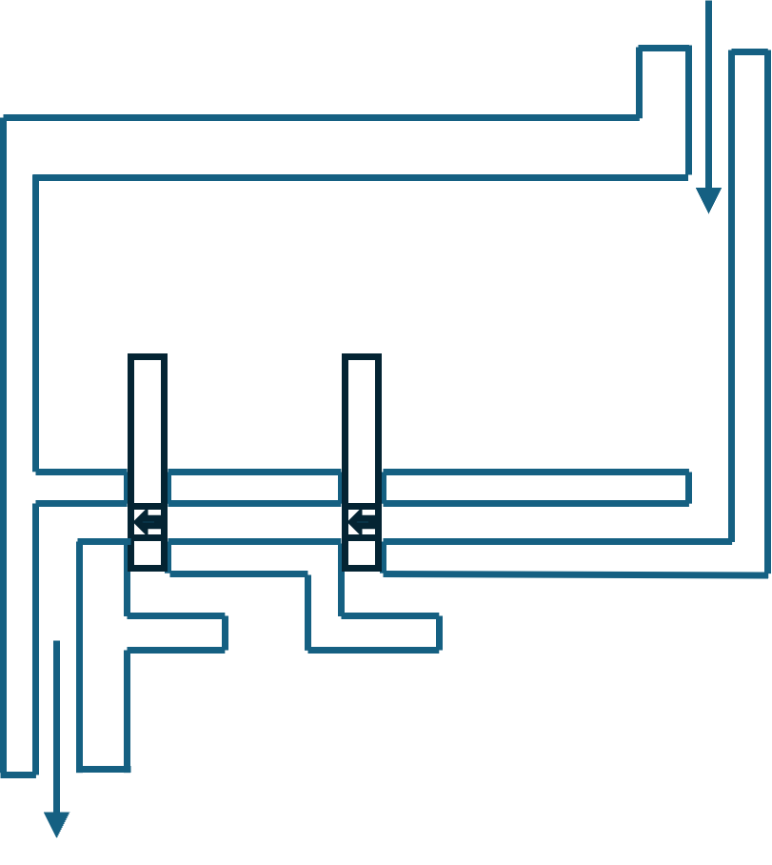
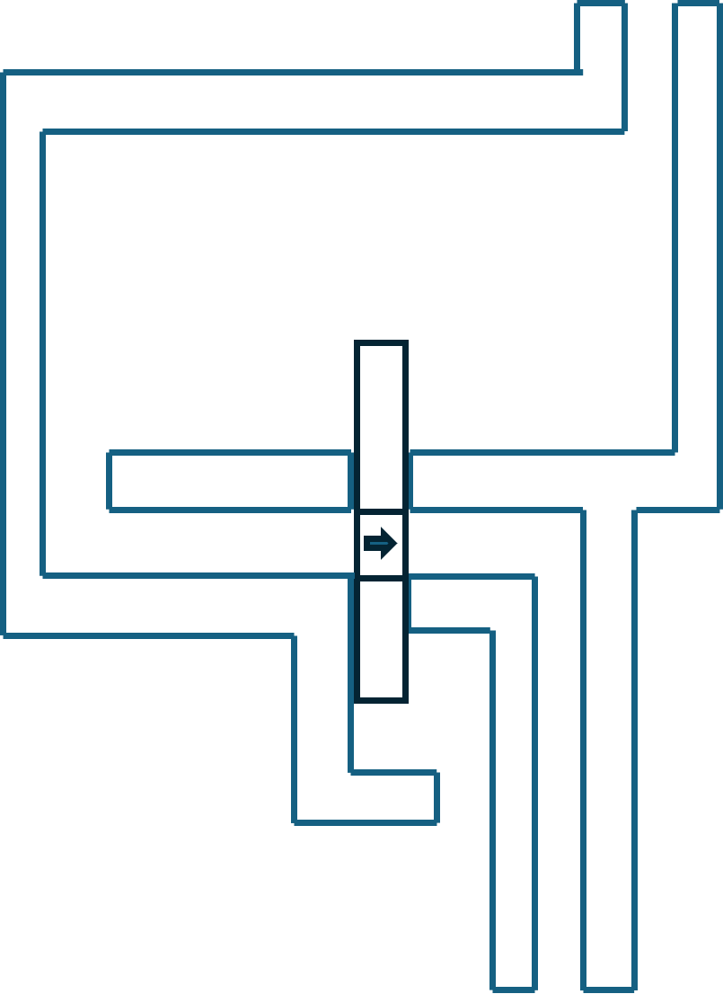
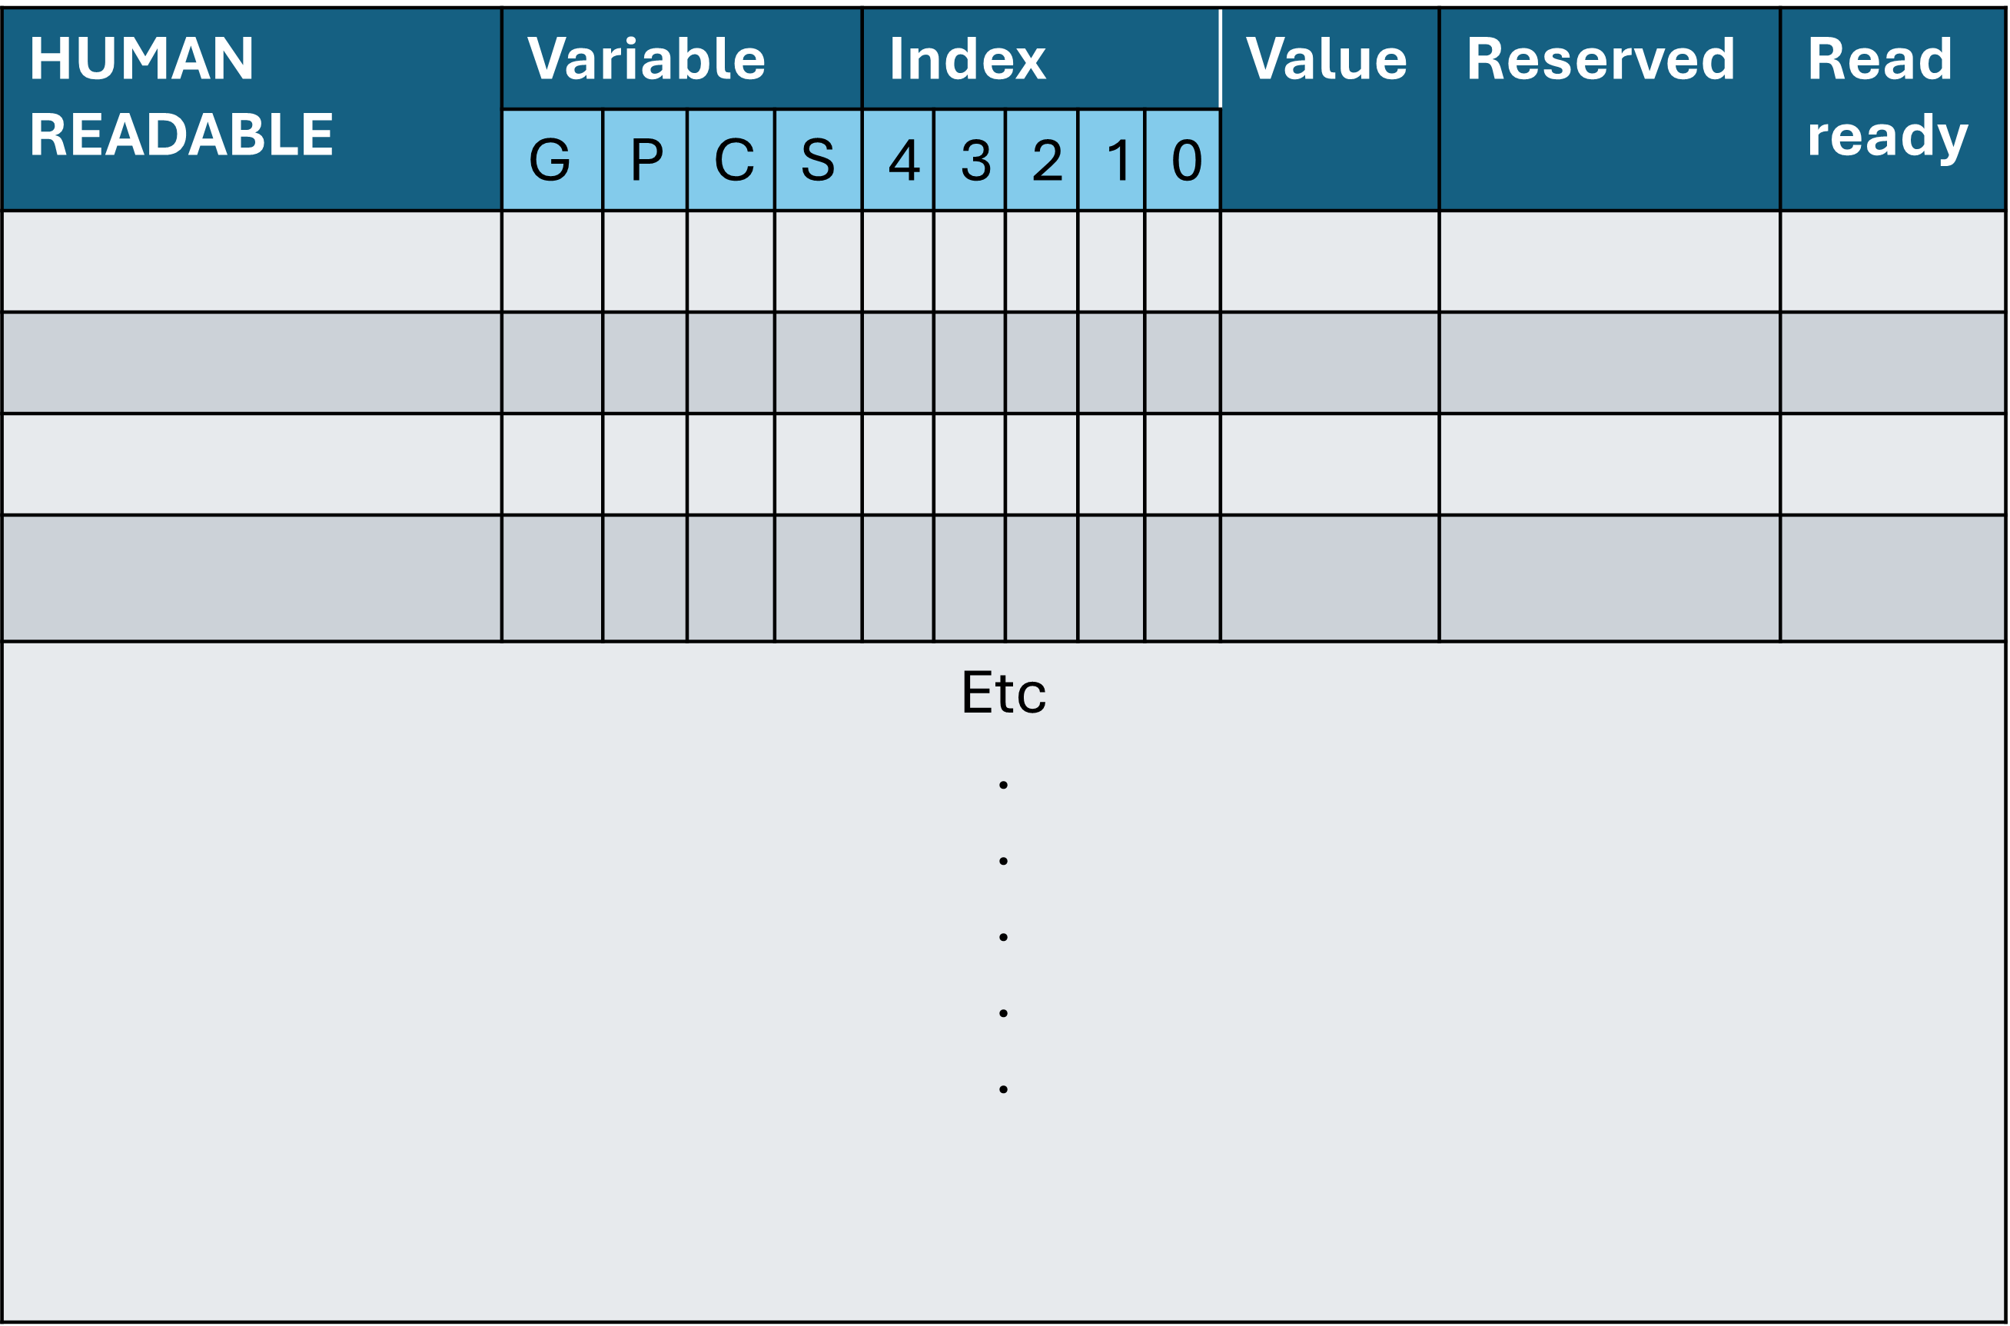
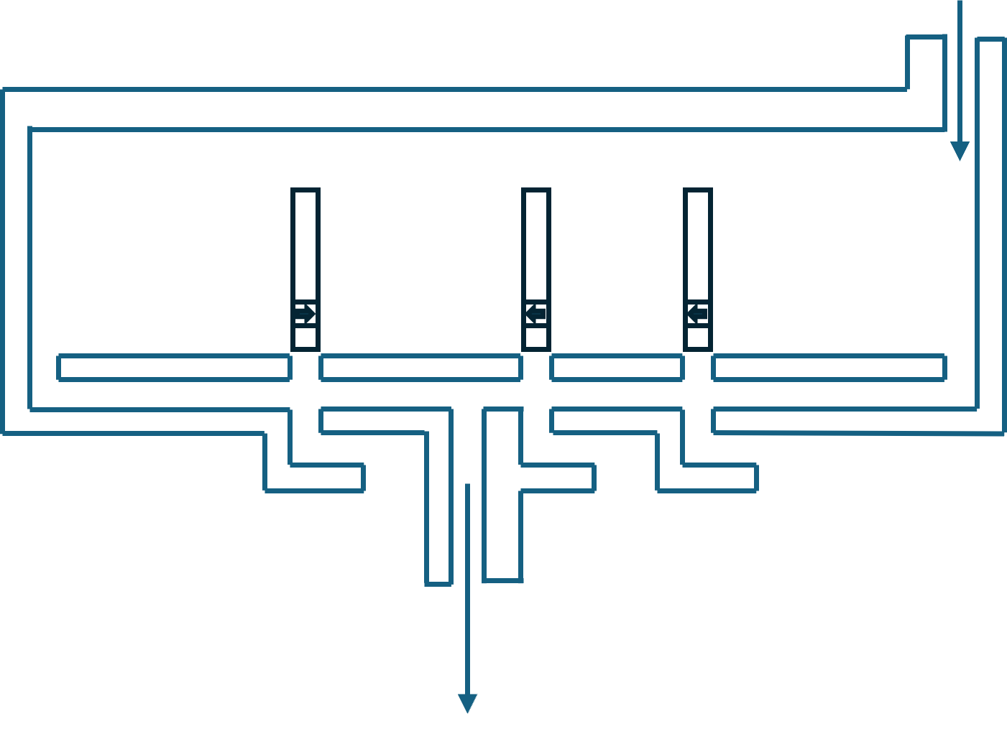
Rough proposed ant board and components
Sand grain storage
Input numbers in decimal
-gate
AND gate
*some number 1* eg 5
*some number 2* eg 3
1. Lay out grains for inputs
Input numbers in binary
2. Calculate
0 | 1 | 0 | 1
0 | 0 | 1 | 1
Memory
3. Display
AND/OR combo gate
Binary output cells
0 | 1 | 0 | 0 | 0
Display decimal final result
*some final number* eg 8

Slide 8
Procedure assuming 1 ant
4. Ant will now calculate P and G rows, starting with P LSB->MSB, using formula:
P_{i} = A_{i} XOR B_{i} ?
5. Memory row reserved for each Pi; filled in except for read-ready and value.
6. Each ‘calculation’ takes one trip to XOR gate, requiring up to three grains (two for input, another to try and pass through with).
7. The result is added to row ‘value’ for Pi, and ‘read-ready’ is checked.
8. When the P row is filled in, the ant starts with G in the same vein using the AND gate. AND grains are loaded, pins are closed, and ant records if he can pass through.
9. (G,P) for each i now calculated.
10. Ant then calculates P₁₋₀, P₃₋₂ , and P₃₋₀ (AND gate)
11. Ant then calculates G₁₋₀ , G₃₋₂ , and G₃₋₀ (OR/AND gate)
12. Ant then calculates P_{2:0} small using P₂ and P_{1:0} at AND gate
13. And then calculates G_{2:0} small using G₂, P₂, and G_{1:0} at OR/AND gate.
14. All (G,P) values are now known.
15. Each carry determined at OR/AND gate
16. Finally, all S_{i} calculated at XOR gate.
17. Each Si is then carried to output binary space, and when full, our decimal is displayed.
Ant ‘looks at’ one of the two inputs.
It moves to the input table and begins to lay out ONE of the inputs, from LSB to MSB, fetching grains as needed.
Ant ‘looks’ at the other number, then does the same.
Input numbers in decimal
*some number A* eg 5
*some number B* eg 3
Input numbers in binary
0 | 1 | 0 | 1
A
0 | 0 | 1 | 1
B

Slide 9
If more than 1 ant available, the following procedure will allow parallel tasks:
Reading in input decimals; for each ant that ‘looks’ at an input number, it can start helping ‘unpack’ the binary.
When a pair [A_{i} , B_{i}] becomes available, the P and G values for i can be calculated
d) If either (G,P) for 1,0 or (G,P) for 3,2 are available, (G,P)_{1:0} or (G,P)_{3:2} can be calculated.
e) Only after small binary (G,P)_{2:0} has been calculated, can the carries be calculated in parallel.
f) As pairs (P_{i} , C_{i}) become available, their S_{i} can be calculated.
Index |  |  |  | Var
3 | 2 | 1 | 0
 |  |  | 1 | A
 |  |  | 0 | B
 |  |  | * | P
 |  |  | * | G
*i=0 for both A and B filled; (G,P)_{I} can now begin in parallel

Slide 10
Graph summary of how parallelism ‘yields’ to other processes (assuming C₀ = 0)
Lay out binary for A and B
Calculate (G_{i} , P_{i})
If pair (A_{i} , B_{i}) becomes available
If pair (G,P)₁ and (G,P)₀ becomes available
Calculate (G, P)_{1:0}
Calculate (G, P)_{2:0}
If pair (G,P)₂ and (G,P)₃ becomes available
Calculate (G, P)_{3:2}
If pair (G,P)_{i:0} becomes available
If pair (G,P)₃ and (G,P)₀ becomes available
Calculate C_{i+1}
Calculate (G, P)_{3:0}
If C_{i} becomes available
Calculate S_{i}

Slide 11
‘Sector Map’ is represented as grids.
Uses ‘matrix’-like M x N naming.
‘Sectors’ are named sim areas corresponding to ant calculator components (e.g. Grain repo).
When describing a sector, ALL indexes must be held seeing as sector shape may be irregular.
0
1
2
3
4
5
6
0
1
2
Example: Grain repo (red)
Sector grain repo -> .cells=[
[0,5], [0,6],[1,5],[1,6],[2,6]
]
3
4
5

Slide 12

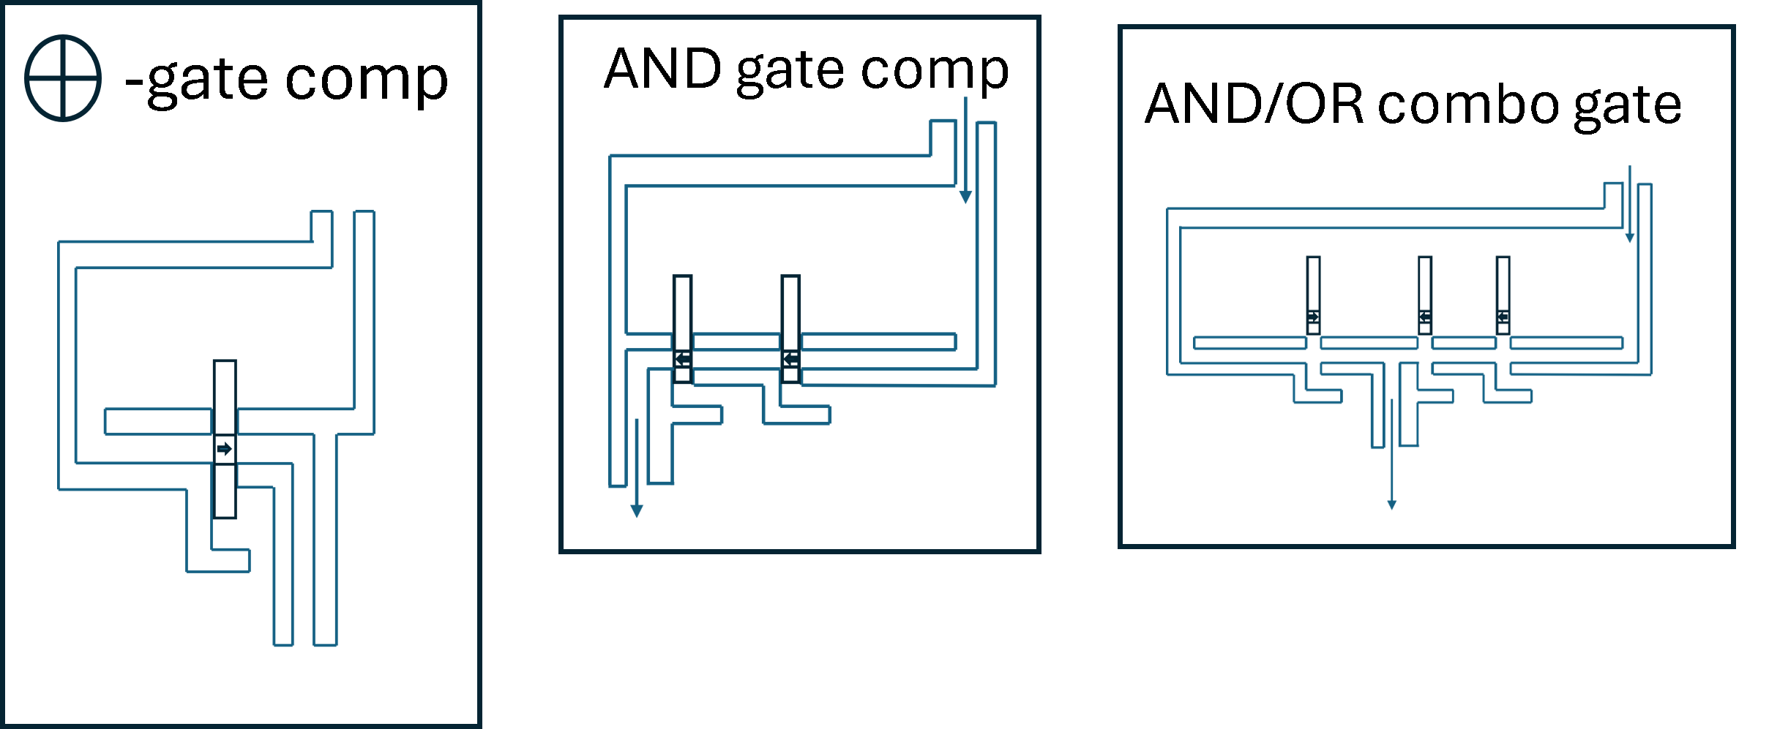
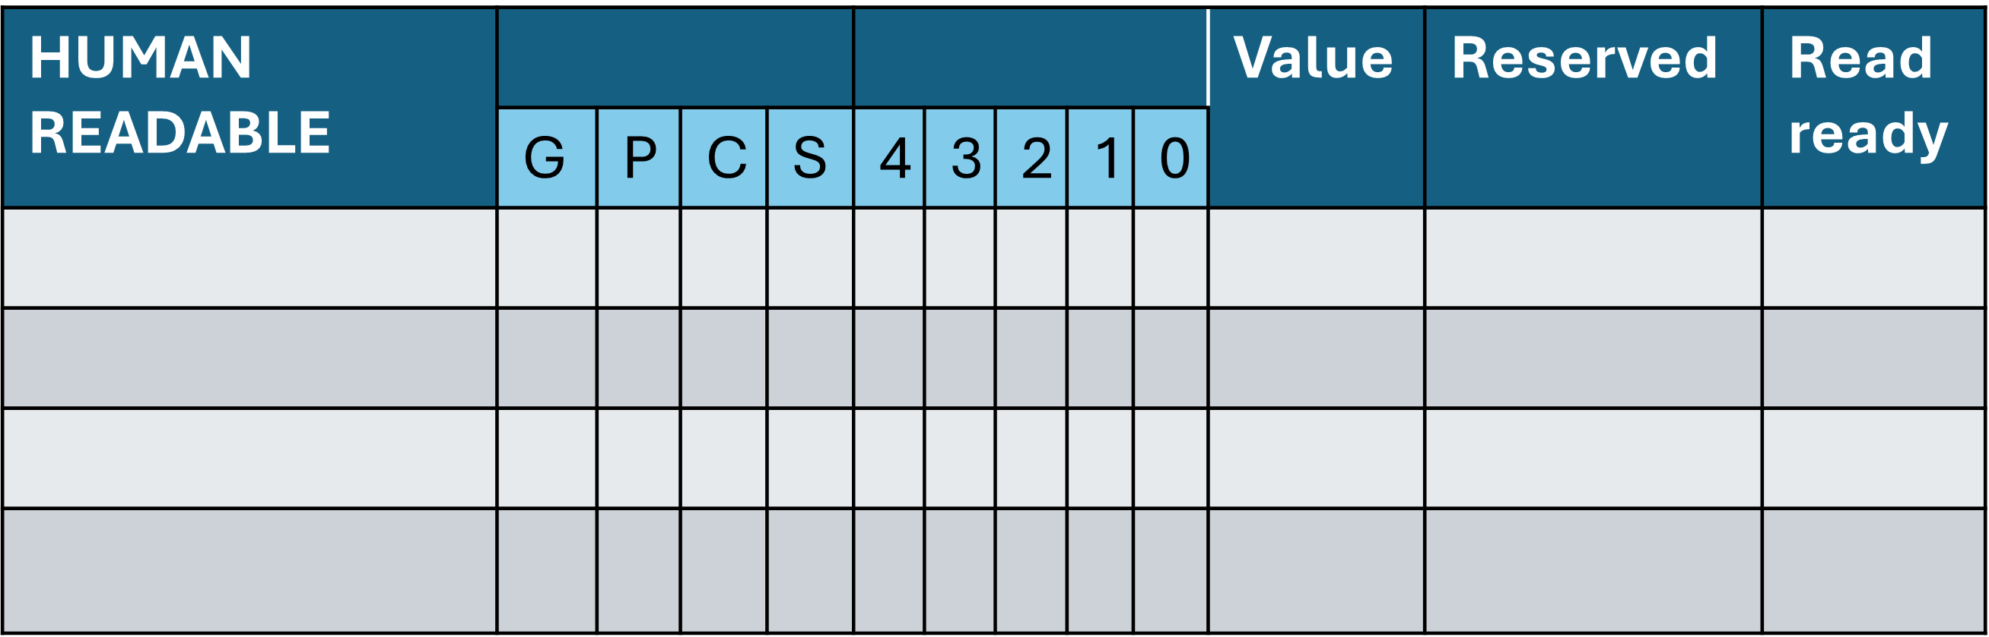
Example of Task progression:
Component: Job Board
Board snapshot 1 (not started)
Component: Decimal input display
A | ~
B | ~
Idle
Idle
Component: Input tracks
Idle
Steps available:
None
Steps complete:
None
Idle
Idle
Idle
Component: Memory Table
Component:
Grain repo

Slide 13
Example of Task progression:
Component: Job Board
1. Place grain in A₀ (assigned)
2. Place grain in A₁ (assigned)
3. Place grain in A₃ (assigned)
4. Place grain in B₀ (assigned)
5. Place grain in B₁ (assigned)
Board snapshot 2 (numbers submitted)
Job 1
Job 2
Component: Decimal input display
A | 11
B | 3
Job 3
Job 4
Job 5
Steps available:
Lay out input A
Lay out input B
Steps complete:
None
Component: Input tracks
Idle
Component: Memory Table
Component:
Grain repo

Slide 14
Example of Task progression:
Steps available:
Lay out input A
Lay out input B
Calculate G values
Calculate P values
Steps complete:
None
Component: Job Board
3. Place grain in A₃ (assigned)
5. Place grain in B₁ (assigned)
6. Place grain in Row 1 ‘reserved’
7. Place grain in XOR input 1
8. Place grain in XOR input 2
Board snapshot 3 (calculation in progress)
Component: Decimal input display
A | 11
B | 3
Idle
 | Component: Input tracks
A
B
Idle
Idle
Idle
Job 3
Job 5
Component: Memory Table
Component:
Grain repo

Slide 15
Example of Task progression:
Steps available:
Lay out input A
Calculate G values
Calculate P values
Steps complete:
Lay out input B
Component: Job Board
3. Place grain in A₃ (assigned)
6. Place grain in Row 1 ‘reserved’ (assigned)
7. Place grain in XOR input 1 (assigned)
8. Place grain in XOR input 2 (assigned)
Board snapshot 4 (calculation in progress)
Job 3
 | Component: Input tracks
A
B
Idle
Idle
Job 6
Component: Memory Table
Job 7
Component:
Grain repo
Job 8

Slide 16
Example of Task progression:
Steps available:
Lay out input A
Calculate G values
Calculate P values
Steps complete:
Lay out input B
Lay out input A
Component: Job Board
8. Place grain in XOR input 2 (assigned)
9. Place grain in Row 1 ‘P’ slot (assigned)
10. Place grain in Row 1 ‘0’ slot (assigned)
Board snapshot 5 (calculation in progress)
 | Component: Input tracks
A
B
Idle
Idle
Idle
Job 10
Job 9
Component: Memory Table
Component:
Grain repo
Job 8

Slide 17
Example of Task progression:
Steps available:
Lay out input A
Calculate G values
Calculate P values
Steps complete:
Lay out input B
Lay out input A
Component: Job Board
10. Place grain in Row 1 ‘0’ slot (assigned)
Board snapshot 6 (calculation in progress)
 | Component: Input tracks
A
B
Idle
Idle
Idle
Idle
Idle
Job 10
Component: Memory Table
Component:
Grain repo

Slide 18
Example of Task progression:
Steps available:
Lay out input A
Calculate G values
Calculate P values
Steps complete:
Lay out input B
Lay out input A
Component: Job Board
11. Operate XOR gate (assigned)
Board snapshot 6 (calculation in progress)
Idle
 | Component: Input tracks
A
B
Idle
Idle
Idle
Idle
Component: Memory Table
Component:
Grain repo
Job 11

Slide 19
Example of Task progression:
Steps available:
Lay out input A
Calculate G values
Calculate P values
Steps complete:
Lay out input B
Lay out input A
Component: Job Board
11. Operate XOR gate (assigned)
Board snapshot 6 (calculation in progress)
Idle
 | Component: Input tracks
A
B
Idle
Idle
Idle
Idle
Component: Memory Table
Component:
Grain repo
Job 11
P₀

Slide 20
Example of Task progression:
Steps available:
Lay out input A
Calculate G values
Calculate P values
Steps complete:
Lay out input B
Lay out input A
Component: Job Board
12. XOR result -> 0; place grain in Row 1 ‘read ready’ as value = 0 means no grain in ‘value’ column (assigned)
13. Clear XOR input 1 (assigned)
14. Clear XOR input 2 (assigned)
Board snapshot 6 (calculation in progress)
Idle
 | Component: Input tracks
A
B
Idle
Idle
Component: Memory Table
Job 12
Component:
Grain repo
Job 14
Job 13
P₀

Slide 21
The Memory table; three components
P | G | C | S | 4 | 3 | 2 | 1 | 0 | Val | Reserved | Read ready
1. ‘housing’
2. ‘memoryrow’
3. ‘cell’ (12 in a row)

