Slide 1
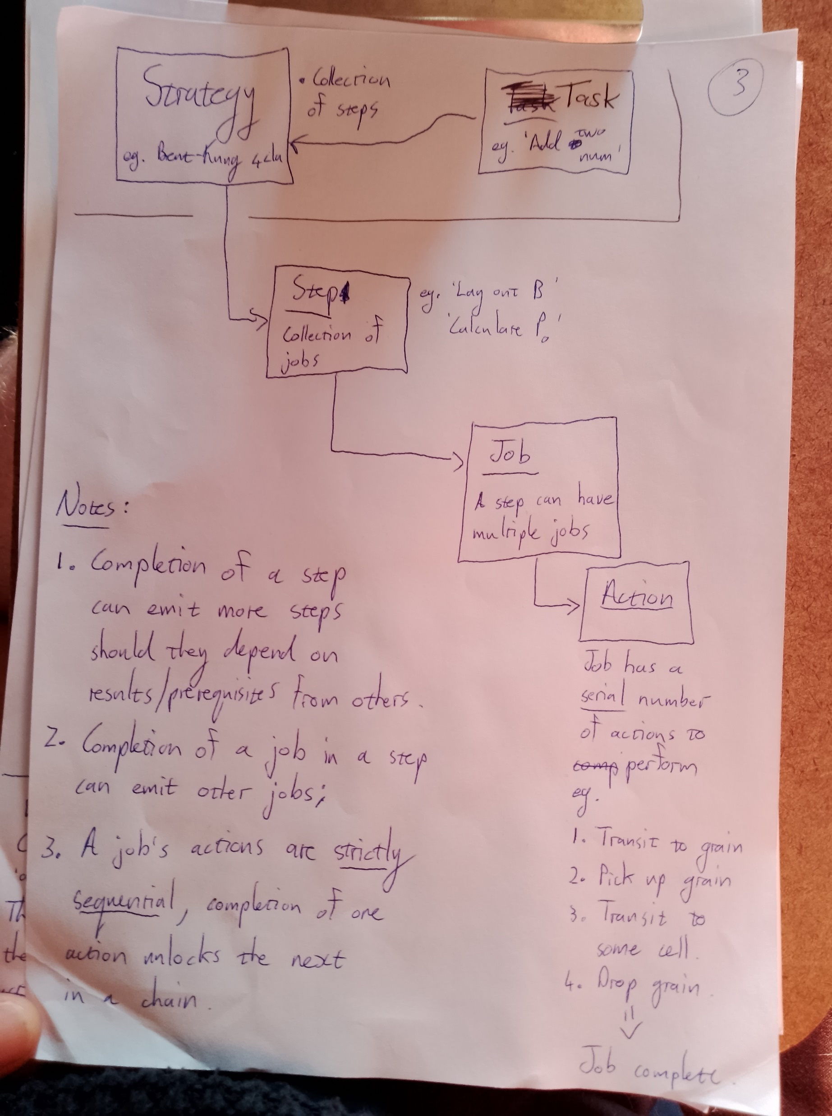
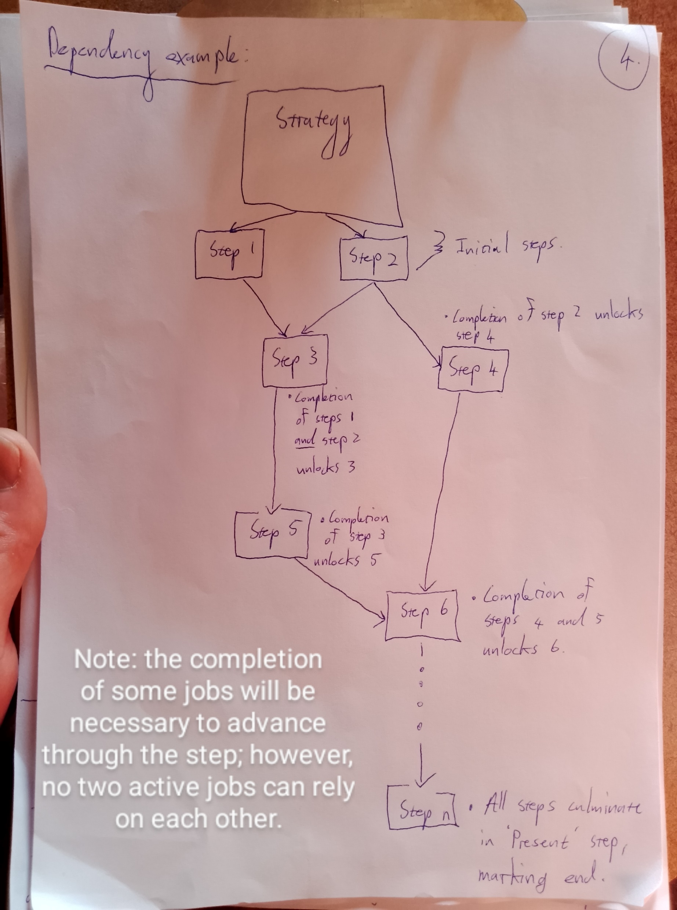

Slide 2
Task
‘Global’ goal; eg, ‘Sum two numbers’
Strategy
Define the steps necessary, and approach. More than one step can be available active at once; some steps are unlocked only when certain other steps have been completed (as in the tree diagram drawing)
Step
A piece in the strategy map; A step is composed of jobs. As exposed jobs in the step are completed, other jobs might be emitted
Job
A serial list of actions that will complete the job.
Actions
The smallest unit of ant behaviour; for example, ‘pick up’, ‘move to’, ‘put down’

Slide 3
Step 1
Step 2
Lay out A
Lay out B
Jobs
Jobs
Place grain in A₀
Place grain in A₁
Place grain in A₂
Place grain in A₃
Place grain in B₀
Place grain in B₁
Place grain in B₂
Place grain in B₃
Actions
Actions
Find grain
Transit to grain
Pick up…
Etc…
Find grain
Transit to grain
Pick up…
Etc…
Steps are configured in a tree; as certain conditions are met (i.e. , pair A_{i} and B_{i} becomes available), more steps are unlocked)
The completion of jobs in two different steps may lead to another step becoming available – HOWEVER, jobs are standalone items and are not directly linked to triggering steps.
As the number of named variables are small, a virtual representation of the calculation tracks which values in the process become available for calculation.

Slide 4
Step 3
Calculate P₀ value
Jobs
Reserve memory row
Place grain in row ‘P’
Place grain in index i
Place grain in XOR input 1 if applicable
Place grain in XOR input 2 if applicable
etc
As other A_{i} B_{i} values become available:
Step 4
Actions
Calculate P₁ value
Find grain
Transit to grain
Pick up grain
Transit to memory component
Inspect and find first ‘unreserved’ row.
Place grain in reserved
Etc…
Note:
The following jobs are then unlocked:
The steps and their dependencies for now will be hardcoded as config.
HOWEVER…as the particular input number is not known, something like a XOR gate may have to be loaded with 1, 2, or no grains.
Therefore, some jobs in a step may depend on the input.

Slide 5

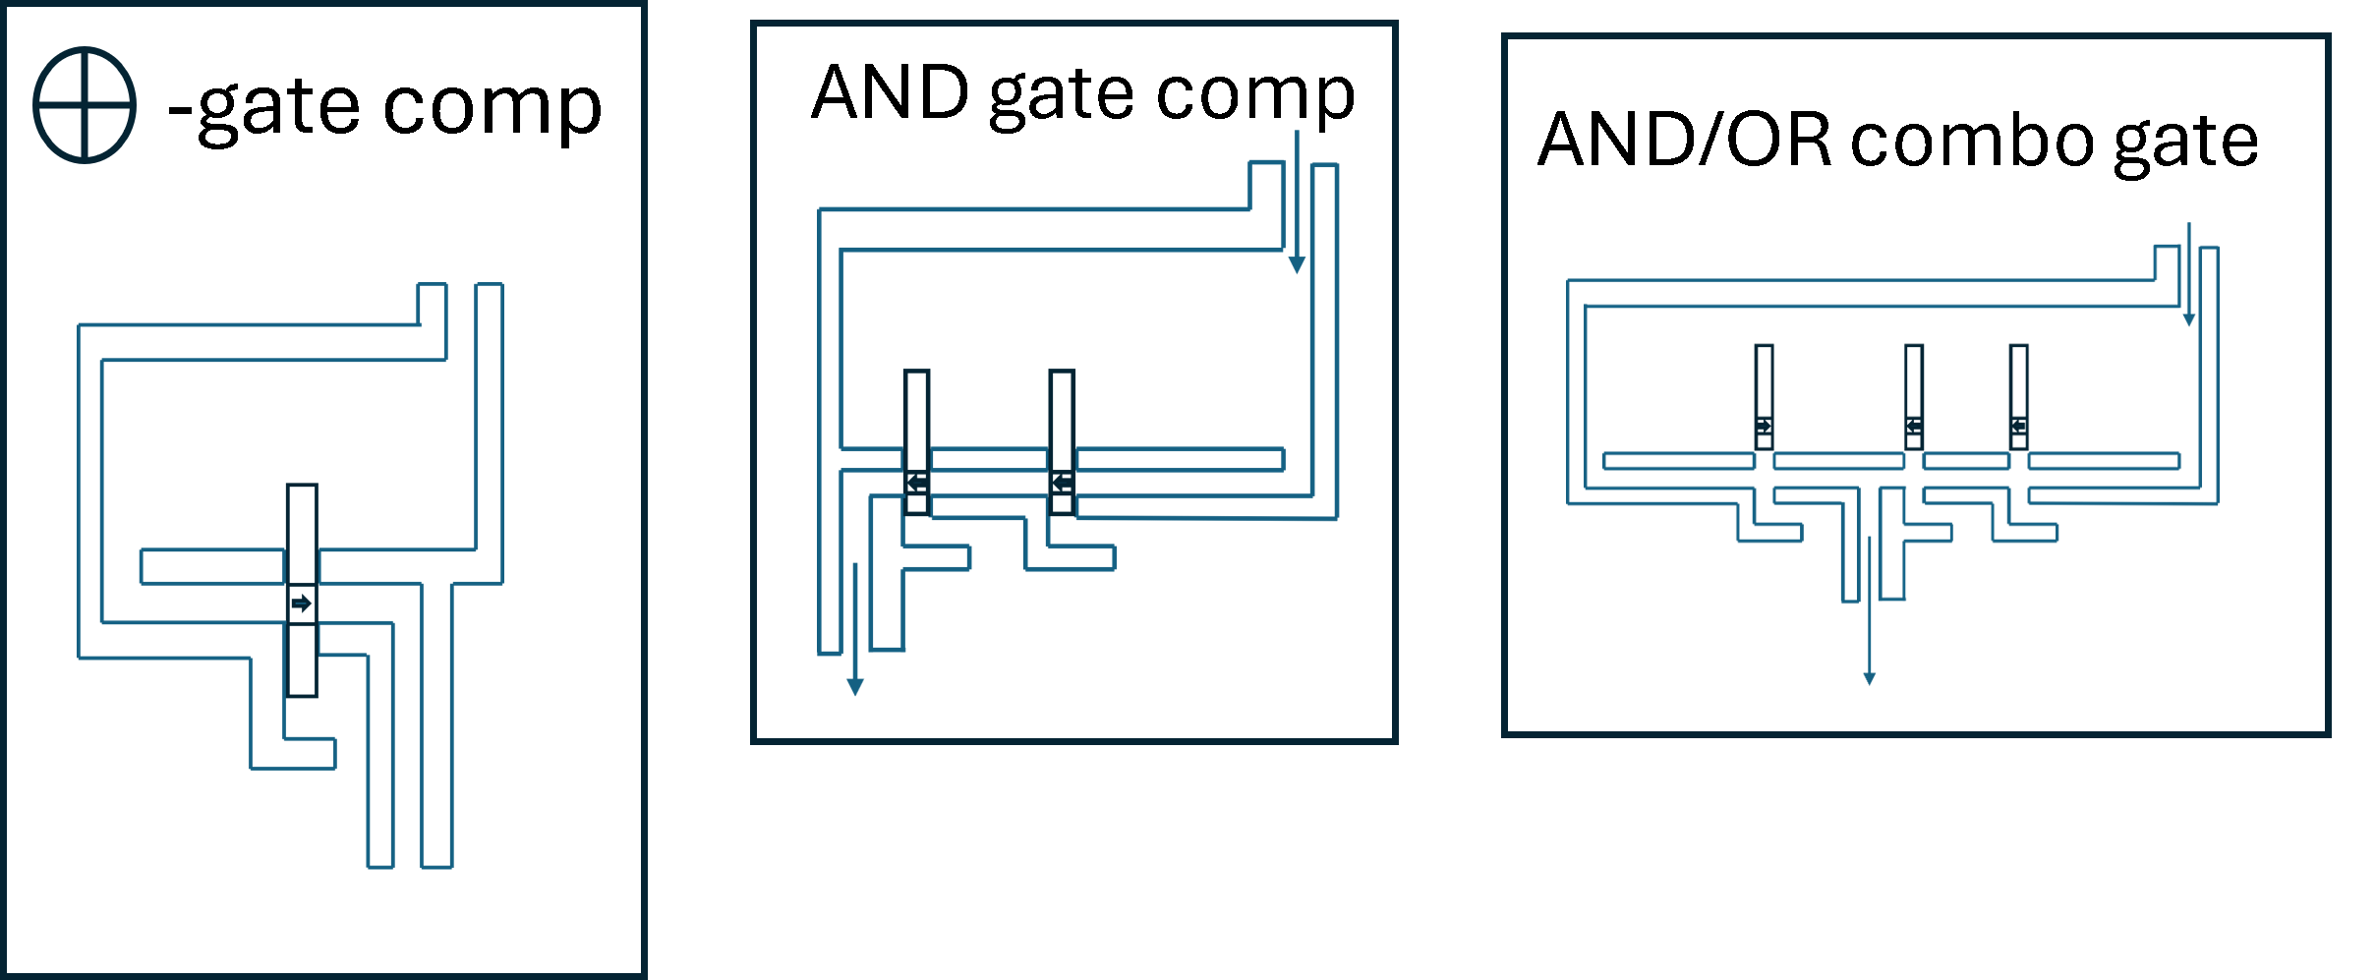
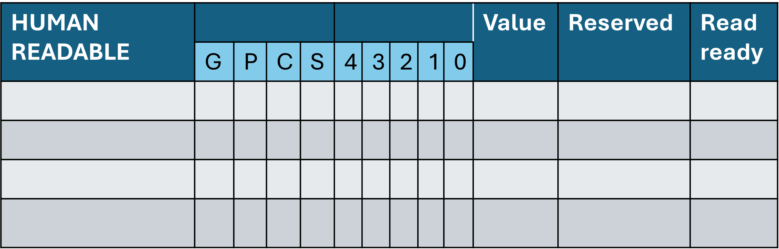
Example of Task progression:
Component: Job Board
Board snapshot 1 (not started)
Component: Decimal input display
A | ~
B | ~
Idle
Idle
Component: Input tracks
Idle
Steps available:
None
Steps complete:
None
Idle
Idle
Idle
Component: Memory Table
Component:
Grain repo

Slide 6
Example of Task progression:
Component: Job Board
1. Place grain in A₀ (assigned)
2. Place grain in A₁ (assigned)
3. Place grain in A₃ (assigned)
4. Place grain in B₀ (assigned)
5. Place grain in B₁ (assigned)
Board snapshot 2 (numbers submitted)
Job 1
Job 2
Component: Decimal input display
A | 11
B | 3
Job 3
Job 4
Job 5
Steps available:
Lay out input A
Lay out input B
Steps complete:
None
Component: Input tracks
Idle
Component: Memory Table
Component:
Grain repo

Slide 7
Example of Task progression:
Steps available:
Lay out input A
Lay out input B
Calculate P_{i} values (a pair (A_{i} , B_{i} available)
Steps complete:
None
Component: Job Board
3. Place grain in A₃ (assigned)
5. Place grain in B₁ (assigned)
6. Place grain in Row 1 ‘reserved’
7. Place grain in XOR input 1
8. Place grain in XOR input 2
Board snapshot 3 (calculation in progress)
Component: Decimal input display
A | 11
B | 3
Idle
 | Component: Input tracks
A
B
Idle
Idle
Idle
Job 3
Job 5
Component: Memory Table
Component:
Grain repo

Slide 8
Example of Task progression:
Steps available:
Lay out input A
Calculate P₀ (pair (A₀ , B₀) available)
Other P values…
Steps complete:
Lay out input B
Component: Job Board
3. Place grain in A₃ (assigned)
6. Place grain in Row 1 ‘reserved’ (assigned)
7. Place grain in XOR input 1 (assigned)
8. Place grain in XOR input 2 (assigned)
Board snapshot 4 (calculation in progress)
Job 3
 | Component: Input tracks
A
B
Idle
Idle
Job 6
Component: Memory Table
Job 7
Component:
Grain repo
Job 8

Slide 9
Example of Task progression:
Steps available:
Calculate P₀ (pair (A₀ , B₀) available)
Other avail P val…
Steps complete:
Lay out input B
Lay out input A
Component: Job Board
8. Place grain in XOR input 2 (assigned)
9. Place grain in Row 1 ‘P’ slot (assigned)
10. Place grain in Row 1 ‘0’ slot (assigned)
Board snapshot 5 (calculation in progress)
 | Component: Input tracks
A
B
Idle
Idle
Idle
Job 9
Job 10
Component: Memory Table
Component:
Grain repo
Job 8

Slide 10
Example of Task progression:
Steps available:
Calculate P₀ (pair (A₀ , B₀) available)
Other avail P val…
Steps complete:
Lay out input B
Lay out input A
Component: Job Board
10. Place grain in Row 1 ‘0’ slot (assigned)
Board snapshot 6 (calculation in progress)
 | Component: Input tracks
A
B
Idle
Idle
Idle
Idle
Idle
Job 10
Component: Memory Table
Component:
Grain repo

Slide 11
Example of Task progression:
Steps available:
Calculate P₀ (pair (A₀ , B₀) available)
Other avail P val…
Steps complete:
Lay out input B
Lay out input A
Component: Job Board
11. Operate XOR gate (assigned)
Board snapshot 7 (calculation in progress)
Idle
 | Component: Input tracks
A
B
Idle
Idle
Idle
Idle
Component: Memory Table
Component:
Grain repo
Job 11
P₀

Slide 12
Example of Task progression:
Steps available:
Calculate P₀ (pair (A₀ , B₀) available)
Other avail P val…
Steps complete:
Lay out input B
Lay out input A
Component: Job Board
12. Record XOR result -> 0; place grain in Row 1 ‘read ready’ as value = 0 means no grain in ‘value’ column (assigned) (result 1 would place grain in ‘value’ and only then read-ready)
13. Clear XOR input 1 (assigned)
14. Clear XOR input 2 (assigned)
Board snapshot 8 (calculation in progress)
Idle
 | Component: Input tracks
A
B
Idle
Idle
Component: Memory Table
Job 12
Component:
Grain repo
Job 14
Job 13
P₀

Slide 13
Example of Task progression:
Steps available:
Other avail P val…
P₀ read-ready; calculate G₀
Steps complete:
Lay out input B
Lay out input A
Calculate P₀ (pair (A₀ , B₀) available)
Component: Job Board
14. Clear XOR input 2 (assigned)
15. Reserve…
16. Another job…
17. etc…
Board snapshot 9 (calculation in progress)
 | Component: Input tracks
A
B
Idle
Job y
Job z
Job 14
Job x
Component: Memory Table
Component:
Grain repo
P₀

