Slide 1
How will your group work be assessed?

Slide 2
Individual Peer Assessed Contribution to group work
Why use IPAC?
Fairer: If you put in more work, you get a higher mark!
More representative of work in and out of class
Assesses work produced, teamwork qualities and professional conduct
Who better to assess these qualities than you?
Notes:
IPAC is a project involving a variety of staff/students looking at how to improve the marking of group work by giving members an individual mark based on an assessment completed by your team.
Usually everyone in the team will receive the same mark, we want to use a system where each member is assessed by their teammates so each member receives their own mark reflecting how much they contributed to the group.
The individual mark is fairer! If you put in more work, you get a higher mark, someone who doesn’t contribute to the group will get a lower mark based on what the team thinks. This will stop people thinking they can get away with not doing any work in the project and still come out with a good mark, this will encourage all members need to contribute to both the work and the dynamics of the team.
It’s all determined by you! Your marks reflect what the team member is actually like to work with in and out of class. The criteria used will assess the amount and quality of the work produced by the person, their team qualities and professional conduct. If someone produces the work, but doesn’t act within the team this will be shown and vis-a-versa.

Slide 3
How does it work?
You will still complete the project in the same way, you will produce a piece of work that is assessed by the tutor to give a group mark.
At the end of the project, each teammate will assess themselves and their peers according to the contribution to the group. Criteria could include things like ability to work in a team, effort, quality of work. The ratings will be used to create an IPAC factor to suitably adjust the group mark for each member.

Slide 4
How does it affect you?
It gives you a platform to indicate and reflect on how the group functioned
Your individual mark will be fairer and more representative than the group mark
You will need to complete a questionnaire on Moodle at the end of the project assessing your group peers
Receive feedback and understand how your peers perceive your performance
Improve your teamwork skills and professional conduct
Notes:
Through the assessment process, you will reflect on how the team functioned. If a member is marked consistently low by all teammates, this will be flagged by the tutor and can be dealt with appropriately.
The mark you receive will let you reflect on the piece of work you produce as a team as well as how the team and its members functioned to complete this. This should encourage all members to participate as people can no long free ride on any work you produce and receive the same grade.
You just need to complete 1 form on Moodle! The form includes the option to write comments about each member which you get back anonymously, this will give you justification for the marks you receive and where you can improve. You will also understand more about how your peers perceive you, for example if you are above or below the average.
Through the feedback you can improve on your teamwork abilities as you will understand your role in the team more, this will be important to employers!

Slide 5
How is IPAC applied?
Multiplication: Group mark * IPAC
E.g. group work assessed at 65%
Student | IPAC | Individual mark
A | 1 | 65
B | 1.2 | 78
C | 0.95 | 61.75
D | 0.85 | 55.25
Notes:
Your final grade can be calculated using multiplication between the group mark and IPAC score. For example if your group mark is worth 65% of the final group and each member had varying levels of contribution, you can see how the mark changes for each member. Here you can see student B did the most work and D the least and how much the individual marks varied for these. If all members receive the same ratings and all get an IPAC rating of 1, all of the team members will receive the same mark.

Slide 6

How is your IPAC rating calculated?
5 attributes: C₁, C₂, C₃, C₄, C₅
Normalisation
$$IPAC= \frac{C_{1}+C_{2}+C_{3}+C_{4}+C_{5}}{5}$$
 | Student A | Student B | Student C | Average
IPAC Rating | 3.7 | 4.2 | 5.1 | 4.3
Normalised rating | 0.85 | 0.96 | 1.18
$$normalised mark= \frac{average mark received}{average for group}$$
Notes:
Each criteria has a weighting that affects how it changes the IPAC rating received.
Delete as appropriate: If you have 5 different attributes of equal weights, the average is calculated. Each criteria could also have a different weighting and the calculation changes as shown.
A calculation can be completed within the system called normalisation which gives the IPAC rating about 1/100% (delete as appropriate). This is calculated by the average mark the person receives / the average mark of the group. Here is an example of 3 members receiving their IPAC ratings which have a team average of 4.3. Dividing each rating by the average gives the normalised value. This also allows you to see how you compare to the rest of the team without you receiving the marks of every member in the team. For example, if you were student C and received the mark of 1.18 you would know that you appreciated by the team and hence received a higher mark.

Slide 7
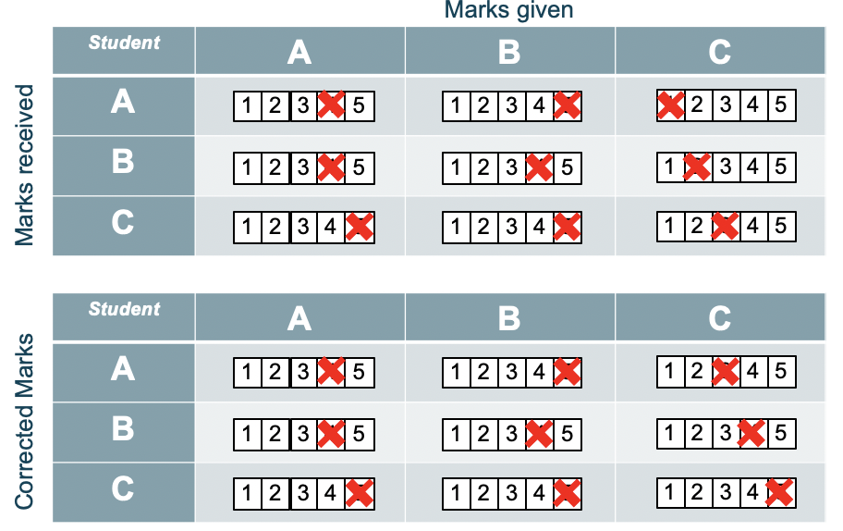
Correcting for Different Markers (students)
Notes:
We understand different studies will be more generous or harsher when assessing their team, a method called bias correction can be used that shifts these marks about a normal. Using this simple example, you can see students A and B have marked themselves and their peers around the 4 or 5 mark and C has marked the lower end of this scale. The ratings C gave will effectively be scaled up to account for the harsh marking but the order of the ranking kept the same.

Slide 8
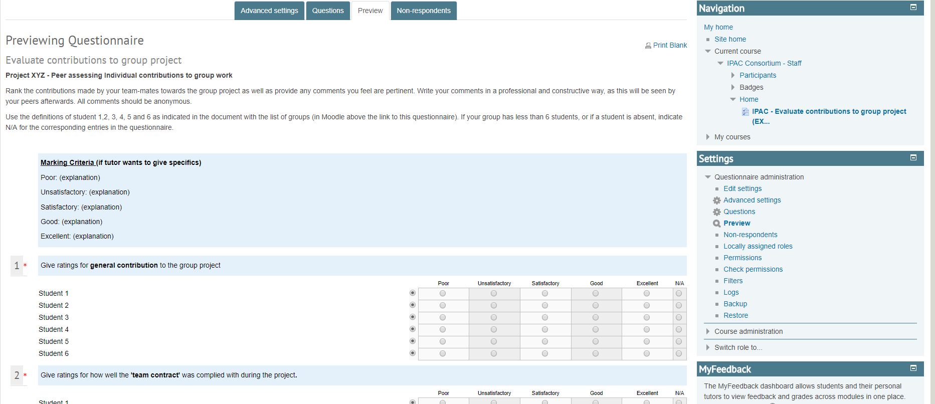
Completing the Assessment
Notes:
To assess each member, you will answer a Moodle questionnaire of about 6 questions assessing different qualities. The ratings for each teammate will be combined to produce the IPAC factor.

Slide 9
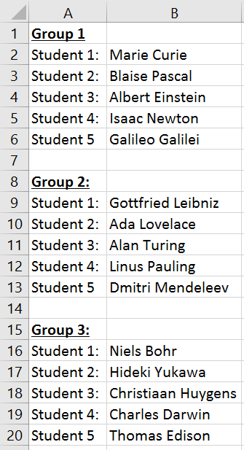
Group members
You will be provided with a document similar to this indicating who student 1, 2, 3 etc are when you are filling the form in.

Slide 10
Column for a non-applicable student
The column for a non-applicable student can be used if your team has one less member than the standard team size
For example, the following shows a team which only had 5 people rather than 6 in it
Notes:
The column for a non-applicable student can be used if your team has one less member, for example here if your team only had 5 people in it, or if a student gets removed from the team or doesn’t turn up.

Slide 11
Justification
You will be required to write a short justification for your assessment of each student.
Write it in a professional, constructive and concise manner
Be honest
Justification you write will get released back to your peers as feedback!
Rather than saying… | Say…
It was annoying that you turned up to meetings late. | You could improve on your punctuality to meetings, and this would help to make the meetings more successful.
You never listened to your team. | You are good at proposing actions and that is very valuable to move things along. However you could work on your ability to take other people’s ideas into consideration, as it was not always clear that this was the case. It is always beneficial for the team to consider a range of ideas/solutions and to hear your critical analysis of each of them.
Notes:
The comments that you write will get used as feedback so your teammates will read them! Make sure you write these in a professional, constructive and concise manner so your teammates take the comments well and use them to improve. This is a good opportunity to raise any issues you have to help them improve to be a better team member – which may help you if you have to work with them again so be honest! Likewise, when this feedback is returned, be receptive and open to criticism, it’s only there to help you!
It’s very important to write comments in the right way…

Slide 12
Feedback and marks will appear in the gradebook on Moodle

Slide 13
When is the tutor involved? – Moderations
Review and moderate comments (penalise inappropriate language)
Ensure the marks and comments are consistent
Compare tutor observed class dynamics with peer marks
Filtering out marks given by low-scoring students
If a student receives an IPAC lower than 0.4, the marks given by them will not get included in the final calculation (as they may not have contributed enough to have sufficient knowledge of how the team performed)
Check for gaming behaviour

Slide 14
What will you be assessed on?
Each group should agree on 4 criteria on which to assess each other. If the group does not wish to choose their own then they may use the following criteria instead.
Criteria | Definition
Attendance | Attending scheduled tutorial sessions, meetings with the TA and other meetings arranged outside of these
Effort | The student’s attitude to work in and out of the class, reflects their attentiveness and contribution to discussion and work load
Quality of work | A reflection of how complete, accurate and informative the work the student produced was
Teamwork | Demonstrates a cooperative and supportive attitude

Slide 15
What does each band mean?
Rank | Definition
Poor | Student did not achieve this criteria point at all
Unsatisfactory | Student needed encouragement and was often unwilling
Satisfactory | Student completed what was expected of them but nothing more
Good | Student did slightly more than expected and was a benefit to the group
Excellent | Student went above and beyond for this project and was essential to the team
Notes:
Here are some explanations of what each ranking means.

Slide 16
What to do if a team member isn’t really a team member
Try to address it in your team
Encourage, adapt, listen to needs, see their strengths
Send reminder emails about work or meetings – but do so without being patronising and in a professional manner
Raise it with your tutor during the project if it’s persistent
Raising the issue doesn’t mean their mark will get penalised, it means the tutor is aware of the problem and can monitor it to decide on the best course of action
Notes:
If you have a team member who you and your team feel like isn’t participating enough, try to resolve it in your team first. You could identify and their strengths and adapt to these, give extra deadlines and send reminder emails about work or meetings – but do so without being patronising and in a professional manner. If their behaviour doesn’t change, raise it with your tutor. Just because you raise the issue doesn’t mean their mark will get penalised, it means the tutor is aware of the problem and can monitor it to decide on what the best course of action to take is.
Raising this as an issue is important! Although they may pass the module or project if you don’t report them, they’re not improving their skills, which they’ll need later in life, and can be damaging to them and to your classmates when they next have to work with them. This will help you to develop assertive skills by dealing with free riders in a secure place where they will be able to develop before they get a job.
Also, due to how the individual grades are calculated, if you mark your teammate down, your mark will go up! However, this has to be justified, if your marks are consistently low and you’re trying to play the system, this will be detected and either corrected using the method mentioned or alerted to the tutor who will decide what to do with your evaluation.

Slide 17
When will the peer assessment be completed?
At the mid-point of the project (end of week 5) - formative
On submission of the final report – to calculate the final marks
Notes:
Note to tutors: Add here information relevant to your project. You could complete the assessment at the end, end and midterm, or multiple times during the project. We recommend giving students sufficient time to have information to assess their teammates on before the initial assessment, and enough time after to take the comments and improve on their skills.

Slide 18
Alternative Assessments
If a student does not engage in group work and receives an IPAC rating lower than 0.4/40% at the mid-term assessment then this will be investigated with the tutor and group concerned.
If a student does not engage in group work and receives an IPAC rating lower than 0.4/40% for the final assessment then they will receive no marks (0%) for the assignment and will be required to complete an alternative assignment. This will be set in accordance with the late summer assessment.

Slide 19
Conclusion
Group work allows for bigger projects and gives relevant experience
Individual marks based on student’s contribution should be awarded
The process gives you the opportunity to get feedback from your peers

