Slide 1
AGREE Event Port Semantics

Slide 2
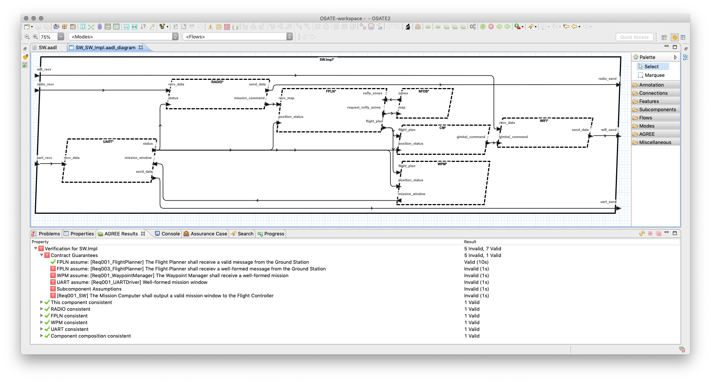
FPLN Assumes Well-formed Mission Commands
Notes:
See SW::SW.Impl.

Slide 3
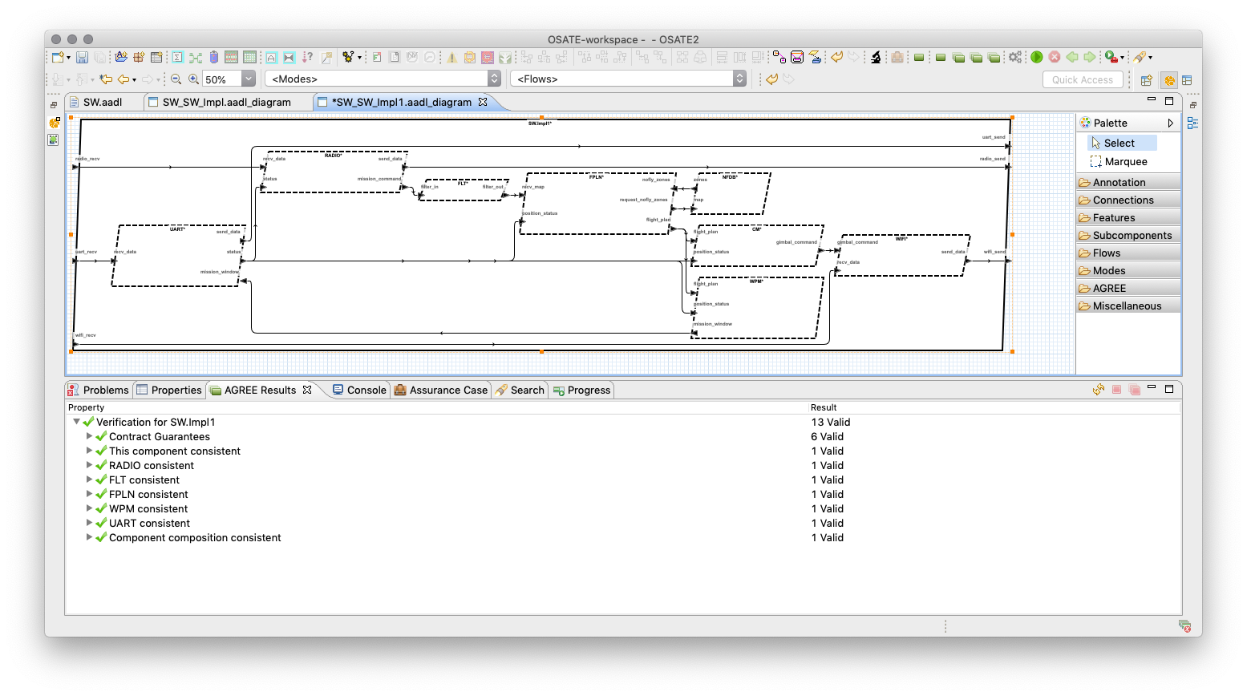
FLT guarantees well-formed but uses event ports that have no AGREE semantics
Notes:
See SW_FLT::SW.Impl

Slide 4

Does AGREE need event semantics

Slide 5
node _TOP__FLT(
__ASSUME__HIST : bool;
filter_in___EVENT_ : bool;
filter_in : SW__RF_Msg__Impl;
time : real;
filter_out___EVENT_ : bool;
filter_out : SW__RF_Msg__Impl
) returns (
__ASSERT : bool
);
var
__GUARANTEE0 : bool;
__GUARANTEE1 : bool;
let
__GUARANTEE0 = SW__VALID_MESSAGE(filter_out);
__GUARANTEE1 = SW__WELL_FORMED_MESSAGE(filter_out);
__ASSERT = (__ASSUME__HIST => (__GUARANTEE1 and __GUARANTEE0));
--%IVC __GUARANTEE0, __GUARANTEE1;
tel;
No input to output relationships: output is not a direct function of the input
No constraints on when events occur
Proof obligation does not need input to output relation to show property
So output may be unrelated to input
How much does that matter?

Slide 6
It depends…
The contract needs the behavior if the proof on the binary is to mean something -- the binary performs the computation
But for cyber properties, is that important?
How much behavior should be included in the contract? For a proof or correctness, the computation needs to be defined
In any case, if the contract guarantee is a function of the input, then events will need to be modeled or some initial value needs to be defined for stuttering

Slide 7
No Behavior in contract: output is not a function of the input
guarantee SW_FLT_Req001_CASE_Filter
"Only valid command messages shall be forwarded to message destination components":
SW::VALID_MESSAGE(filter_out);
guarantee SW_FLT_Req001_FLT
"Only well-formed messages shall be forwarded to message destination":
SW::WELL_FORMED_MESSAGE(filter_out);
Behavior in contract: output depends on input
guarantee SW_FLT_Req001_CASE_Filter
"Only valid and well-formed command messages shall be forwarded.":
SW::VALID_MESSAGE(filter_in) and SW::WELL_FORMED_MESSAGE(filter_in) =>
(filter_out = filter_in);
guarantee SW_FLT_STUTTER
"Stutter if input is not a valid and well-formed message":
not(SW::VALID_MESSAGE(filter_out) and SW::WELL_FORMED_MESSAGE(filter_out)) =>
prev(filter_out, INIT) -- What should INIT?
Notes:
It is possible to connect inputs to outputs without events but the modeler would need to introduce an initial message that is valid and well-formed so that the output can stutter in the absence of valid input—initialization problem…

Slide 8
AGREE Event Port Semantics for Assume
in₁
out₁
in₂
out₂
in_{n}
out_{m}
-- Constraint on any group of inputs only holds at the event
assume constraint_in ”in constraint”:
event(in_{i}) and … => constraint_in(in_{i}, …);
…
Only include the event based ports on left (could mix with regular ports)
All input events listed must be present for the constraint to hold
Notes:
Constraint_in() is some function over the inputs that participate in the constraint
It still is not clear that events add any real meaning to the proof: the proof certificate provides no additional assurance over that without events.

Slide 9
AGREE Event Port Assume Syntax
assume constraint_in₁ ”in₁ constraint”: constaint_in₁(in_{_1});
assume constraint_in₂_in₃ ”in₂ and in₃ constraint”:
constaint_in₂_in₃(in₂,in₃);
…
-- Constraint on any group of inputs only holds at the event
assume constraint_in₁ ”in₁ constraint”:
event(in₁) => constraint_in₁(in₁);
assume constraint_in₂_in₃ ”in₂ and in₃ constraint”:
event(in₂) and event(in₃) => constaint_in₂_in₃(in₂,in₃);
…

Slide 10
AGREE Event Port Semantics for Guarantee
in₁
out₁
in₂
out₂
in_{n}
out_{m}
-- Define when out₁ fires relative to input and output events and values
guarantee event_out₁ ”out₁ event condition”:
event(out₁) <=> (event(in_{i}) and … and event(out_{j}) and … and event_out₁(in_{i},…,out_{j},…));
-- Define constraints on the value of out₁ at the time of its event
guarantee constraint_out₁ ”out₁ constraint at event”:
(event(out₁) and event(out_{j}) and …) => constaint_out₁(in_{i},…,out_{j},…);
Notes:
event_out1(…) is a fuction defined over input and output values that determine when the output should fire.
Constraint_out1(…) is a function defined over input and output values that determine what the output should look at the time the output event fires.
Only include input event ports in the condition trigger as with assume statements.

Slide 11
AGREE Event Port Guarantee Syntax
out event out₁ ”out₁ event condition” : event_out₁(in_{i},…,out_{j},…);
guarantee constraint_out₁ ”out₁ constraint”: constaint_out₁(in_{i},…,out_{j},…);
out event out₂ ”out₂ event condition” : event_out₂(in_{x},…,out_{y},…);
guarantee constraint_out₂ ”out₂ constraint”: constaint_out₁(in_{x},…,out_{y},…);
…
-- Define when out₁ fires relative to input events and values
guarantee event_out₁ ”out₁ event condition”:
event(out₁) <=> (event(in_{i}) and … and event_out₁(in_{i},…));
-- Define constraints on out₁ at the time of its event
guarantee constraint_out₁ ”out₁ constraint”:
(event(out₁) and event(out_{j}) and …) => constaint_out₁(in_{i},…,out_{j},…);
…

Slide 12
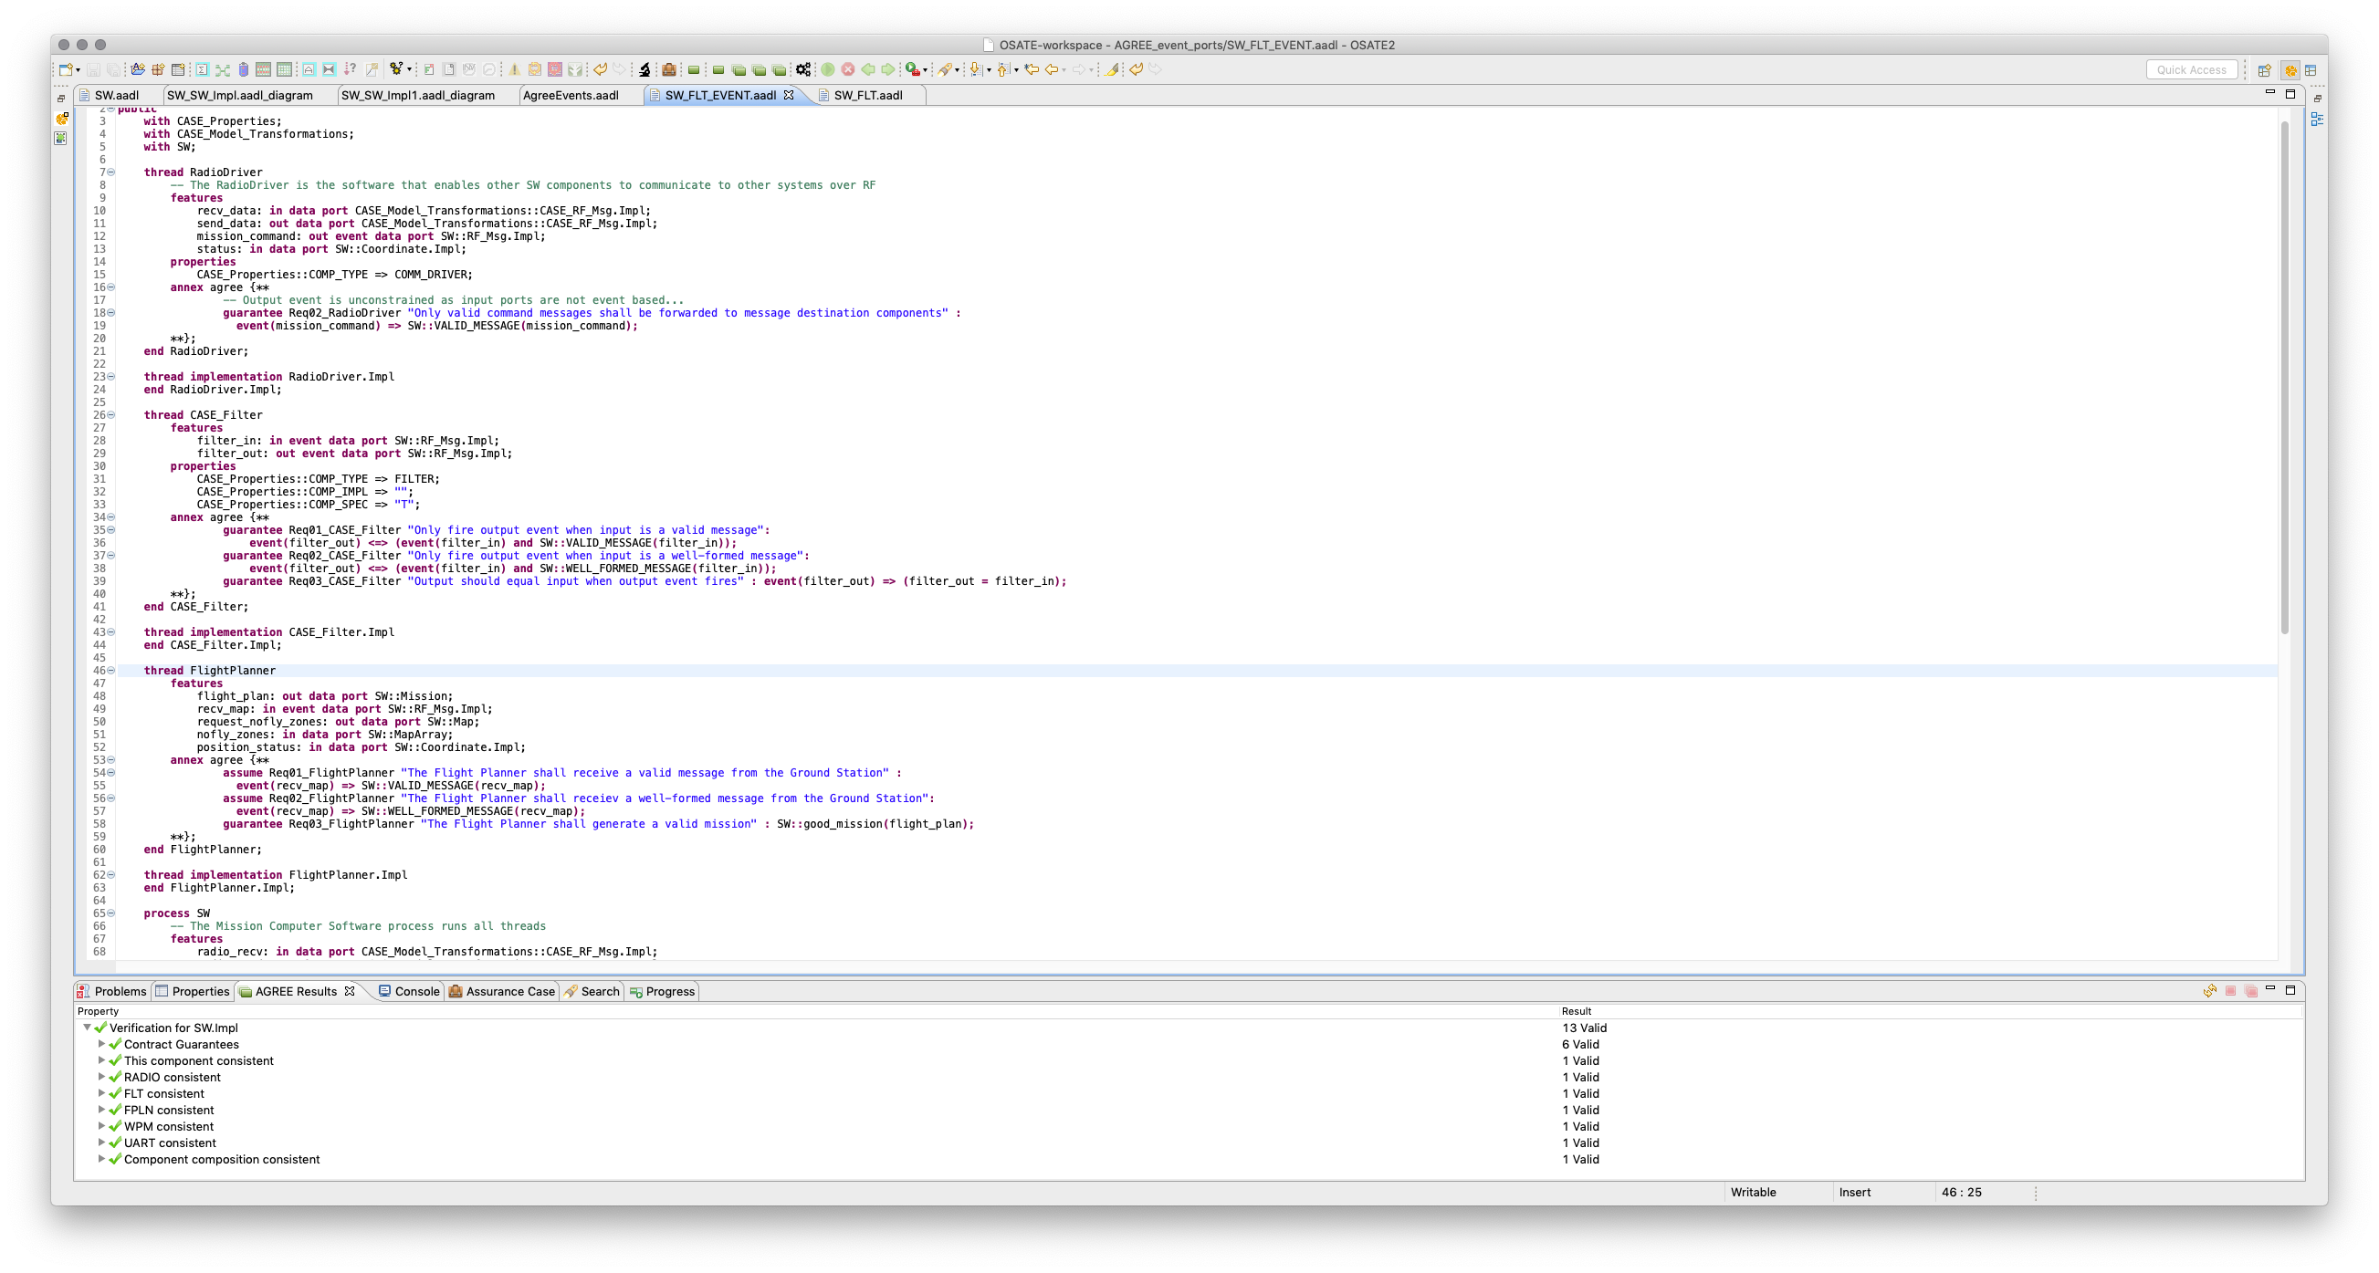
With event semantics on the contracts
Notes:
See SW_FLT_EVENT::SW.Impl

Slide 13
If no events, does the contract hold?

Slide 14
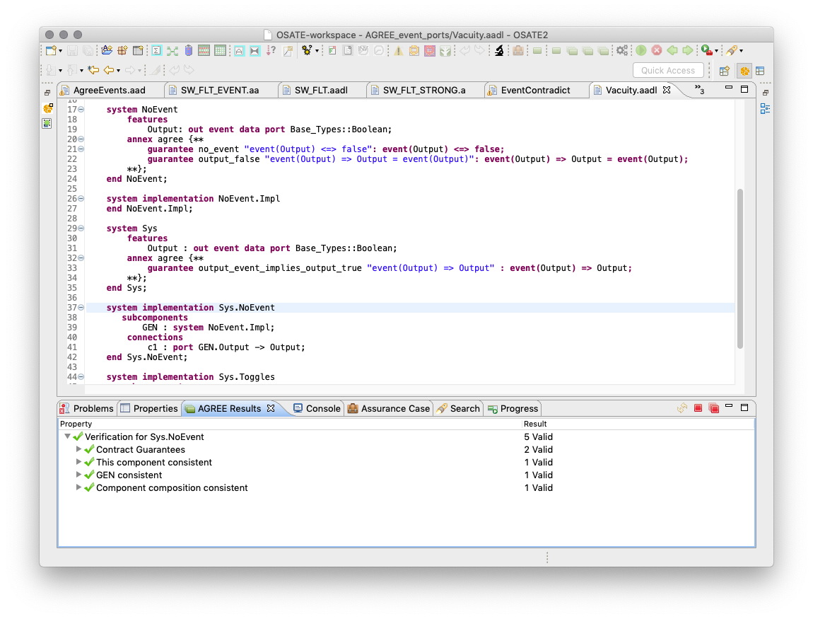
No output event
Output high
Notes:
Write contract that fires no output event: trigger condition is always false.
Look at the contract semantics to see if it is possible to have an always false trigger condition. If yes, then how would it be verified? Does consistency catch it?

Slide 15
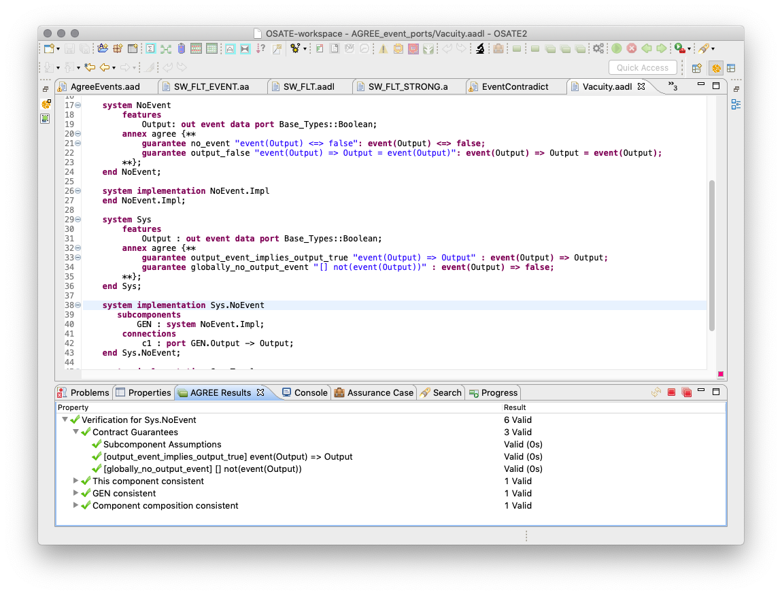
No output event
Output high
Should fail on event
Bad!
Notes:
See Vacuity::Sys.NoEvent

Slide 16
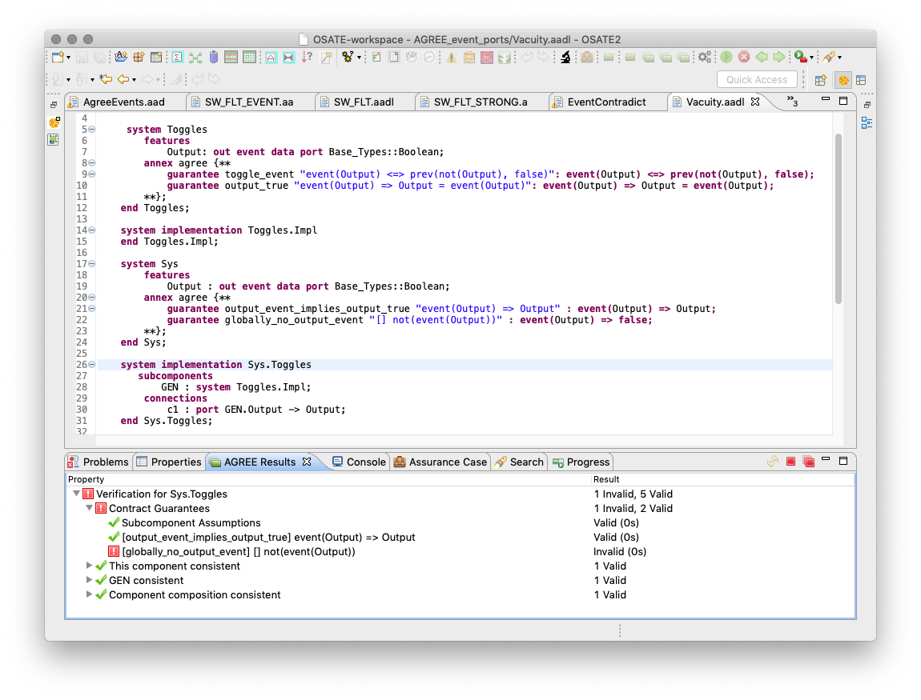
Output event toggles
Good
Notes:
See Vacuity::Sys.Toggles.

Slide 17
Modified AGREE Semantics to Witness Event
in₁
out₁
in₂
out₂
in_{n}
out_{m}
-- Define when out₁ fires relative to input and output events and values
guarantee event_out₁ ”out₁ event condition”:
event(out₁) <=> (event(in_{i}) and … and event(out_{j}) and … and event_out₁(in_{i},…,out_{j},…));
-- Define constraints on the value of out₁ at the time of its event
guarantee constraint_out₁ ”out₁ constraint at event”:
(event(out₁) and event(out_{j}) and …) => constaint_out₁(in_{i},…,out_{j},…);
-- Witness out event condition (should fail)
guarantee globally_no_event_out₁ ”[] not(event(out₁))”: not(event(out₁));
Notes:
event_out1(…) is a fuction defined over input and output values that determine when the output should fire.
Constraint_out1(…) is a function defined over input and output values that determine what the output should look at the time the output event fires.
Only include input event ports in the condition trigger as with assume statements.

Slide 18
General Concern With AGREE Semantics
There are no semantics---what does model checking actually prove?
The meaning of AGREE is understood relative to the LUSTRE model
The LUSTRE model is not easy to understand
The LUSTRE translation framework is anything but direct and simple

Slide 19
Consider Formalizing AGREE Semantics
Prove LUSTRE model implements AGREE semantics
Connects model checking result to the meaning of AGREE
We insist on this fidelity with SPLAT to seL4
Why not with AGREE?
Turns on a synthesis path from AGREE to verified software
For a leaf component:
Write a contract in AGREE
Write an implementation in AGREE
Verify implementation satisfies contract
Compile implementation down to actual code in something similar to SPLAT
Without liveness it’s hard to show the implementation does anything

Slide 20
system Filter
features
Input: in event data port Base_Types::Integer;
Output: out event data port Base_Types::Integer;
annex agree {**
guarantee Gua01_output_equals_input "Output = Input":
event(Output) => Output = Input;
guarantee Gua02_output_in_range "output when Input in range":
event(Output) <=> (event(Input) and LOW <= Input and Input <= HIGH);
**};
end Filter;
system implementation Filter.Impl
annex agree {**
eq val: int = Input;
eq in_range: bool = (LOW <= val and val <= HIGH);
eq has_input : bool = event(Input);
assert event(Output) = (has_input = true and in_range = true);
assign Output = if (has_input = true and in_range = true) then val else LOW;
**};
end Filter.Impl;
Notes:
The formal semantics would enable us to
Verify that Filter.Impl satisfies the Filter contract
Compile Filter.Impl down to actual code for the filter
AGREE is a simple language…
Would need to give more control to specifying output event behavior in the implementation.
Would need something more than contracts to indicate the implementation does more than just meet the contract---liveness maybe?

Slide 21
Other Random AGREE Things
Contracts have a global namespace
Can be solved with naming convention: pkg_component_*
AADL scoping would be nice though…

