Slide 1
AGREE Event Port Semantics

Slide 2
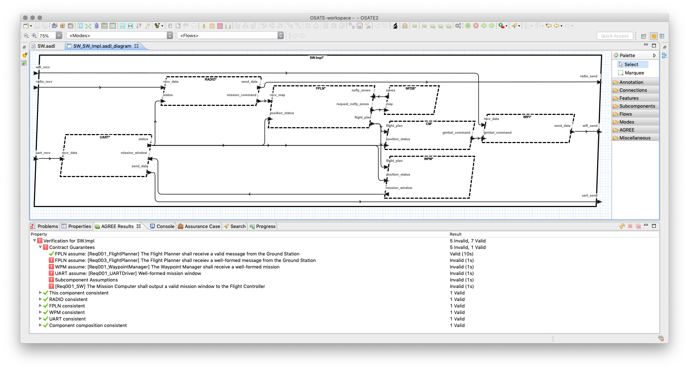
FPLN Assumes Well-formed Mission Commands

Slide 3
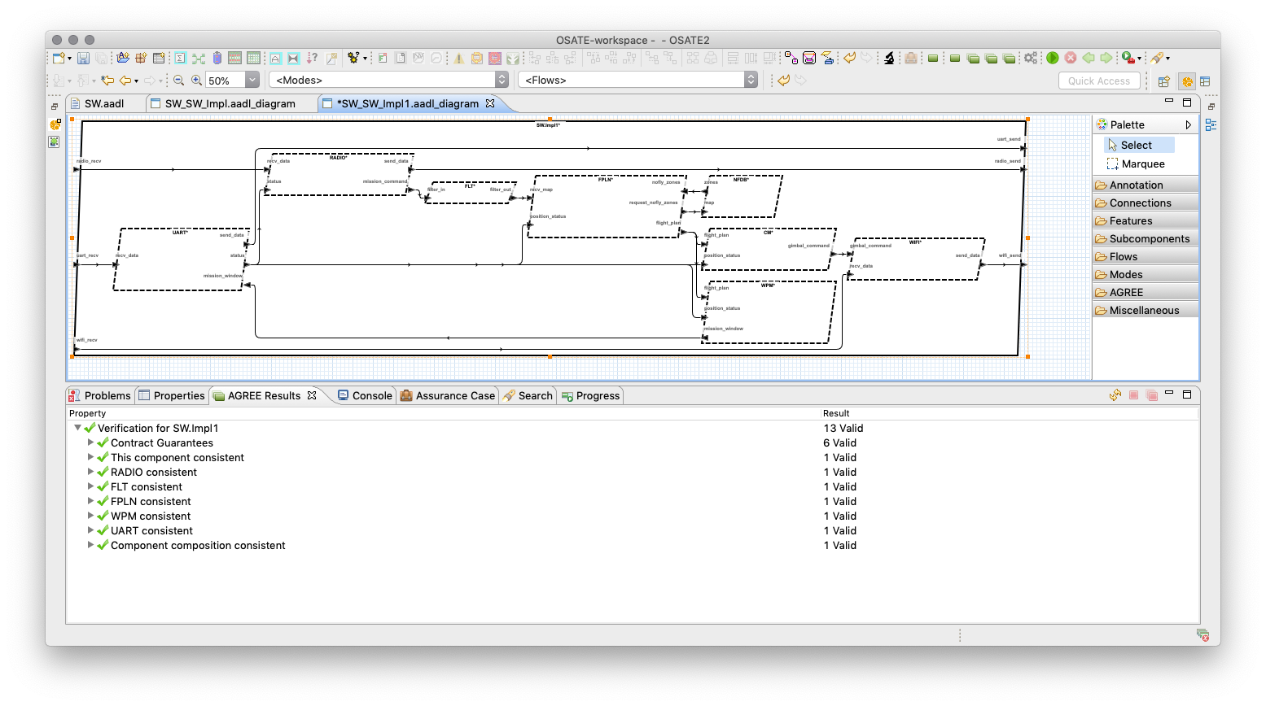
FLT guarantees well-formed but uses event ports that have no AGREE semantics

Slide 4
node _TOP__FLT(
__ASSUME__HIST : bool;
filter_in___EVENT_ : bool;
filter_in : SW__RF_Msg__Impl;
time : real;
filter_out___EVENT_ : bool;
filter_out : SW__RF_Msg__Impl
) returns (
__ASSERT : bool
);
var
__GUARANTEE0 : bool;
__GUARANTEE1 : bool;
let
__GUARANTEE0 = SW__VALID_MESSAGE(filter_out);
__GUARANTEE1 = SW__WELL_FORMED_MESSAGE(filter_out);
__ASSERT = (__ASSUME__HIST => (__GUARANTEE1 and __GUARANTEE0));
--%IVC __GUARANTEE0, __GUARANTEE1;
tel;
No constraints on when events occur
No input to output event relationships
Proof obligation does not need causality or sequencing to show property
But assuming such a detail does matter…

Slide 5
Proposed AGREE Event Port Semantics
in₁
out₁
in₂
out₂
in_{n}
out_{m}
-- Define when out₁ fires relative to input and output events and values
guarantee event_out₁ ”out₁ event condition”:
event(out₁) <=> (event(in_{i}) and … and event(out_{j}) and … and event_out₁(in_{i},…,out_{j},…));
-- Define constraints on the value of out₁ at the time of its event
guarantee constraint_out₁ ”out₁ constraint at event”:
(event(out₁) and event(out_{j}) and …) => constaint_out₁(in_{i},…,out_{j},…);
Notes:
event_out1(…) is a fuction defined over input and output values that determine when the output should fire.
Constraint_out1(…) is a function defined over input and output values that determine what the output should look at the time the output event fires.

Slide 6
Proposed AGREE Event Port Syntax
out event out₁ ”out₁ event condition” : event_out₁(in_{i},…,out_{j},…);
guarantee constraint_out₁ ”out₁ constraint at event”: constaint_out₁(in_{i},…,out_{j},…);
out event out₂ ”out₂ event condition” : event_out₂(in_{x},…,out_{y},…);
guarantee constraint_out₂ ”out₂ constraint at event”: constaint_out₁(in_{x},…,out_{y},…);
…
-- Define when out₁ fires relative to input events and values
guarantee event_out₁ ”out₁ event condition”:
event(out₁) <=> (event(in_{i}) and … and event_out₁(in_{i},…));
-- Define constraints on out₁ at the time of its event
guarantee constraint_out₁ ”out₁ constraint at event”:
(event(out₁) and event(out_{j}) and …) => constaint_out₁(in_{i},…,out_{j},…);
…

Slide 7
Does AGREE need event semantics
What needs to be proved relative to events and sequencing?
How would the input to output event constraint strengthen the AGREE proof relative to the output property?
Does the output constraint need to be tied to the input event?
How would downstream component assumptions rely on events or sequencing relative relative to the system level properties?

Slide 8
General Concern With AGREE Semantics
There are no semantics---what does model checking actually prove?
The meaning of AGREE is understood relative to the LUSTRE model
The LUSTRE model is not easy to understand
The LUSTRE translation framework is anything but direct and simple

Slide 9
Consider Formalizing AGREE Semantics
Prove LUSTRE model implements AGREE semantics
Connects model checking result to the meaning of AGREE
We insist on this fidelity with SPLAT to seL4
Why not with AGREE?
Turns on a synthesis path from AGREE to verified software
For a leaf component:
Write a contract in AGREE
Write an implementation in AGREE
Verify implementation satisfies contract
Compile implementation down to actual code in something similar to SPLAT
Without liveness it’s hard to show the implementation does anything

Slide 10
system Filter
features
Input: in event data port Base_Types::Integer;
Output: out event data port Base_Types::Integer;
annex agree {**
guarantee Gua01_output_equals_input "Output = Input":
event(Output) => Output = Input;
guarantee Gua02_output_in_range "output when Input in range":
event(Output) <=> (event(Input) and LOW <= Input and Input <= HIGH);
**};
end Filter;
system implementation Filter.Impl
annex agree {**
eq val: int = Input;
eq in_range: bool = (LOW <= val and val <= HIGH);
eq has_input : bool = event(Input);
assert event(Output) = (has_input = true and in_range = true);
assign Output = if (has_input = true and in_range = true) then val else LOW;
**};
end Filter.Impl;
Notes:
The formal semantics would enable us to
Verify that Filter.Impl satisfies the Filter contract
Compile Filter.Impl down to actual code for the filter
AGREE is a simple language…
Would need to give more control to specifying output event behavior in the implementation.
Would need something more than contracts to indicate the implementation does more than just meet the contract---liveness maybe?

