Slide 1
MVC
Model View Controller
By John Jackson

Slide 2
Primer
Software architecture patterns:
Manages complexities in application development
Keeps application modular
Enhances code re-usability during upgrades/changes

Slide 3
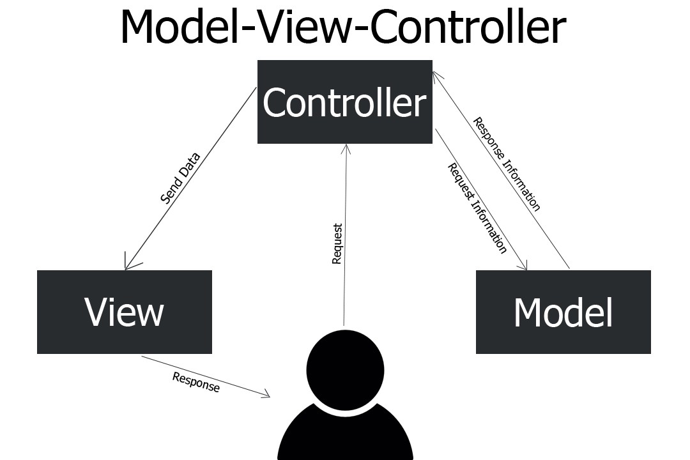
What does MVC look like

Slide 4
Why use MVC
Follows rule number 1(separation of concerns)
Code breaks down into specialized components
Easy to manage complex code base
Allows changing out components without affecting other components

Slide 5
Descriptions
Model:
-Manages data inside database
View:
-Handles how content is displayed
Controller:
Links Model and View, handles requests from user, displays content to user

