Slide 1

{
// |~~~~~~~|
// | |
// | |
// | |
// | |
// | |
// |~.\\\_\~~~~~~~~~~~~~~xx~~~ ~~~~~~~~~~~~~~~~~~~~~/_//;~|
// | \ o \_ ,XXXXX), _..-~ o / |
// | ~~\ ~-. XXXXX`)))), _.--~~ .-~~~ |
// ~~~~~~~`\ ~\~~~XXX' _/ ';)) |~~~~~~..-~ _.-~ ~~~~~~~
// `\ ~~--`_\~\, ;;;\)__.---.~~~ _.-~
// ~-. `:;;/;; \ _..-~~
// ~-._ `'' /-~-~
// `\ / /
// | , | |

Slide 2
// | ' / |
// \/; |
// ;; |
// `; . |
// |~~~-----.....|
// | \ \
// | /\~~--...__ |
// (| `\ __-\|
// || \_ /~ |
// |) \~-' |
// | | \ '
// | | \ :
// \ | | |
// | ) ( )
// \ /; /\ |
// | |/ |
// | | |
// \ .' ||
// | | | |
// ( | | |
// | \ \ |

Slide 3
// || o `.)|
// |`\\\\) |
// | |
// | |
GOD-FIRST-JOHN-JAMES
ABUNDANCE-MARBLE
The LORD is my shepherd; I shall not want.
He maketh me to lie down in green pastures: he leadeth me beside the still waters.
He restoreth my soul: he leadeth me in the paths of righteousness for his name's sake.
Yea, though I walk through the valley of the shadow of death, I will fear no evil: for thou art with me; thy rod and thy staff they comfort me.

Slide 4
Thou preparest a table before me in the presence of mine enemies: thou anointest my head with oil; my cup runneth over.
Surely goodness and mercy shall follow me all the days of my life: and I will dwell in the house of the LORD for ever.

Slide 5

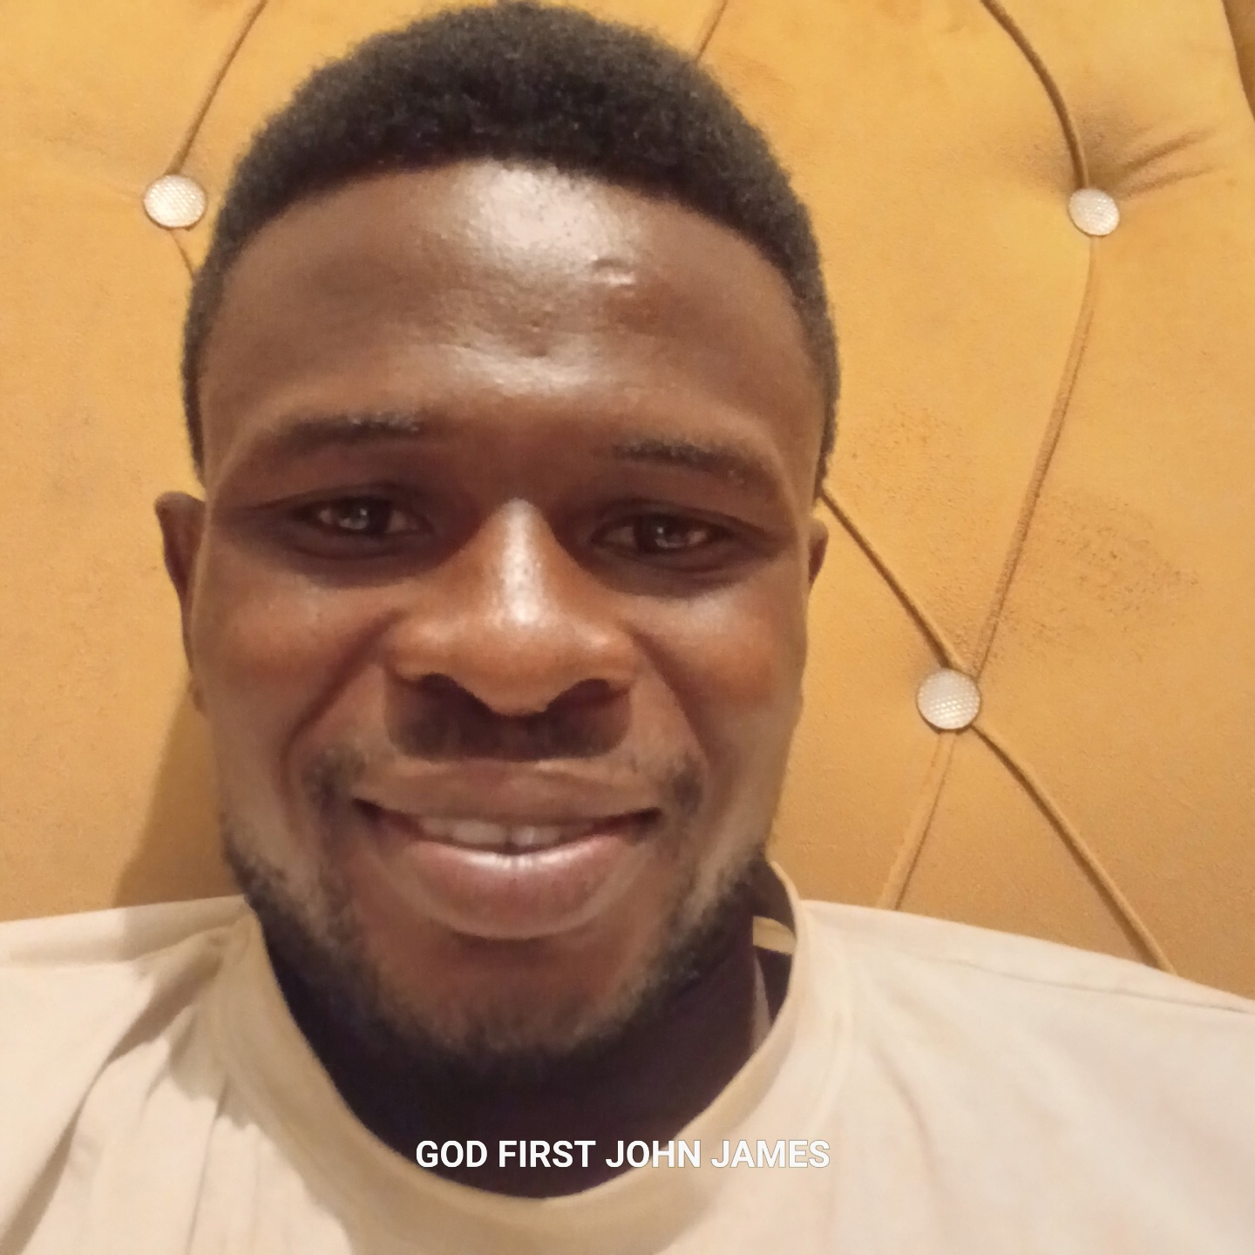

Slide 6

BIBLE
BOOK OF JOHN::7:17
=If any man will do his will, he shall know of the doctrine, whether it be of God, or whether I speak of myself.}

