Slide 1


Slide 2
What Is React?
React.js is an open-source JavaScript library used for building user interfaces, particularly for single-page applications where the user interacts with dynamic content. React was originally developed by Facebook and is maintained by Facebook and a large community of developers. It allows developers to create reusable UI components that manage their own state and update efficiently when the state changes. Instead of manipulating the browser's DOM directly, React creates a virtual DOM in memory, where it does all the necessary manipulating, before making the changes in the browser DOM.

Slide 3

Why React.js
Build reusable components for efficient development.
1
Performance
2
Scalability
Virtual DOM for faster rendering
Manage large and complex applications
3
Community
4
Flexibility
Vast resources and support
Works with various tools and frameworks

Slide 4
REACT FEATURES
Component-Based Architecture React promotes building applications using reusable components.
Declarative UI React allows developers to describe what the UI should look like for any given state, and it efficiently updates and renders the components when data changes.
JSX (JavaScript Syntax Extension) React uses JSX, which is a syntax extension that allows HTML-like code to coexist with JavaScript. This makes the code more readable and expressive.
Virtual DOM DOM- React utilizes a virtual DOM to optimize rendering performance. Instead of directly manipulating the browser's DOM, it performs updates in a virtual representation first, then applies only the necessary changes to the actual DOM.
Unidirectional Data Flow Data in React flows in one direction—from parent components to child components—making it easier to understand how data changes affect the UI.

Slide 5




Components and JSX
Components are building blocks of React applications.
JSX
Write HTML-like syntax in JavaScript files
Components
Reusable blocks of UI with props and state
Rendering
Components are rendered to the browser

Slide 6
HOW DOES REACT WORK?
React creates an in-memory representation of the DOM (the virtual DOM). When changes occur, it calculates the most efficient way to update the browser's DOM by comparing the current virtual DOM with a previous version and applying only the necessary updates. This results in improved performance and a smoother user experience.

Slide 7


Slide 8
VITE
Vite is a modern build tool and development server designed to enhance the development experience for web applications, particularly those built with frameworks like React. It focuses on speed and efficiency, making it an excellent choice for developers looking to streamline their workflow. VITE FEATURES: Fast Development Server: Vite serves files over native ES modules, which allows for extremely fast hot module replacement (HMR). This means that changes in your code are reflected in the browser almost instantly without needing a full page reload.
Optimized Build Process: When it's time to build your application for production, Vite uses Rollup under the hood to bundle your code efficiently, producing highly optimized static assets.
Support for Modern JavaScript: Vite supports the latest JavaScript features out of the box, allowing developers to write modern code without worrying about compatibility issues with older browsers.
Framework Agnostic: While Vite is often associated with React, it also supports other frameworks like Vue, Preact, and Svelte. This makes it versatile for various project types.
Plugin Ecosystem: Vite has a rich plugin ecosystem that allows developers to extend its functionality easily, integrating with other tools and frameworks as needed.

Slide 9

Setting Up Vite
Vite makes setting up React projects simple.
1
Install Node.js
Download and install from the official website
2
Run the Command
Use the command: npm create vite@latest my-react-app --template react
3
Start the Project
Navigate to the project directory and run: npm run dev

Slide 10
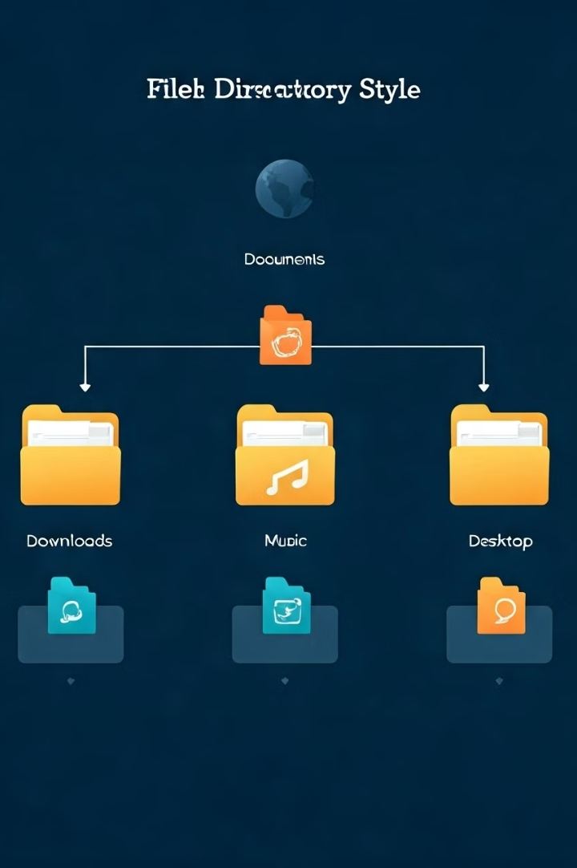
Project Structure
Understanding the file structure helps navigate the project.
public
Contains static assets like index.html and favicon.ico
src
Holds the main React components and logic
node_modules
Stores project dependencies
vite.config.js
Configuration file for Vite

Slide 11

<theJohnBradley/>

