Slide 1
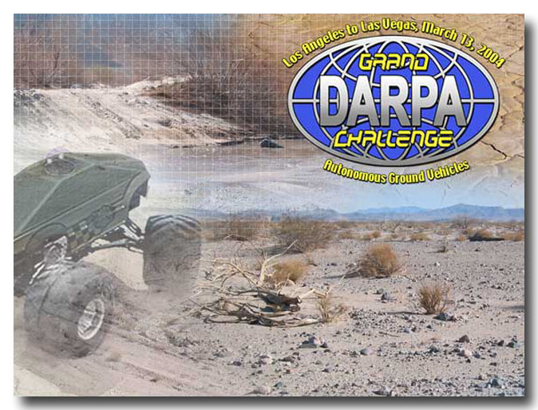
The DARPA Grand Challenge
150 miles
across the Mojave Desert
10 hours
No driver
$1,000,000 prize

Slide 2
The rules – tough
Totally autonomous. No radio communication.
  DARPA controls remote emergency stop.
Route announced 2 hours before race.
  DARPA distributes CD-ROM at 0430 hrs
  Start at 0630 hrs.
Route is 2000 GPS waypoints.
  Width of route varies from 10 feet to 200+ feet.
Drivable in a 4x4 pickup truck.
Every year until somebody finishes in 10 hours.

Slide 3
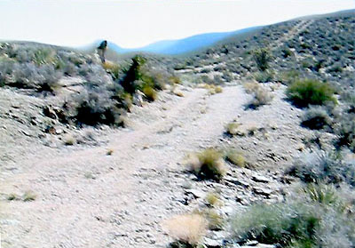
The terrain – hard

Slide 4
The competitors - disappointing
65 entrants applied, 20 showed up.
Only a few have a clue.
  Caltech – student project with JPL advisors.
  CMU – 50 students, $350K cash expenditure.
  Overbot – not ready in time, skipped this year.
MIT, Stanford – no entry
No big company entries.
Little real innovation.

Slide 5
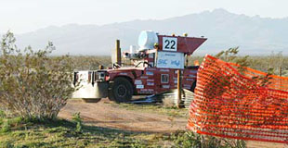
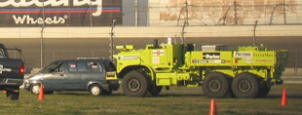
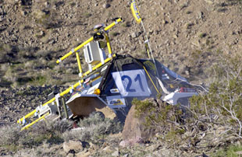
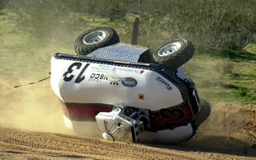
The 2004 results - disastrous

Slide 6
What went wrong?
Red Team (CMU) – At mile 7.4, plowed through sheet metal fence. On switchbacks in a mountainous section, vehicle went off course, got caught on a berm.
  Analysis – botched tight turn control at speed.
SciAutonics II – At mile 6, vehicle went into an embankment and became stuck.
  Analysis – off course. Reason unknown.
Team DAD – At mile 6, hung up on rock
  Analysis – off course. Used GPS guidance only.

Slide 7
All others failed near the start
Golem Group – throttle problem at mile 5
Caltech – off course at mile 1.3
SciAutonics I – off course at mile 1.5
TerraMax – went into reverse at mile 1.5
Virginia Tech, Axion Racing, CajunBot, Ensco, Palos Verdes HS, Cimar, Blue Team – failed within sight of the starting line.

Slide 8
Why nobody won
Rush job – inadequate testing
Poor sensor technology
  Stereo vision doesn't work well on dirt.
  Stereo from motion doesn't work yet.
  Image understanding doesn't work at all.
  Fixed line-scan LIDAR has too small a field of view.
  Movable line-scan LIDAR is a mechanical nightmare.

Slide 9
Team Overbot

Slide 10
Team Overbot
A Silicon Valley project
All volunteers
Many Stanford alumni
Privately funded (about $400K)
Startup space in Redwood City
About 20 people over the last year.
Four people now, starting on 2005.

Slide 11
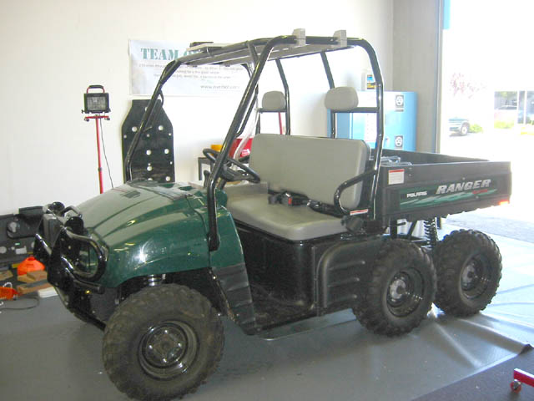
Base vehicle
Polaris Ranger 6x6.
Most rugged platform available stock.
Top speed 40MPH.
Continuously-variable auto transmission.
2 wheel steer, 4 or 6 wheel drive.
No computers.

Slide 12
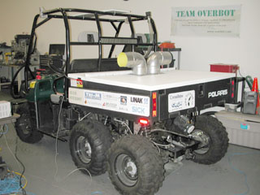
Rear view
Electronics in back bed of vehicle.
Filtered air, but no air conditioning
Engine generator

Slide 13
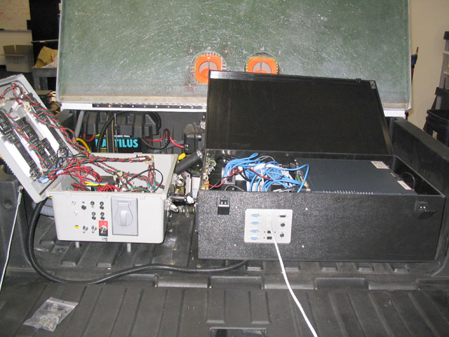
The Overbot

Slide 14
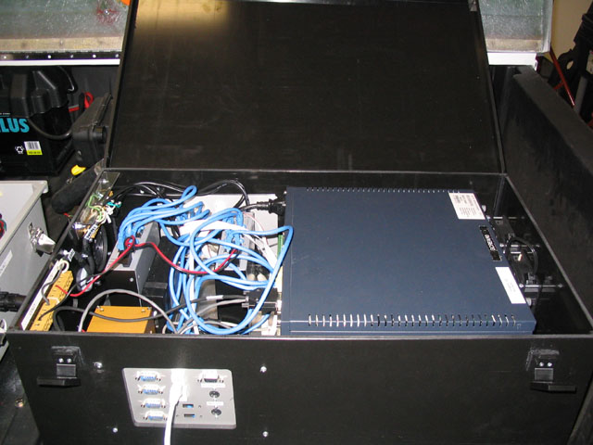
Computer box
Nova 8660 single-board Pentium 4 industrial computers (2)
Crossbow INS unit
Industrial Ethernet hubs.
VORAD radar interface.

Slide 15
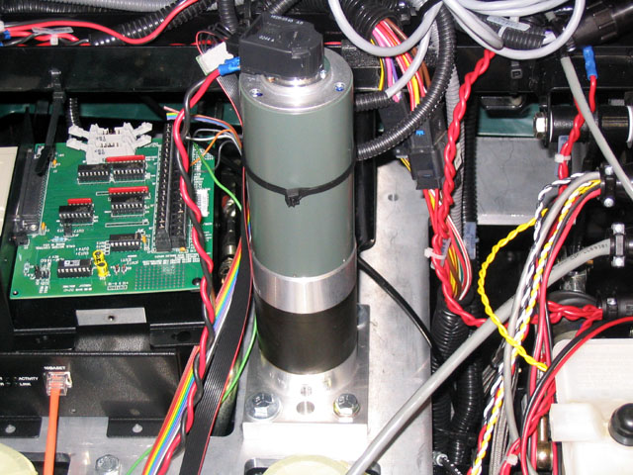
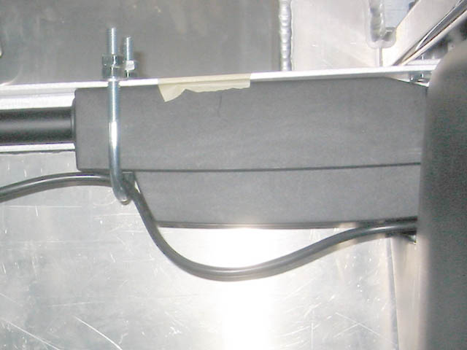
Vehicle actuators
Transmission
Steering
Throttle
Brake

Slide 16
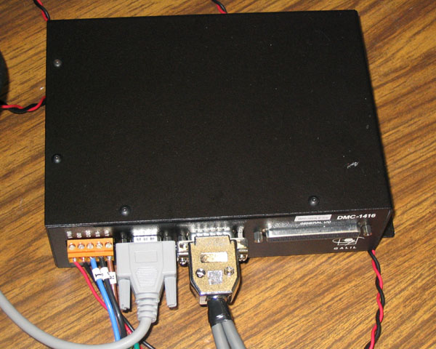
Distributed control
Five Galil motor controllers.
On Ethernet
M680xx ColdFire CPU.
Some programmability.
Power amp.

Slide 17
External sensors
Scanning laser rangefinder (terrain)
Phased array radar (anti-collision)
Digital camera (road following)
Inertial guidance (attitude, heading)
GPS with corrections (location)
Radar speedometer (odometry, slip)
Sonars (backup, tight spots)
Water detectors (fording)

Slide 18
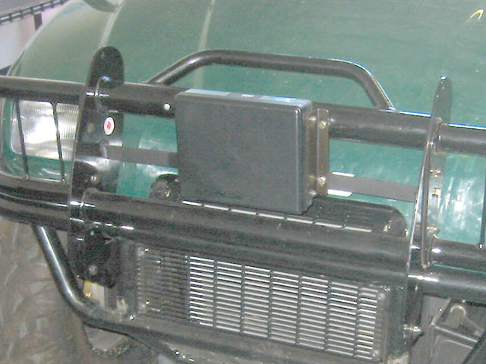
Phased-array radar

Slide 19
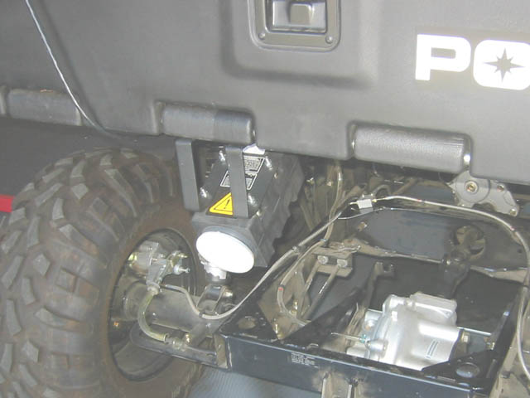
Radar speedometer

Slide 20
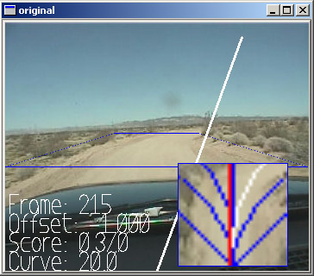
Visual road follower
Images from camera atop vehicle
Images projected onto ground plane
Looks for linear/curved uniformity
Statistical, not neural net

Slide 21
Internal sensors
Driveshaft speed
Engine RPM
Brake pressure
Encoders on motors

Slide 22
Misc. systems
Emergency stop
  Engine to idle, brakes on
  100ms watchdog timer
  Radio link
  Emergency stop buttons
40 gallon fuel tank
  NASCAR-qualified
Aux generator
  Polaris generator far too small
LED sign
  Only output device
Flashing lights
Horn

Slide 23
Sensing the terrain ahead
Stereo vision
  Dirt doesn't have enough edges for stereo lock.
  Sizing potholes and ditches is tough.
Submillimeter radar
  Technology not here yet, although promising
Image understanding
  Very hard problem. Long history of failure.
Laser rangefinders
  Good range and data quality, but have limitations.

Slide 24
The key to success: better laser rangefinders
Existing devices are big, heavy, slow, expensive, and have too many big moving parts.
This is an electronics problem Silicon Valley can and should solve.
Much R&D has been done with DoD funding, but few if any products have resulted.
There's an opportunity here. The true 3D camera is within reach.

Slide 25
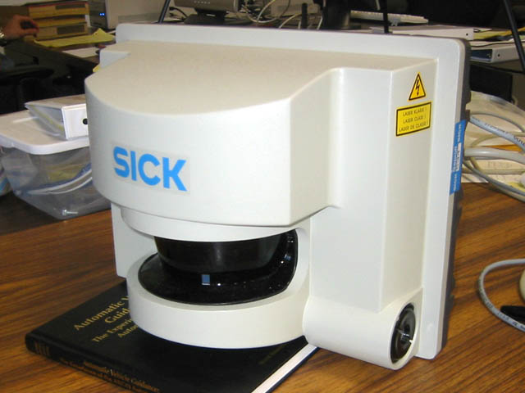
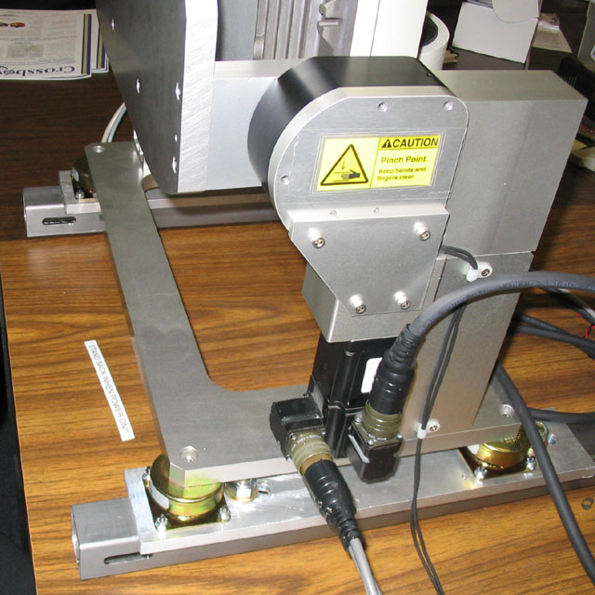
What we have now
Laser line scanner on tilt mount
Spinning prism scan
Custom tilt head

Slide 26
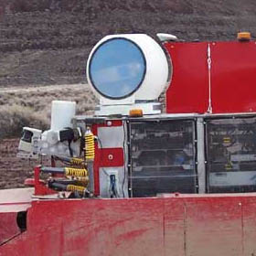
What CMU has:
Laser line scanner on 3D gimbal
REIGL spinning prism line scanner
Big, heavy 3 axis stabilized gimbal.
Expensive (>$100K).
CMU unit damaged in crash, backup unit performed badly.
Technical dead end

Slide 27
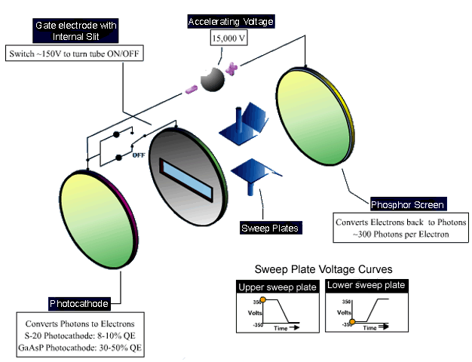
Streak tube 2D flash LIDAR receiver
Arete Industries
(Tucson, AZ)
Flash line scan
Works
in sunlight.
Claimed cost
$20K per tube.
In prototype.

Slide 28
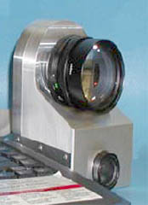
ADLR 3D Flash LIDAR prototype
Advanced Scientific Concepts, Inc.
(Santa Barbara)
128x128 pixels
True 3D depth images
Sunlight tolerant
> 50m range.
Cost: $20K to $70K

Slide 29
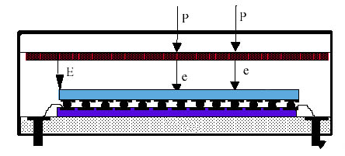
ADLR detector principles
1
2
3
  1. Photons hit intensifier photocathode. Electrons emitted. 1KV+ electric field accelerates electrons.
  2. Accelerated electrons hit silicon detector array.
  3. Timing/readout chip bonded to detector array times incoming events for each pixel.

Slide 30
Other no-moving parts LIDAR R&D
CSEM (Switzerland)
  Low cost, short range, CW (not flash)
  Not sunlight tolerant
Raytheon missile seeker
  > 1KM range, not eye safe
MIT Lincoln Labs (?)
General Dynamics Robotics
  One mechanically scanned axis, 16 lasers

Slide 31
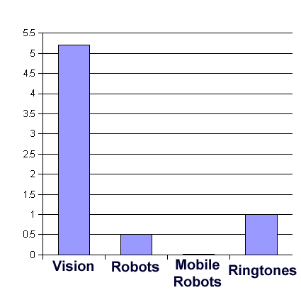
True 3D camera technology is almost ready for the real world
It's time to commercialize this technology. But not primarily for robots.
Computer vision is a viable industry. Robotics is tiny.
General 3D camera applications as image quality improves.
2003 sales, US$ BN

Slide 32
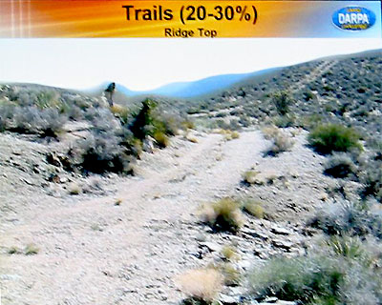
Automatic Driving
With all this data from sensors, how do we drive?
We have 1000+ waypoints and a really good GPS.
Now what?

Slide 33
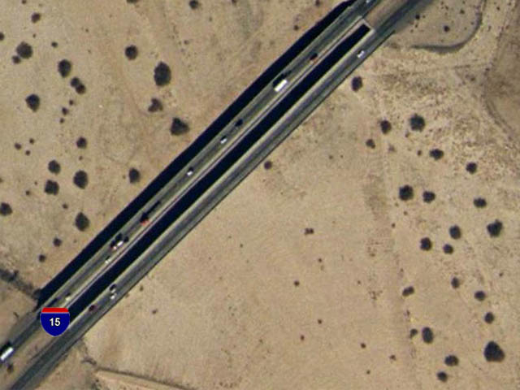
Approach #1 – Preplan in detail
Get available high resolution imagery and elevation data
Make plan
Follow plan using GPS.
Classic “Stanford approach” (Latoumbe)

Slide 34
Available imagery
Off-the-shelf imagery
  Resolution high in major US urban areas, low in Mojave Desert.
  Elevation data very low res (20m)
Overflight with LIDAR-equipped aircraft
  20cm resolution.
  $0.50/acre, minimum $5000
  Area of race is 20,000 square miles.
  CMU did this. Didn't help

Slide 35
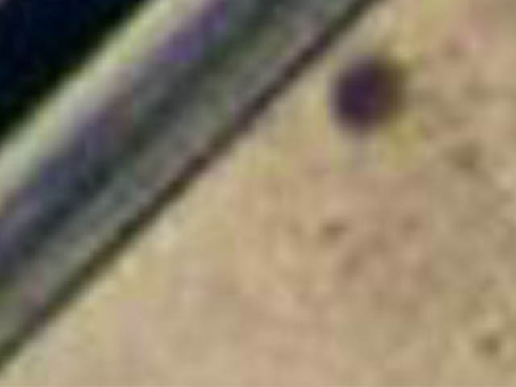
Why preplanning won't work
Available imagery resolution too low.
Need to see anything the vehicle can't roll over.
DARPA may place obstacles on route.
CMU tried and failed.

Slide 36
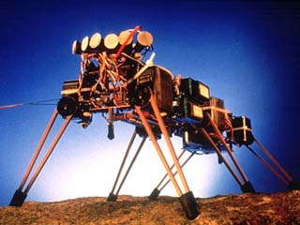
Approach #2 – reactive behaviors
React to sensor data
  “MIT approach” (Brooks)
  No maps, no models.
  Deals well with unstructured environments.

Slide 37
Limits of reactive behaviors
Slow, bumbling movement.
Maxes out at insect-level AI.
Insects work best when viscosity dominates inertia.
Work on purely reactive systems peaked a decade ago.

Slide 38
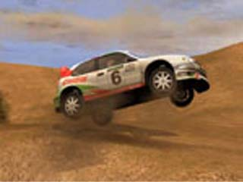
Approach #3 – game AI
Games have good vehicle control.
Game AIs don't cheat as much as they used to.
Game AI R&D efforts sizable – real applications.

Slide 39
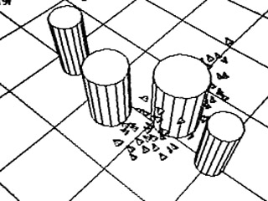
Field-based control
First seen in Reynolds' “boids” (1985)
Attracted to goal (constant)
Repelled by obstacle (1/x, exp)
Improved versions widely used in games

Slide 40
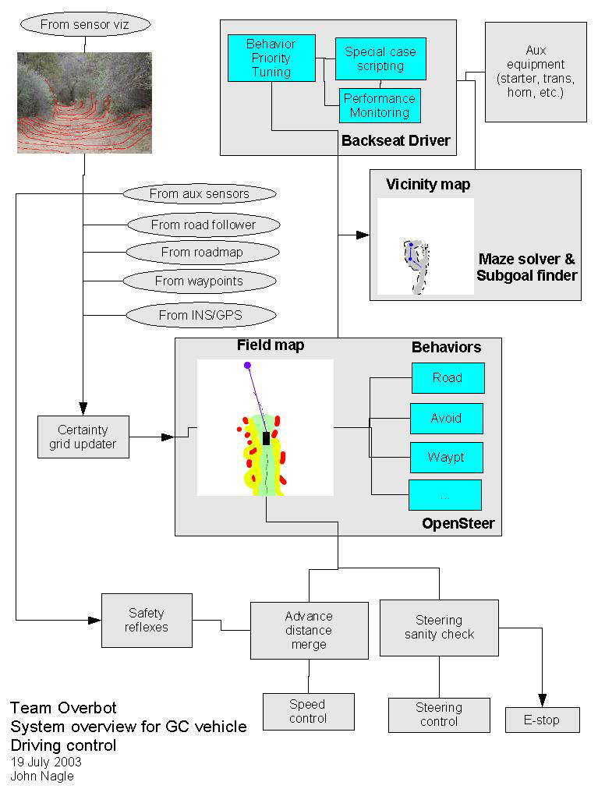
Our architecture
Reactive survival behaviors at the bottom.
Field based map in the middle
“Back seat driver” adds subgoals when stuck.

Slide 41
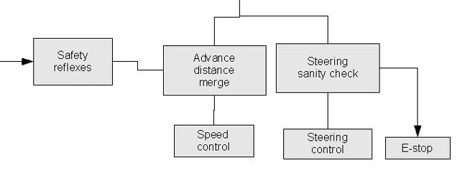
Low-level – reactive behaviors
Self-protection reactions
Anti-collision, anti-tip, etc.
Has veto power over higher levels.

Slide 42
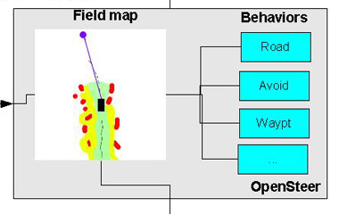
Mid-level – field map
Does most of the work.
Map centered on vehicle.
Sensors put data into map. GPS/INS data used to scroll map.
Borrowed from game technology

Slide 43
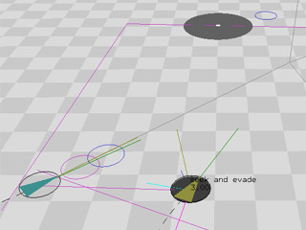
OpenSteer as a starting point
Starting from OpenSteer (Reynolds, SourceForge)
Changes to model
  Obstacles as certainty grids
  Vehicle path as snake
  World map scrolls

Slide 44
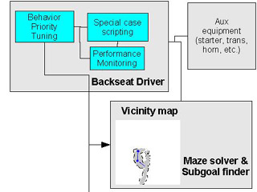
High-level - “backseat driver”
Limited authority, hence the name.
Can change goal direction; can't directly control vehicle.
Classic A* planner.
Used only when field map stuck in local minima.

Slide 45
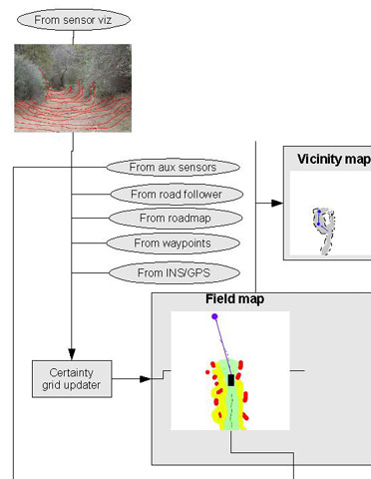
Map updating
All sensors feed into map.
Map is centered on vehicle.
Map moves with vehicle.
Map is a certainty grid (Moravec)

Slide 46
Rejected approaches
“Learning” (a.k.a. hill-climbing)
  Terrain too varied
  Poor-performing systems hard to improve.
More vision processing
  We have a good road-follower. That's do-able.
  General image understanding still doesn't work.
  Stanford vision group eliminated last year.
Logic-based AI
  Hard to map to real world.

Slide 47
Underlying OS – QNX
Hard real-time microkernel message passing OS
Guaranteed response times for external events
True microkernel
  Very stable. Seldom changed.
  Kernel: message passing, clocking, memory management
  File systems, networking, etc. are user programs.
POSIX compatible, but not UNIX-based.
GCC toolchain

Slide 48
Software architecture
Many small processes, rather than a few big ones.
Intercommunication via message passing.
Asynchronous organization.

Slide 49
Restart
Main reliability feature is ability to restart everything.
Watchdog process monitors all others.
Hardware watchdog monitors watchdog process.
Fault trips emergency stop hardware.
  Brakes lock, engine drops to idle, everything restarts.
Programmers are told that it's OK to abort, but not OK to fail to start.

Slide 50
Summary
A good problem – there's no faking it.
Hard, but solvable
We need volunteers
  Two senior software leads.
  Electronics techs.
  Control engineer.
  No pay, some risk, share the $2,000,000 prize.
Web site: www.overbot.com
Questions?

Slide 51
Beyond Overbot - Applications
3D cameras
  Effects
  Inspection
  Security
Military
  Limited use in combat environment – too confusing
  Useful for logistics
Automotive
  Parallel parking
  Rental car return
  Off-site parking
  Forklifts, tractors, trucks

