Slide 1
Electronic Medical Record System (EMRS)
John Neis & Richard Osborn
G18

Slide 2
Introduction
EMRS – Electronic Medical Record System
Objective: Provide patients and healthcare professionals easier access to relevant information they may need in the course of treatment. It should be able to streamline tedious tasks repeatedly carried out by healthcare personnel as well as patients.

Slide 3
Design
Considerations
Provide easy to use, consistent, and reliable system
Data recorded should be relevant to medical care
EMRS system should be broken into subsystems

Slide 4
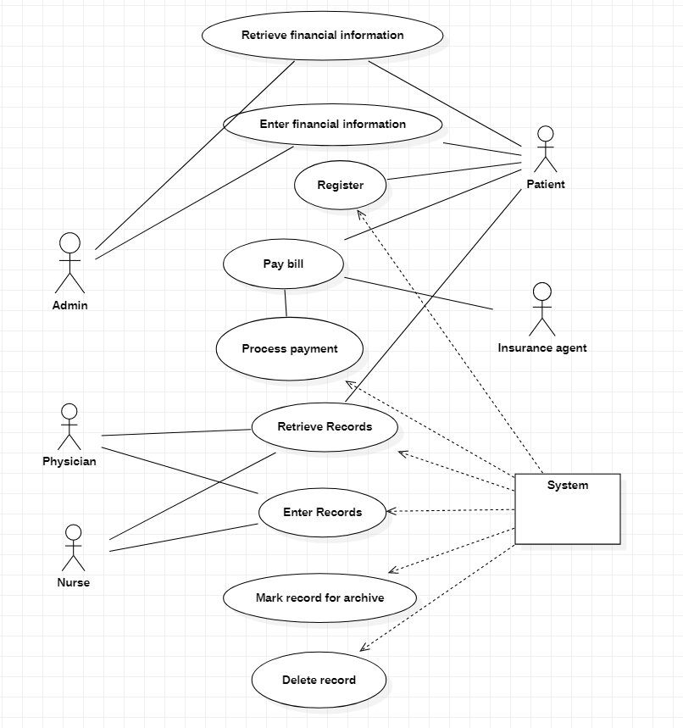
Design – Use Case Diagram

Slide 5
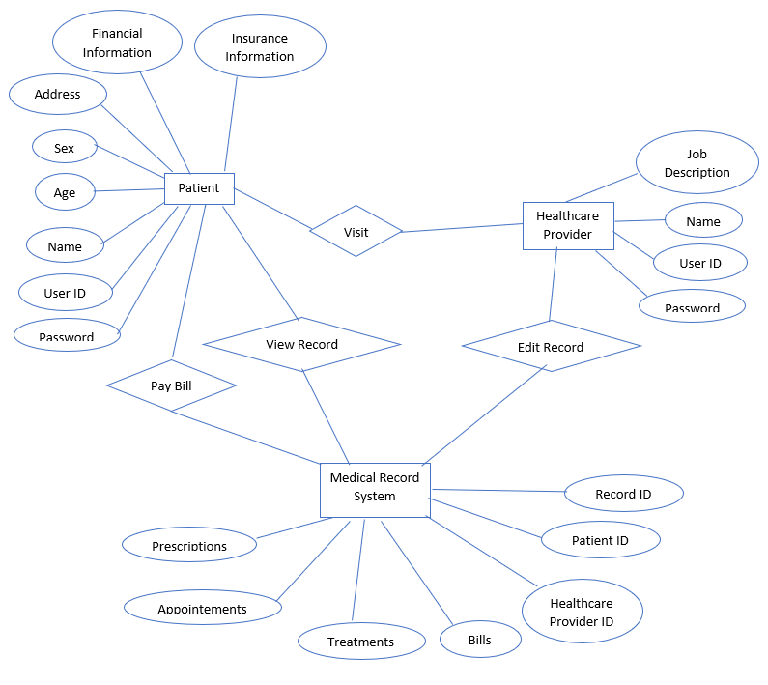
Design – ER Diagram

Slide 6
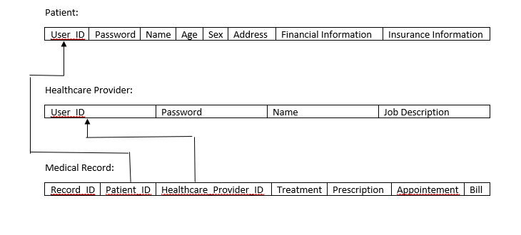
Design – Schema Diagram

Slide 7
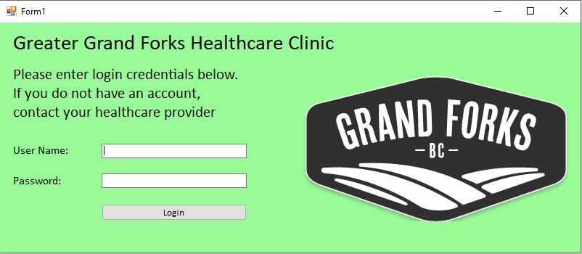
Design – UI Prototypes

Slide 8
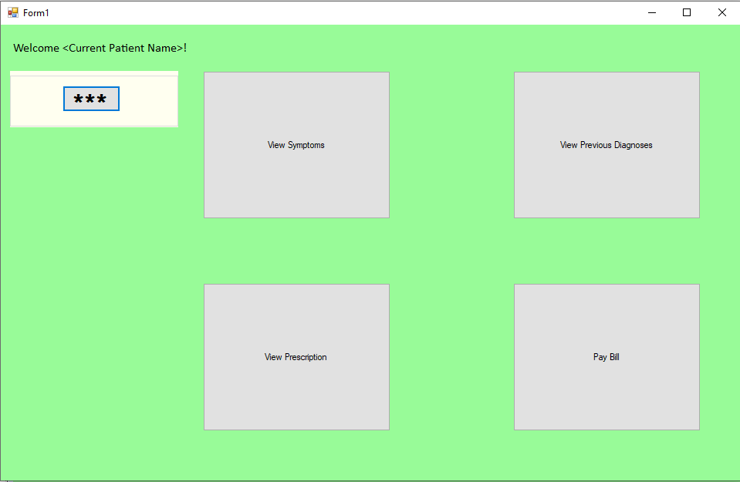
Design – UI Prototypes

Slide 9
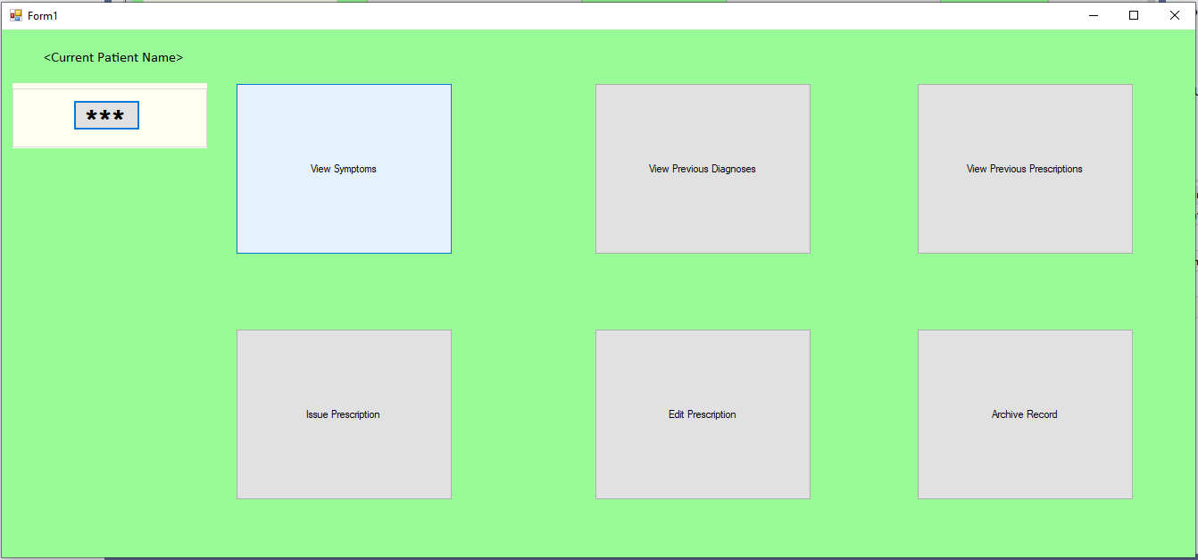
Design – UI Prototypes

Slide 10
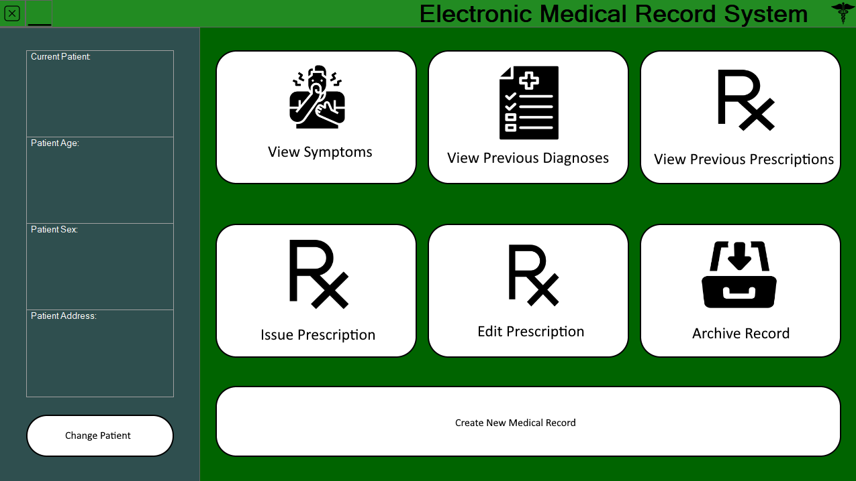
Design – Updated UI

Slide 11
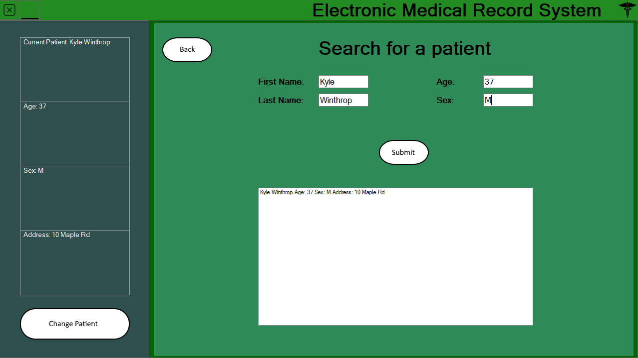


Design – Updated UI

Slide 12
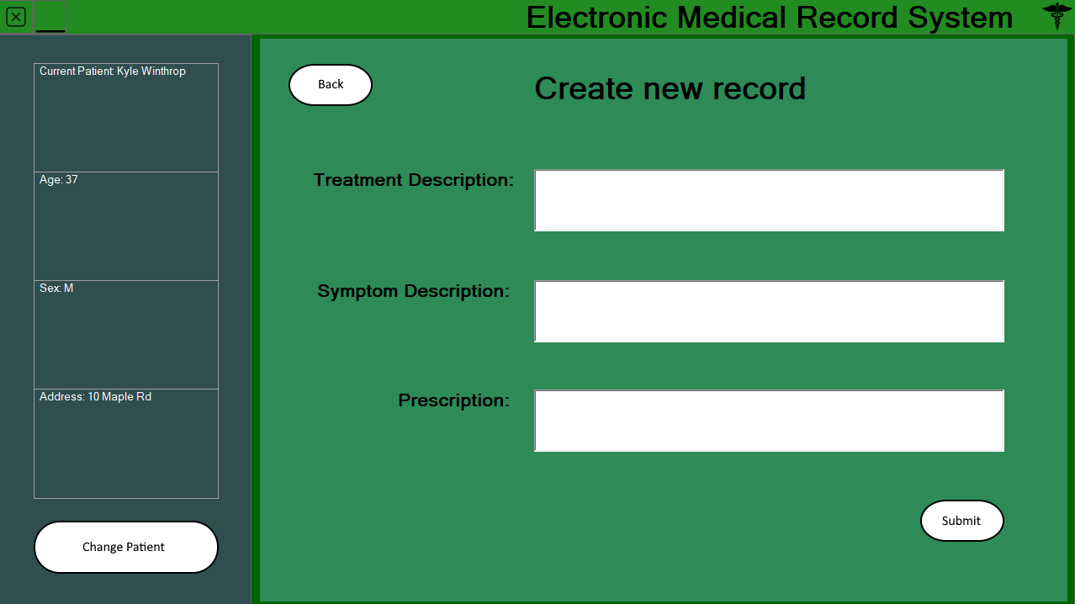
Design – Updated UI

Slide 13
Tools
Development tools
Visual Studio 2019
Paint.NET
Windows PowerShell
MySQL client terminal
Windows Subsystem for Linux

Slide 14
Tools
Programming Languages
Visual C#
.NET 4.7.2
SQL

Slide 15
Tools
Version Control and Documentation
GitHub
Microsoft Word
StarUML

Slide 16
Lessons Learned
Implementation and integration of a database system
Debugging and maintenance of a database system
Validation of database state with constraints
Engineering and documentation of major software system

Slide 17
EMRS Demo

