Slide 1
Money Hub
John Neis & Samuel Dressler
G3

Slide 2
Introduction

Slide 3
Design
Considerations
Testing and reliability
Network connectivity and usage
Server persistence
Development
Waterfall design method
Proof-of-concept prototyping
Component Reuse

Slide 4
Design
System Architecture
Query based
Client-Server relationship
Subsidiary client-server relationship between server and database

Slide 5
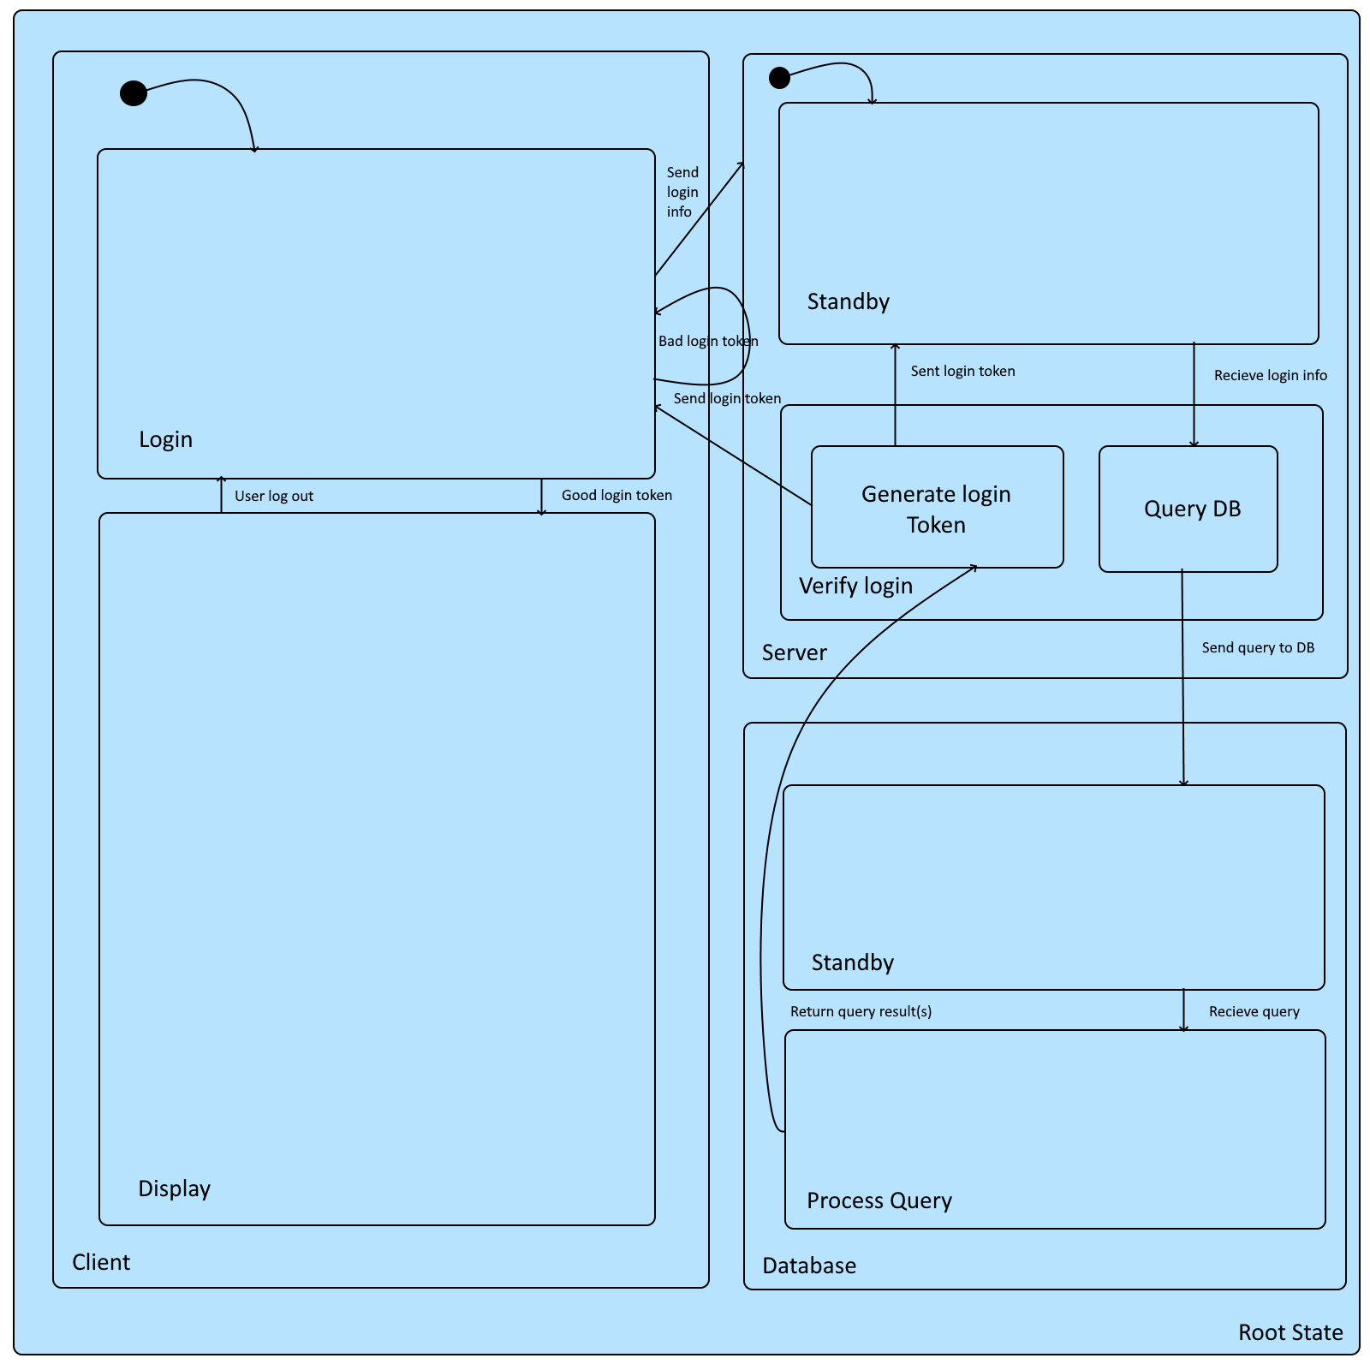
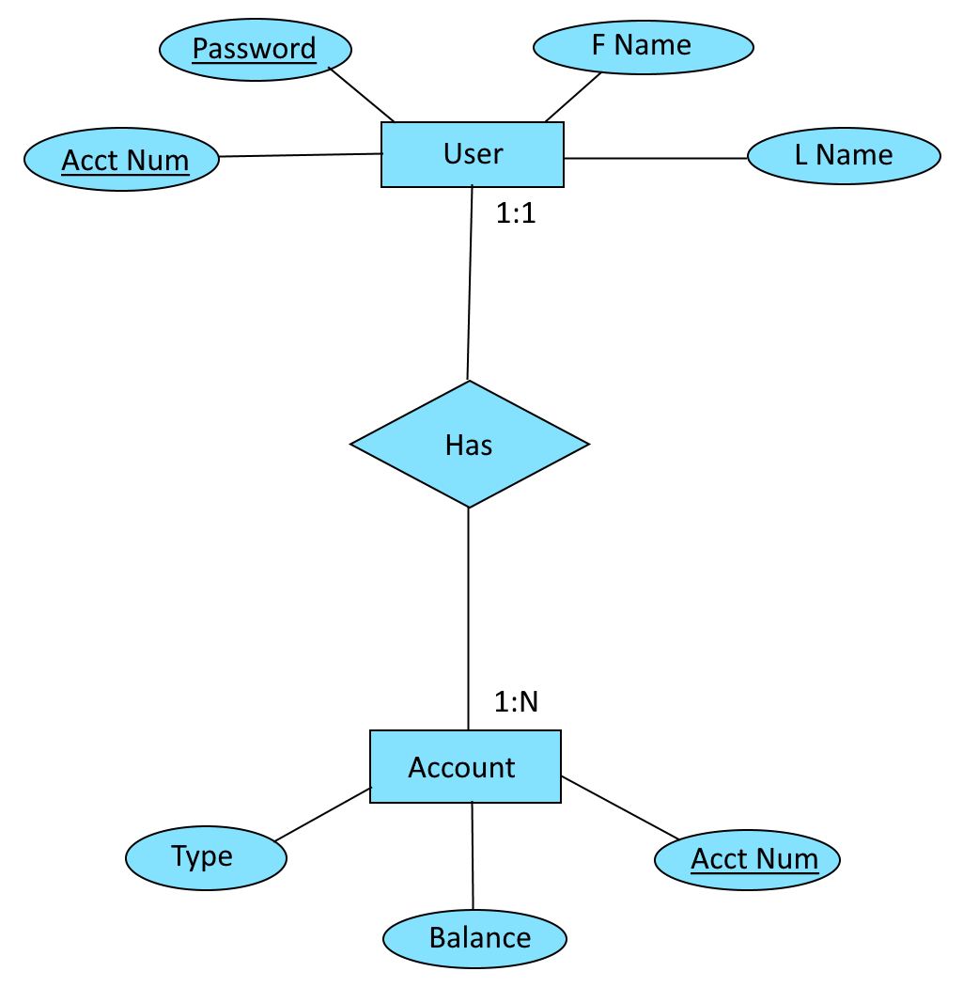
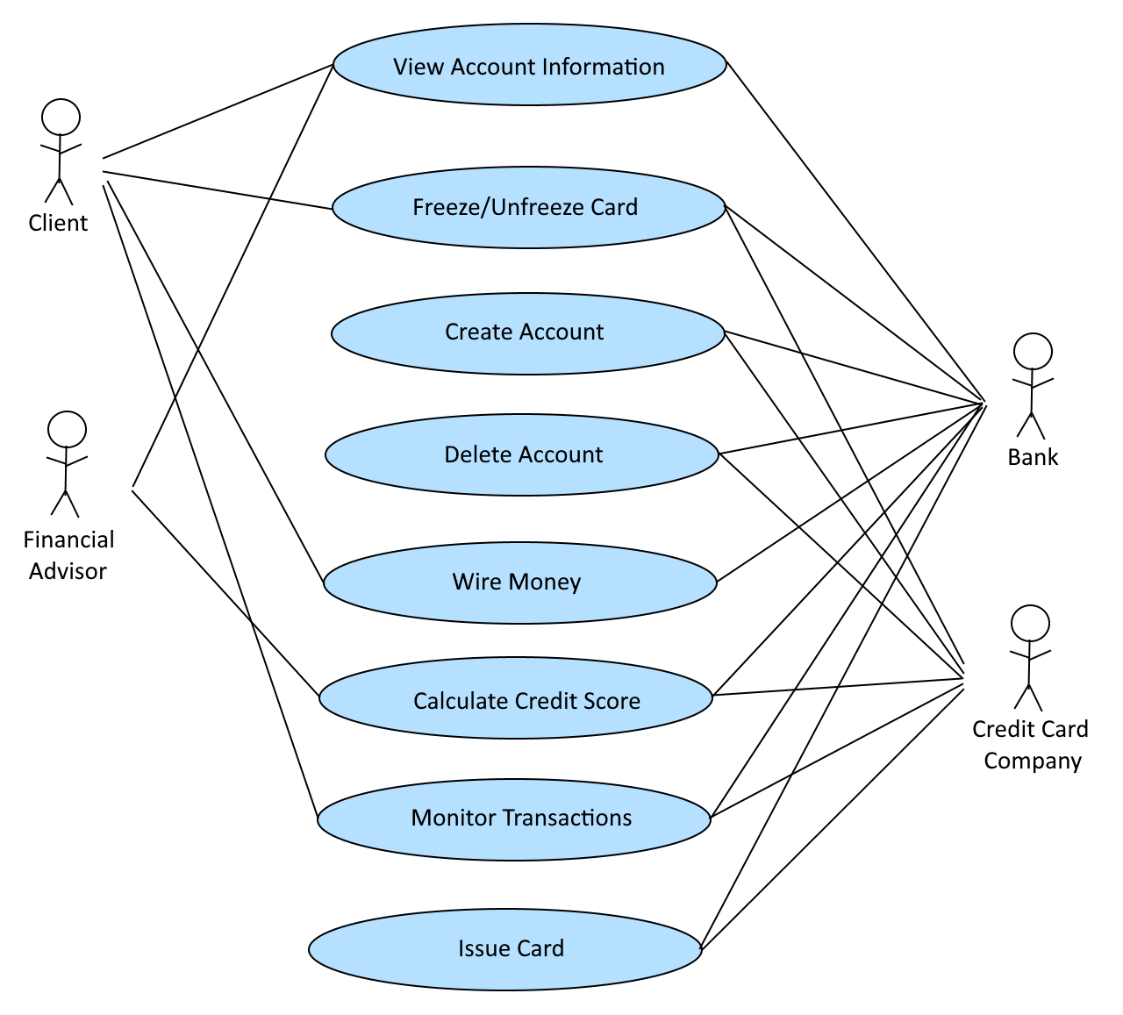
Design

Slide 6
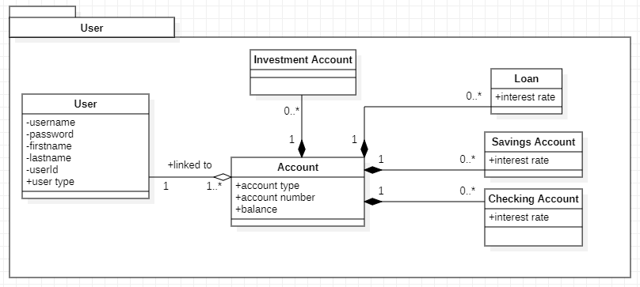
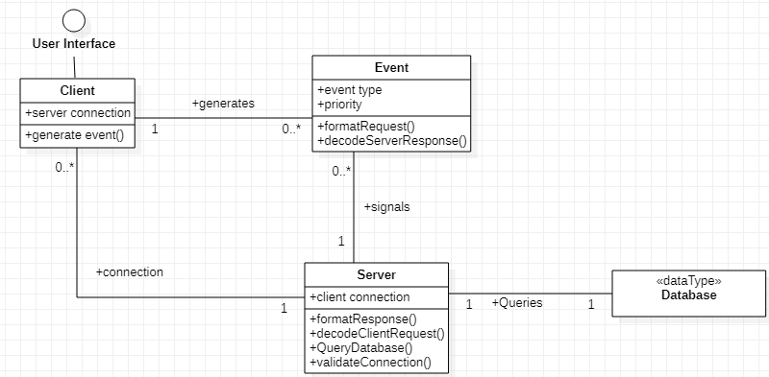
Design

Slide 7
Tools
Development tools
Visual Studio 2019
Visual Studio Code
Windows PowerShell
Windows Subsystem for Linux – Ubuntu Terminal
MySQL Server 8.0
Paint.NET
StarUML

Slide 8
Tools
Programming Languages
Java
Visual C# w/ .NET Framework 4.7.2
SQL
Bash Shell

Slide 9
Tools
Networking Protocols
TCP/IP
Standard MySQL port: 3306
Java/C# .NET Sockets
Database Connectivity
MySQL JDBC driver for Java
Database connectivity strictly server-side

Slide 10
Tools
Record keeping and version control
Microsoft Word
Microsoft Excel
GitHub

Slide 11
Lessons Learned

Slide 12
Money Hub Demo

