Slide 1

Analysis of US Household Pulse Survey
For Unmet Mental Health Needs

Slide 2
Overview
Determine if there’s unmet mental health needs in American households and which factors may contribute to those needs.
Location ( FL & its bordering states AL & GA)
Sex
Age

Slide 3
Data
The Household Pulse Survey conducted by the US Census Bureau in collaboration with five federal agencies which began on April 23, 2020.
Focus on responses to the question “At any time in the last 4 weeks, did you need counseling or therapy from a mental health professional, but did not get it for any reason?”.
Raw Data available here

Slide 4

Location, Location, Location

Slide 5
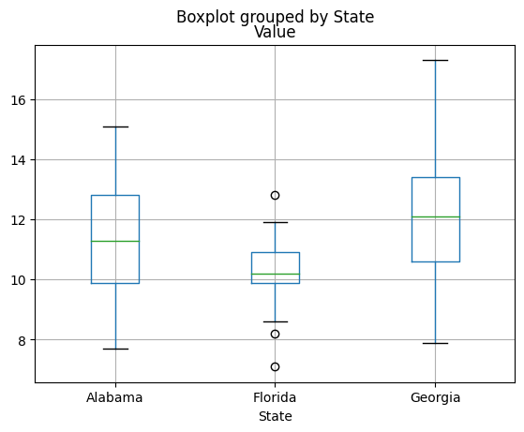
Percentages of households indicating an unmet need in FL and its bordering states AL & GA
Households in FL did indicate an unmet need for mental health services.
That need was at a lower percentage than its bordering states.

Slide 6

Percentage of people having an unmet mental health need by sex.

Slide 7
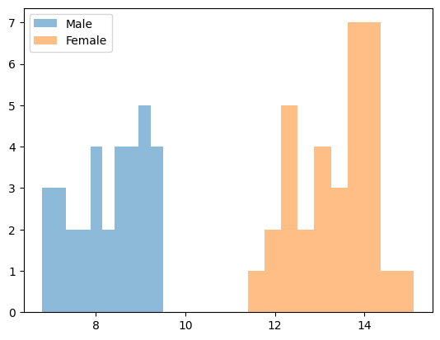
There appears to be a significant difference in the number of females versus males of the population who feel they have an unmet mental health need.

Slide 8
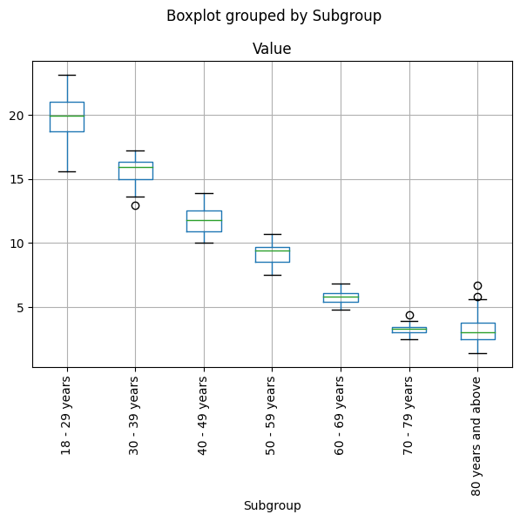
Percentages of those with unmet mental health needs by age group.

Slide 9
With age comes happiness?
It appears the largest percentage of the population with an unmet mental health need are those aged 18 -29.
A steady decline in unmet mental health needs was shown for each age group of the population as it aged.

Slide 10
Where to direct resources?
Although Florida was lower than its bordering states it still showed that there’s an unmet need for mental health services in the state.
Based on the data, targeting resources towards the younger female (18 – 29 & 30 – 39 years old) population would have the greatest immediate effect.

Slide 11

Discussion
Any biases in the data that may need further dialogue?
Cultural / societal norms
Age versus sampling methods

Slide 12

Questions?

Slide 13

Thank You

