Slide 1
Survival Analysis in R
Roland Vazquez-Molina

Slide 2


Mandatory slide: who’s this guy/bloke?
Roland Vazquez-Molina
Universidad Panamericana - Mexico City, Mexico
B. Eng, PE: Industrial Engineering.
Specialist’s Degree: Operations Management/Engineering Management
Southeast Missouri State University – Cape Girardeau, MO
MBA International Business
Current Role: Data Scientist @ Dot Foods, Inc.
Previous Roles:
Engineering Intern @Sanofi S.A.
Research Assistant @ SEMO
Engineering Consultant @UP

Slide 3

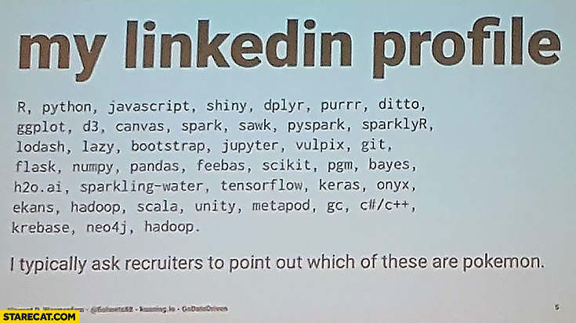
R Experience (3 years)
Notes:
Some of my R projects:
ML on survival
Data Exploration
Data Binning
Predictive Analytics

Slide 4
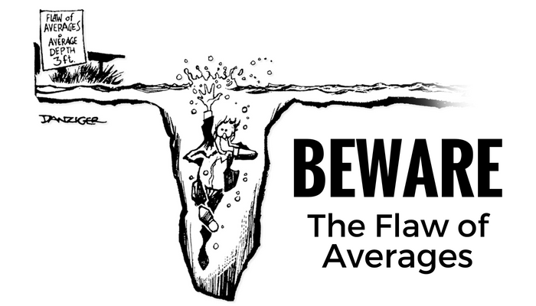
Survival Analysis
Notes:
Bill Gates average millionaire in the room.

Slide 5
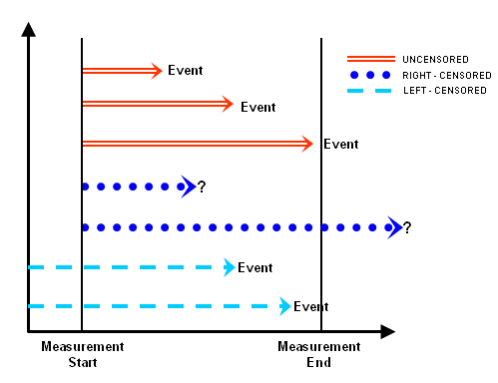
Types of Survival Analysis
Notes:
Unfortunately survival datasets are hard to obtain (harder), we’ll start by reviewing the results of a survival analysis and then work using R studio on a survival analysis from scratch.

Slide 6
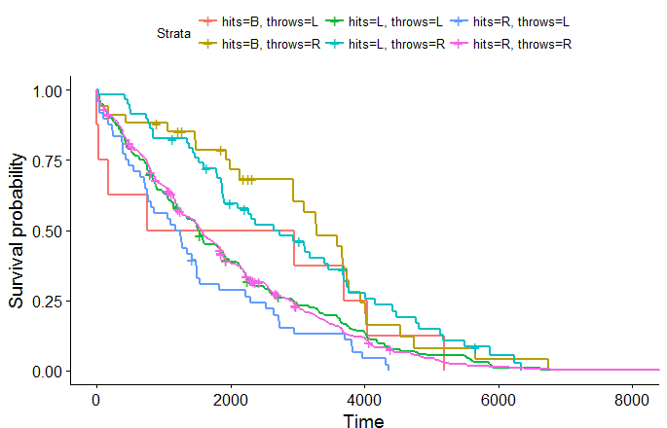
Survival Analysis
In survival analysis, we measure the odds of an event not happening.
It is named “survival” because it was devised to test the effects of drugs on patients and whether their survival odds were enhanced.
In the following example we can see the “survival rates” for baseball players in MLB. Survival here meaning the longevity of their careers.

Slide 7
References
Manuel Amunategui
https://amunategui.github.io/survival-ensembles/
https://www.youtube.com/watch?v=6q-UFJUZK0g
STHDA
http://www.sthda.com/english/wiki/survminer-r-package-survival-data-analysis-and-visualization
Establishing the Discrete-Time Survival Analysis Model (ALDA, Ch. 11) John Willett & Judy Singer Harvard University Graduate School of Education May, 2003
Joshua Ulrich

Slide 8


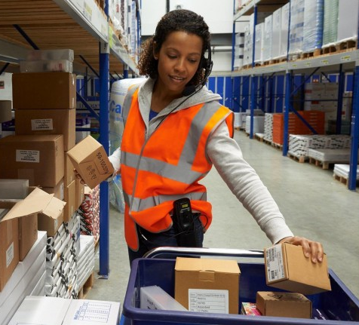
Survival Analysis: Warehouse Injuries

Slide 9
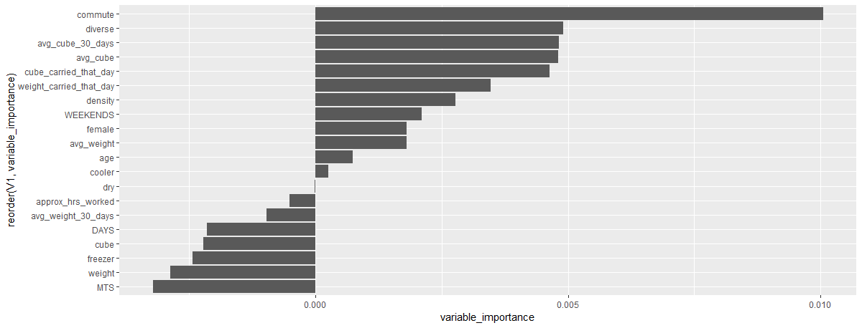
Survival Model
A survival model “grabs” a multiple set of variables and assigns an importance factor for each in predicting an event.
According to these results the most important variables in predicting shoulder injuries are the following.

Slide 10
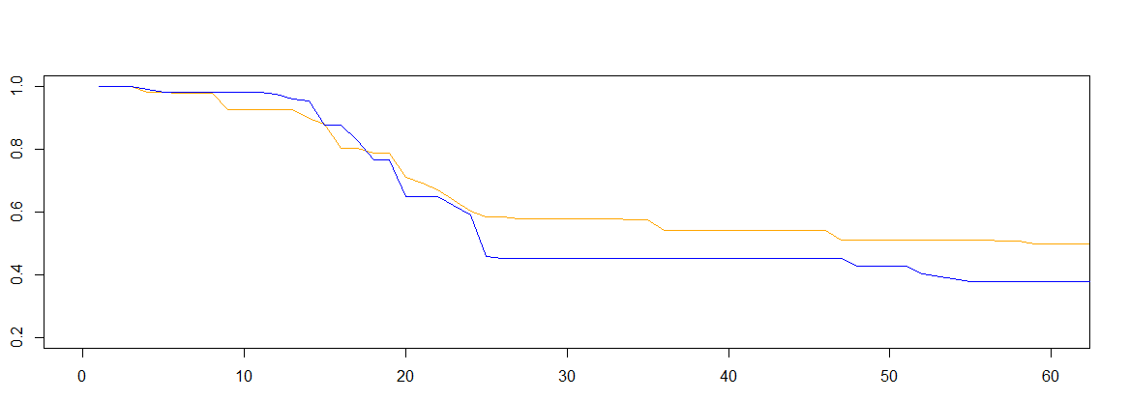
Survival Odds
If we graph the survival odds for two random employees in the warehouse we can observe that they have a very distinct pattern.
We must note that for this analysis we are focusing on the survival odds for an employee’s first 60 months in the company
Notes:
Survival is the probability of an event NOT happening within a specific amount of time. In this case, the probability of an employee working in the warehouse for 60 months without suffering a shoulder injury.

Slide 11
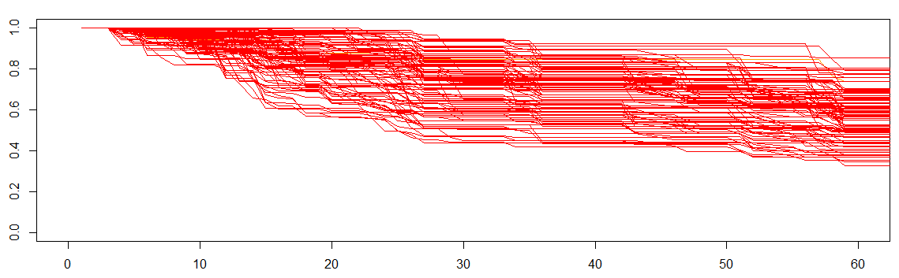
Survival Odds: Random 100 Employees
Notes:
As we can observe here, the pattern from the previous slide is repeated.
Our biggest slope (change in risk) is from month 12-25; which means that this is when warehouse employees have the highest risk change in being involved in a shoulder injury.

Slide 12
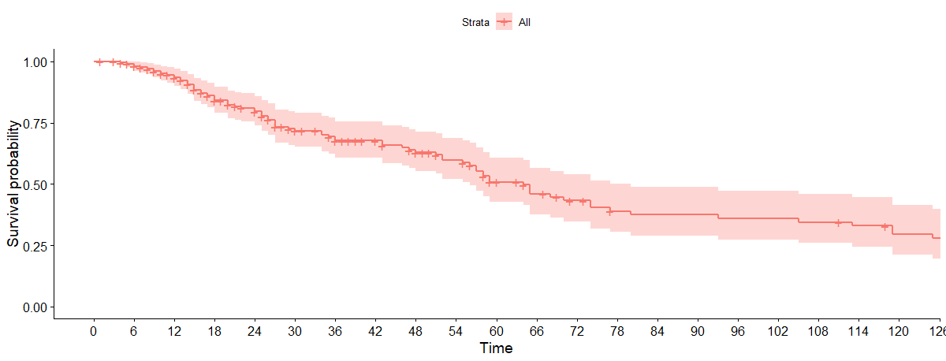
Overall Survival Rate

Slide 13
OK, We have Established the survival Model’s definition and the Odds… Now let’s ask the data some questions:

Slide 14
As We remember the #1 motive for risk was commute… How does the risk changes for different commuting distances?

Slide 15
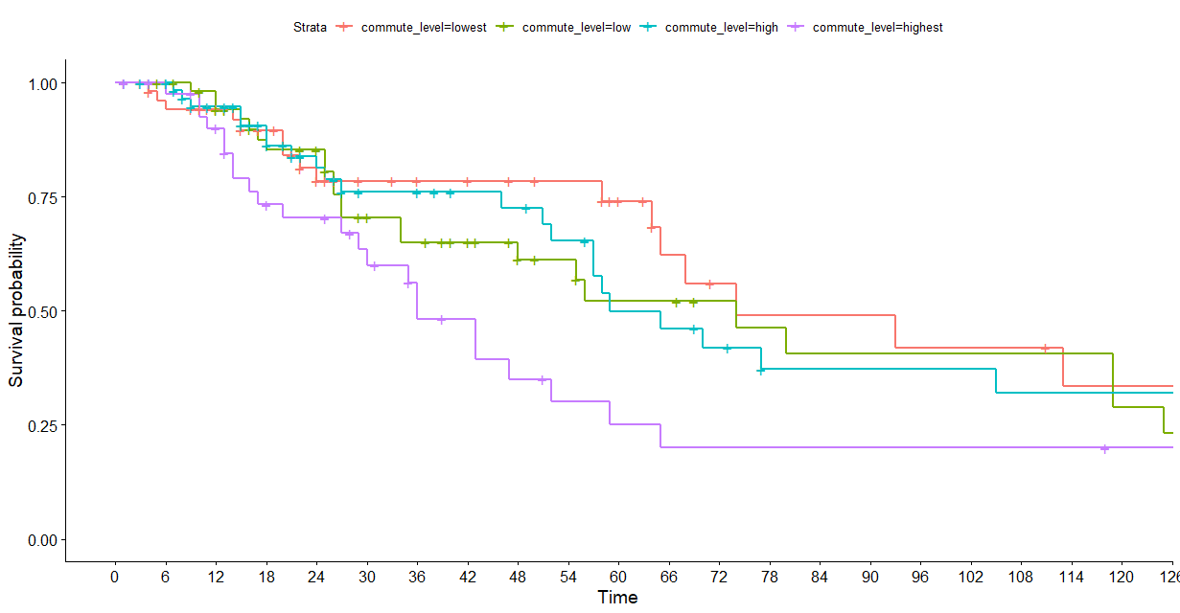
Notes:
The commuting categories are included below. As it can be observed there is a clear difference in injury risk for the “highest commute” categories, beginning approximately in month 12. The highest category is people that commute 52 miles or higher to work; which means that they are the riskiest group of employees.
[0, 12.51393906] [13.44028941, 27.26495024] 55 56 [27.97382924, 51.61041155] [51.83728303>] 65 44

Slide 16
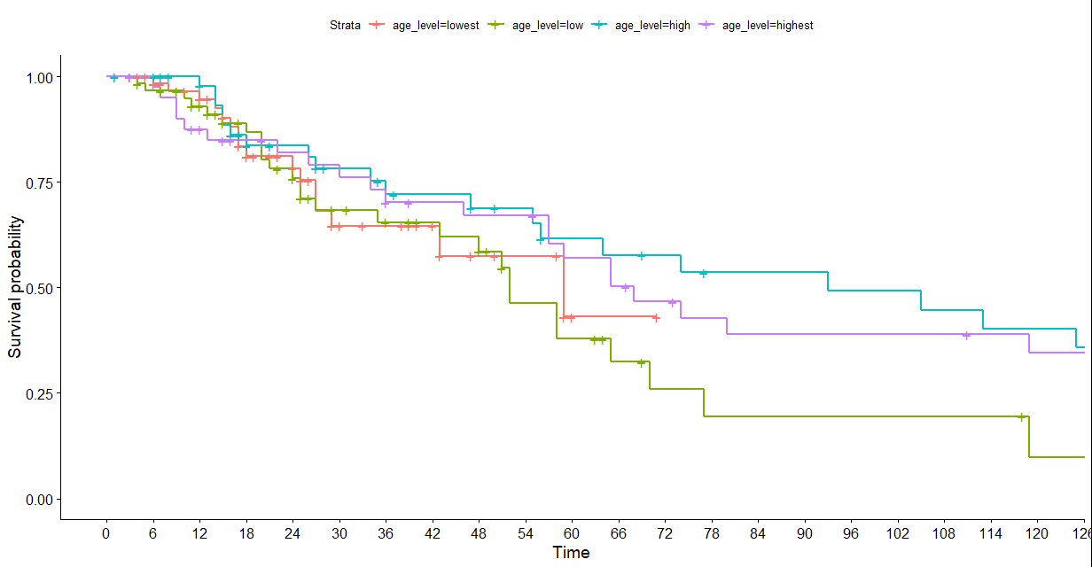
Notes:
As a comparison, there is not a clear concise difference between the same differential with age. In fact, the lower aged employees tend to show a higher risk.
[19, 24] [25, 30] [31, 39] [40, 57]

Slide 17
We saw commute made a splash, but what about cube? How does the risk changes for Cube picked in the last 30 days?

Slide 18
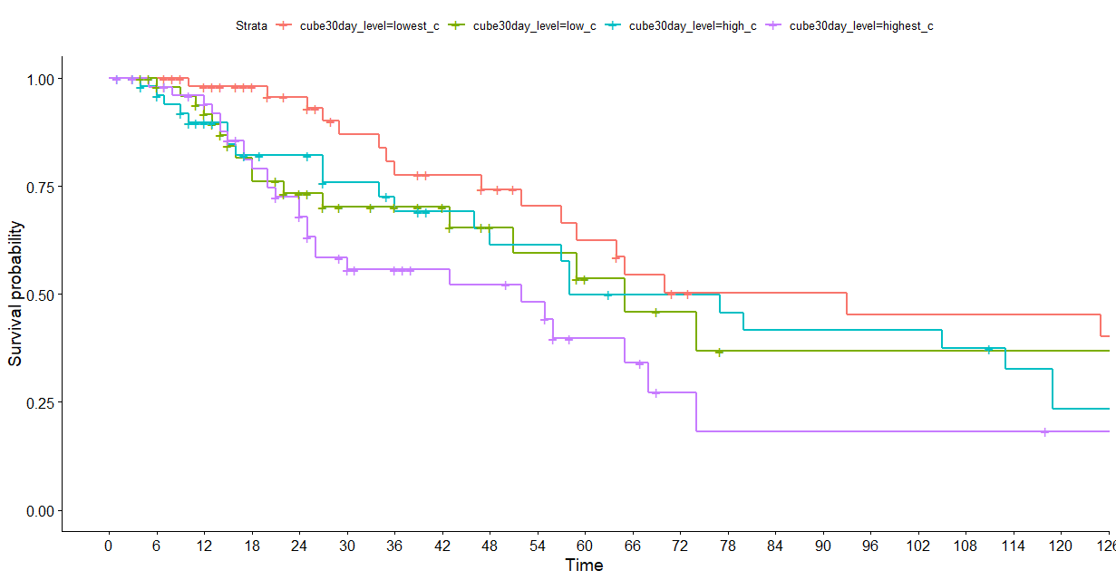
Notes:
As we can observe, this is another clear differential; the employees with the highest amount of cube picked, on average, tend to have a riskier survival odd.
In contrast, those with the lowest cube are the safest.
[2.193333333, 26.22038251] [26.36649038, 34.71294964] 55 55 [34.83225352, 41.63819672] [41.728125, 87.06277778] 55 55

Slide 19
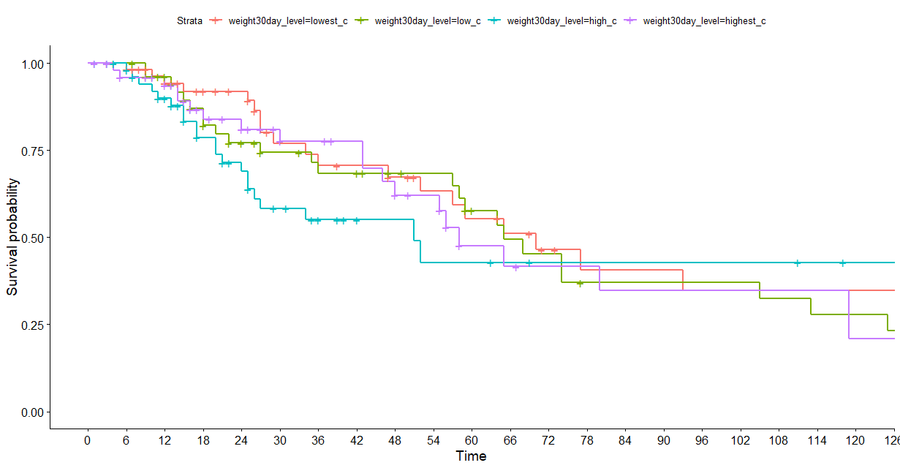
Notes:
Interestingly, we cannot observe the same relationship for weight picked in the last 30 days. Although higher weight decreases survival odds, it is not on the same level as cube.

Slide 20
So Weight DOES not matter? Not so quick…

Slide 21
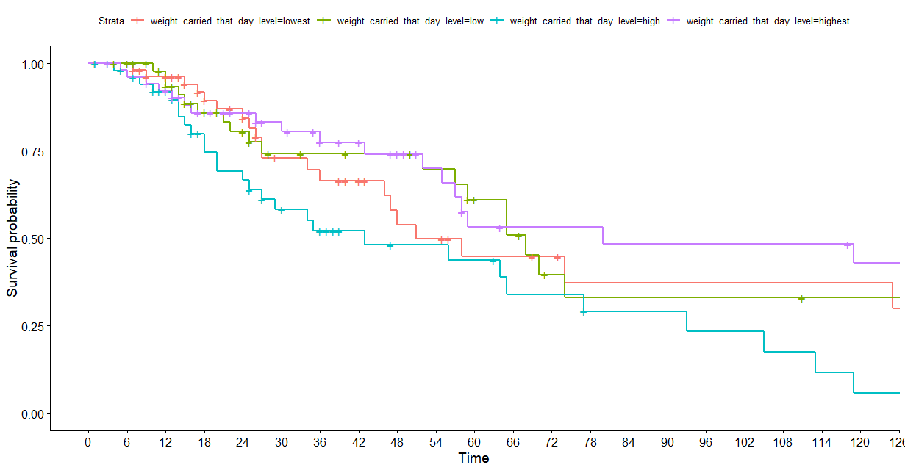
Notes:
Although the total average weight carried in the last 30 days is not very relevant, the total weight carried per day is actually a pretty relevant factor to predict injury risk. However, this is only the case after the first 18 months of the job. (wear and tear)

Slide 22
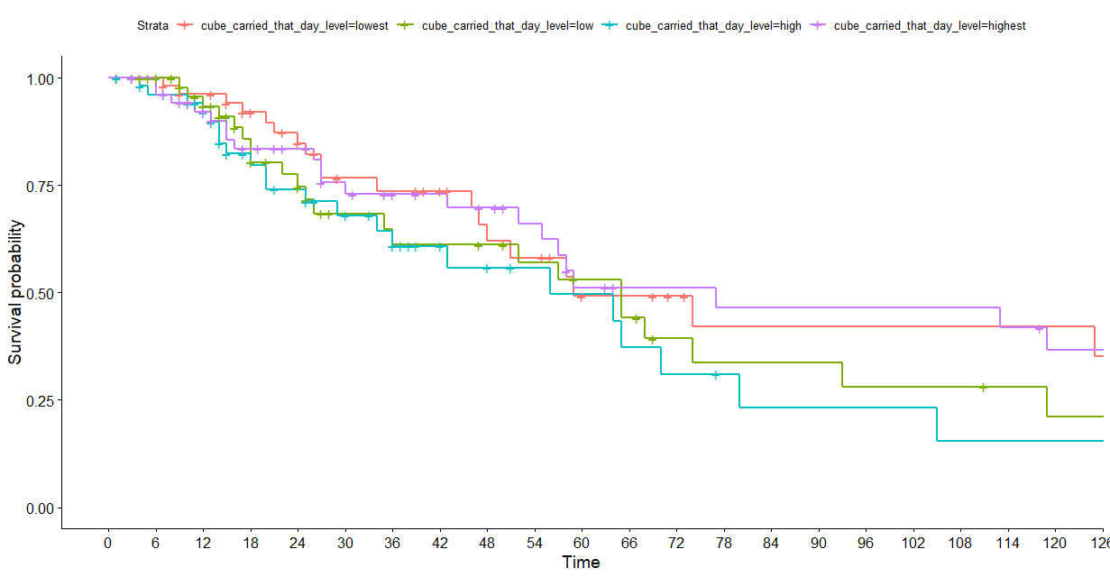
Notes:
In contrast, cube carried that day is not as relevant.

Slide 23
This means that… higher cube carried in the last 30 days + higher weight carried today = highest injury risk …Plus Long commuters adds another red flag!

Slide 24
Does Another location behave differently?

Slide 25
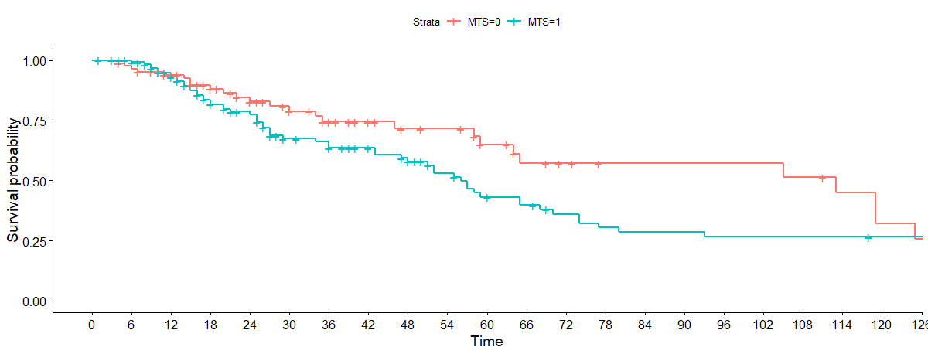
Notes:
As it can be observed Mt Sterling has a worse survival probability, which means that in fact, there is evidence that suggests that Mt. Sterling increases the likelihood of injuries.

Slide 26
What about the ladies?

Slide 27
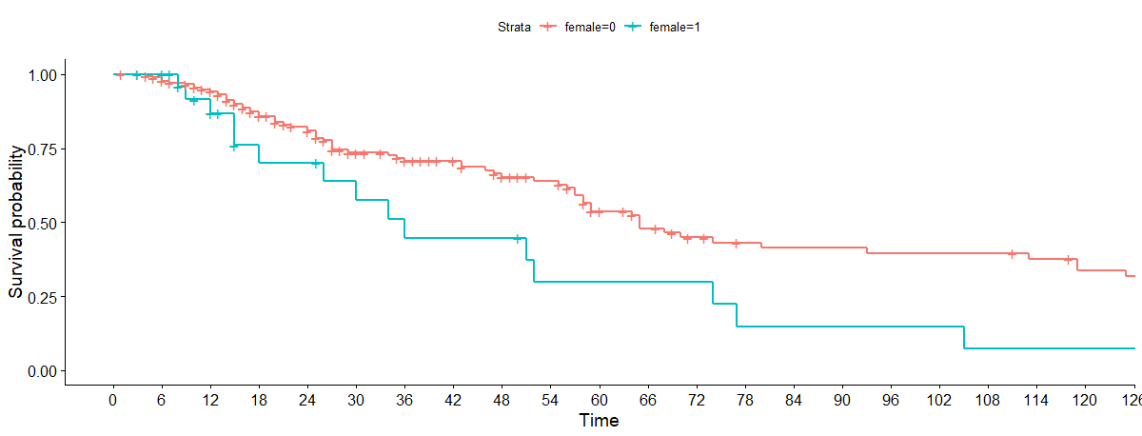
Notes:
According to our analysis, after the first 6 months of the job, there is a substantially higher risk for females to incur in a shoulder injury than men.

Slide 28
Let’s look at some code… (attrition rates)

Slide 29
Sources for images
webfocusinfocenter.informationbuilders.com
Danzinger, Flaw of Averages

