Slide 1
St. Louis R User Group
December 20, 2016

Slide 2
Agenda
Part I – Google APIs in R
Google APIs
Getting Data from websites
Parsing XML
Creating Functions
Part II – Large Data in R
Sunshine Act
Getting Data
Reading in Data
Exceling in R
Some Graphing

Slide 3
Google APIs
Recreating Wheels Made by Numerous R Packages

Slide 4
Part I – Google APIs
Google APIs (Application Program Interface) allow us to get data from Google using R. In this exercise, we will use these to determine driving time and driving distance between pairs of locations
We use data read into R to construct a url string which is access the API(s)
We then use the httr package to pull back the data as XML (eXtensible Markup Language) or JSON (JavaScript Object Notation)
We parse that information with R to get the driving time and driving distance
Note: there are existing R packages which actually do a lot of what we are going to manually (much more effectively)

Slide 5
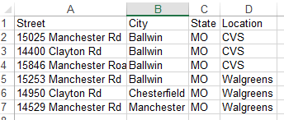
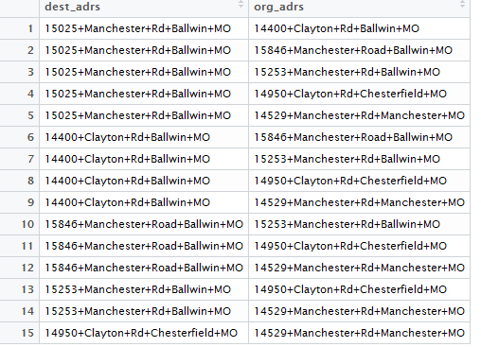
Getting Data
The url we pass to the API must have ‘+’ in place of spaces. First, we process the raw data to get columns of to and from
Starting Data
#read in data
address_data <- read.csv("C:/stl_rug/data/rx_address.csv",
stringsAsFactors = FALSE)
#create a readible address, stick columns together with '+' and replace
#any existing spaces with a '+'
address_data$api_add <- paste(address_data$Street, address_data$City,
address_data$State, sep = "+")
address_data$api_add <- gsub(" ", "+", address_data$api_add)
#get pairs of addresses
df_to_from <- data.frame(t(combn(address_data$api_add, 2)),
stringsAsFactors = FALSE)
#sensible names
names(df_to_from) <- c("dest_adrs", "org_adrs")
End up with This
Run this Code

Slide 6
Running a Test
We can select the first two elements to create a test url which we can manually paste into a browser to test the process
From the API documentation, our url should look something like:
We will pass our origins and destinations addresses as well as a mode of driving to the API
Also, we’ll have an outputFormat of XML
http://maps.googleapis.com/maps/api/distancematrix/outputFormat?parameters
#Set up a base url endpoint for the API
base_url <- "http://maps.googleapis.com/maps/api/distancematrix/xml?"
#stick the paramters onto this url
test_url <- paste(base_url, "origins=", df_to_from[1, 2], "&destinations=",
df_to_from[1, 1], "$mode=driving", sep = "")
test_url
[1] "http://maps.googleapis.com/maps/api/distancematrix/xml?origins=14400+Clayton+Rd+Ballwin+MO&destinations=15025+Manchester+Rd+Ballwin+MO$mode=driving"
We can test this url by manually pasting it into our browser

Slide 7
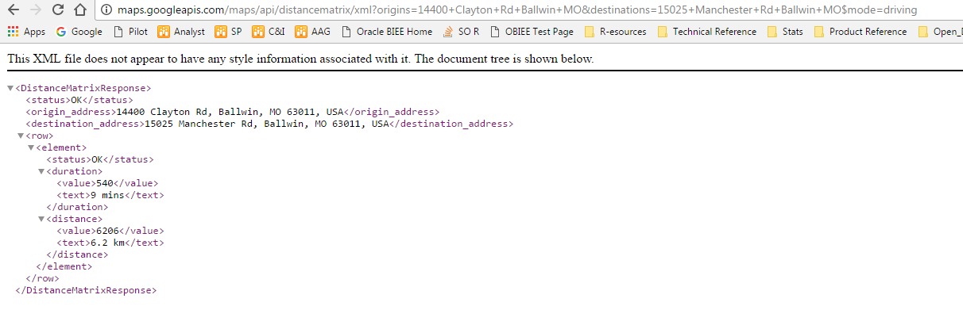
Success!
Our test url worked. In the page, we can see the duration and distance elements we are looking for

Slide 8
Returning and Parsing Results
We have established that we can generate the url we want. Now, we need to programmatically call the API and parse the results
We use the GET function from httr to call the API and then xmlParse from the XML package to process that call into an XML file. Then we use other functions from XML to get the information we want
library(httr)
library(XML)
#GET the web results with GET from httr and parse them with xmlParse from XML
xml_res <- xmlParse(GET(test_url))
xml_res
#extract the durration path
xpathApply(xml_res, path = "//duration")
[[1]]
<duration>
<value>540</value>
<text>9 mins</text>
</duration>
attr(,"class")
[1] "XMLNodeSet"
#we only want the first element
xpath_dur <- xpathApply(xml_res, path = "//duration")[[1]]
xpath_dur
<duration>
<value>540</value>
<text>9 mins</text>
</duration>
#extract the actual values (in seconds)
as.numeric(xmlValue(xmlChildren(xpath_dur)$value))
[1] 540
<?xml version="1.0" encoding="UTF-8"?>
<DistanceMatrixResponse>
<status>OK</status>
<origin_address>14400 Clayton Rd, Ballwin, MO 63011, USA</origin_address>
<destination_address>15025 Manchester Rd, Ballwin, MO 63011, USA</destination_address>
<row>
<element>
<status>OK</status>
<duration>
<value>540</value>
<text>9 mins</text>
</duration>
<distance>
<value>6206</value>
<text>6.2 km</text>
</distance>
</element>
</row>
</DistanceMatrixResponse>

Slide 9
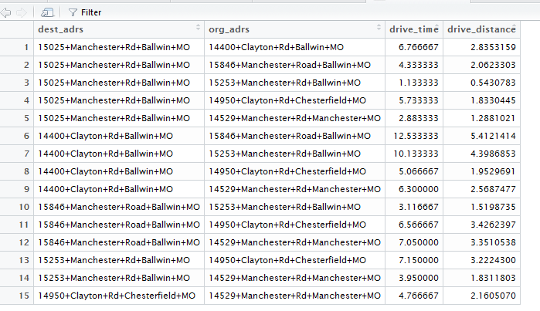
Putting it all together
We want to run this function across all fifteen combinations. To do this, we write a function to return the driving time and driving distance
#function to return driving time and distance
get_dist_time <- function(org = "15025+Manchester+Rd+Ballwin+MO",
dest = "14400+Clayton+Rd+Ballwin+MO"){
#create url
working_url <- paste(base_url, "origins=", org, "&destinations=",
dest, "$mode=driving", sep = "")
#return XML
xml_res <- xmlParse(GET(working_url))
#get duration (in minutes)
xpath_dur <- xpathApply(xml_res, path = "//duration")[[1]]
drive_time <- as.numeric(xmlValue(xmlChildren(xpath_dur)$value)) / 60
#get driving distance (in miles)
xpath_dis <- xpathApply(xml_res, path = "//distance")[[1]]
drive_dist <- as.numeric(xmlValue(xmlChildren(xpath_dis)$value)) * 0.000621371
#return results
c(drive_time, drive_dist)
}
#run this function across the entire set of to-from addresses with mapply
time_dist_res <- mapply(function(m, n) get_dist_time(m, n),
m = df_to_from$dest_adrs,
n = df_to_from$org_adrs,
SIMPLIFY = TRUE)
#stick the results onto the initial df_to_from data frame
complete_results <- cbind(df_to_from,
data.frame(t(final_res), row.names = NULL))
#rename
names(complete_results)[3:4] <- c("drive_time", "drive_distance")

Slide 10
Geocoding API
The Geocoding API provides latitude and longitude based on an input address
Another API available from Google is a Geocoding API which allows us to provide an address and get the latitude and longitude
This is extremely helpful for map-making which is essentially a scatter plot with x values as longitudes and y values as latitudes
Again, we look to the documentation to find the API base url
#get a new base url for the geocoding API
gc_base_url <- "http://maps.google.com/maps/api/geocode/xml?address="
#use one of our addresses to test the API
gc_test_url <- paste(gc_base_url, complete_results$dest_adrs[1], sep = "")
> gc_test_url
[1] "http://maps.google.com/maps/api/geocode/xml?address=15025+Manchester+Rd+Ballwin+MO"

Slide 11
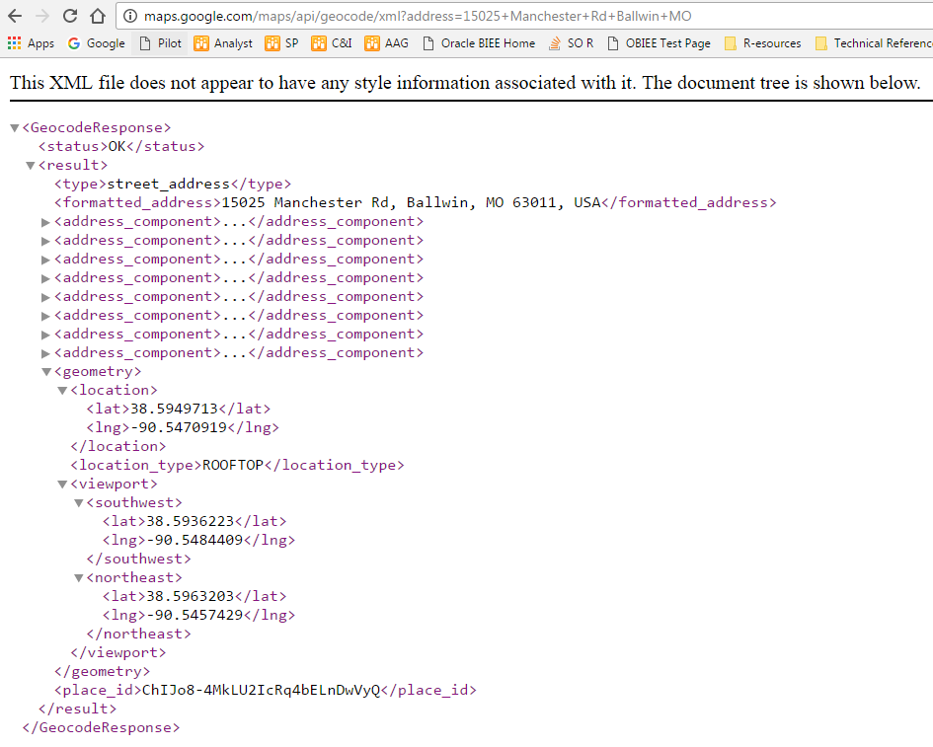

Slide 12
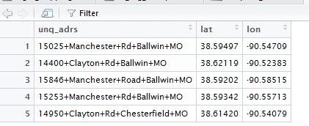
Geocoding API Function and Results
#function to pull back lat / lon
find_ll <- function(adrs){
gc_url <- paste(gc_base_url, adrs, sep = "")
gc_xml <- xmlParse(GET(gc_url))
lat <- as.numeric(xmlValue(xmlChildren(xpathApply(gc_xml,
path = "//location/lat")[[1]])[[1]]))
lon <- as.numeric(xmlValue(xmlChildren(xpathApply(gc_xml,
path = "//location/lng")[[1]])[[1]]))
Sys.sleep(0.5)
c(lat, lon)
}
#get all lat / lon for unique addresses
unq_adrs <- unique(complete_results$dest_adrs)
all_lat_lon <- sapply(unq_adrs, function(m) find_ll(m))
geo_coded_results <- data.frame(unq_adrs, t(all_lat_lon), row.names = NULL,
stringsAsFactors = FALSE)
names(geo_coded_results)[2:3] <- c("lat", "lon")

Slide 13
Google Places API
This API allows for a “look around” type search
Parameters include
Latitude and Longitude of lookaround origin
Type (bank, bar, library, pharmacy, …)
Keyword
Radius
Requires an API key → these are free as long but require registering with Google
JSON, rather than XML is recommended as the return type
This can be used with the prior two APIs to find the nearest location of interest to a given address

Slide 14
More on Google APIs with R
There are many Google APIs which can be accessed via R using homebrewed solutions or existing packages
Google APIs have throttling limits regarding how many times they can be accessed within given time periods
Current packages:
RgoogMaps, gmapsdistance, placement, googleway

Slide 15
Large Data in R
No, A VLOOKUP Won’t Work on This One

Slide 16
Large Data – A Working Definition
“Large Data” sets are too massive to work with in Excel and have other characteristics which make R a great analytic tool for these data sets
For this discussion, characteristics of Large Data include
Too large to open in Excel
Note: with tools like Power Query and Power Pivot, this might be less of a problem
Not readily available in any kind of data warehouse
Not readily connected to any kind of BI tool
Big, but not too big → can live inside our computer’s RAM
R is really good at doing things with large data
Getting the data into R can be effectively accomplished with the readr package or fread from data.table

Slide 17
Our Large Data – The Sunshine Act
The Physician Open Payment Sunshine Act data contains nearly 30M records detailing payments made by medial device and drug companies to physicians
Starting in mid-2013, medical device companies and drug makers were required to disclose their financial relationships with physicians
The 2015 data were released in June 2016, brining the total number of observations in the data to nearly 30M records
All the data are available on the CMS website
The data are broken into three types
Research payments – Payments made in conjunction with a research study
General payments – Payments made not in conjunction with a research study (consulting fees, lunches, travel, honoraria, …)
Ownership interest
Our analysis will focus on research and general payments since the ownership interest data is not Large Data
We will focus only on the 2013 data

Slide 18
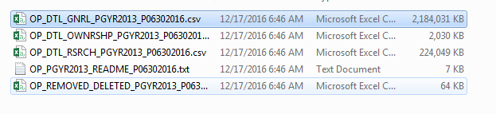

Getting Large Data
In the interest of reproducibility and streamlining our workflow, we can use R to download and unzip the data for the analysis
We need to provide R with a url from which to download the data, a file locations where to download it to, and a path to put the unzipped data
#create a path for the zip file we download
unz_dest <- "C:/stl_rug/data/sunshine_act_13.ZIP"
#provide R with the url from which we want to download the data
sa_13_url <- "http://download.cms.gov/openpayments/PGYR13_P063016.ZIP"
#download the file from the provided URL to the provided destination folder
#we use the mode = "wb" argument because it is a zip file
download.file(sa_13_url, unz_dest, mode = "wb")
#Unzip the file to a folder called sunshine_act_13_files
unzip(unz_dest, exdir = "C:/stl_rug/data/sunshine_act_13_files")
That is Large Data!
?download.file

Slide 19
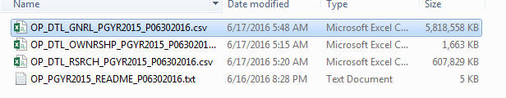
Getting Large Data
Contributed packages can help us get Large Data into R more effectively than the base read.csv function can
The first computational hurdle we face in the analysis is getting all of this data into R. In this analysis, we’ll use the read_csv function from the readr library
#set up paths to read in the general and research payments
path_gen_13 <- paste("C:/stl_rug/data/sunshine_act_13_files/",
"OP_DTL_GNRL_PGYR2013_P06302016.csv", sep = "")
path_res_13 <- paste("C:/stl_rug/data/sunshine_act_13_files/",
"OP_DTL_RSRCH_PGYR2013_P06302016.csv", sep = "")
#Now do the same for general payments
#read.csv
system.time(read.csv(path_gen_13))
user system elapsed
206.93 7.64 216.22
#read_csv
system.time(read_csv(path_gen_13))
user system elapsed
33.11 2.48 37.90
#compare time to read in
#research payments with read.csv
system.time(read.csv(path_res_13))
user system elapsed
21.87 0.97 22.90
#research payments with read_csv from readr
system.time(read_csv(path_res_13))
user system elapsed
4.23 0.21 4.48
The general payments improvement is measured in minutes. This is extremely important because the 2013 data is the smallest by far
The research payments read in a little less than 20 seconds faster. Awesome

Slide 20
Exploring our Large Data
Once we get our Large Data into R, we should look at a few key metrics about it
First steps once we get our Large Data into R
Figure out the row and column count
Examine the structure of the data
Find missing value rate
dim(res_13)
[1] 294569 166
dim(gen_13)
[1] 4162791 65
From this exploration, it is clear that we have many, many observations in the general payment table, that there are way more columns in both tables than we’d ever need, and that we have many missing values in both tables
str(res_13)
str(gen_13)
#get tables of missing values
missing_vals_gen <- data.frame(colMeans(is.na(gen_13)))
missing_vals_res<- data.frame(colMeans(is.na(res_13)))

Slide 21
Isolating the Items of Interest
Once we know the columns we want, we grab those and rename them to be easier to deal with
library(tidyverse)
#Select only interesting fields from the general data
gen_small <- gen_13 %>%
select(Applicable_Manufacturer_or_Applicable_GPO_Making_Payment_Name,
Date_of_Payment, Nature_of_Payment_or_Transfer_of_Value,
Physician_Last_Name, Physician_First_Name,
Physician_License_State_code1,
Total_Amount_of_Payment_USDollars) %>%
rename(MFG = Applicable_Manufacturer_or_Applicable_GPO_Making_Payment_Name,
Payment_Nature = Nature_of_Payment_or_Transfer_of_Value,
Phys_Last = Physician_Last_Name,
Phys_First = Physician_First_Name,
State = Physician_License_State_code1,
Pmt_Total = Total_Amount_of_Payment_USDollars)
#Select only interesting fields from the research data
res_small <- res_13 %>%
select(Applicable_Manufacturer_or_Applicable_GPO_Making_Payment_Name,
Date_of_Payment, Principal_Investigator_1_Last_Name,
Principal_Investigator_1_First_Name, Principal_Investigator_1_State,
Total_Amount_of_Payment_USDollars) %>%
rename(MFG = Applicable_Manufacturer_or_Applicable_GPO_Making_Payment_Name,
Phys_Last = Principal_Investigator_1_Last_Name,
Phys_First = Principal_Investigator_1_First_Name,
State = Principal_Investigator_1_State,
Pmt_Total = Total_Amount_of_Payment_USDollars)
Select allows us to filter by column
Rename allows us to change the names of the columns we select to ones that are easier to type

Slide 22
Exceling Large Data – Making Pivot Tables
Now that we have our data in the form we want, we can begin to explore it as we would if it were in Excel
#Get the top 10 manufacturers by spend in research payments
res_summary <- res_small %>%
group_by(MFG) %>% #Row headers in our pivot table
summarise(total_payment_val = sum(Pmt_Total), #sum of all payments
avg_payment = mean(Pmt_Total), #average payment value
number_of_records = n()) %>% #get a count of records
top_n(n = 10, wt = total_payment_val) #top 10 by total payment
#Get the top 10 manufacturers by spend in general payments
gen_summary <- gen_small %>%
group_by(MFG) %>% #Row headers in our pivot table
summarise(total_payment_val = sum(Pmt_Total), #sum of all payments
avg_payment = mean(Pmt_Total), #average payment value
number_of_records = n()) %>% #get a count of records
top_n(n = 10, wt = total_payment_val) #top 10 by total payment
#Find the general payments by month
library(lubridate)
gen_mo_sum <- gen_small %>%
mutate(mo_start = floor_date(mdy(Date_of_Payment), "month")) %>% #add month start column
group_by(mo_start) %>%
summarise(total_payment_val = sum(Pmt_Total))
#find the total spend by mfg on research payments in missouri and illinois
mo_il_res <- res_small %>%
filter(State %in% c("MO", "IL")) %>%
group_by(MFG) %>%
summarise(tot_payment_val = sum(Pmt_Total))
#Find the number of unique manufacturers making general payments by state
gen_mfg_state_sum <- gen_small %>%
group_by(State) %>%
mutate(mfgs_making_pmts = length(unique(MFG))) %>%
select(State, mfgs_making_pmts) %>%
ungroup() %>%
distinct() %>%
arrange(desc(mfgs_making_pmts))
In Excel parlance…
group_by sets up the ‘row headers’ of our pivot tables
summarise adds the calculated fields to our pivot table
mutate adds new columns to our data

Slide 23
Visualizing our data
We can use ggplot2 to quickly get summary information on this very large data set
Find the relationship between research and general payments → A good way to check manufacturers who say they are upping their prices due to research and development costs!
Right now, our two dataset are completely separate
We can combine them with the bind_rows function from dplyr / tidyverse
Then we can widen the data with spread from tidyr to allow us to plot general payments on the y and research payments on the x
Which payment nature in general payments are the largest?
What is the geography of payments in Missouri and Illinois?

Slide 24
#pull out the mfg info from the general payments
gen_mfg_only <- gen_small %>%
select(MFG, Pmt_Total) %>%
mutate(Type = "General")
#pull out the mfg info from the research payments
res_mfg_only <- res_small %>%
select(MFG, Pmt_Total) %>%
mutate(Type = "Research")
#stick these two together
comb_data <- bind_rows(gen_mfg_only, res_mfg_only)
#aggregate by type and mfg
comb_data_agg <- comb_data %>%
group_by(MFG, Type) %>%
summarise(tot_payment_val = sum(Pmt_Total))
#turn the type column into two new columns
wide_comb_data <- comb_data_agg %>%
spread(key = Type, value = tot_payment_val, fill = 0)
library(scales)
ggplot(data = wide_comb_data, aes(x = Research, y = General)) +
geom_point() + geom_text(data = subset(wide_comb_data, Research > 40000000 | General > 15000000),
aes(label = MFG), size = 3) +
scale_x_continuous(name = "Research Payments",
label = dollar) +
scale_y_continuous(name = "General Payments",
label = dollar) +
ggtitle("2013 Sunshine Act Data - Relationship Between General and Research Payments",
subtitle = paste("Only MFGs with over $15M in General Payments or $40M",
" in Research Payments are labeled", sep = ""))
Getting just the payment amount and MFG name from each data set. Then adding a column to identify which set the data came from and sticking the two datasets together
Aggregating the data by MFG and Type, then turning the Type column into two different columns
Creating a ggplot with Research payments on the x and General payments on the y. Label points when the Research payment is over $40M or the general payment is over $15M

Slide 25
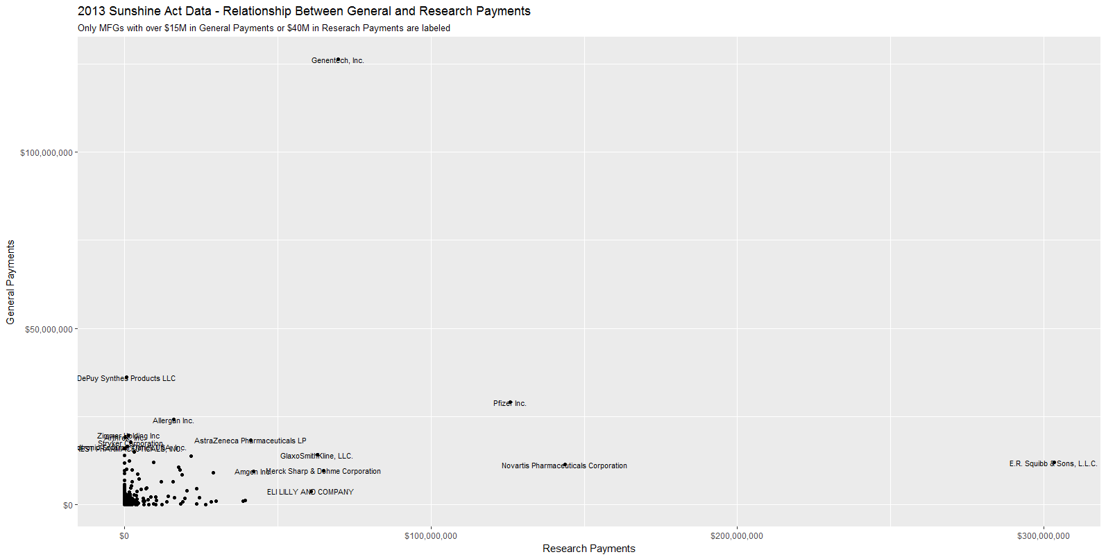

Slide 26
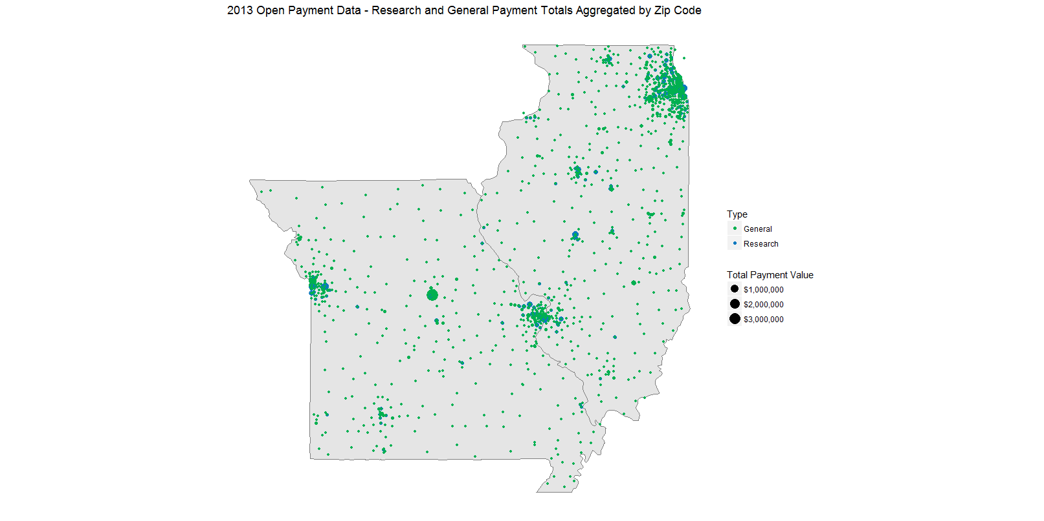

Slide 27
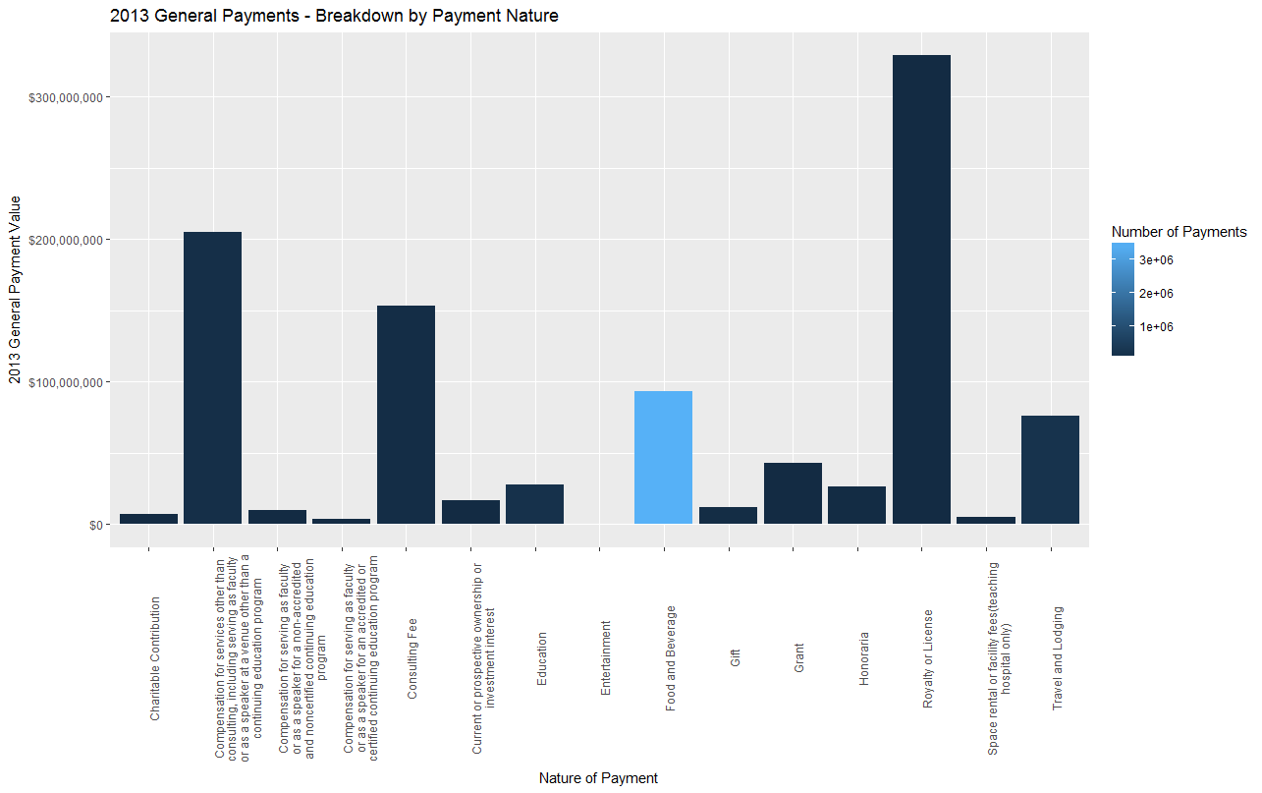
Exceling Large Data – Some Graphs

Slide 28
Appendix – ggplot code

Slide 29
#Nature of payment
library(scales)
library(stringr)
gen_small %>%
mutate(ntr_warp = str_wrap(Payment_Nature, width = 40)) %>% #wrap the payment nature column for better labeling
group_by(ntr_warp) %>%
summarise(tot_payment_val = sum(Pmt_Total),
number_of_payments = n()) %>% #get total payments and number of records by payment nature
ggplot(aes(x = ntr_warp, y = tot_payment_val,
fill = number_of_payments)) +
geom_bar(stat = "identity") +
scale_y_continuous(name = "2013 General Payment Value",
label = dollar) +
scale_x_discrete(name = "Nature of Payment") +
scale_fill_continuous(name = "Number of Payments") +
ggtitle("2013 General Payments - Breakdown by Payment Nature") +
theme(axis.text.x = element_text(angle = 90))

Slide 30
#geography of MO and IL payments
#pull out the mfg info from the general payments
mo_il_gen <- gen_small %>%
filter(State %in% c("MO", "IL")) %>%
select(MFG, Pmt_Total, Zip_code) %>%
mutate(Type = "General")
#pull out the mfg info from the research payments
mo_il_res <- res_small %>%
filter(State %in% c("MO", "IL")) %>%
select(MFG, Pmt_Total, Zip_code) %>%
mutate(Type = "Research")
#stick these two together
mo_il_comb_data <- bind_rows(mo_il_gen, mo_il_res)
#aggregate by type, zipcode, and mfg
mo_il_comb_data_agg <- mo_il_comb_data %>%
group_by(MFG, Type, Zip_code) %>%
summarise(tot_payment_val = sum(Pmt_Total))
library(zipcode)
#clean zipcode and add lat / lon
mo_il_comb_data_agg <- mo_il_comb_data_agg %>%
mutate(zip = clean.zipcodes(Zip_code)) %>%
left_join(zipcode) %>%
filter(state %in% c("IL", "MO"))
state_data <- map_data("state") %>%
filter(region %in% c("missouri", "illinois"))
ggplot() + geom_polygon(data = state_data, aes(x = long, y = lat,
group = group),
colour="grey50",fill="grey90") +
geom_point(data = mo_il_comb_data_agg,
aes(x = longitude, y = latitude, colour = Type,
size = tot_payment_val)) +
scale_size_continuous(name = "Total Payment Value",
label = dollar) +
scale_colour_manual(values = c("#00B050", "#0B79BF")) +
theme(axis.line=element_blank(),
axis.text.x=element_blank(),
axis.text.y=element_blank(),
axis.ticks=element_blank(),
axis.title.x=element_blank(),
axis.title.y=element_blank(),
panel.background=element_blank(),
panel.border=element_blank(),
panel.grid.major=element_blank(),
panel.grid.minor=element_blank(),
plot.background=element_blank()) +
coord_map() +
ggtitle("2013 Open Payment Data - Research and General Payment Totals Aggregated by Zip Code")

Slide 31
St. Louis R User Group
December 20, 2016

