Slide 1
Binary Classification in R: Assessing and predicting on-time performance
Roland Vazquez-Molina
In regards to the contents of this presentation, the copyright Disclaimer under section 107 of the Copyright Act 1976, allowance is made for “fair use” for purposes such as criticism, comment, news reporting, teaching, scholarship, education and research.

Slide 2


R Experience (4 years)
Notes:
Some of my R projects:
ML on survival
Data Exploration
Data Binning
Predictive Analytics

Slide 3
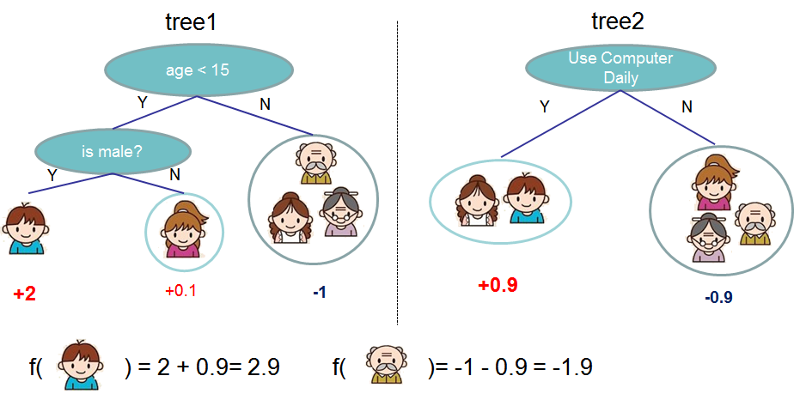
XGBoost In a nutshell
Notes:
http://dmlc.cs.washington.edu/xgboost.html

Slide 4



Problem statement

Slide 5

Late deliveries
Most routing software uses time methods, which is based of standards.
Reactivity vs. Proactivity
What can we actually do to prevent late deliveries?

