Slide 1

Hyper Link Tag and Attribute

Slide 2
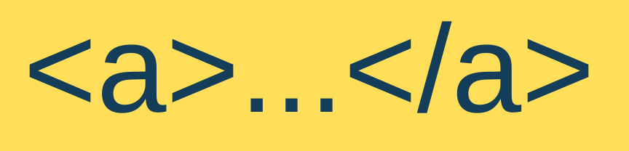
The anchor tag
The <a> tag is used to create hyperlinks.
A hyperlink allows users to:
navigate to another webpage
open a document
jump to a section within the same page
sends email

Slide 3
The link text
The link text is the part that will be visible to the reader.
Clicking on the link text, will send the reader to the specified URL address.

Slide 4
Anatomy of an anchor tag
PART | DESCRIPTION
<a> | opening anchor tag
href | destination of the hyperlink
target | specifies where the link opens
title | displays a tooltip when hovered
link text | clickable text
</a> | closing anchor tag

Slide 5
Anatomy of an anchor tag
<a href="https://www.example.com" target="_blank" title="Visit Example"> Visit Example </a>

Slide 6
The href attribute
href stands for Hypertext Reference
It specifies the destination of the hyperlink.

Slide 7
The href attribute
Example 1: External Website
<a href="https://www.youtube.com"> Visit YouTube </a>

Slide 8
The href attribute
Example 2: Local HTML File
<a href="about.html"> About Us </a>

Slide 9
The href attribute
Example 3: PDF File
<a href="lesson.pdf"> Download Notes </a>

Slide 10
The href attribute
Example 4: Email
<a href="mailto:teacher@email.com"> Email the Teacher </a>
Opens the default email application.

Slide 11
The title attribute
It provides extra information about the hyperlink.
When users hover the mouse over the link, a tooltip appears.

Slide 12
Hyperlink texts of different colors

Slide 13
Different colors of links
An unvisited link is underlined and blue
A visited link is underlined and purple
An active link is underlined and red

Slide 14
Different colors of links
An unvisited link will be green with no underline
A visited link will be pink with no underline
An active link will be yellow and underlined
When mousing over a link (a:hover) it will become red and underlined:

Slide 15
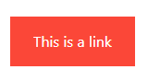
Link buttons
Link that create bookmarks
Bookmarks can be useful if a web page is very long.
Create a bookmark, then add a link to it.
When the link is clicked, the page will scroll down or up to the location with the bookmark.

