Slide 1
DATA SCIENCE Support Vector Machines

Slide 2
Support Vector Machines
Supervised Machine Learning Model
Can be used for regression..
Constructs a hyperplane to separate classes in space

Slide 3
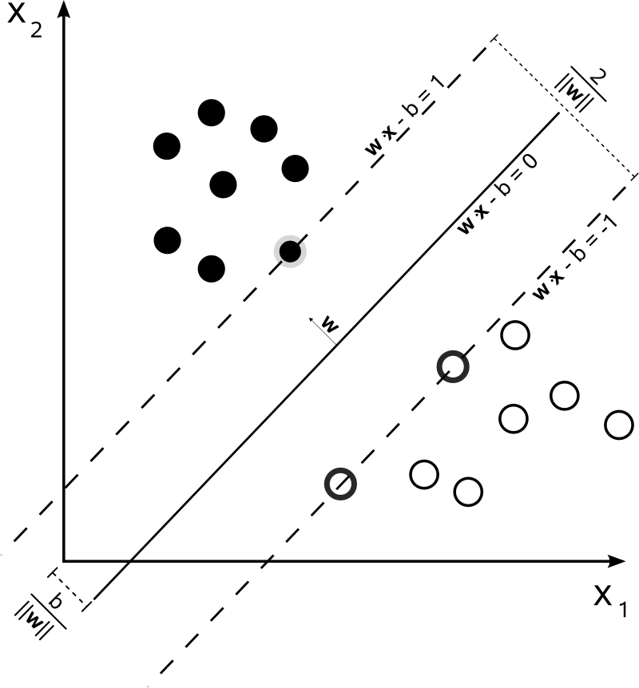
Support Vector Machines

Slide 4
Support Vector Machines
The margin is the distances between the nearest data points and the hyper-plane.

Slide 5
Support Vector Machines
We want to maximize
the width of the margin

Slide 6
Support Vector Machines
The idea is to construct a hyperplane that separates the data, making this a discriminative model

Slide 7
Support Vector Machines
What if there is no easy hyperplane?

Slide 8
Support Vector Machines
What if there is no easy hyperplane?
Walk with me on this,
a mathematical journey

Slide 9
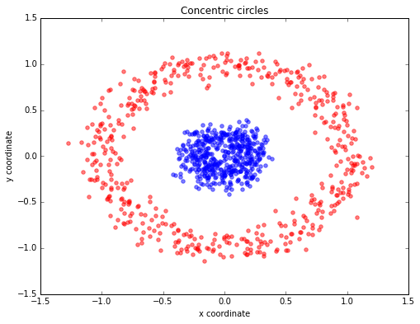
Support Vector Machines

Slide 10
Support Vector Machines
Pretty much no hyperplane
will separate this out, but what if we could add a third dimension?

Slide 11
Support Vector Machines
Q. OK fine, but what if I have 100 predictors? How many dimensions should I project into?
A. An arbitrary amount, possible infinite..

Slide 12
Support Vector Machines
Q. OK fine, but what if I have 100 predictors? How many dimensions should I project into?
A. An arbitrary amount, possible infinite..
OK but this can take time..

Slide 13
Support Vector Machines
Kernel Trick
We assume a certain shape of the data and the kernel trick saves us MASSIVE computation time

Slide 14
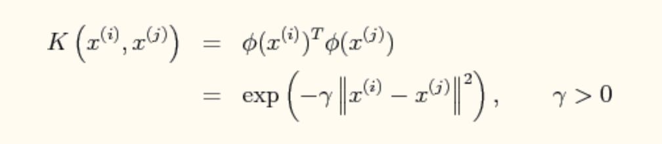
Support Vector Machines
Kernel Trick
Example Gaussian or RBF (radial basis function)
Brings points out and makes a “pointed” manifold

Slide 15
Support Vector Machines
Kernel Trick
Example:
Linear ( assumes a linear boundary)
Poly ( assumes a curved boundary)
Gaussian ( assumes a spherical boundary)

Slide 16
Support Vector Machines
Pros
Cons
Very fast training and predicting with kernel trick
Built on solid mathematical foundation (unlike ANN)
Very common and in sklearn
It uses a small subset of training points in the decision function (the support vectors), so is memory efficient.
A lot of “guess work” with kernels
Hard to grasp math behind it (ok if you accept the black box)

